Slide 1
THE
NORTHAVEN
PROJECT
REDEFINING THE AMERICAN HOME

Slide 2
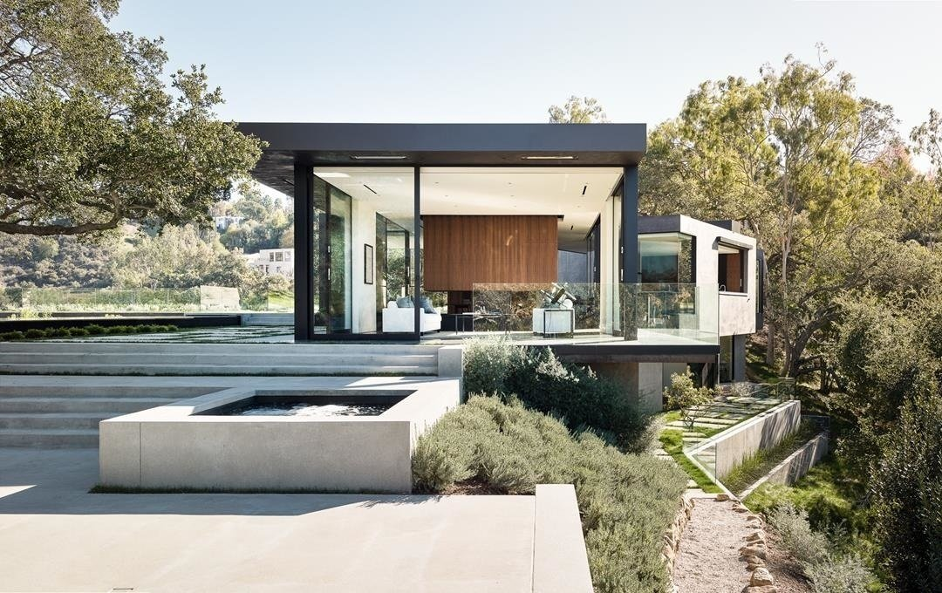
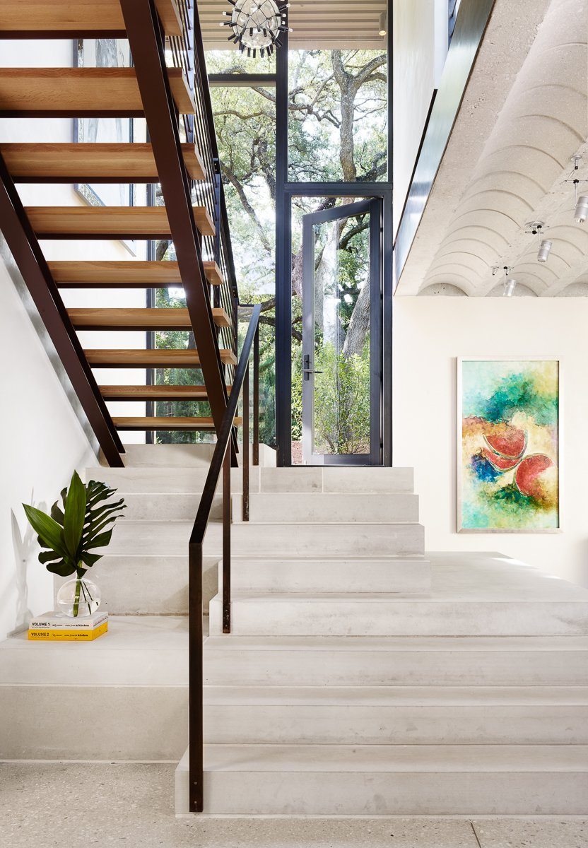
  INSPIRATION
“While touring the homes at the NAHB International Builder’s Show in Las Vegas, we were intrigued by the guided tours focused on products. We knew we had to build on this concept and bring it to Dallas…except Texas style.”
~ William Riseman

Slide 3
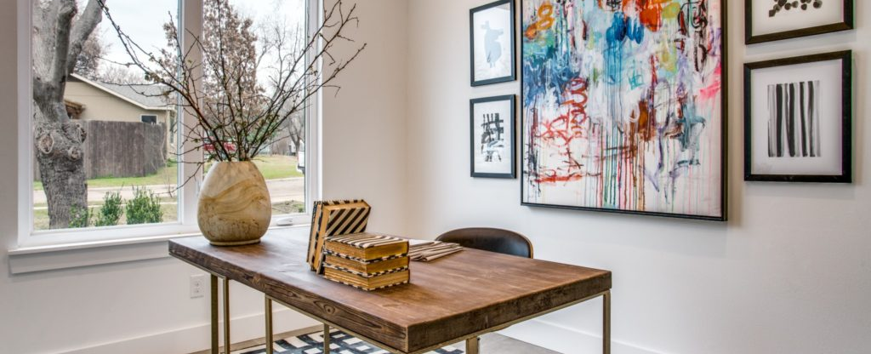
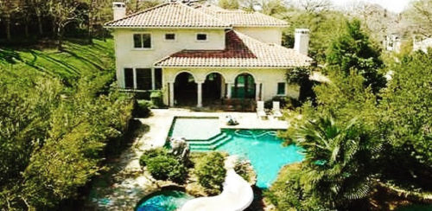
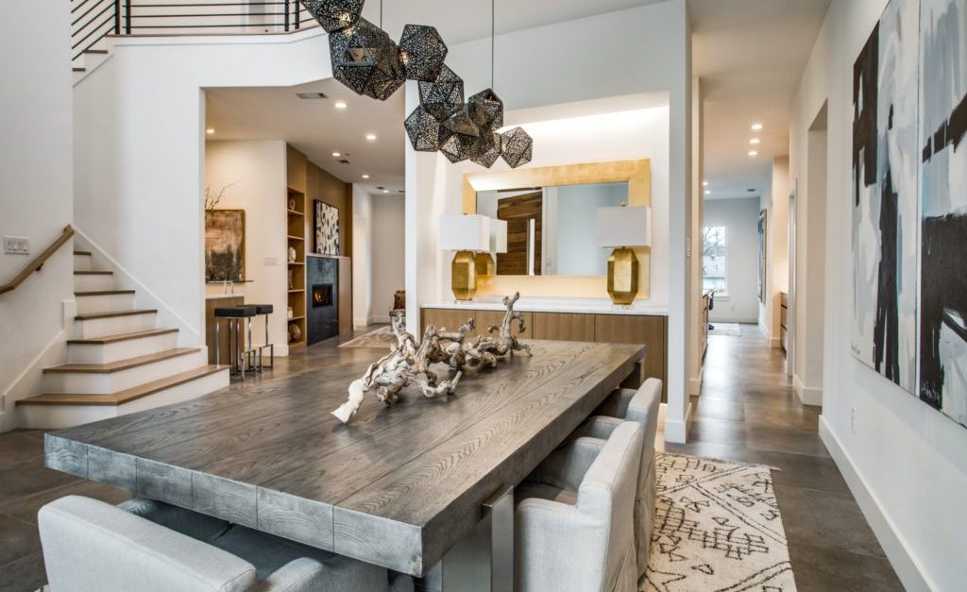
VISION
We drive awareness by creating an educational space for consumers and construction industry professionals to learn more about the home building products they use every day.
With the ability to see materials, equipment and technology in action, our target consumer can make more informed purchases and investments.
THE NORTHAVEN PROJECT is a home environment so that everyone—from home buyers, to developers, builders, and designers—can get a practical, up-close look at products in use.

Slide 4
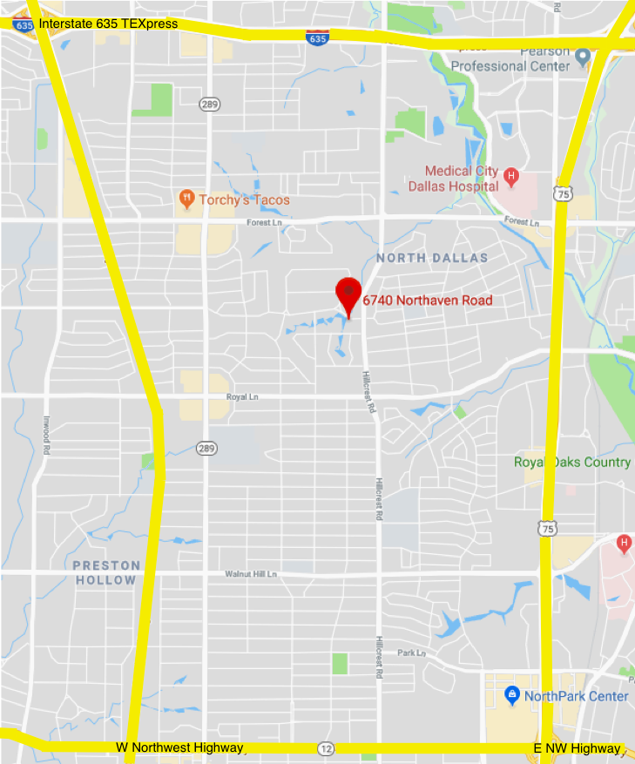

PRIME LOCATION
Dallas North Tollway
THE NORTHAVEN PROJECT
is situated between four major highways.
Notes:
The Dallas-Ft. Worth area is the #1 spot for strong, predictable growth. Thanks to a growing corporate base, higher-than-average salaries, and low unemployment rates, real estate values are expected to rise at a consistent rate now—and in the future.

Slide 5
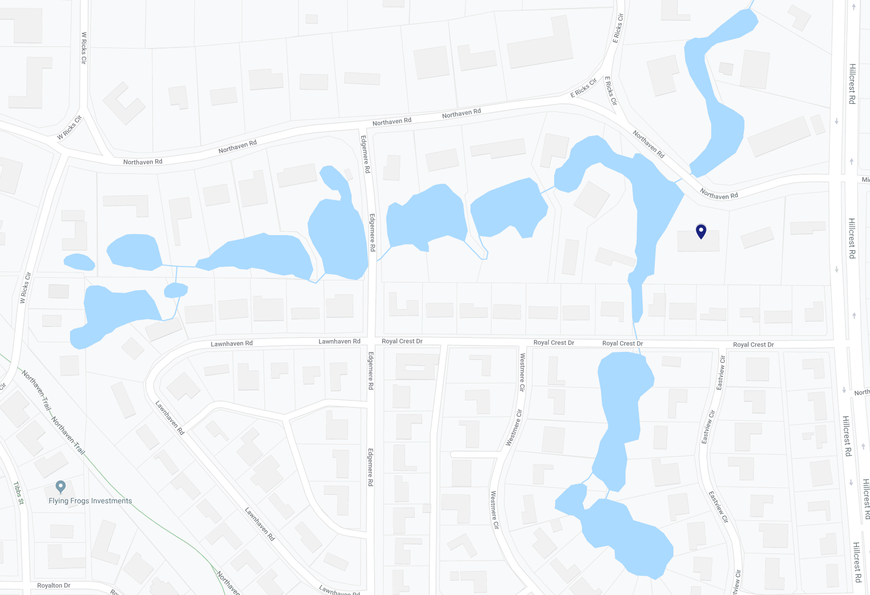
1.46 acres of rare in-town waterfront property in one of the most exclusive areas of Preston Hollow
6740 Northaven Rd

Slide 6
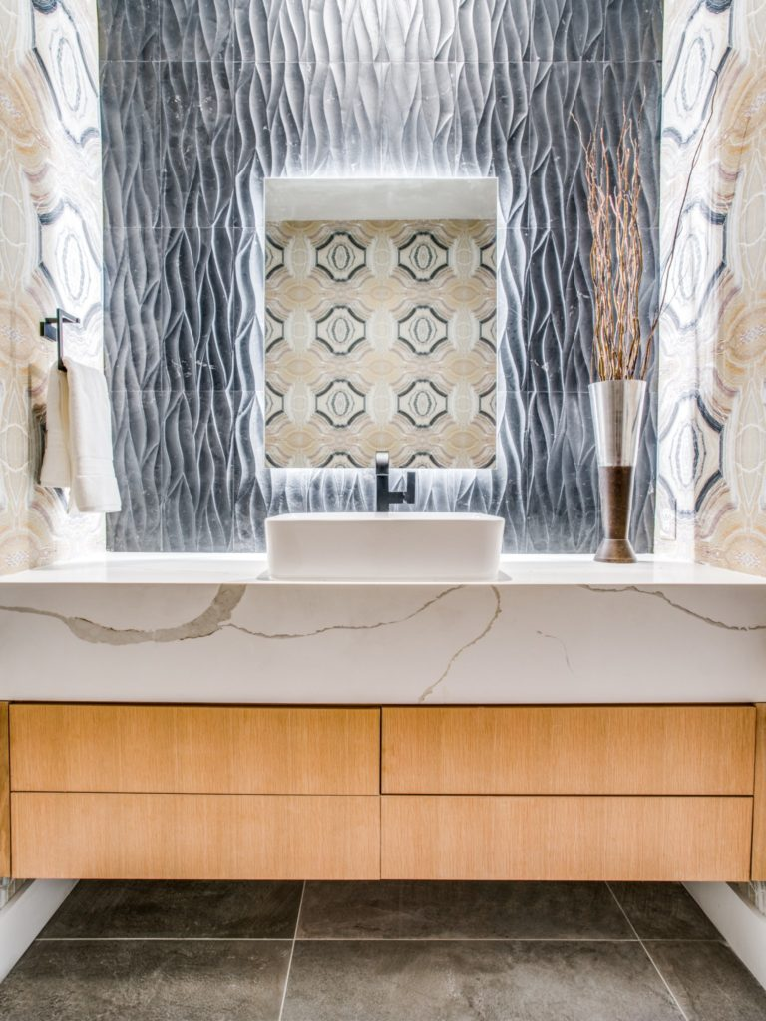
Whether you are building, buying or designing a home it can be challenging.
THE NORTHAVEN PROJECT
is dedicated to showcasing products and services in an upscale, hands-on environment.

Slide 7



CORE VALUES
Healthy
living
Multi-generational living
Integrative technology
Transitional outdoor living
Trending products
Materials, systems, and design that protects everyone’s overall health and wellness
Well-designed spaces the whole family or extended stay company can relax in without compromising on privacy
Products that are created to keep your home connected and efficient
Open spaces and natural environments enhanced by modern technology
A deeper look at the newest products, systems, and materials in the housing market

Slide 8
Exposure
+
Education
=
Sales
Notes:
The Northaven Project brings consumer and vendor together . Consumers and industry professionals will have the opportunity to be educated and vendors will get maximum incomparable exposure as they showcase their products.

Slide 9
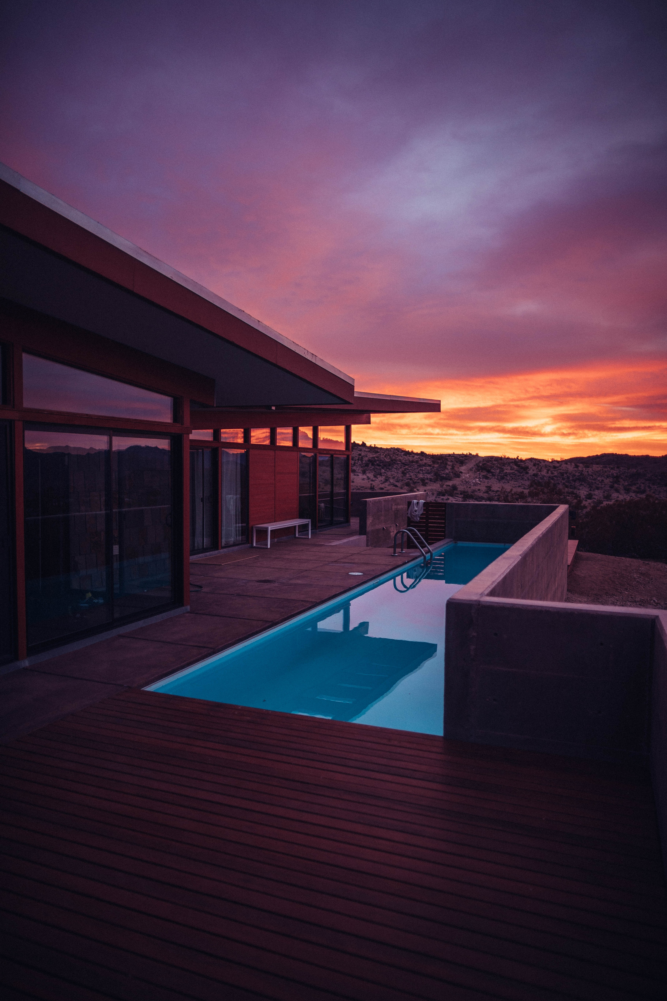



Children’s Medical Center of Dallas
will honor their most distinguished donors at an onsite dinner
EXPOSURE
Feature home for the 2021 Dallas Parade of Homes and part of an award-winning education series during and upon construction.

Slide 10





EXPOSURE
Followed on social media using live streams, educational videos, photography and blog updates.

Slide 11

EXPOSURE
Promoted through targeted advertising

Slide 12
EDUCATION
On-site continuing education classes in partnership with the Dallas Builders Association.
Fulfill continuing education requirements
Get hands-on experience with products
and materials
Talk directly to vendors and suppliers about their products
LEARN MORE. GROW FASTER.

Slide 13
We invite
Luxe Interiors + Design to become part of something bigger
THE NORTHAVEN PROJECT

Slide 14
THANK YOU!
Notes:
[Conclusion]
Thank you and contact information #1

