Slide 1
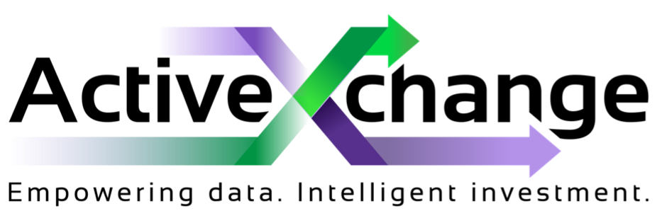
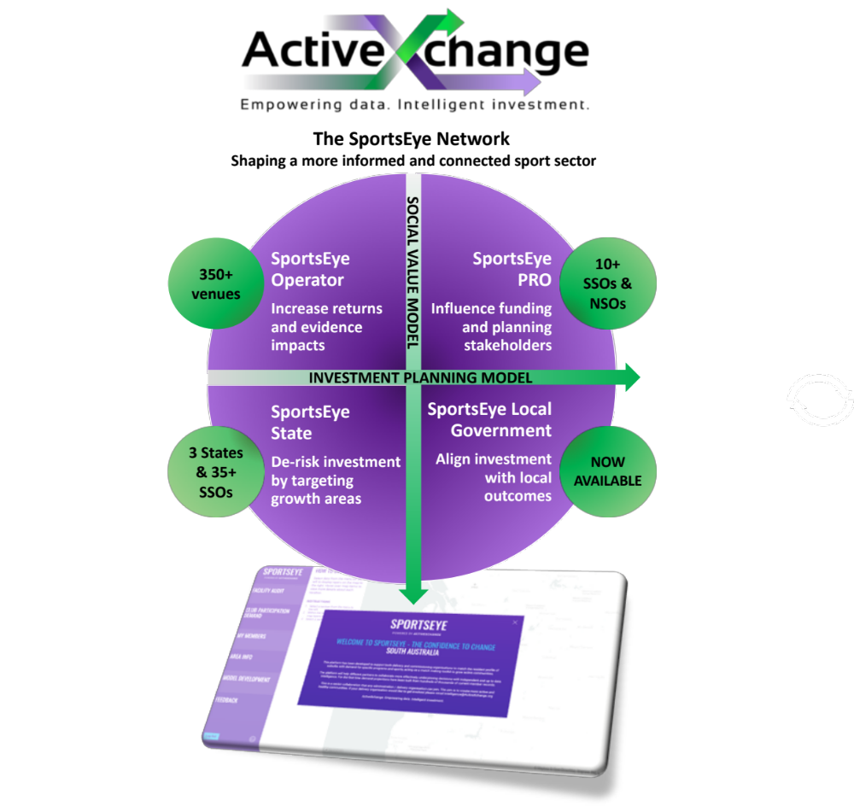
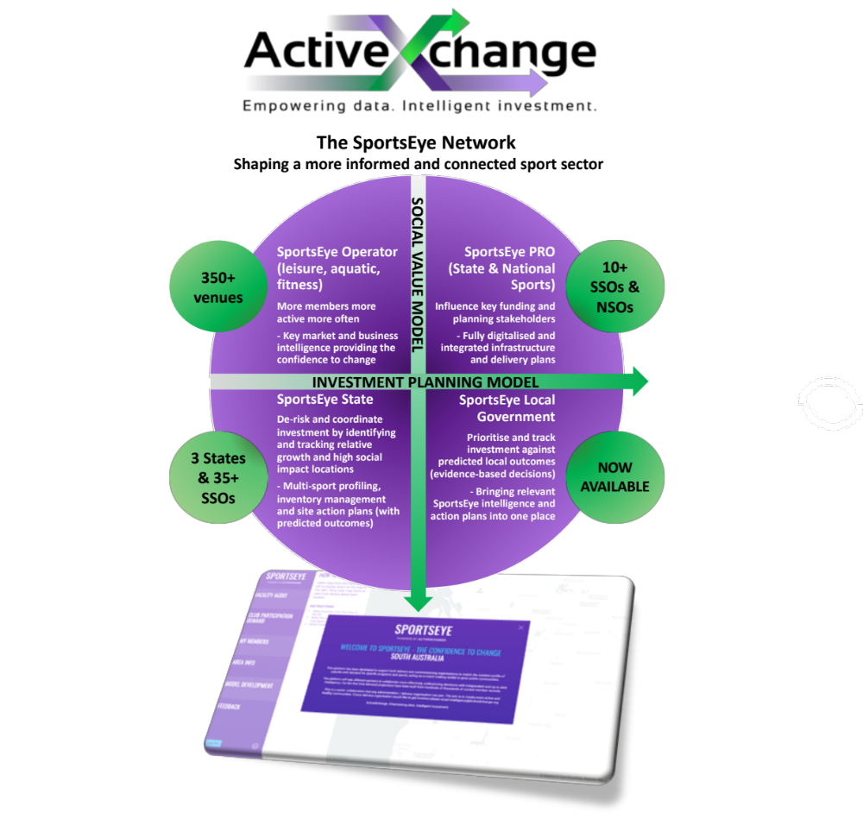
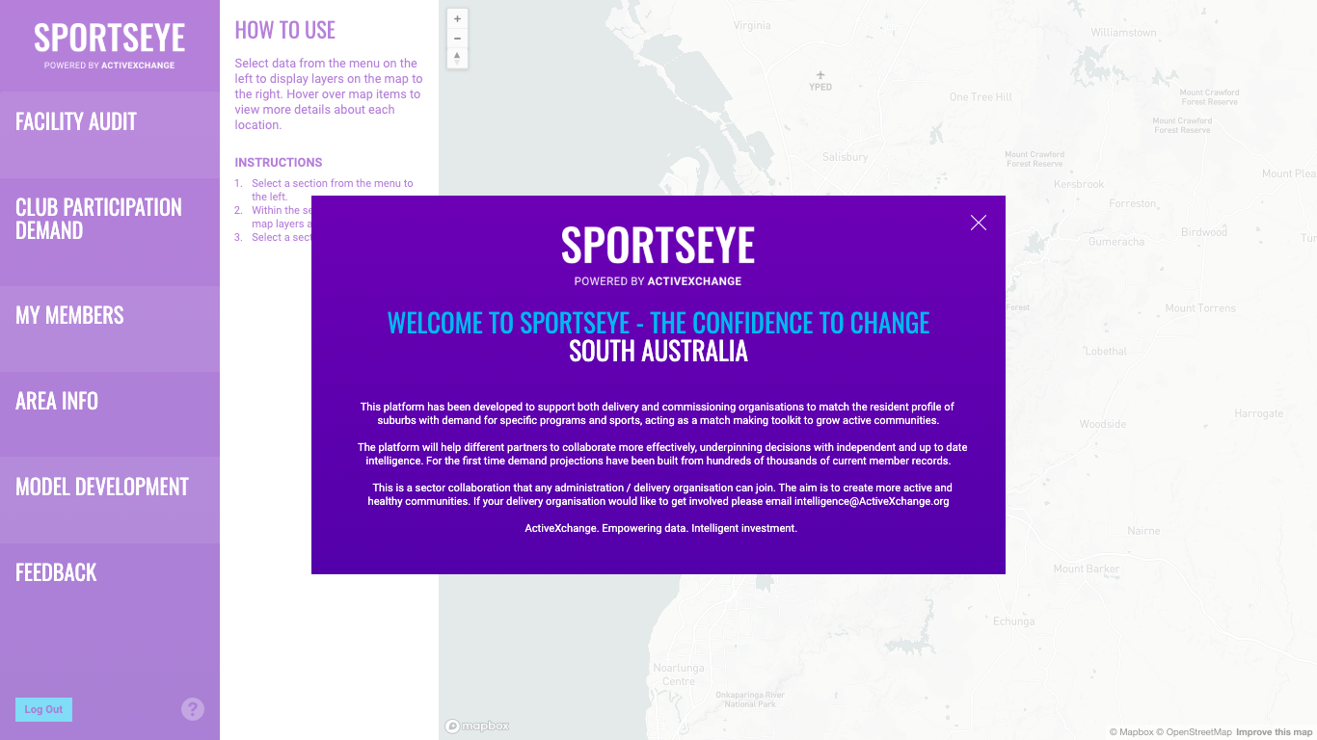
The SportsEye Network
Shaping a more informed and connected sport sector
SportsEye Operator
Increase returns and evidence impacts
SportsEye PRO
Influence funding and planning stakeholders
SportsEye Local Government
Align investment with local outcomes
SportsEye State
De-risk investment by targeting growth areas
The SportsEye Network
Shaping a more informed and connect sport sector
350+ venues
10+ SSOs & NSOs
SportsEye Operator (leisure, aquatic, fitness)
More members more active more often
- Key market and business intelligence providing the confidence to change
SportsEye PRO (State & National Sports)
Influence key funding and planning stakeholders
- Fully digitalised and integrated infrastructure and delivery plans
SportsEye Local Government
Prioritise and track investment against predicted local outcomes (evidence-based decisions)
- Bringing relevant SportsEye intelligence and action plans into one place
SportsEye State
De-risk and coordinate investment by identifying and tracking relative growth and high social impact locations
- Multi-sport profiling, inventory management and site action plans (with predicted outcomes)
350+ venues
10+ SSOs & NSOs
INVESTMENT PLANNING MODEL
SOCIAL VALUE MODEL
3 States & 35+ SSOs
NOW AVAILABLE
INVESTMENT PLANNING MODEL
SOCIAL VALUE MODEL
3 States & 35+ SSOs
NOW AVAILABLE

