Slide 1
ActiveXchange Investment Planning Model
- Example Site Report -
September 2019– New Site
Report options: New Site, Area Analysis, Existing Site, Optimal Location, Blank Page, Full Optimal Program and Price

Slide 2
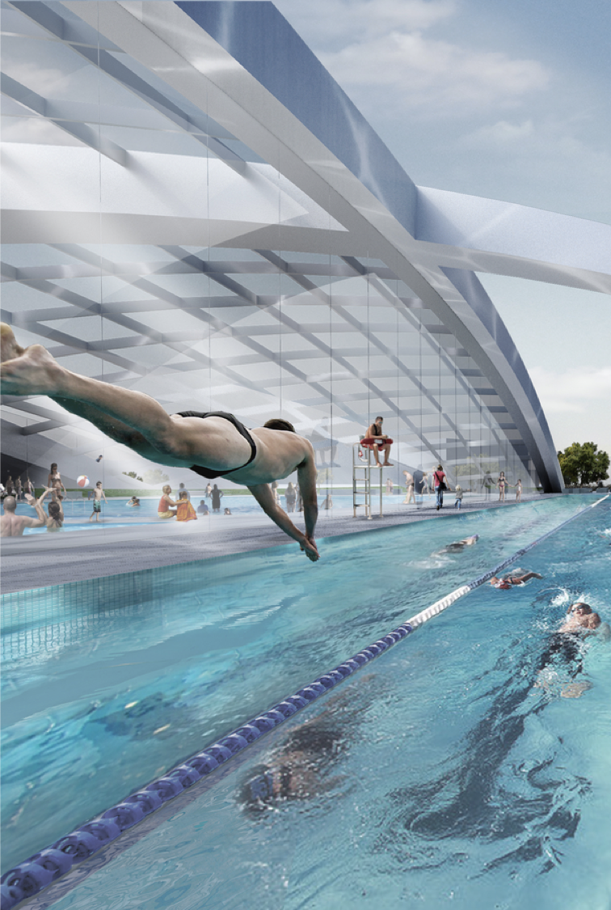
Report structure – market intelligence applied locally
Process overview – a sector first
How data from over 2 million community program and facility members and participants, millions of visits, and the performance of hundreds of facilities is used to create a supply and demand model that predicts member and visits outcomes (and therefore optimal capacity) with 90% average accuracy
01
02
Catchment overview
Location of the site, competition, the travel time decay factor, and profile of demand (segments)
03
Projected demand + optimal offer
Projected members and visits by facility
Optimal program and pricing to reflect the profile of the area
Optimal estimated capacity aligned with demand and viability benchmarks

Slide 3
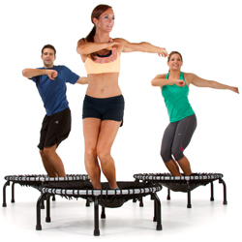

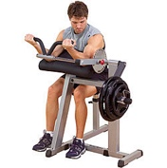



Investment Planning Model – full overview video www.ActiveXchange.org
Model metrics
- DEMAND: likelihood of each individual to use the facility based on factors including demographics, lifestyle (segments), deprivation, mobility (willingness to travel) – correlated against types of facility (SUPPLY offer) factors: capacity (if known), access, age of the facility, parking, competition, opening hours, proxy program and pricing assumptions
Demand profiling
785 demographic and lifestyle indicators appended to every record to create specific membership and activity (visit) demand segments and model parameters that are extrapolated nationwide (SA1 level)
Demand allocation
Based on the model run a number of likely members (and attributed visits from these to each facility type) from each SA1 is allocated to the site
Supply and competition
All competition audited. Travel time catchments mapped, factoring in relevant travel time decay modelling. Weighting applied to different competition based on type and capacity
Validation
Member and visit outcomes are regularly checked against the actual performance of hundreds of facilities. The model is constantly refined to increase average accuracy, which is currently at over 95%.
ActiveXchange database – a sector first
Data from 2m participant/ member records, millions of session visits, performance of hundreds of facilities across Australia and New Zealand are brought together through facility operator and system provider partnerships

Slide 4
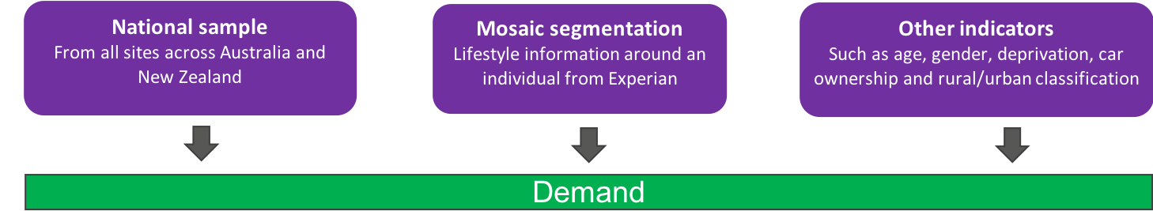
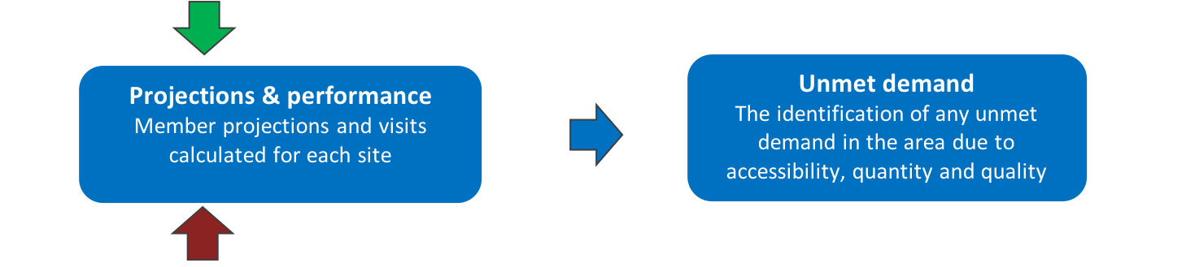
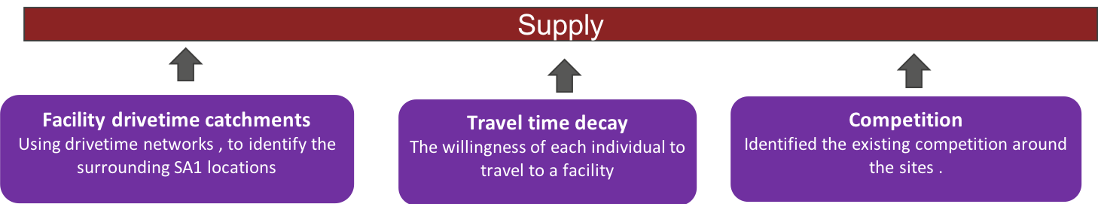
Investment Planning Model – full overview video www.ActiveXchange.org

Slide 5
Site overview – Stromlo Forest Park Site
Location and competition
Rural Drive time decay

Slide 6

Projected demand map – Stromlo Forest Park
Demand Heatmap & Competition
Catchment breakdown
Within a 30 minutes drive time catchment region, after applying travel time decay
Total Population – 449,570
Population after applying travel time decay – 14,731
Total leisure member demand – 75,078
Total leisure member demand after applying Drive Time decay –2,243
*Not including competition.

Slide 7
Top segment profiles in the catchment including drive time decay – full details at: www.ActiveXchange.org/segments
B05
Informed and Educated wealthy families in desirable suburbs on city perimeters
Out on the Edge
2,554
B06
Educated, maturing family households located in outer metropolitan suburbs
Maturing Assets
1,555
F22
Young families and singles on tight budgets in fast growing metropolitan areas
New Bubs, New Burbs
1,359
D16
Empty nester couples living in large houses in sought after metropolitan suburbs
Ageing Gracefully
1,008
Free PowerPoint Templates

Slide 8
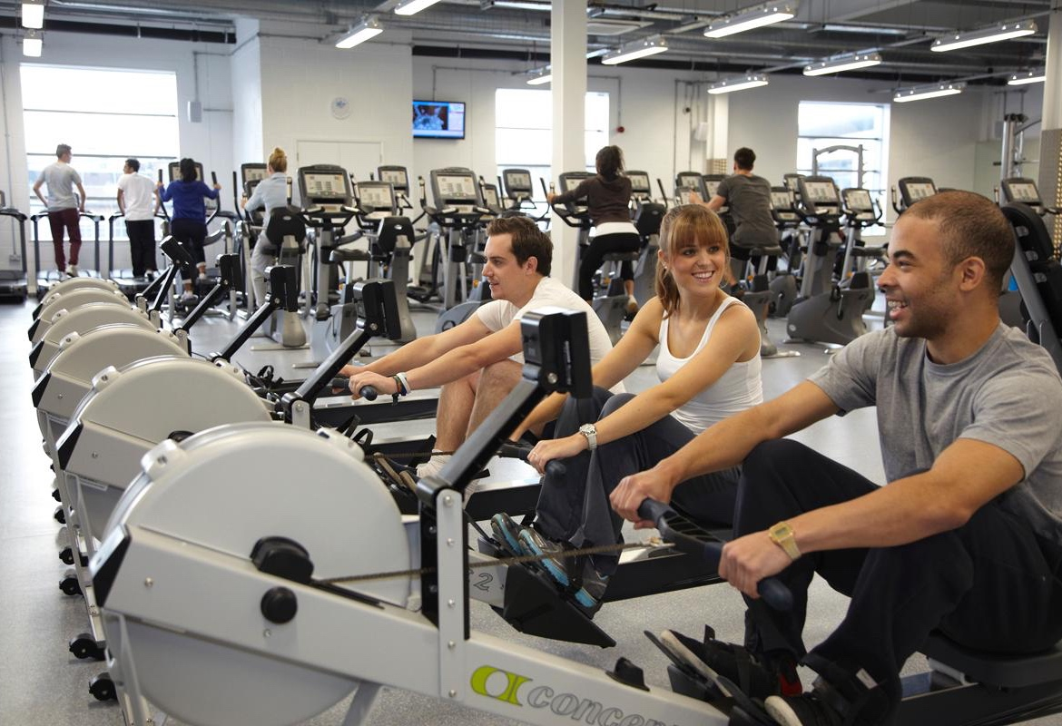


Projected Demand - Stromlo Forest Park Site
Gym
Swimming
Group exercise
Approximately 80 station facility
Project demand (users) – 3,406
Projected visits per month – 4,459
Approximate 1,915² pool area (Including main pool, learn to swim and leisure pools).
Project demand (users) – 1,633
  Projected members -339
  Projected visit pass holders – 509
  Projected swim school – 784
Projected visits per month – 4,716
Dry program/multi purpose rooms
Outdoor circuit training
Project demand (users) – 200
Projected visits per month – 130

Slide 9
Overall facility demand – membership locations (Stromlo Forest Park Site)
Customer demand at the site
(factoring competition and profile of the proposed site)
Catchment breakdown
Within the 30 minutes drive time catchment region, after applying travel time decay factoring in competition
Demand at the site factoring in competition
    Gym users – 1,406
    Swimming pool users – 2,633
    Group exercise users – 300
    Optimal Pricing for Gym - $18.75 per week
    Optimal Pricing for Aquatic - $16.90 per week

Slide 10
Demand by drive time banding
0-10 minute drive time
The percentage of projected members which are located within a 10 minutes drive of the site.
10-20 minute drive time
The percentage of projected members which are located within a 5 to 10 minute drive of the site.
20-30 minute drive time
The percentage of projected members which are located within a 10 to 15 minute drive of the site.

Slide 11


Program and pricing – Swimming : Stromlo Forest Park Site
AQUA FUSION
AQUACISE
23%
16%
01
02
Optimal Timetable
14%
If you had 100 hours of programs per month – how should you split the timetable
14%
DEEP WATER RUNNING
03
04
AQUA ZUMBA
14%
11%
05
06
CHILDRENS SWIMMING LESSONS
Aqua Aerobics

Slide 12


Program and pricing – Group exercise : Stromlo Forest Park Site
RPM
YOGA
17%
12%
01
02
Optimal Timetable
12%
If you had 100 hours of programs per month – how should you split the timetable
11%
BODY ATTACK
03
04
PILATES
11%
10%
05
06
BODY BALANCE
BODY PUMP

Slide 13
Optimal capacity –Stromlo Forest Park Site
Gym Stations
The optimal capacity for a facility is determined by maximizing the member per station ratio to achieve the greatest possible yield. For the site, the optimal capacity is 80 stations.
Stations | Members/Users | Users per station
80 | 2,337 | 29.21
100 | 2,370 | 23.70
130 | 2,406 | 18.5

Slide 14
Target performance - 75th sector quartile benchmark (against projected performance)
48
9.4
358
45
8.5
310
40
7.5
290
35
75th quartile
6.5
267
30
5.5
200
25
50th quartile
4.2
134
24
3.7
125
22
25th quartile
3.3
115
19
2.9
102
10
1.5
50
0
0
0
GYM
Users per station: 29.21
Optimal pricing and programs drive growth
MAIN POOL (1213m2)
Users per m2: 1.35
Optimal pricing and programs drive growth
STUDIO
Visits per studio: 300
Optimal pricing and programs drive growth

Slide 15

ActiveXchange – creating more active and healthy communities
INVESTEMENT PLANNING – activeCAMPAIGNS – SOCIAL VALUE
ActiveXchange Pty Ltd
Spaces Surry Hills
Sydney. NSW.
Australia
www.ActiveXchange.org
intelligence@ActiveXchange.org
+61 (2)4017 1234
Twitter: @ActXchange / #ActiveXchange

