Slide 1
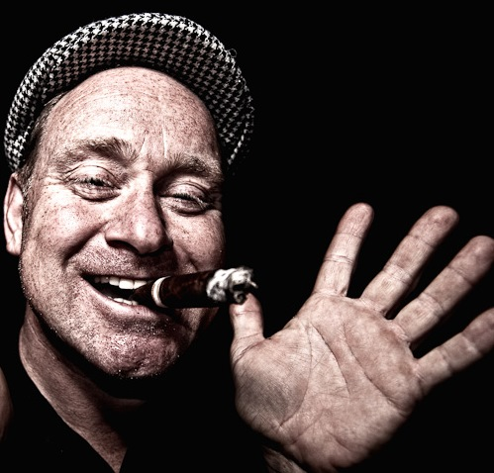
Lord
Kooperman

Slide 2


Slide 3
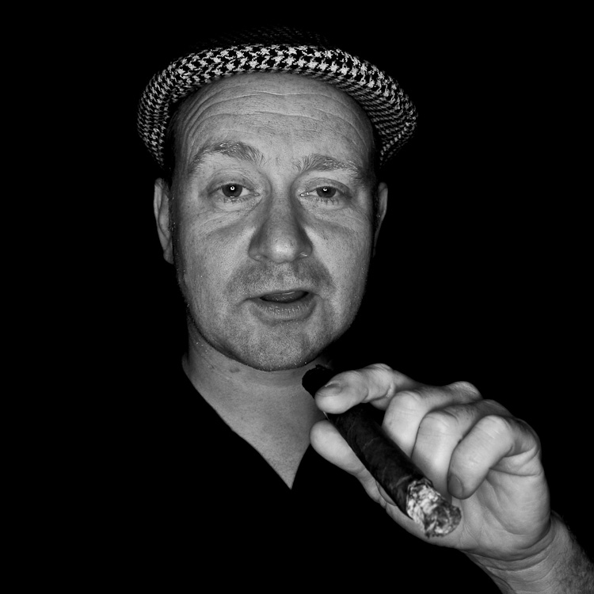

Slide 4
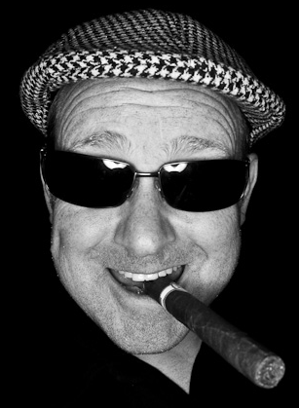
LORD
Kooperman

Slide 5
LORD
KOOPERMAN

Slide 9


