Slide 1
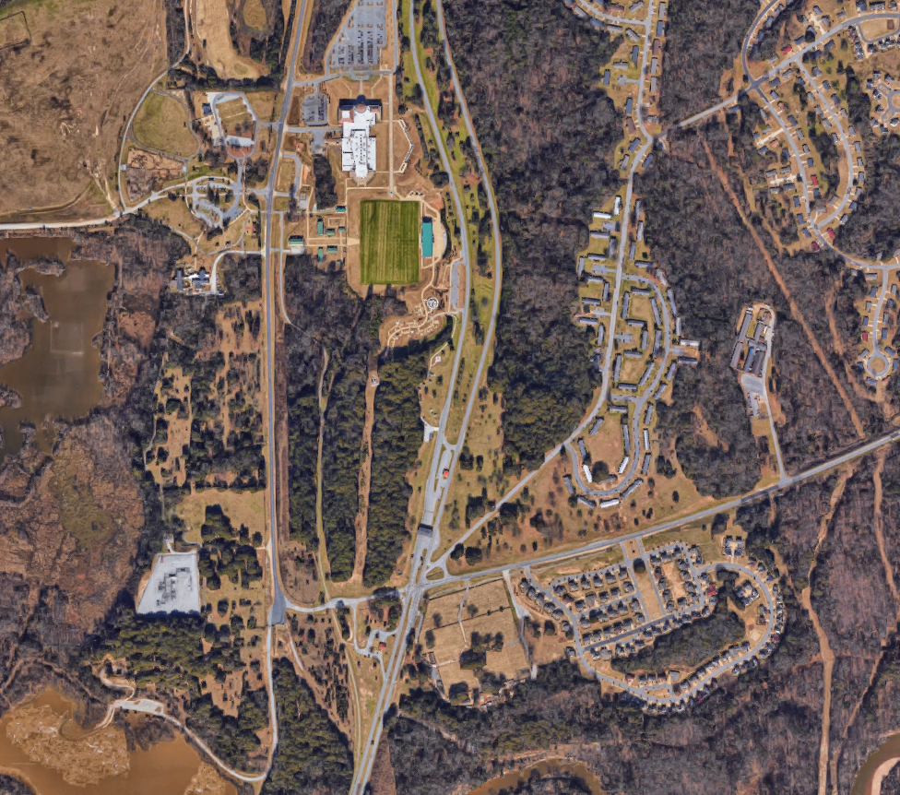
Camp David
Camp David RV resort, is a beautiful rustic 33 acre property, conveniently located near Columbus and Fort Benning local attractions, including Historic Westville and the National Infantry Museum.
Columbus City Dog Park
National Infantry Museum
Convenient Location:
Fort Benning (Cemetery entrance): <1 mi
National Infantry Museum: 0.7 mi
Columbus City Dog Park: 0.6 mi
Fort Benning Visitor Center (main post entrance): 10 min, 4.3 mi
Gas Stations, grocery stores, restaurants, and shopping all within 10 minutes
Open to the Public including:
Visitors to Historic Westville
Families in the Columbus and Chattahoochee Valley Area
Families visiting Soldiers at Fort Benning
Retired military personnel
Visitors to the National Infantry Museum
Soldiers at Fort Benning for temporary duty stations
Soldiers stationed at Fort Benning
Historic Westville
Riverwalk
Entrance to Fort Benning
Camp David
Contact Information
Camp David, LLC
Adam Hunt
adam.dale.hunt@gmail.com
870-632-0788

Slide 2
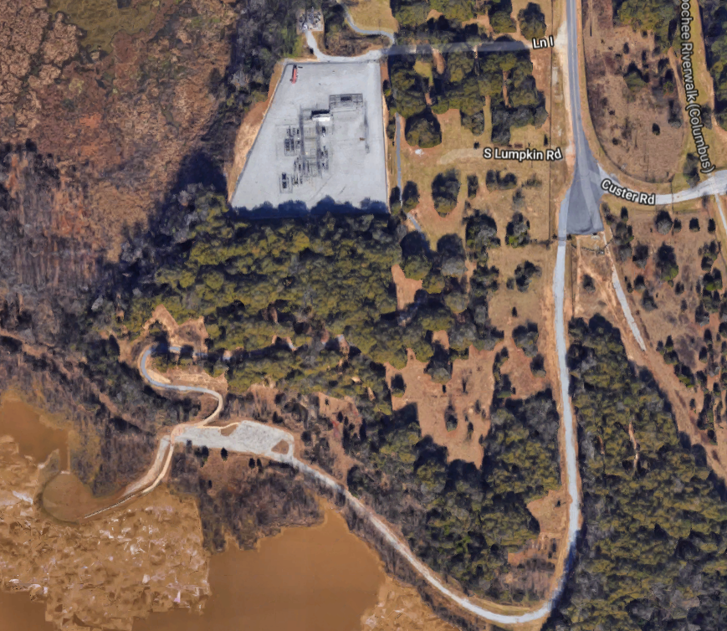
Camp David
Camp David RV resort, is a beautiful rustic 33 acre property, conveniently located near Columbus, GA and Fort Benning local attractions.
Materials to be used:
Roads (gravel)
RV Pads (concrete)
Bathhouse (concrete)
Parking lots (gravel)
Camp house (vertical roof, metal building)
Pavilion area with outdoor kitchen (concrete with wooden pillars and metal pavilion cover)
RV Lots
Camp House / Office
Bath House / Laundry
Westville Proposal
CAMP DAVID’s 33-acre rustic area, three acre pond with access to the Upatoi Creek and Columbus River Walk trail is an ideal location for a family-friendly campground. Our team will provide a variety of services, with initial offerings including, but not limited to:
30 RV full hook-up sites
  20’ x 40’ pads
  30/50 amp
  water and sewer hookups
Tent camping area with water and electricity
Campgrounds
Laundry facilities
Bath house
Camp house
Wi-fi access
Fishing area with dock
Access to nature trail
Pavilion area with outdoor kitchen.
Parking
Parking
Phase 2 Development Area
Primitive Camping Area
Parking
Tent Camping Area
Fishing Dock
Contact Information
Camp David, LLC
Adam Hunt
adam.dale.hunt@gmail.com
870-632-0788

Slide 3
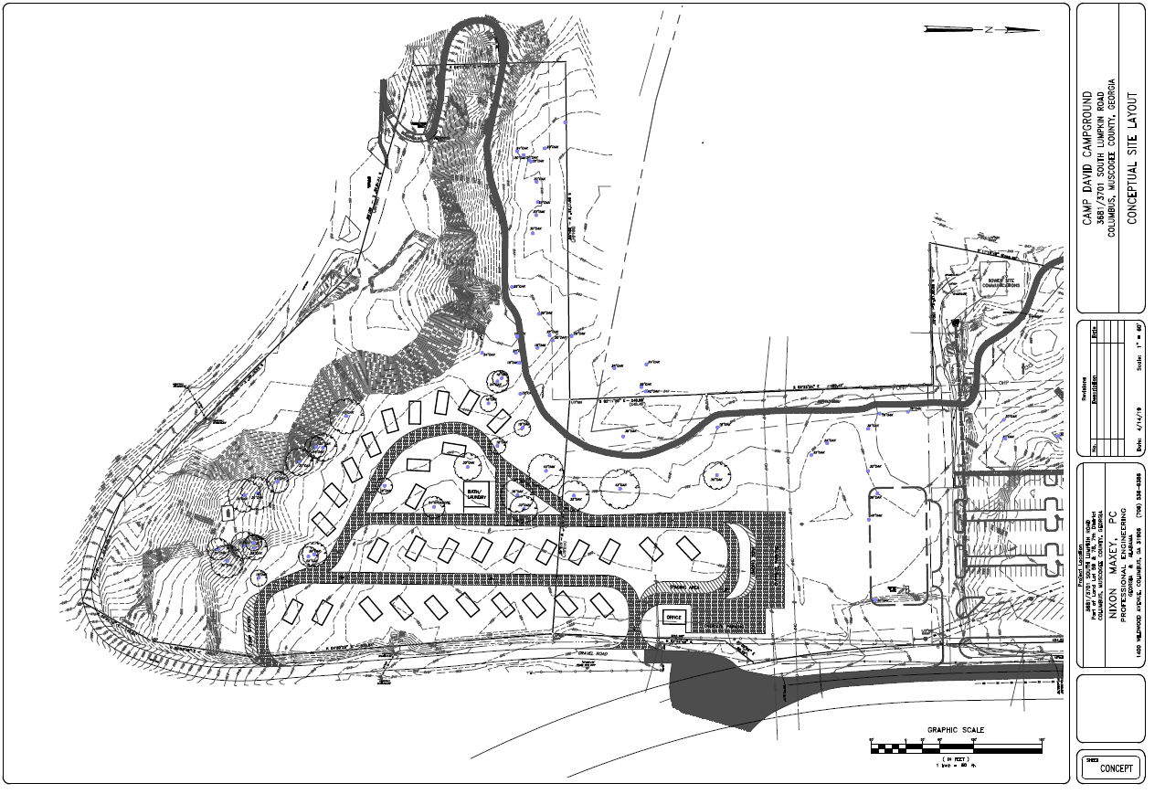

Slide 4
Electric Line
Sewer Line
Water Line
Intent is to minimize number of main and branch lines while maintaining hydraulic pressures for all units to preserve the natural scenery on the property. Exact positioning of water, utilities, and sewer depends on existing lines in the area, pending information from the city plans office, and an official site evaluation conducted by a civil engineering firm.
Not all RV sites are depicted. Branch lines would exist for each site off main lines.
Materials to be used:
Roads (gravel)
RV Pads (concrete)
Bathhouse (concrete)
Parking lots (gravel)
Camp house (vertical roof, metal building)
Pavilion area with outdoor kitchen (concrete with wooden pillars and metal pavilion cover)
Contact Information
Camp David, LLC.
Adam Hunt
adam.dale.hunt@gmail.com
870-632-0788

Slide 5
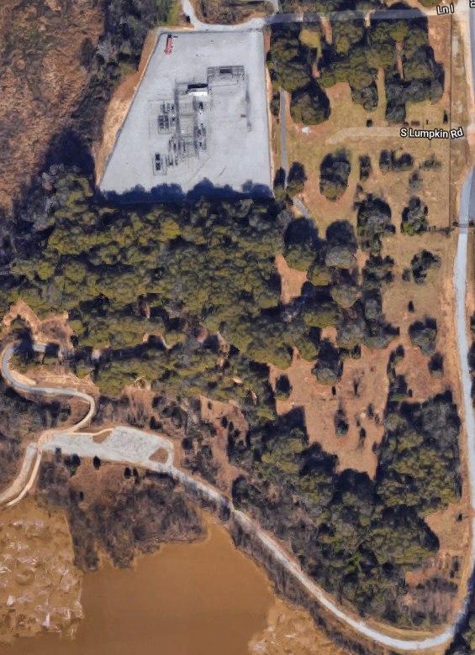
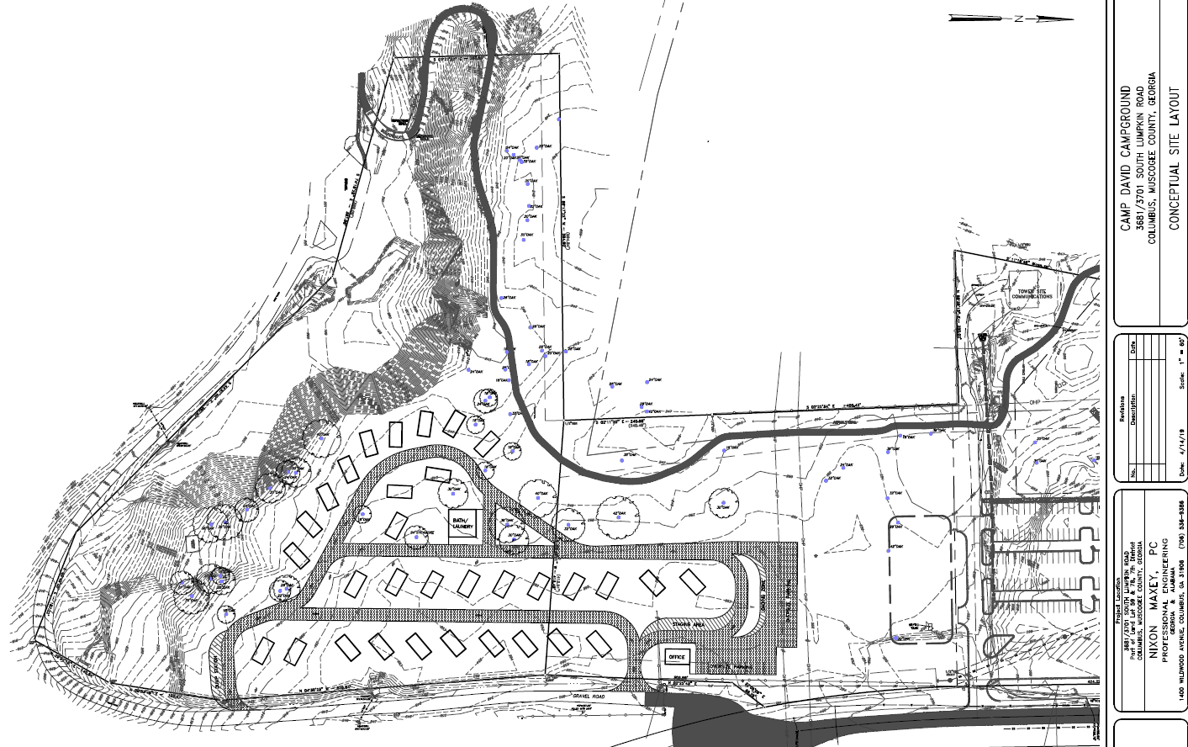
Camp David
Phase 2 development area, is an additional 50 full hookup RV slots, 12 dry cabins, two covered pavilions, restrooms/ bath house, additional walking trail, and paving all roads .
RV Pads (concrete)
Bathhouse (concrete)
Roads/ Parking lots (paved)
Cabins (log construction, metal roof)
Pavilion area with outdoor kitchen (concrete with wooden pillars and metal pavilion cover)
RV Lots
Cabins / Chalets
Bath House / Laundry
Covered Pavilion

