Slide 1

Title
Customer name
xx of xxxxx of 201x
#Ref
Internal Information– Authorized for Customer / Supplier

Slide 2




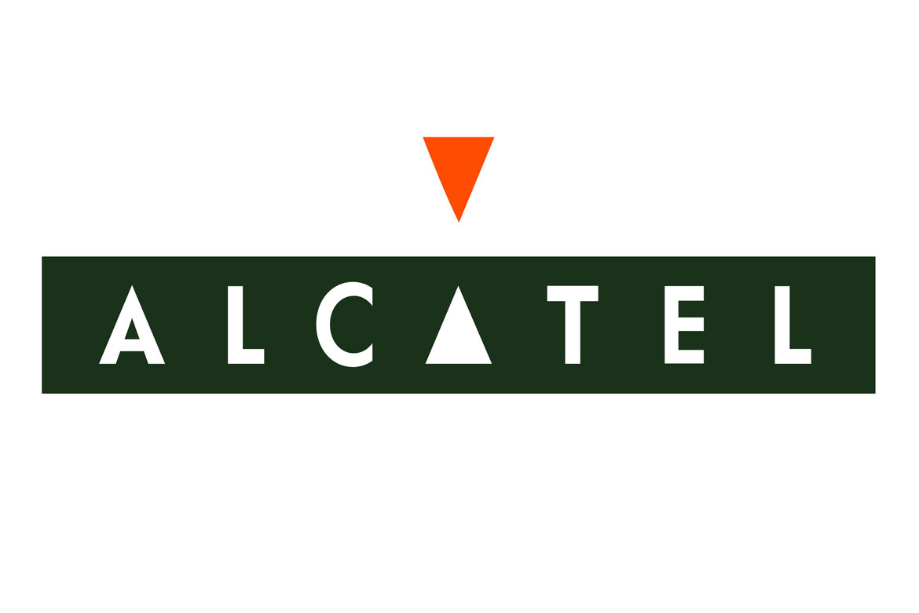


History
Portugal
2000
2014
2017
1989
2002
2016
E-Business Distribution
Espanha
2019: Warpcom incorporates virtualization and cloud area of Ozona Portugal
Notes:
Os mais de 20 anos a operar no setor das TIC, fazem com que a Warpcom tenha uma experiência e know-how ímpares.
Mesmo com as diversas alterações de brand e de estrutura acionista, a Warpcom é reconhecida no setor das TIC como uma empresa de confiança e qualidade inequívocas.
Durante estes anos foram várias as alterações:
As origens remontam a 1989 como ALCATEL Comunicação de Empresa
Em 1997 a ALCATEL Comunicação de Empresa é integrada na ALCATEL Portugal
Em 2000 dá-se a separação da ALCATEL Portugal dando origem à ALCATEL E-Business Distribution
Em 2002 a NextiraOne adquire as unidades de negócio europeias da ALCATEL E-Business Distribution
Em 2014 as operações europeias da NextiraOne são adquiridas pela Dimension Data (Grupo NTT)
É então em 2016 que nasce a Warpcom fruto de um Management Buyout das operações Portuguesas da Dimension Data

Slide 3





Mission
Vision and
Values
Mission
Our mission is to contribute for the technological evolution and for our customers’ efficiency and productivity, increasing their competitive capacity. Focused on the customer, we demand quality in all processes in which we are involved, aiming to ensure the delivery of solutions within high quality and reliability patterns, exceeding the expectations of our customers.
Vision
We want to be a leading national company in the design, supply, integration and management of technological solutions, contributing for the technological evolution, for our customers’ efficiency and productivity and for the increase of their competitivity.
Values
Trust, quality, proximity and compromise
Notes:
The customer is in the center of everything we do. This way of being is reflected in our mission, vision and in our values.
We want our customers to regard us as a partner for their journey, as we highlight in our claim “together with you”.
We are a trustworthy partner which makes a compromise to always be close and available, providing the quality which characterizes us. (values)
We demand high quality patterns in everything we do, from the services provided to the solutions developed.

Slide 4

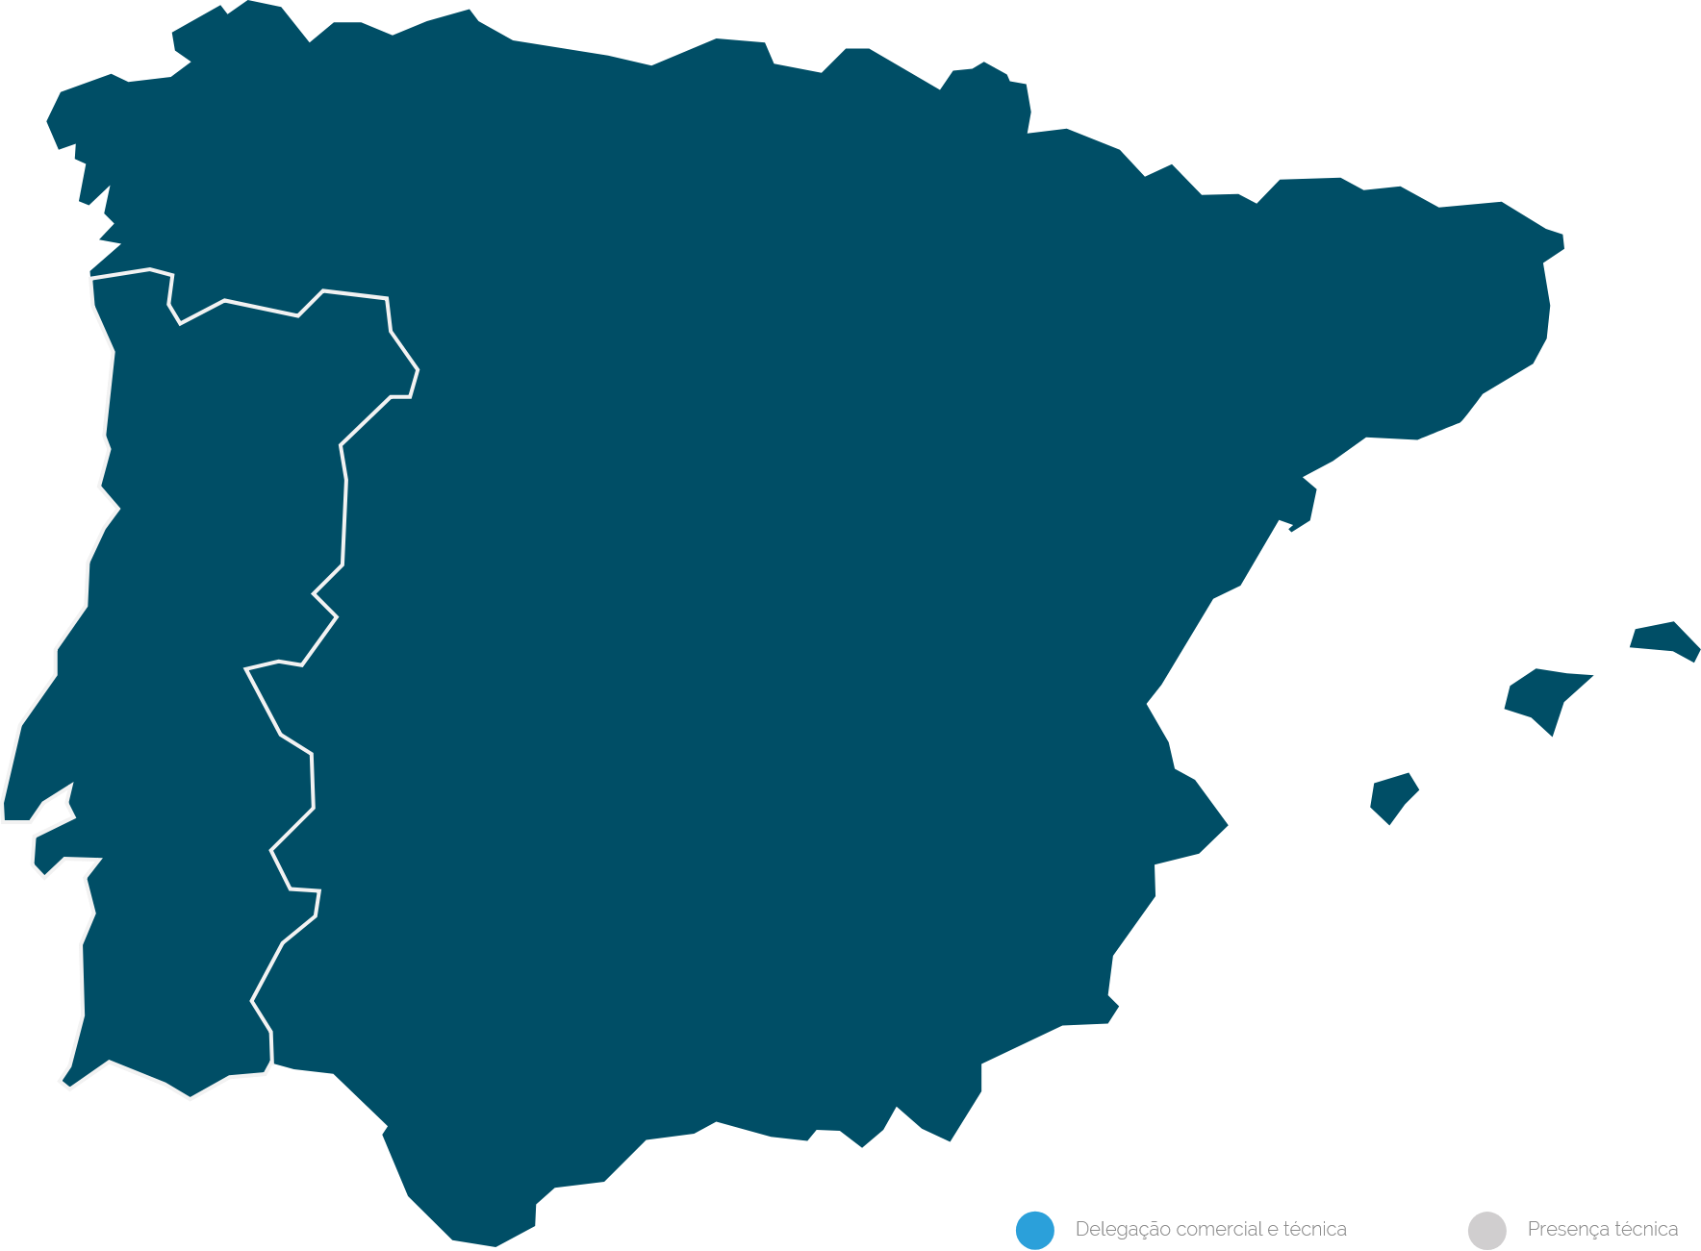




revenue
leading
technological
integrator
> 30M
Euros
~120
Coruña
Oviedo
Bilbau
Ponta Delgada
Pamplona
employees
Zaragoza
Porto
Valladolid
Barcelona
> 2000
customers
Funchal
Madrid
Valencia
Palma
Lisbon
Alicante
wide
Seville
Faro
MARKET
Tenerife
Málaga
EXPERIENCE
Commercial and technical delegation
Technical presence
Notes:
Warpcom is the benchmark technological integrator within the IT sector.
With a revenue of about 30 Million Euros in 2019, we have a global coverage/scale focused on the Iberian market.
Currently we have about 100 collaborators and more than 2000 customers on the various markets and industries.

Slide 5


Why Warpcom

Slide 6



Our
differentiation
Independent integrator
able to manage multi-vendor
environments
Technological innovation and customization
of the solutions developed
Transversal partner in the
Digital Transformation
of our clients
Technological know-how supporting our customers in all their technological stages
Focused on the Iberian market with
Geographical coverage at a
global scale
Warpcom Command Center
with the offer of managed services
(NOC and SOC)
Notes:
Our focus is to provide the technology to the customer in order to guarantee their satisfaction. We are agnostic regarding the technology used, always aiming to find the solution/technology which best suits the identified needs.
As a result of our experts’ know-how on the different technologies, we have the ability to intervene and manage multi-vendor environments.
2. We do not believe in the motto “one size fits all” and, therefore, we adjust the solutions developed to the needs and reality of each customer.
Furthermore, in order for the solutions to competently answer to the existing needs, we try to make them innovative and scalable. Recently we have developed an Open Innovation area, Warpdev, which aims for the development of solutions based on emerging and, sometimes, disruptive technologies to offer even more value to our customers.
Our know-how covers the end-to-end Digital Transformation process and comprehends several activity sectors.
Different organizations, different technological stages. We have the capacity to support our customers regardless of their technological maturity level.
We are able to develop projects at a global scale (our strategical partnerships allow us to cover several geographical locations). In terms of physical premises we are, to this day, focused on the Iberian market.
We have a solid offer of Managed Services, either on their network operations center (NOC) and on the security operations center (SOC) components. For the provision of these services, we resort to our specialized and dedicated operations center – Warpcom Command Center.

Slide 7










What do we do?
Consulting
Services
Professional
Services
Support
Services
Network Operations
Center
Security Operations
Center
Networking & Infrastructure
Collaboration & Customer Experience
Data Center & Multi Cloud
Cybersecurity & Public Safety
Notes:
Company which holds a complete offer of solutions regarding communication and the networks and systems management and evolution services for the business area and public bodies;

Slide 8




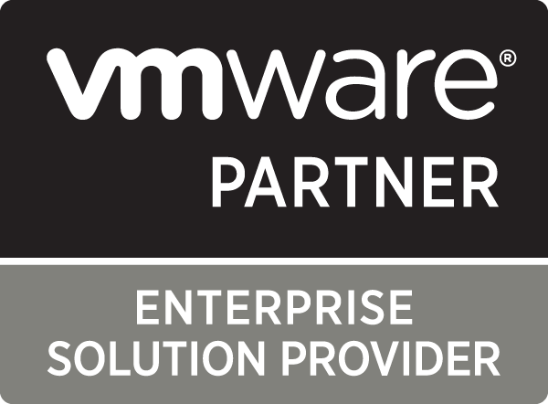
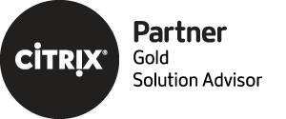


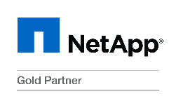

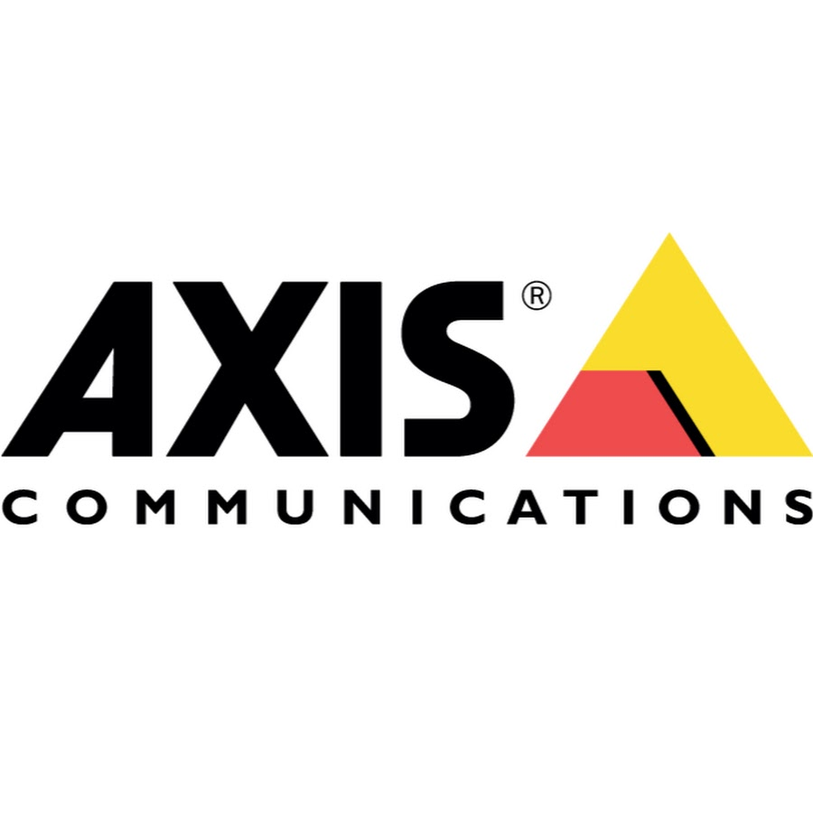





Technological
Partnerships
Certifications
Notes:
Warpcom solidly invests in technical and business certifications and specializations which aim to offer our customers unrivalled quality services/solutions supported by a great knowledge of the technologies, their tends and the business as a whole.
We believe that this investment is crucial for the reinforcement of our position and differentiation on the market.
We developed an Integrated Management System based in 5 normative references, from which we highlight:
ISO 27001 – management of the information’s security
ISO 20000 – management of the quality of the IT services
We also hold the certifications ISO 9001, 14001 and OHSAS 18001 inherent to the quality, environmental management and health and safety management, respectively.

Slide 9







































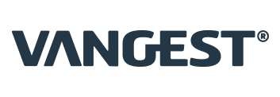









































Some of our customers
Finance & Insurance
Utilities & Operators
Public Sector
Industry & Services
Healthcare
Hospitality
Notes:
Warpcom has a wide market experience, taking pride in counting with the trust of more than 2000 customers from several activity sectors.
We present a small sample of our wide customers portfolio.

Slide 10

Digital Transformation

Slide 11



Change is inevitable in every market.
Innovation is the only way to survive.
Taxi Services
Uber/Lyft
Retail Stores
Amazon.com
Hotels
Airbnb
Points of Sale
Square
Advertisement
Google/Facebook
Vehicles
Tesla Motors/Faraday Future
Music
Spotify/Pandora
Your Industry
Your competition

Slide 12








As it is inevitable, the
Digital Transformation
comprises, in itself, several opportunities.
1.7
$
New ecosystems
New models
Trillions Economy DXI
2019
AI
VR/AR
BOT
IoT
Proactive and personal user’s experience

Slide 13

DX Opportunity
User’s Experience
AI, Bots, Augmented Reality and Virtual Reality
Operational Efficiency
Processes’ automation
Cultural Change
Collaboration and Knowledge Sharing

Slide 14
Networking & Infrastructure

Slide 15





Networking & Infrastructure
Physical Infrastructure
Network Virtualization (SDN)
Mobility & Analytics
IoT & Smart Cities
Routing and switching
Cable systems
Transport (Wi-Fi, FHZ, DWDM)
Data center infrastructure (UPI, climatization, CA, UPS)
SD-WAN: performance, reliability and visibility
SD-DC: automation and security
SD-LAN: visibility and control
High-performance wireless network
Analytics
End-to-end visibility and localization
Cost reduction
Optimization of the resources’ use
Improvement of the services’ quality and efficiency
Notes:
The Networking & Infrastructure BU is divided into 4 technological vectors:
1st vector associated to the conventional networking, for which we are widely known on the market - ADN WARPCOM
2nd, 3rd and 4th vectors reflect market trends and are Warpcom’s solid focal points. These are growing areas in which we hold specialized resources that dominate the solutions that best suit our customers’ needs.
SDN – emerging area mainly centered in SD-WAN and SD-DC. We have projects with big customers and the trust of the main manufacturers of these solutions (Cisco, Nuage, VMWARE).
Mobility & Analytics – reflects the evolution of the connectivity concept which is now based on the wireless (exponential growth of wireless devices: IoT, tablets, smartphones, laptops, gadgets, etc.), as well as on the growing importance of analytics (new oil) which is able to be extracted from these devices and reveals itself to be crucial to leverage the business and the decision-taking.
IoT & Smart Cities – at a time when the efficiency on the natural resources’ costs is a constant discussion topic and when the adoption/use of gadgets is massive (previous vector), talking about IoT and Smart Cities become unavoidable. It is crucial to leverage the smart cities and buildings, which allows: i) a greater efficiency on the resources management (energy, waste, water, gas) and ii) a better usage experience for the citizens.

Slide 16

Collaboration & Customer Experience

Slide 17




Collaboration & Customer Experience
Unified Communications
Videoconference
Applications
User Experience
Voice and video
IM and presence
Terminals and customers
Multipoint conferences
Content sharing
Collaboration
Call recording
Unified messages
SBC/Gateways
Omnichannel
Analytics
Optimization of teams
Notes:
The Collab & CX Bu offer solutions which ensure, to the organizations and their collaborators, simple, efficient and intelligent ways to communicate and collaborate, within and outside the company, with customers, suppliers and business partners.
These are an essential tool for the companies which aim to succeed in the digital economy market, in which the work teams geographical dispersion and the market competitivity demand a way of working which does not depend on the physical and traditional presence, maintaining the teams’ productivity. To do so, these collaboration tools must provide its users an excellent customer experience, so that the adoption and use levels and the desired investment returned are achieved.
Our offer is divided into 4 fundamental pillars:
Unified communications: essential base component of the collaboration architecture, where the voice and video communication platforms and terminals, as well as the chat and presence applications, are included.
Videoconference: for 1-to-many collaboration, the voice, video and content conference solutions are an essential tool which is natively integrated with the unified communications solutions, allowing the conference calls to be easy to carry out.
Applications: as a supplement to the UC core and conference, we provide voice calls and conference meetings recording solutions; a solution of integrated voice mail in unified messaging solutions with email; SBCs and gateways of voice and videoconference, which interconnect the customer’s network with external entities.
User Experience: includes the traditional Contact center solutions.

Slide 18

Data Center & Multi Cloud

Slide 19
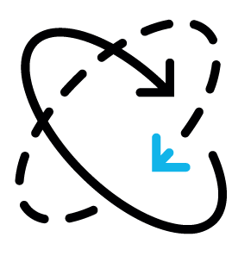



Data Center & Multi Cloud
Virtualization and Hyperconvergence
Data storage and backup
Cloud Services
Virtual Workstations
Simplified operation
Performance increase
High availability
Flexibility
Flash, disk or cloud
Disasters recovery and backup
Self-service and automation
Business continuity
IaaS, PaaS and SaaS
Public, private, national and world leading Clouds
Data migration and backup
Disasters recovery
Data centralization and protection
Simplified access and management of applications and desktops
Unified management of devices
Access security
Notes:
The Data Center & Multicloud BU is divided into 4 technological vectors:
Virtualization and Hyperconvergence:
By analyzing the current infrastructure, we are able to conceptualize, in computation terms, solutions created for the last generation of workloads
We ensure the high availability of the solutions according to the applications’ needs and critical status, through the use of best practices and the last virtualization features
Regular works with hyper convergent solutions, when these are assets
Data storage and backup:
We are a benchmark integrator for the implementation of storage solutions, from high-end to small solutions, not less crucial for the customer
As protecting critical infrastructures without visibility is not possible, the suggested solutions consider an integration with monitorization and alarm tools
By approaching the data backup and recovery from the storage, we ensure that the RPO (recovery point objective) and the RTO (recovery time objective) are suitable to the systems’ critical status, achieving almost null values
The backup is also, usually, a overload for the IT, therefore we can delivery self-service capacities (with approved workflows) to the users. Regarding the disasters recovery, we built fully automatized solutions
The business continuity is essential for many of our customers, several with 24/7 services, therefore we work with leading solutions to mitigate the risk
Cloud services
We work with several cloud models
Regarding the IaaS, we have partnerships with national and international market leading providers, working on the sizing and migration of corporative workloads to the cloud
Regarding the PaaS, we work with the great cloud providers to ensure scalable and last generation DevOps architectures, always with the hybrid cloud in mind.
Regarding the SaaS, we usually use cloud solutions to meet the business goals, both on the flexibility of licensing models and on the solutions’ resilience and simplicity
Overall, we are the right partner to help on the establishment of the path and migration strategies for the several Cloud models
Virtual workstations
With benchmark projects within this area, we design solutions to make sure that the workstation focus changes from the PC to the user
With this goal, we increased the security, simplified the management and significantly improved the user experience
We also work with specific vertical solutions, which allow us to address the requirements with the best suited solutions
It is clear that there are cloud and DC applications and that these may have customers for desktop, web or smartphone. We are able to provide the same app-store to all devices regarding the security, to comply with the most demanding requirements and, simultaneously, simplify the access and management of the applications and desktops
There is no need to say that these 4 vectors are interconnected in all our solutions, revealing a contact concern of always offering integrated and future-proof solutions.

Slide 20

Cybersecurity & Public Safety
Notes:
At a time when the applications and the data are the greatest support drivers to the business and services, in which the concerns are in equal measure, the modular and hybrid Warpcom’s cybersecurity architectures aim to address the access acceleration, risk exposure and information loss topics within a four-staged context: Cloud – Perimeter – Datacenter – EndPoints.
We cannot talk about cybersecurity when the logistics, physical and virtual areas are dissociated and, therefore, the Cybersecurity and Public Safety BU is focused on the weighting of these 3 vectors.
The cybersecurity may only exist when it is provided through 4 fundamental points: Visibility, Context, Control and Management. This management is customized at Warpcom through a Command Centers distributed solution where we approach the several topics and exposure vectors with operational capacity, management of NOC and SOC incidents, analytics and advanced research.

Slide 21



Cybersecurity & Public Safety
Next Generation Security
Safe Mobility & User Experience
Data Protection & APPs
Public Security
Perimeter
Cloud security
Micro grids
Security of critical infrastructures (SCADA)
Devices
Applications (customers)
Authentication (2FA/3FA)
Protection and recovery
Information classification and control
Private data
Applications (servers)
Data loss prevention
Information Encryption
Situational knowledge
Biometric recognition in real-time
Video analytics
Deep web and social networks
Notes:
The Cybersecurity & Public Safety BU is divided into 4 technological vectors:
Advanced or Next Generation Security
Safe Mobility and User Experience
Data Protection and Apps
Public Security

Slide 22

Warpdev

Slide 23





Warpdev
Investors
Tech
partners
Software
partners
Customers
Startups
Warpcom
Startups
Alfa & Beta
HUB
Innovation & Creativity Platform

Slide 24






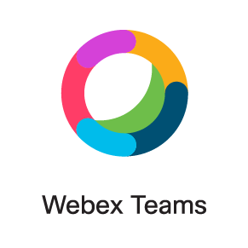

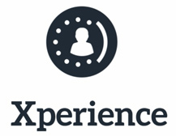

Warpdev as a business partner
Customization
and differentiation
Manufacturers platforms

Slide 25

Services

Slide 26







Life Cycle Management
Strategic Services
Assessment
Technological Solutions
Warpcom Command Center
Management
Conception
Support
Implementation
Technical Services
Notes:
Online dashboards
Services 24/7
ITIL standards
Management complexity
Security vulnerabilities
Management costs

Slide 27
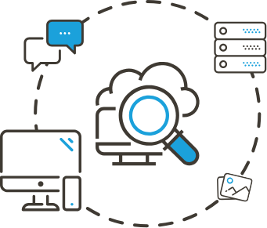

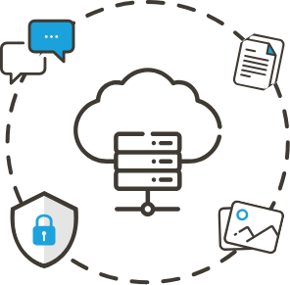
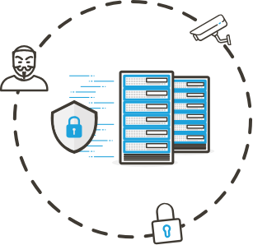





Solutions and Services
Networking & Infrastructure
Collaboration & Customer Experience
Data Center & Multi Cloud
Cybersecurity & Public Safety
Warpcom Command Center
Security
Operations
Center
Managed Services
Network
Operations
Center
Support
Services
24/7 On Site Support Services
Technical Services
Implementation & Integration Services
Professional
Services
Strategic Services
Design & Transformation Consulting Services
Consulting
Services

Slide 28
Warpcom Command Center
Support Services
Network Operations
Center
Security Operations
Center
Support Business
Support Advanced
Support Standard
Support Economy
Bolsa de horas
Events’ monitorization – equipment and applications
LAN and WAN management
SDN networks management
Management of unified communications and videoconference
DC Management
Workstation management
Events’ monitorization - security (perimeter, network, UC, DC and cloud)
Incidents analysis
Advanced research
Security rating

Slide 29
Strategic Services
Consulting Services
Assessments and establishment of architectures (network, unified communications and videoconference, DC, cloud, work station and security)
SDN Strategy
Cloud Strategy
Training
Incidence response plans
Vulnerability and intrusion tests
Compliance and regulation

Slide 30
Technical Services
Professional Services
Site survey
Project management
Implementation
Integration

Slide 31



