Slide 1
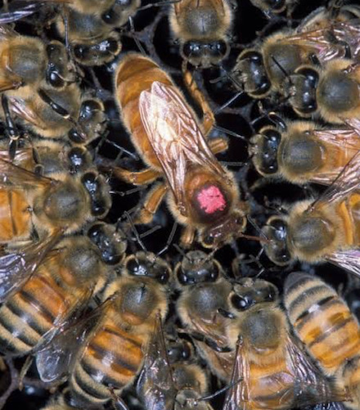
Levi and Eleks Design Crowd logo

Slide 2
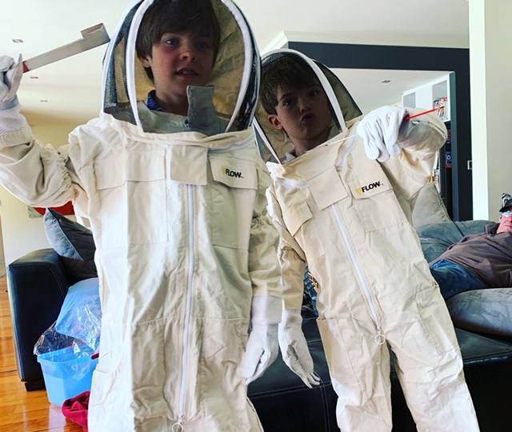
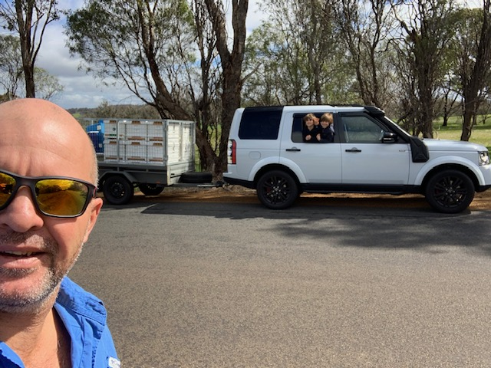
The Beekeepers
The owner of Levi and Elek’s is our dad Steve, he buys the resources needed for the company. Steve is in the bottom left picture and Levi (me) and my brother Elek are in the top left.

Slide 3
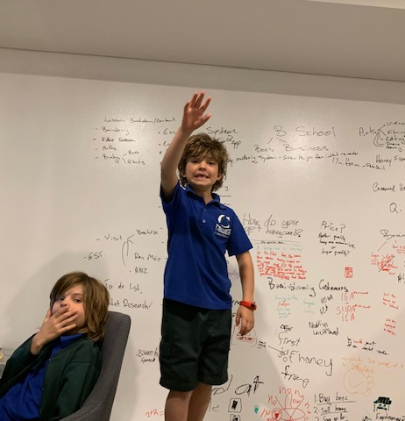
Brainstorming
In this photo, my brother and I are brainstorming initial ideas for our beekeeping project. We decided to sell
Honey
Creamed Honey
Honey Comb in boxes
High Quality Queen Bees that we breed

Slide 4
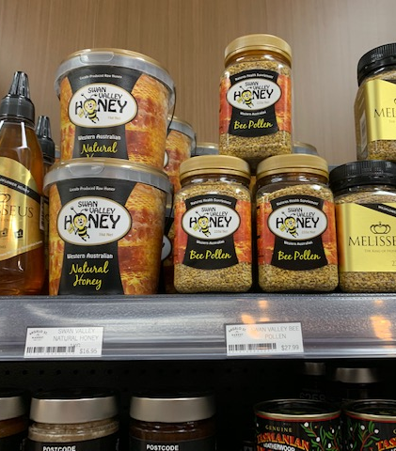
Market Research
Every now and then we do a little bit of market research and go to shops to have a look at honey and the packaging it comes in.

Slide 5
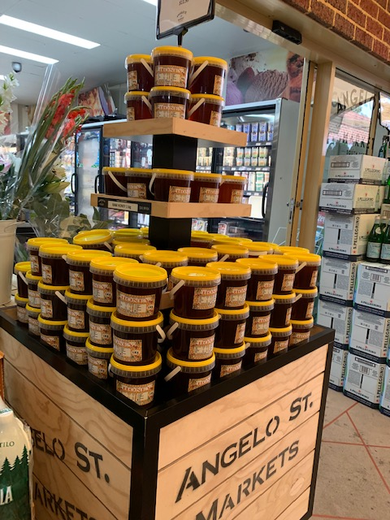
Market Research
This is an example of low-cost bulk honey.

Slide 6
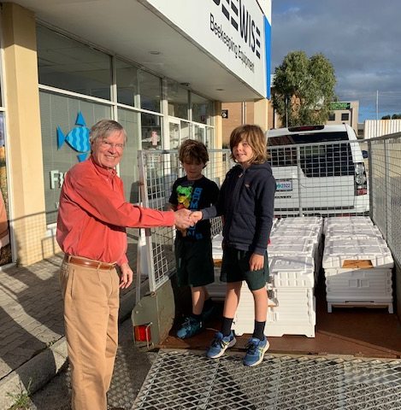
Hive Acquisition
Here is a picture of us purchasing our first beehive boxes.

Slide 7
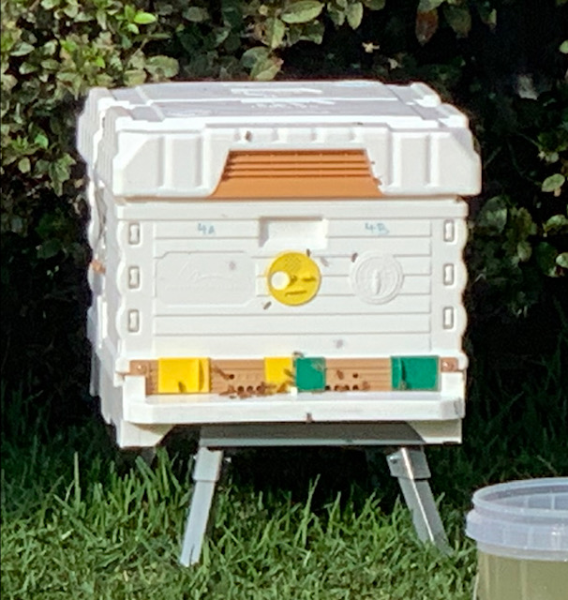
Our Apimaye Hives
This hive is from Turkey and won the Apimonda award. The hives are insulated to keep the bees warm in the winter and cool in the summer.

Slide 8
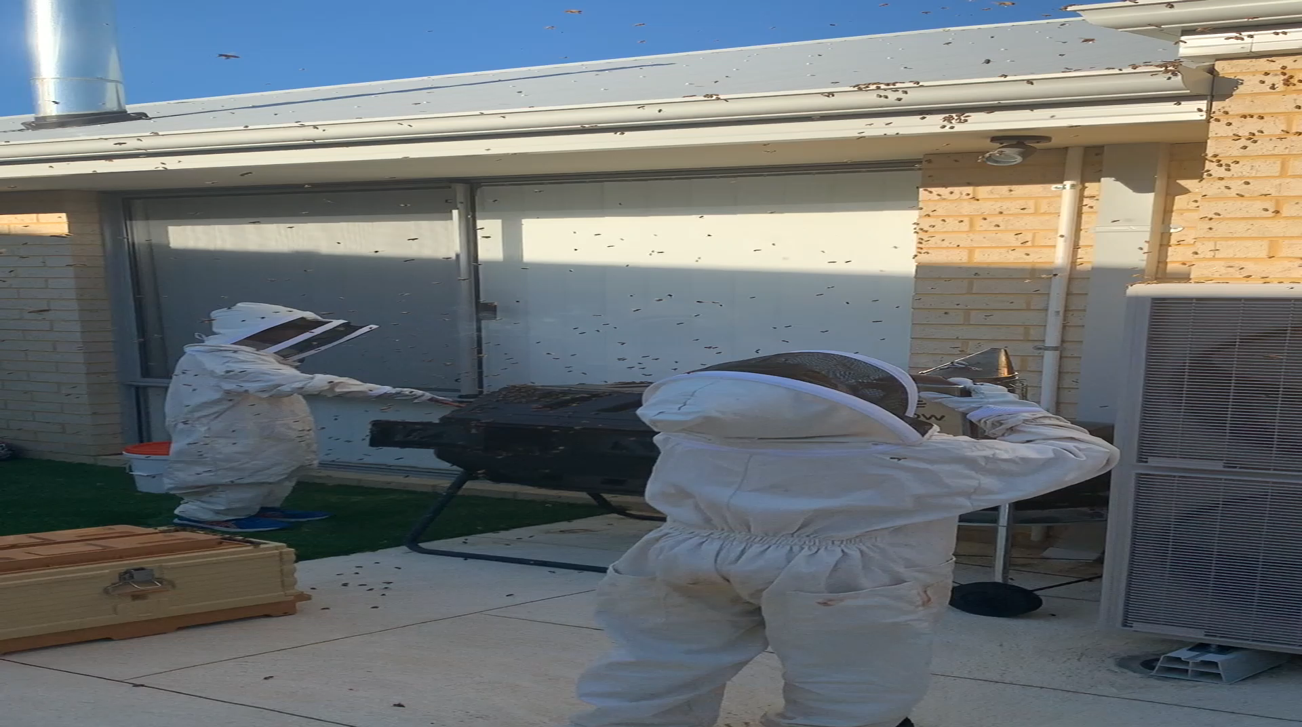
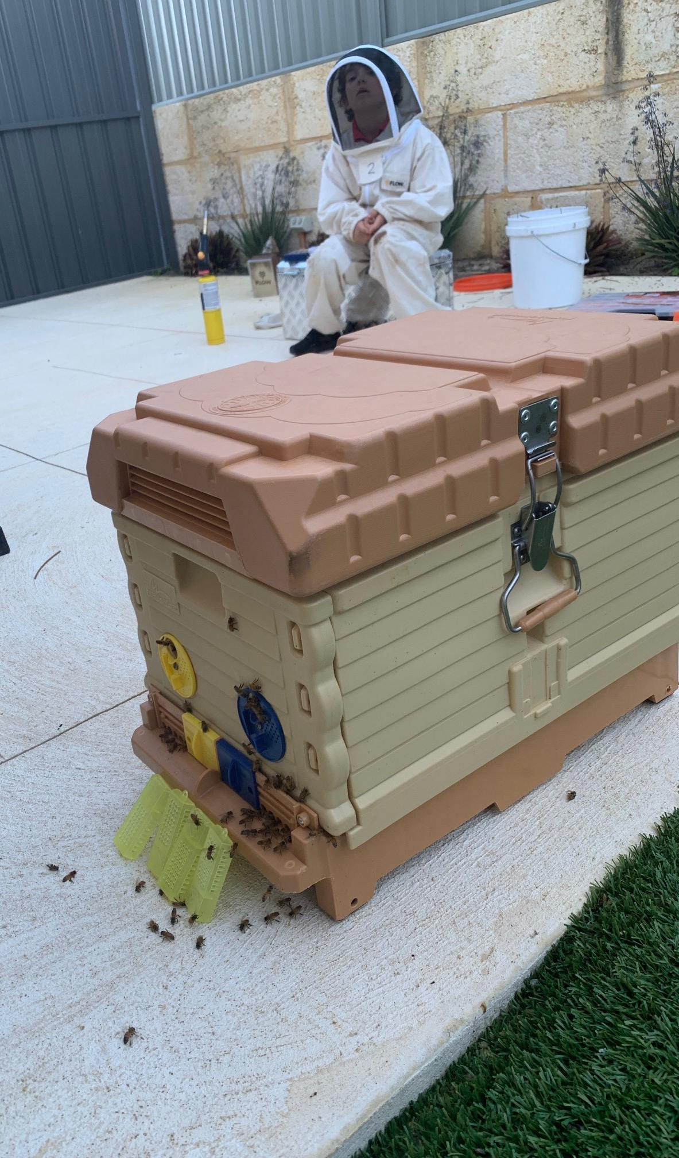
Acquiring Bees
When a beehive gets overpopulated, it swarms. This is when 60% of the hive fly away with the old queen and the bees still left in the hive make a new queen. The swarm will then fly from one place to another until they find a suitable home. This is where we come in, the swarms fly a few hundred metres at a time. When they stop we shake or scrape them into a beehive box.
Double Click the pic on the left for video

Slide 9
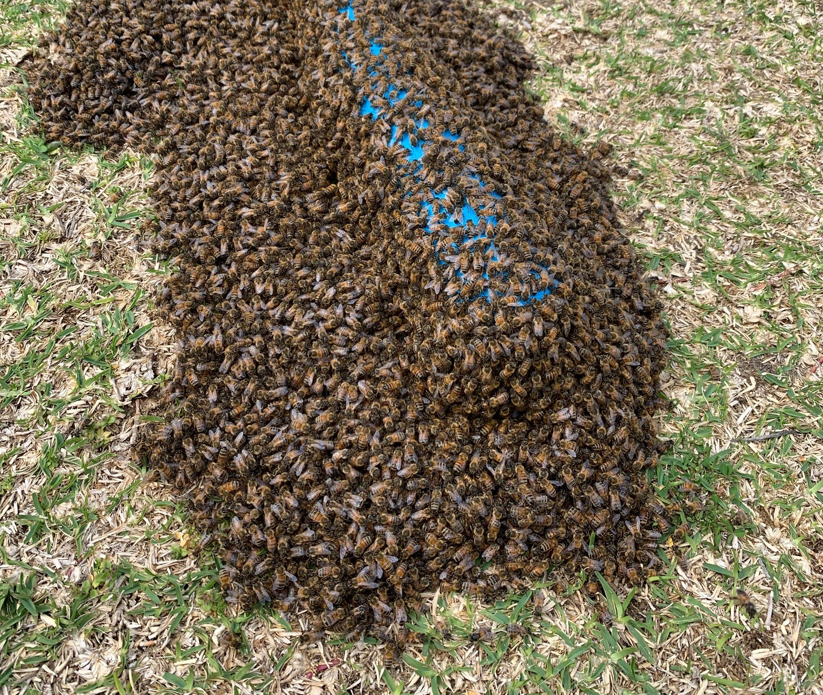
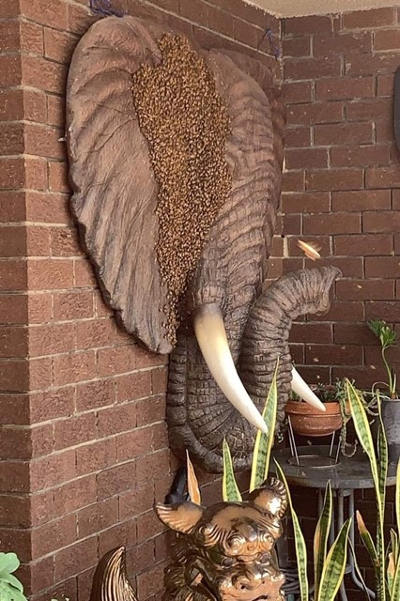
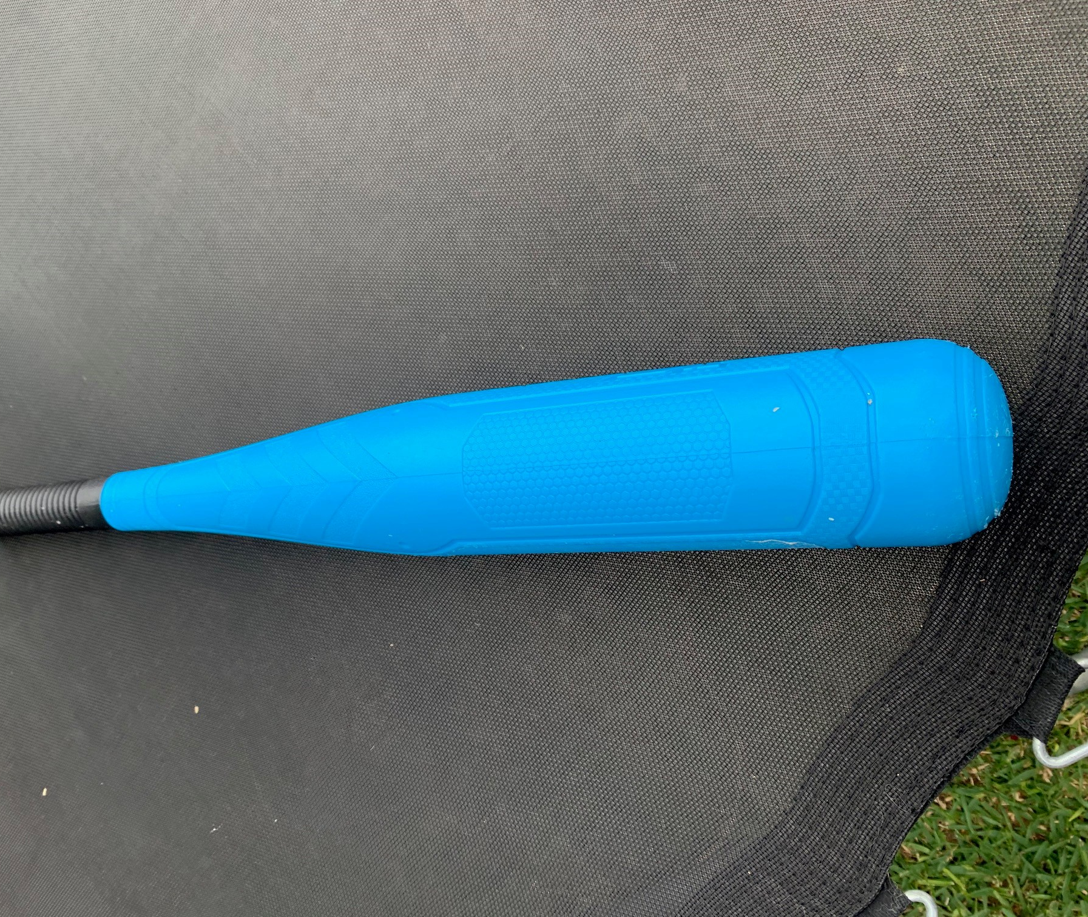
Acquiring Bees con’t
We find them in all sorts of strange places.

Slide 10
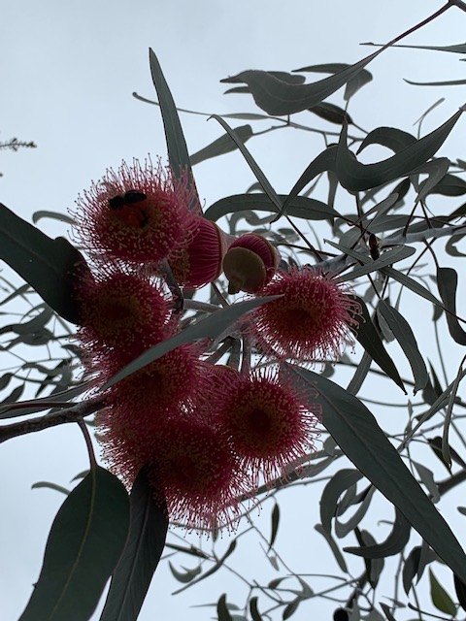
Bee Food
This is red flowering gum; it is an Australian eucalypt and bee heaven.

Slide 11
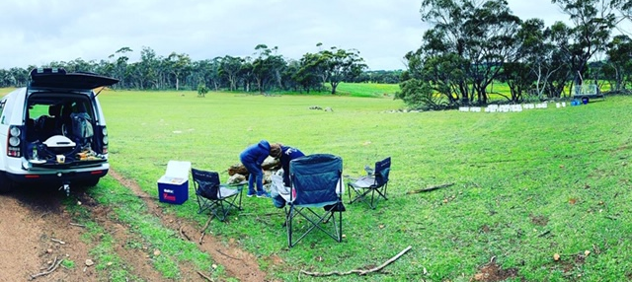
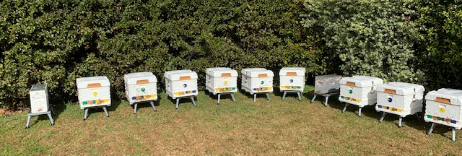
Our Apiaries
Our two main apiaries are in Dawesville and Dryandra, though we sometimes have hives in our backyard located at Como.

Slide 12
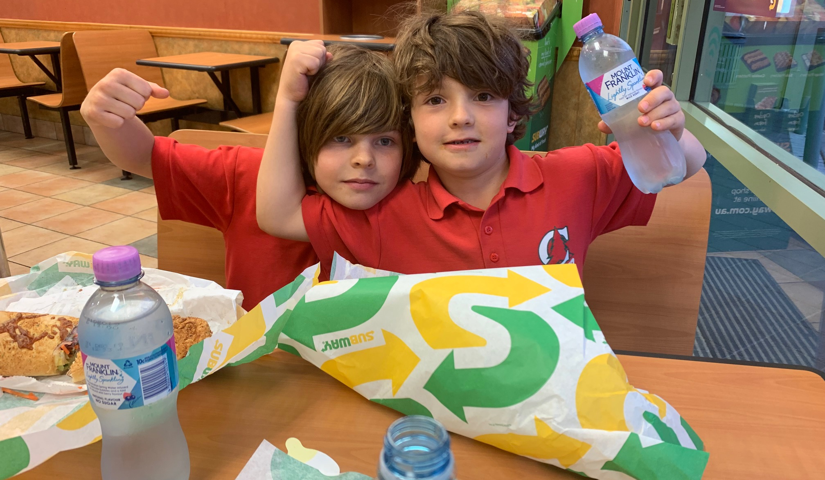
The End
Thanks very much for listening and we really look forward to seeing your design concepts.

