Slide 1
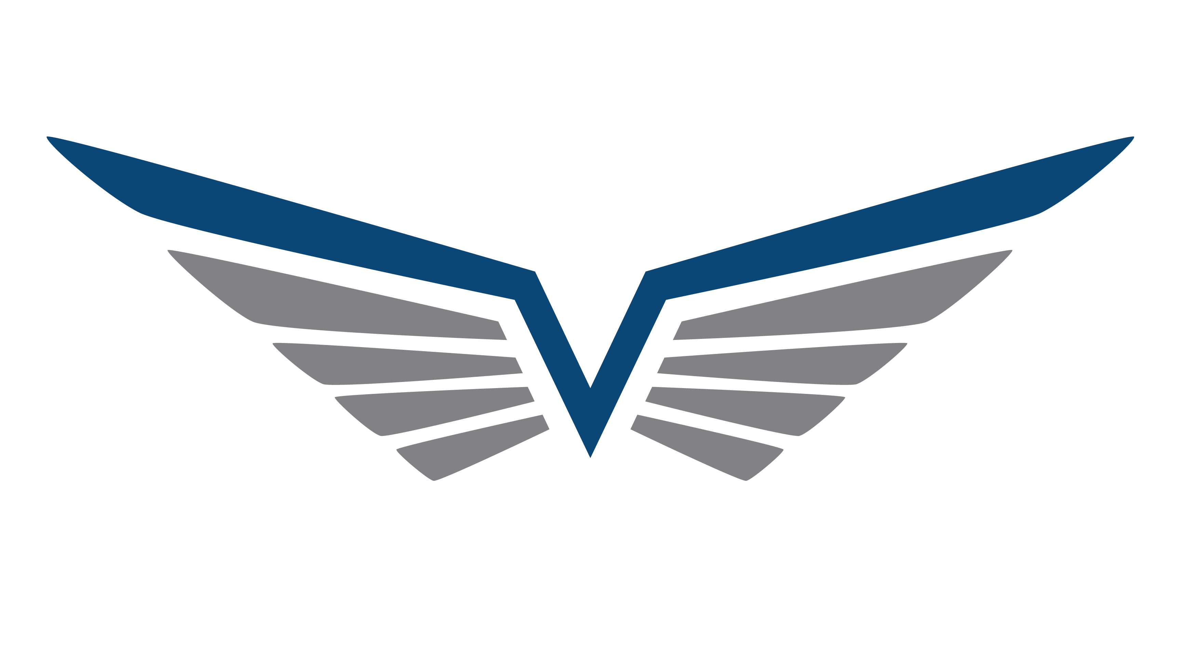

a
MASSTOK
THE ONLY TRUSTED SURPLUS SOURCE
FROM & FOR CONTRACTORS

Slide 2
88%
of contractors have
excess material
only
11%
SURPLUS
Did you know?
Which represents up to
2%
of spare materials circulate back into the market
of annual turnover for contractors
The
87%
left has been sleeping on the balance sheet as inventory

Slide 3
The Consequences
INNACURATE FINANCIALS
SLOW INVENTORY DEPLETION
HIGH WAREHOUSING COSTS

Slide 4
The solution ?

Slide 5
MASSTOK
Sales Team ?
Write-off ?
HIGH COST
DISPOSABLE COSTS
NO ADDITIONAL COSTS
LOW SUCCESS RATE
DISPOSAL LOCATION
VAST NETWORK REACH
LIMITED REACH
NEGATIVE IMPACT ON BOOKS
SIMPLE INTEGRATED SOLUTIONS

Slide 6
INSPECTION
ONLINE
Masstok Inspects & Evaluates material
Masstok uploads the list to it’s online listing database
LIST
seller provides surplus material
list & description
PUBLISH
Masstok publishes & shares the listing with it’s wide network outreach
Selling process
SELLER

Slide 7
BUYER
Buying process
DELIVERY
Masstok arranges for material shipping & delivery to buyer
BROWSE
buyers browse & search through Masstok online
material database
PO
buyer submites purchase order after confirmation from Masstok
INQUIRY
buyer submits request to Masstok to purchase the material

Slide 8
The Terms :
PURCHASE ORDER
SHIPPING & HANDLING
MATERIAL WARRANTY
Masstok arranges for shipping
Masstok provides 7 days return warranty with full refund
Buyer wires payment for material & shipping to Masstok

Slide 9
ADDITIONAL
REVENUE
CARBON
FOOTPRINT
REDUCTION
HIGH CONTRIBUTION TO ICV
IMPACT
ICV
SELLERS
PROCUREMENT SAVINGS
BOTH
IMPROVED
FINANCIALS
BUYERS
MATERIAL
RECYCLING
COLLABORATIVE
TECHNOLOGY
TIME OPTIMIZATION

Slide 10
Scope of Charges
1%
CHARITY
1%
7%
12.5%
TOTAL
OPERATIONS
4.5%
PROFIT MARGIN
4.5%

Slide 11
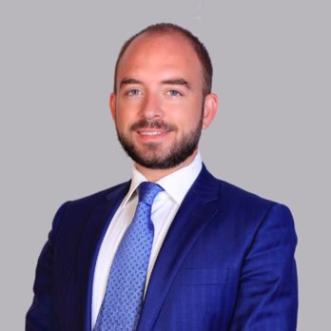
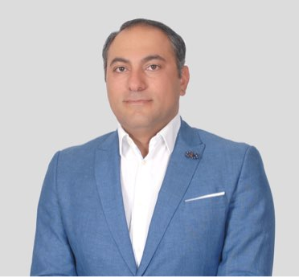
The Management
Mehdi Mebarek
Mohamad Koaik
Founder and CEO, extensive knowledge and experience in oil and gas contracting and material trading; Managing Director of FALCOR Engineering, INSEAD graduate and Member of the Board for the French Chamber of Commerce in Abu Dhabi.
Co-Founder and COO, extensive knowledge in online industry, shareholder in Propertyfinder Group, Managing Partner in MMG Group,, was their Head of International Operations setting up operations in 6 MENA locations.

Slide 12


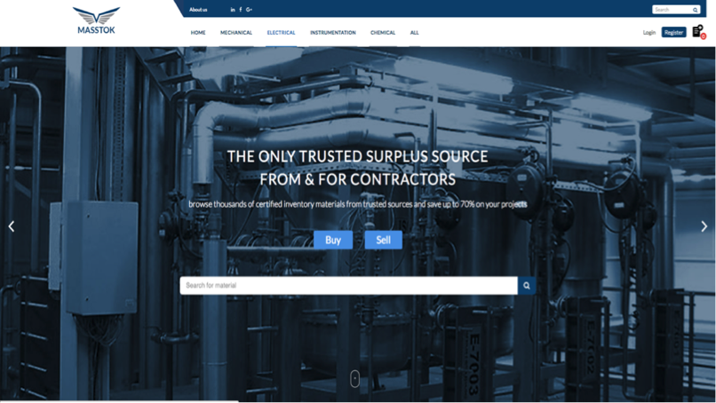
MASSTOK
CONTACT DETAILS
WEB & SOCIAL MEDIA
info@masstok.com
800-MASSTOK
License no. 064146
DMCC, Dubai, UAE
www.masstok.com

