Slide 1
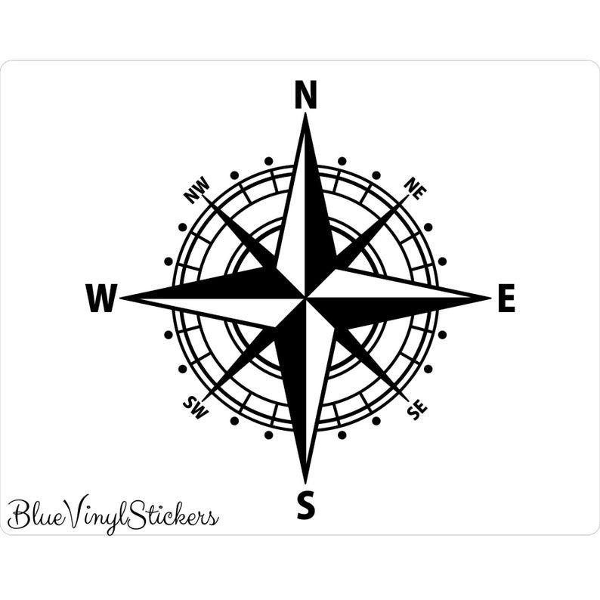
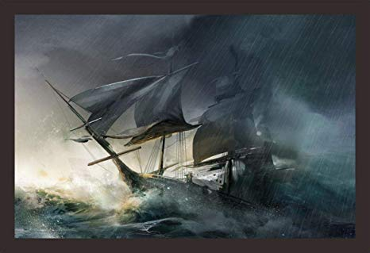
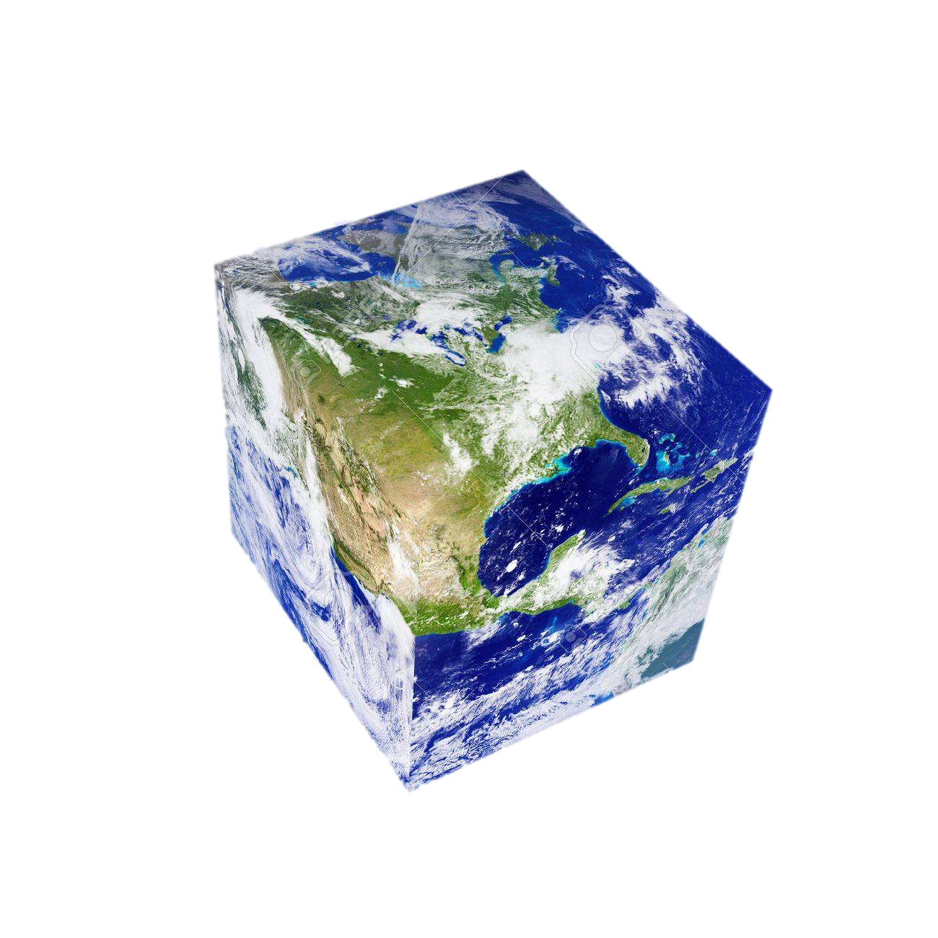
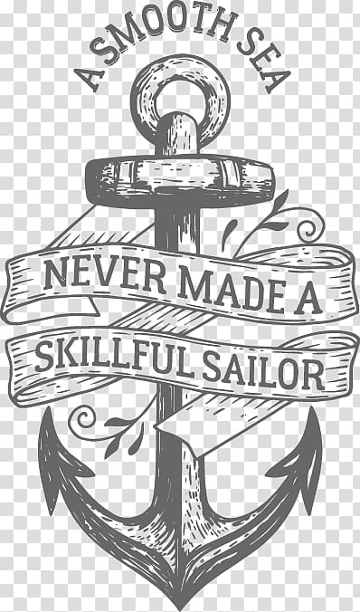
Notes:
We are grad students at a military school.
We want something that meets these requirements;
0. All the pieces must transition seamlessly. The whole piece can take a traditional old school vibe to it. You can substitute the earth for a typical circular earth if it looks better.
1. Use of a compass as shown (the inside triangle can get removed, or maybe transitioned into the center piece. Numeral or cardinal marks suffice. The more detail the better.
2. An old school typee cubed earth for the center piece. It must be a in the form of a rubix cube. Would be great if it is shown as unsolved, but still possible to decipher that we are on this side of the glove would be great.
The background can be merely the ocean, and clouds/horizon. but any better ideas are welcomed.
3. Top Left. Galeon on rough water.
4. Bottom Left. Anchor resting on a propeller on the bottom of the ocean. It does not have to have the cloths exactly as it is. As long as it is legible. “A Smooth Sea Never Made A Skillful Sailor”
5. Top right. Amphitrite and Poseidon. Both must have Tridents. Realistic muscular (poseidon) and feminine (amphitrite) on possibly a rock
6. Bottom Right. Parchment paper (the old school style paper) with the quote “The sea is selective; slow at recognition of effort and aptitude, but fast in sinking the unfit” – Felix Reisenberg
you may call me at 551-655-2427 or email me at juang.luzuriaga@outlook.com

