Slide 1
Brief Logo Comex Lab

Slide 2
Who we are
Losam Agency, marketing agency specializing in the creation and animation of communities.
Losam Agency created Future of Procurement :
FoP is an event for purchasing managers of large French companies. It consists of 3 highlights
- 1 conference on the future of the Purchasing in Companies function
- workshops to reflect among peers on the evolution of the purchasing function
- Networking with a booth space to discuss new solutions / software dedicated to the purchasing function

Slide 3
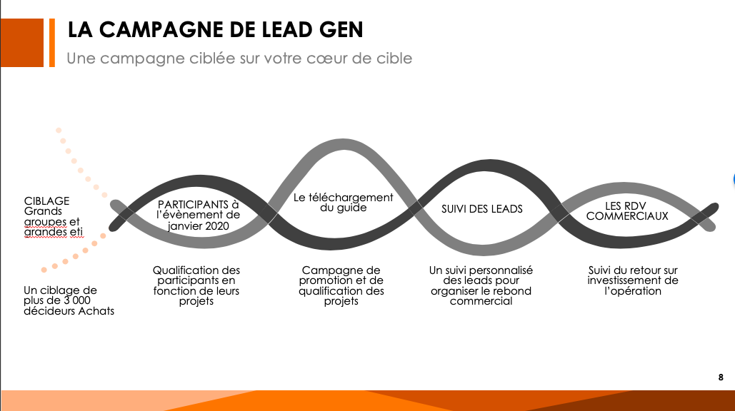
Future of Procurement - Brand Guidelines
RGB
24 – 23 - 23
RGB
64 – 64 -64
RGB
24 – 23 - 23
RGB
212 – 80 - 0
RGB
254 -117 - 0
RGB
126 - 126 - 126

Slide 4
FoP
Target:
COMEX membre
Positioning :
High-end, we address a target of corporate decision makers
Leadership – the theme of the think tank
Professional, we address companies exclusively

Slide 5
Brief
What: Creating a logo
Sector: Events
Logo text: FoP
Elégant
Amusant
Traditionnel
Personnel
Féminin
Coloré
Bas de gamme
Audacieux
Sérieux
Moderne
Professionnel
Masculin
Noir et Blanc
Haut de Gamme
v
v
v
v
v

Slide 6

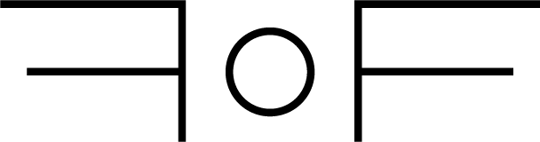
Inspiration
Losam Agency created 4 years ago Future of Finance, Future of Procurement is a declination of Future of Finance (event for finance function companies)

