Slide 1
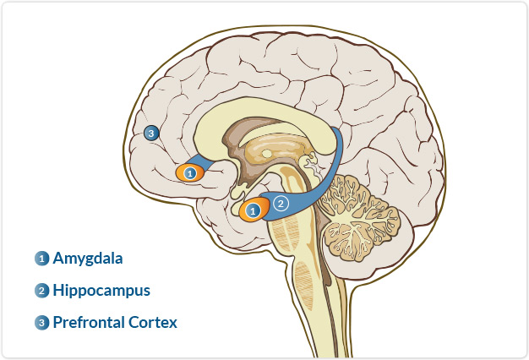
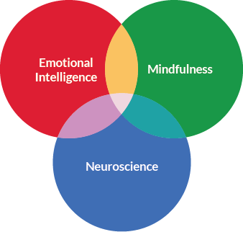
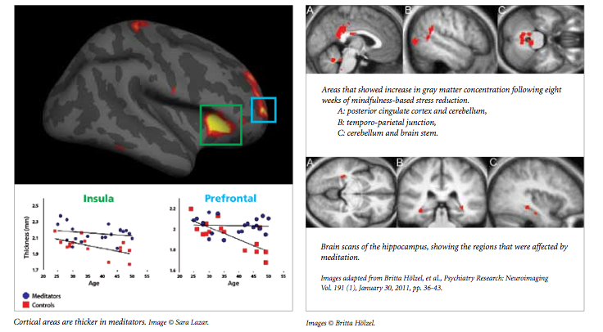
Mindful Learners, Mindful Leaders: How Mindfulness Transforms Workplace Cultures, Leadership and Learning and Development in Organizations
Jeff Melillo
Graduate School of Education, Advisor: Dr. Angela O’Donnell
Motivation
Objectives
Mindfulness Changes the Brain
1 Amygdala
Aroused when detecting and reacting to emotions, especially difficult or strong emotions such as fear. This part of the brain is less activated and has less gray matter density¹¹ following mindfulness training.
2 Hippocampus
Critical to learning and memory, and helps regulate the amygdala. This part of the brain is more active¹²and has more gray matter density following mindfulness training.
3 Prefrontal Cortex
The part of the brain most associated with maturity, including regulating emotions and behaviors and making wise decisions. This part of the brain is more activated following mindfulness training.
Americans work more than any other country in the world. Work often involves a process of doing which can leave workers stressed, depressed, anxious and consistently in an unhealthy state of mind. One we know is not ideal for learning. Taking what we know about workplace culture, adult learning, emotional intelligence and neuroscience, I propose that mindfulness meditation working groups can create workplace cultures that support learning and leading in a healthy, balanced and practical way.
To organize common experiences of individuals who establish a mindfulness practice.
To create best practices for organizations to adopt mindfulness into workplace cultures so that norms are created and value is understood.
To determine the best contexts, environments and spaces for individuals to practice mindfulness as leaders and learners in organizations both individually and collectively.
Vision for Study
Scientific Findings To Build On
Facilitate weekly working groups that last 8 -15 weeks with diverse leader/ learner populations. Participants will self select. And opt in given general criteria. Rough methods: Survey participants using a qualitative pre and post questionnaire that can get at the heart of what one experiences using techniques of phenomenological study. Code and organize the responses to generate trends and themes in experience to better understand the individual and collective transformative qualities. Develop best practices for application.
Increased ability to work in teams and maintain positive relationships
Increased ability to counteract stress; lowers depression, increases happiness
Decreased anxiety and fatigue levels in college students; improves sleep
Increased personal efficiency through attentional regulation and focus, working memory and cognitive functioning
Increased compassion, emotional intelligence and overall wellbeing (body and mind)
Better control over processing of emotions and stress management
Notes:
feel free to change background colors & text boxes and use sections for difference purposes!

