Slide 1
SIGA Technologies (SIGA)

Slide 2


SIGA Technologies (SIGA)
Specialty Pharma focused on biodefense
FDA Approved: TPOXX – only antiviral for smallpox
Smallpox – World’s deadliest decease
Declared eradicated in the late 1970s
Routine vaccination stopped in the US after 1972
Notes:
30% fatality rate
Responsible for ~300M deaths in the 20th century
Easily transmitted and contagious – through direct contact and through the air

Slide 3

Smallpox = Biothreat
Sample smallpox virus: United States and Russia
Threat of synthetic creation in labs and used as bioweapon
2004: Enacted The Project BioShield Act
Overseen by BARDA
Biothreat countermeasures: Smallpox, Botulism, Anthrax, Ebola virus, Nerve agents
Notes:
After 9/11
US Congress Enacted and funded with over $5B
Biomedical Advance Research & Development (BARDA) – Protect public against Chemical, Biological, Radiological, and nuclear (CBRN) threats
to procure biothreat countermeasures for the US National Strategic Stockpile

Slide 4
Unconventional Biotech
SIGA - $5.50/share and ~$450M in Marketcap as of 10/14/19
Flushed with cash: ~25% of stock price in net cash
>$200M in cash and $85M in debt
Not burning cash: R&D funded
NIH, BARDA, CDC, USDA, DOD
Recurring revenue
~$600M BARDA contract for US Strategic National Stockpile (SNS)
Replenish 1.7M courses of TPOXX that expires every 7 years
Notes:
Nearly $1.50/share of the $5 stock price is in net cash

Slide 5
Opportunity
Post bankrupted company
No wall street coverage
Messy and lumpy financials
Limited trading volume
View as risky microcap biotech
Notes:
Nearly $1.50/share of the $5 stock price is in net cash

Slide 6
1) Value – Bird in the hand
~$7.00/Share or ~30% upside
~$600M BARDA contract
1.7M courses needing to be replenish every 7 years
No price and volume increase
At 60-65% operating margin and 24% tax rate
Discounted rate of 10%
Over $100M in net cash
Notes:
Nearly $1.50/share of the $5 stock price is in net cash

Slide 7
2) Value – Many in the bush
Growth from Market Expansion
Partnering with Meridian Medical, a Pfizer company, for international sale of TPOXX
EMA filing for regulatory approval targeted for 2020
Targeting G8 countries already stockpiling smallpox vaccines
Notes:
Targeting those who are already stockpiling a smallpox vaccine (World Health Organization, Israel, South Korea, Britain, France, Germany, Japan, New Zealand, Australia

Slide 8
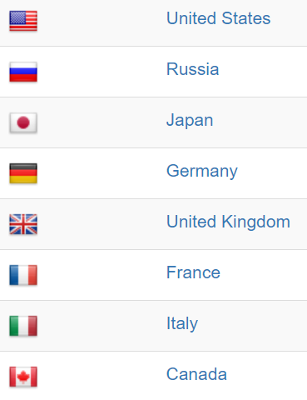
2) Value – Many in the bush
BARDA Contract | 2010 | 2019
US population (mn) | 310 | 329
Contraindication rate | 4.5% | 0.5%
SNS Courses (mn) | 14 | 1.7
Price Per Course | $240 | $281
G8 Stockpile | 2019 | Target
G8 population (ex. US) | 588 | 588
Contraindication rate | 0.52% | 0.26%
G8 Courses | 3.0 | 1.5
Price Per Course |  | $351
Price Increase over US |  | 25%
Revenue Potential (mn) |  | $534
Value Per Share |  | $4 - $5
Notes:
Targeting those who are already stockpiling a smallpox vaccine (World Health Organization, Israel, South Korea, Britain, France, Germany, Japan, New Zealand, Australia

Slide 9
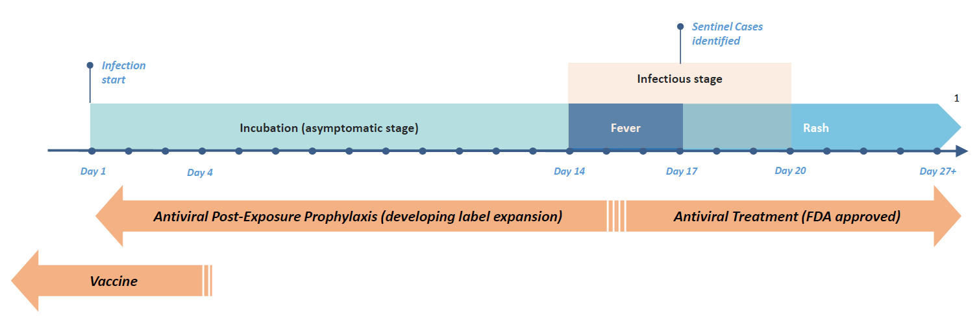
3) Value – Many in the bush
Growth from Product Expansion
TPOXX label expansion for Post Exposure Prophylaxis (PEP)
July 2019: ~$20M funding by DOD – 14 days to 28 days indication
Notes:
DOD funding R&D of almost $20M

Slide 10
3) Value – Many in the bush, cont.
Growth from Product Expansion
What is sufficient sized stockpile for TPOXX?
Original BARDA contract stated 14M courses
Opportunity if PEP indication expands to 28 days
Current US strategic national stockpile
~75M doses of Antrax vaccine
~300M doses of Smallpox vaccine
1.7M courses of Smallpox antiviral
Assume: Stockpile doubles to ~3M courses
$7
$4
~$11/share
Notes:
DOD funding R&D of almost $20M

Slide 11
4) Value – Jackpot
Growth from New Product – No Value Assigned
2nd Mechanism of Action
BARDA wants to stockpile two smallpox antivirals
Oncology opportunity/collaboration
Potential use of TPOXX as rescue therapy to improve safety profile and more aggressive treatment of vaccinia therapy

Slide 12
Base Case – 30% Upside
1. Replenishment of 1.7M courses already in US national stockpile
Assuming no price increase
70 cent dollar
Valuation Potential
Total
$12
Base
$7
PEP
$2
New
$0
G8
$3
Base + Expansion – 100%+ Upside
2. G8 countries sale
70% probability
3. PEP expansion label
50% probability
4. New Product Expansion
0% probability

Slide 13
Risk
BARDA funding is significantly reduced or eliminated
BARDA’s budget has been increasing every year since 2004 with Bi-Partisan support
New competition
Liability risk

