Slide 1
SHAMPOO & CONDITIONER INSPIRATION #1
Argan Magic Shampoo and Conditioner Set for Dry and Damaged Hair (32 oz). Can be used on all hair types and Great for reviving dully, dry, frizzy hair.
LUXURIOUS HAIR CARE WITH 100% ARGAN OIL: Restores hair by drenching it in a highly concentrated formula rich in Argan Oil and antioxidants
SHINE BOOSTING SHAMPOO: Nutrient-rich shampoo helps restore elasticity, moisture and manageability - while sealing in shine to create lush, soft hair.
MOISTURIZING CONDITIONER: Nutrient-rich conditioner helps restore moisture and manageability. Gently detangles and helps to repair chemically damaged hair. Can be used on all hair types.
Paraben-free

Slide 2
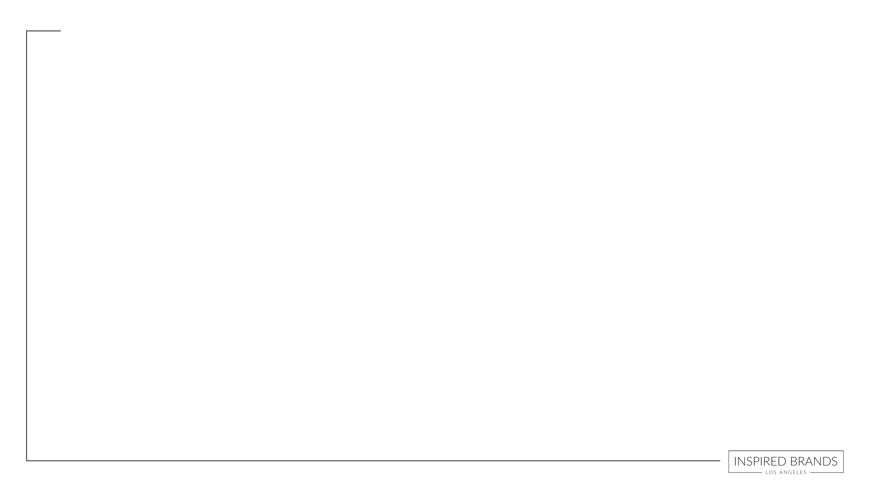
SHAMPOO & CONDITIONER INSPIRATION #2
DESCRIPTION
formulated with botanical extracts to gently hydrate hair while intensely refreshing and reinvigorating dry strands
paraben-free, phthalate-free, sulfate-free, color-safe
for all hair types

Slide 3
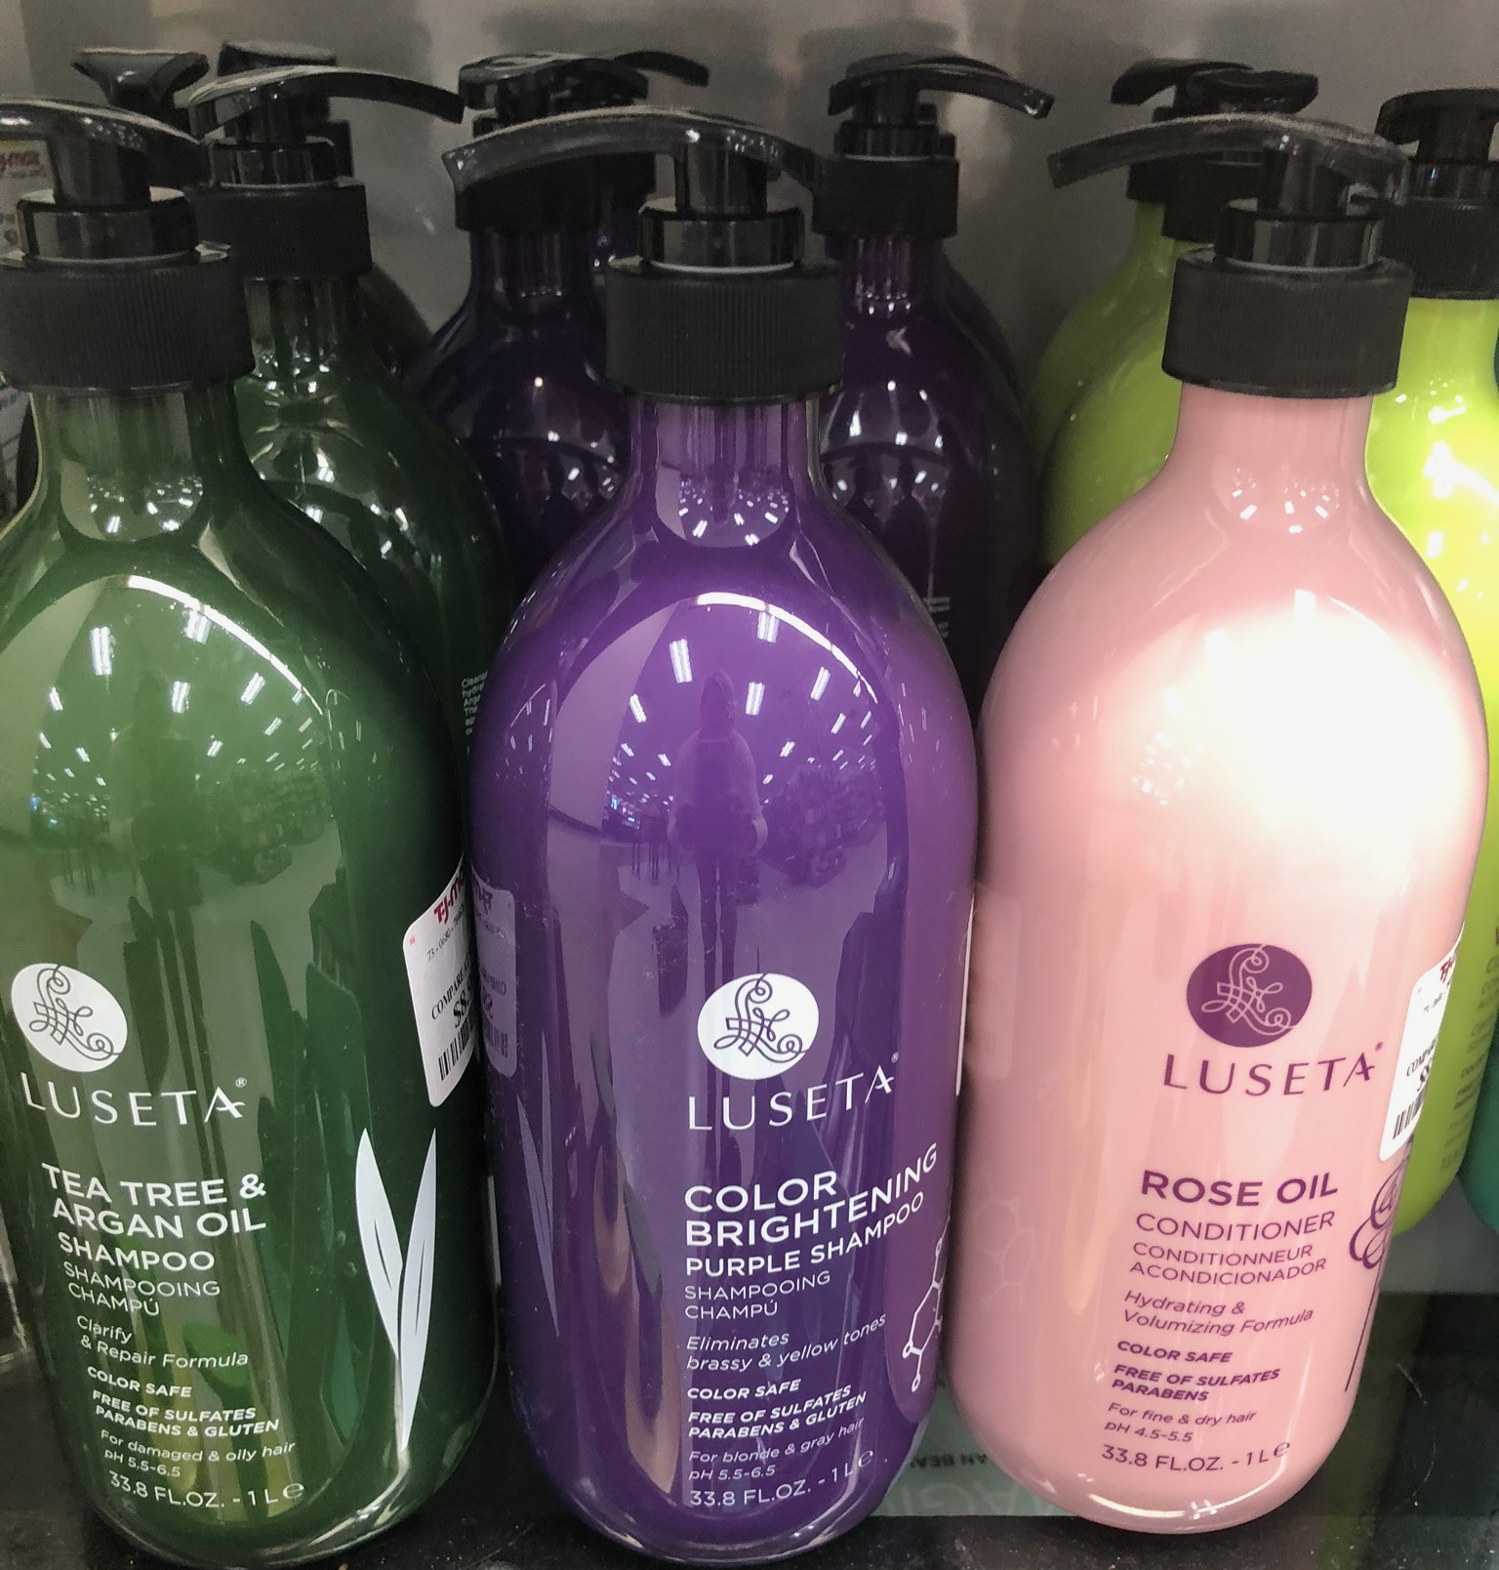
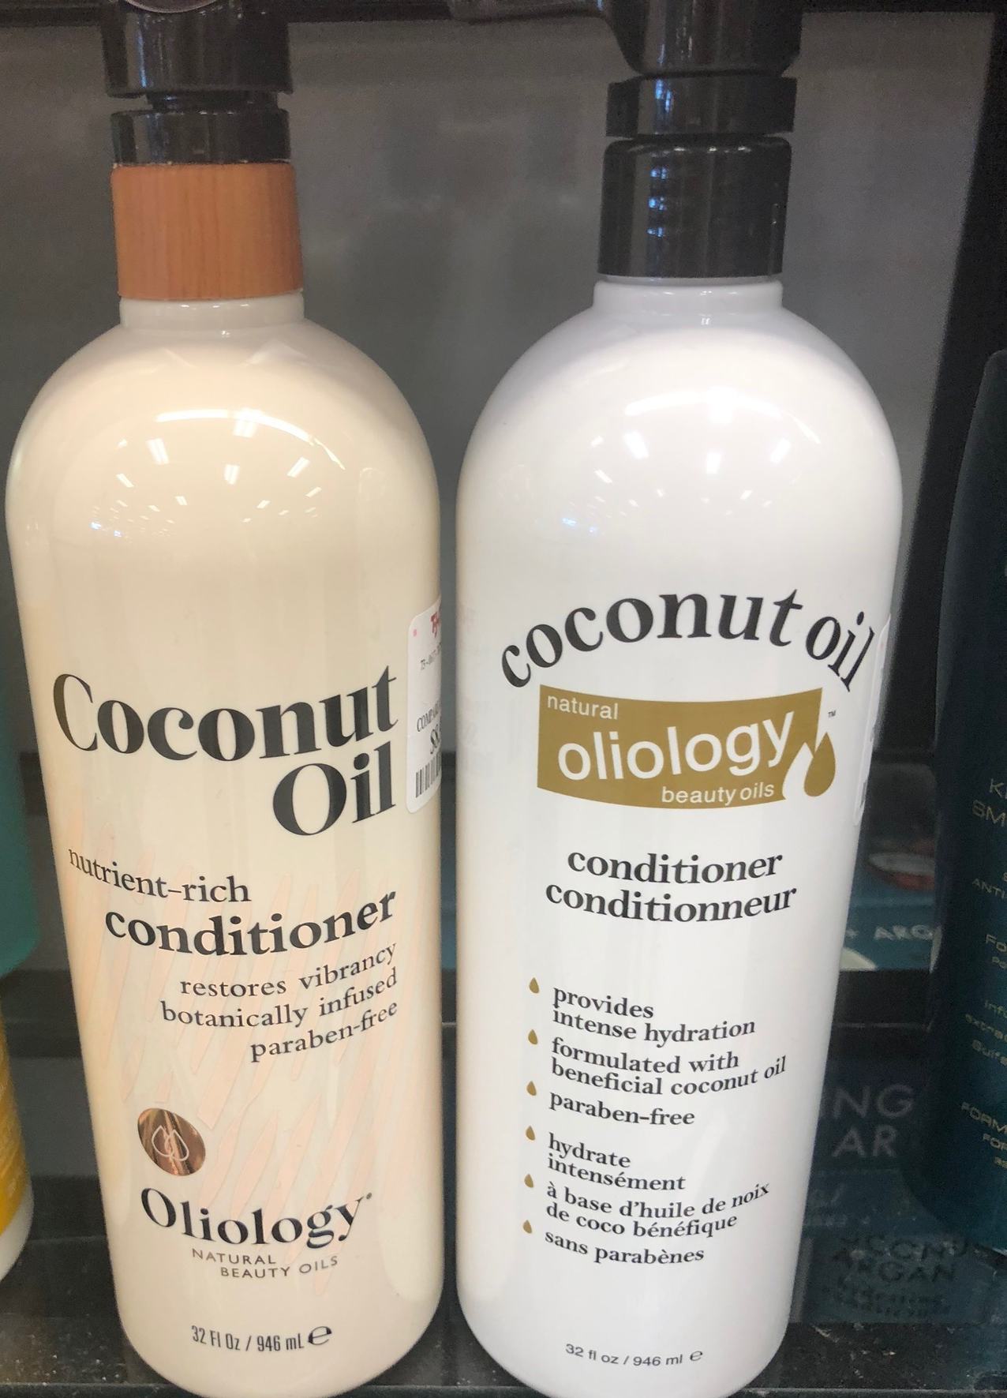
PRODUCT INSPIRATION #3

Slide 4
SHAMPOO & CONDITIONER INSPIRATION #4
DESCRIPTION
A rich and deeply hydrating shampoo that is gentle enough for daily use. Infused with moisture-attracting red algae, antioxidant argan oil and Vitamins A and E.
BENEFITS
Cleanses and helps maintain an ideal moisture balance to promote healthy-looking and manageable hair.
SUGGESTED USE
Massage through wet hair and scalp. Rinse thoroughly. Add more water to activate a rich lather. Follow with Moroccanoil Hydrating Conditioner.

Slide 5
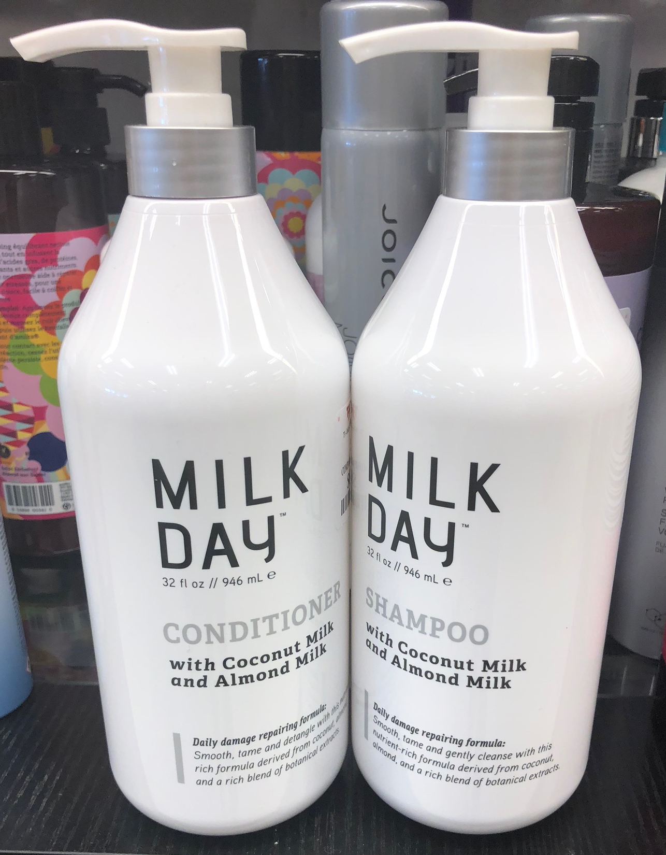
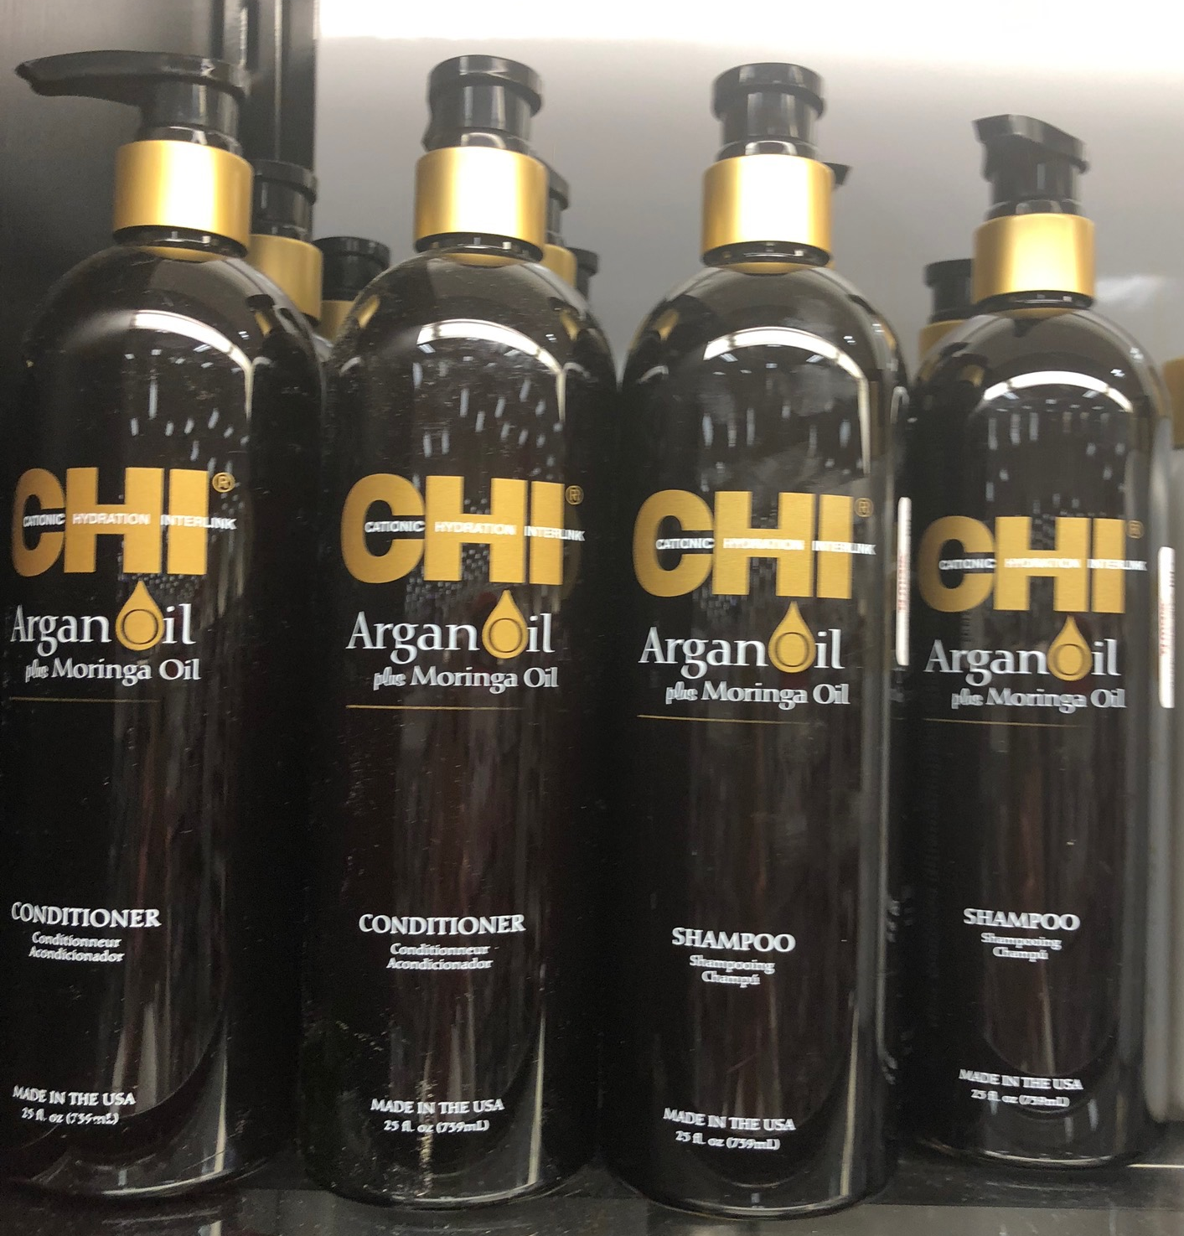
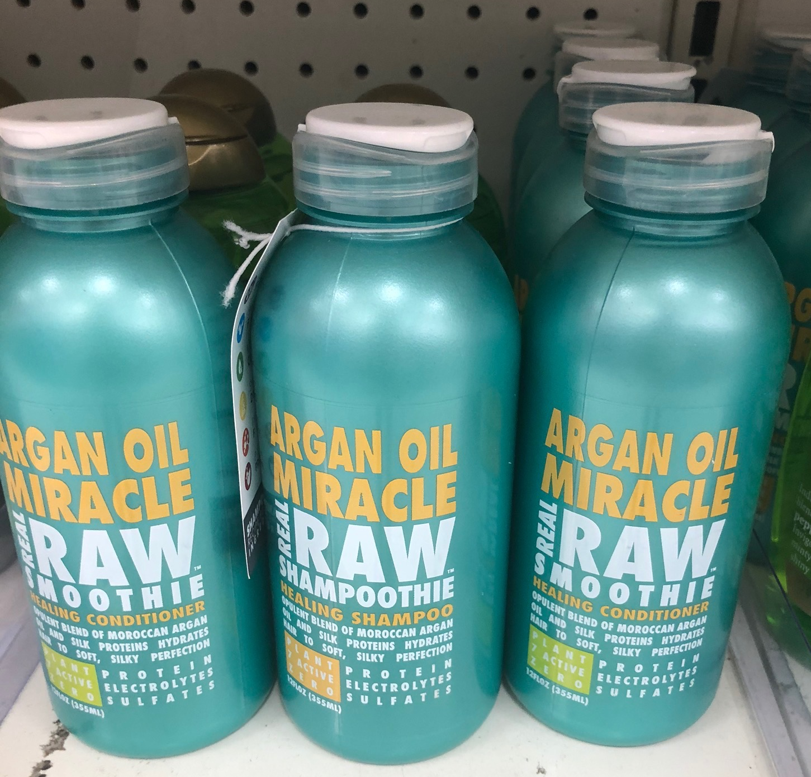
PRODUCT INSPIRATION #5

Slide 6
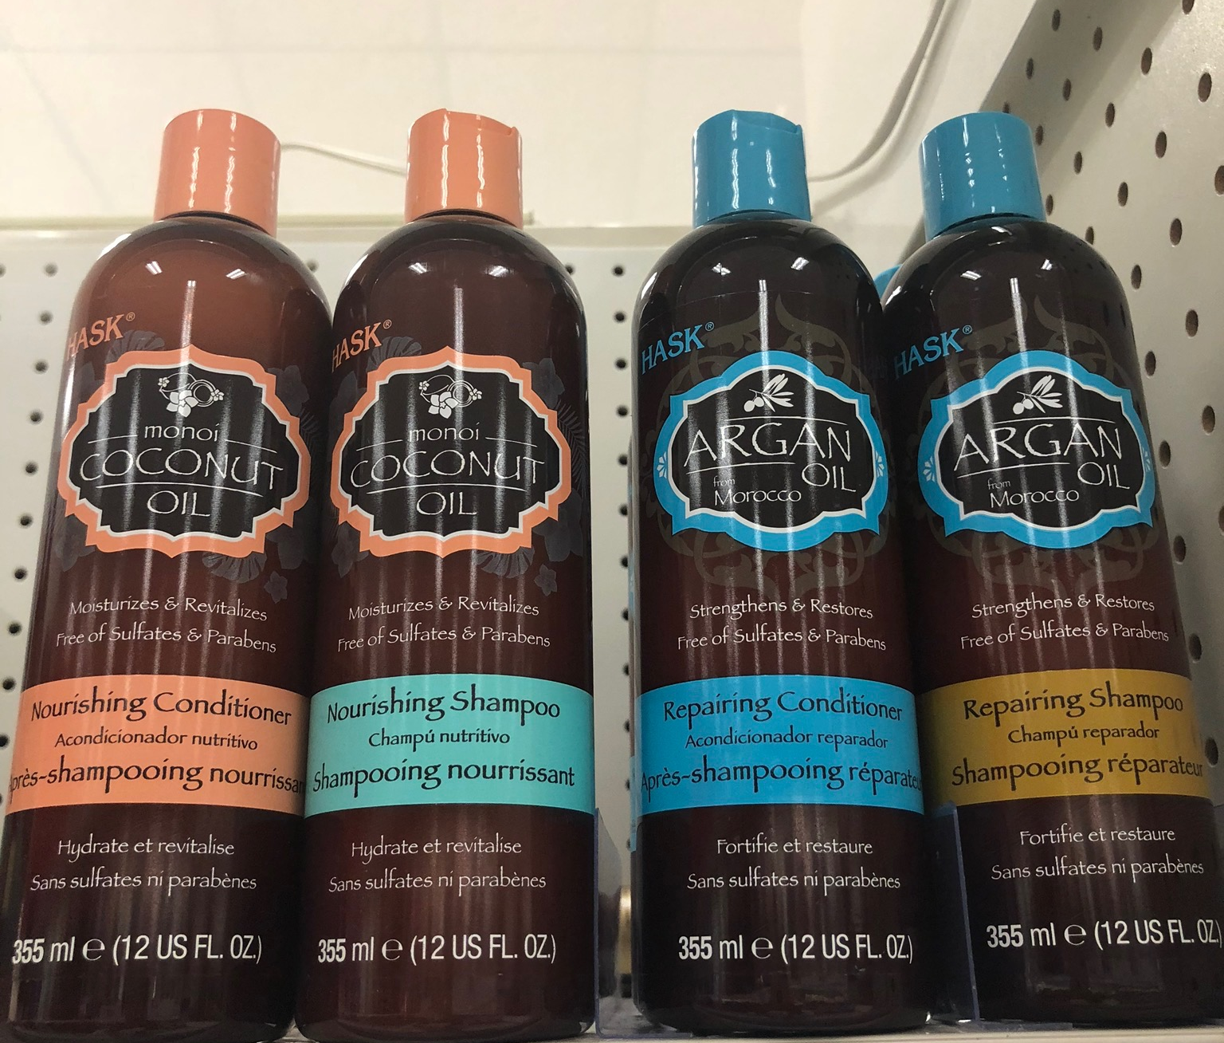
PRODUCT INSPIRATION #6
Revive and restore the look of your hair with Hask Argan Oil from Morocco Repairing Shampoo. Infused with moisturizing Argan Oil, this shampoo penetrates the hair shaft, gently cleansing while repairing damage and breakage. Leaves even the most rebellious hair frizz-free, silky-soft and super glossy. Ideal for dry, damaged or color-treated hair. Free of: sulfates, parabens, phthalates, gluten, alcohol and artificial colors.

Slide 7
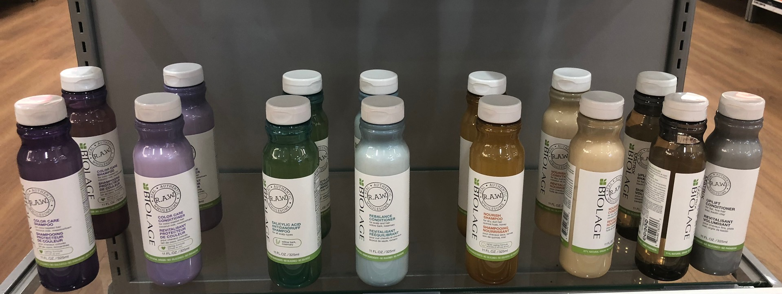
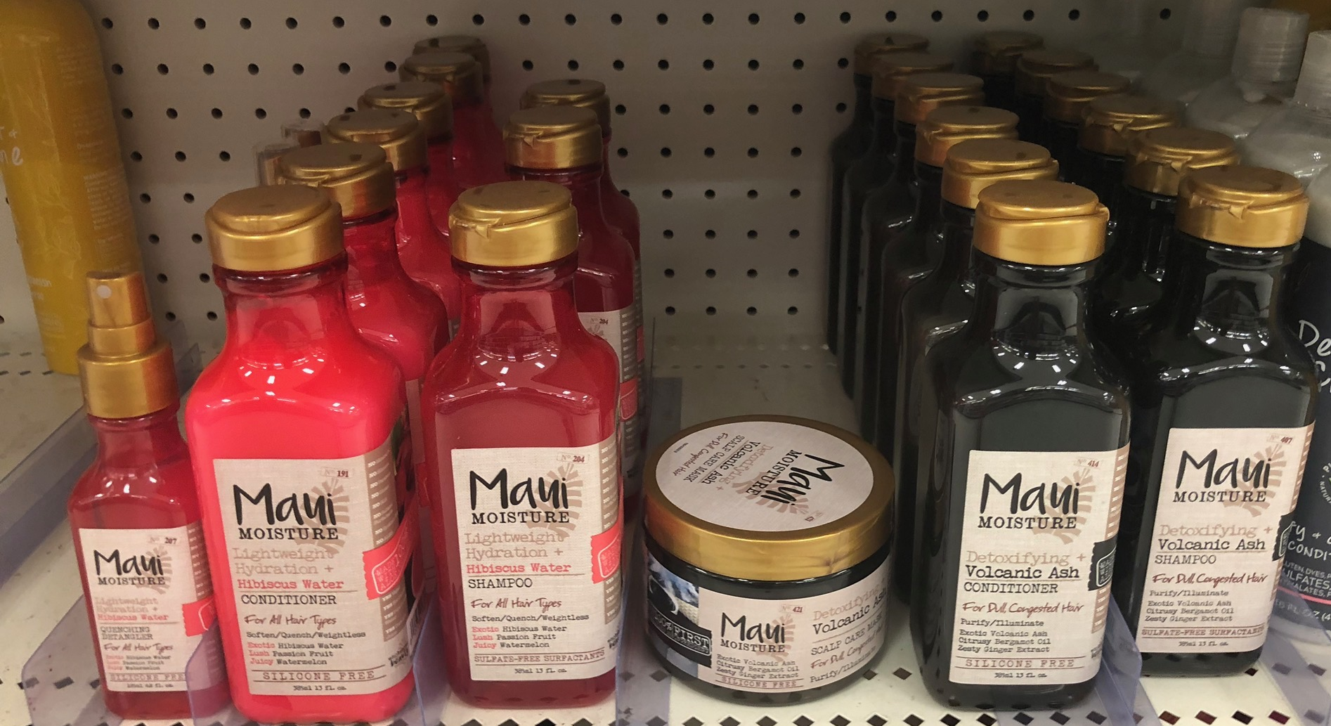
PRODUCT INSPIRATION #7

Slide 8
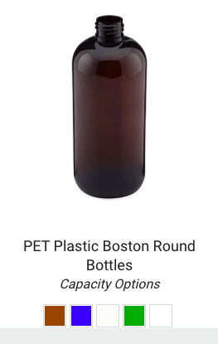
PACKAGING & BRAND DETAILS
ARGAN LOVE (Open to other ideas on name)
Packaging design for women’s hair care. We will be using a 32 ounce Boston round with pump or a 32 oz Bullet Bottle with pump - possible bottle colors are noted (amber, green, cobalt, white, black or clear).
This product will be sold at national retailers and needs to look like a brand that is sold at boutique
32 oz bottle – likely Boston Round or Bullet
Smooth Head Pump in either black, natural, or white
Deco to be a wrap label or front/back label
Front should have marketing claims
Back will have Ingredient List (to be provided) and directions. Can use what is on the packaging of inspiration products for now.
Placeholder for barcode

