Slide 1

Concept Plan
A concept owned by
Wagih Doss
May 2019

Slide 2
This confidential Business Plan (the ‘Plan’) is being furnished by Wagih Doss to a limited number of Real Estate Owners and / or developers for use in considering their interest in doing business with Urban Vejjie LLC, DBA Urban Vejjie.
This Plan is not to be reproduced or used, in whole or in part, for any other purpose or made available to anyone not directly concerned with the decision to do business with Urban Vejjie LLC.
The information contained herein has been prepared to assist interested parties in making their own evaluation of Urban Vejjie LLC business. The information does not purport to be all-inclusive or to contain all of the information a prospective lender may require. Information presented on market analysis and client needs (and trends) were extracted from a number of sources. In all cases, interested parties should conduct their own investigation and analysis of Urban Vejjie LLC opportunity, and the data set forth in this Document.
The document includes certain statements, estimates, and forecasts with respect to the anticipated future performance of Urban Vejjie LLC. Such statements, estimates & forecasts reflect various assumptions concerning anticipated results; these assumptions may or may not prove to be correct. No representations are made to the accuracy of such statements, estimates & forecasts. No dealer, broker, financier, etc has been authorized to give information or to make any representations with respect to this proposed financing, other than those contained in this Plan. Any information that is provided should not be relied upon as having been authorized or approved by the Management or associated partners / vendors of Urban Vejjie LLC.
Any questions should be directed to the following company officers:
wagihd@hotmail.com
(Owner & President, Urban Vejjie) Robert Ancill (CEO – The Next Idea)
Tel: 818 599 5195 Tel : 818 448 9888 / 818 887 7714
wagihd@hotmail.com Email: robert@thenextidea.net

Slide 3
The Mission and Vision
Mission
Urban Vejjie is a vibrant and modern Vegetarian fast casual restaurant concept that mixes fresh food, energy, great décor, and a comfortable, welcoming atmosphere to provide a memorable and all Vegetarian dining experience.
Our Mission is to be top of mind when consumers think Vegetarian food!
Vision
Our Vision is to grow and become a national / international branded chain through corporate owned locations and franchising.
Looking to the future, Vegetarian food will be a mainstream category in the food sector, Urban Vejjie will capitalize on this trend and be at the forefront leading the way as global eating migrates from meat to plant.

Slide 4
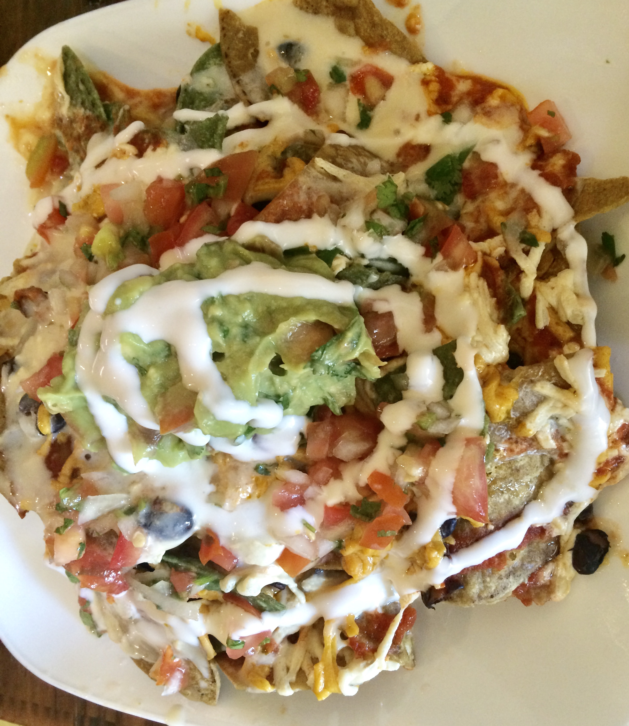
The Concept
Vegetarian restaurant concept
Signature Vegetarian products
Vibrant environment design
To Go and Eat in options
1,500 – 2,000 sq ft approx.
Interactive service experience
Catering sales channel
Wonderful service and food are our mantra

Slide 5
Concept Summary
FOOD & DRINK | VENUE | SERVICE & PRICE
High quality ingredients 100% Vegetarian Smoothies and Juices Fresh Heart-friendly Unique options Affordable at under $15 for food and drink | 1, 500 – 2,000 sq ft Strategic locations with high passing traffic Focus on carry-out & delivery Vibrant décor Fresh atmosphere | Highly interactive and friendly Cross-trained staff Order food at table or counter Efficient and fast Food served over counter/at table Competitive & high value price Grab and go option
Core Values
High Quality
Prime Location
Quality of Service
Great Ambience

Slide 6
Service Philosophy
Service Philosophy:
Creating an astonishing customer experience is not an option, but essential for Urban Vejjie. It should be reflected by giving our valuable customers a little or a lot more than what they expect.
This starts from the moment customers begin their online or offline research, staff greeting, ordering queue in the restaurant or remotely, receiving the food exactly as their order within our promised time in case of delivery, and this will never end as it should be a continuous exercise even when the customer leaves the restaurant.
Complaining customers are precious because they are giving us an opportunity to fix what is wrong and show our appreciation to them which will decrease the negative word of mouth.
In short, our motto is simple: Customers are always right and we will never promise what we cannot deliver

Slide 7
Corporate Citizenship
Our Corporate Citizenship Philosophy:
We are a Responsible Business and this is our philosophy in all aspect of the business.
To reflect this philosophy, we have to give back some of our profit to the community in topics which concerns them, such as environmental matters, feeding the hungry and sustainability.
Also, profitability is a must which will allow us to do far more social good than the traditional approach.
We will always act ethically and in the best interests of the communities we serve and further – if its wrong, we will not do it!

Slide 8
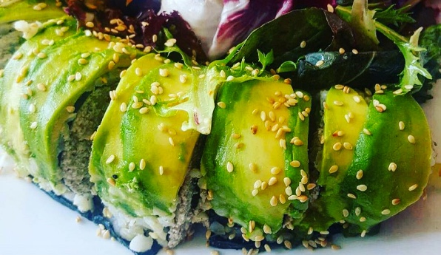
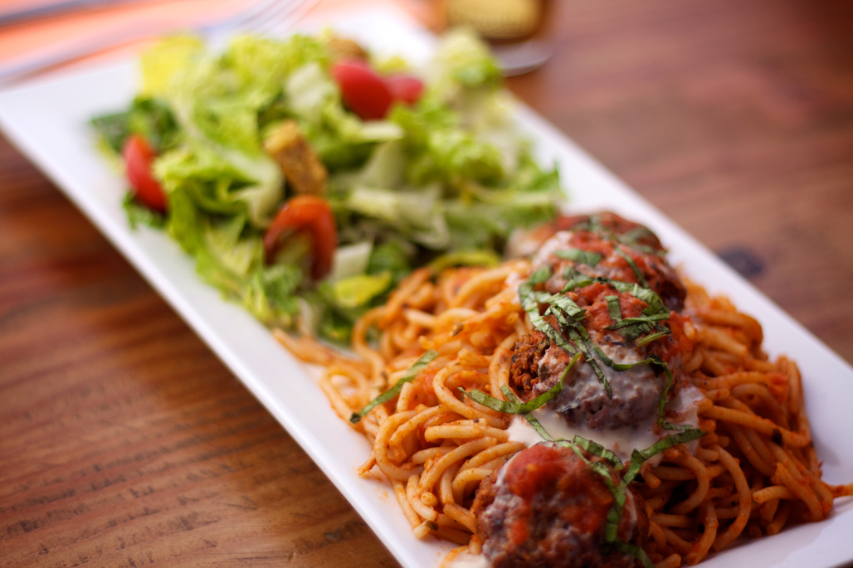
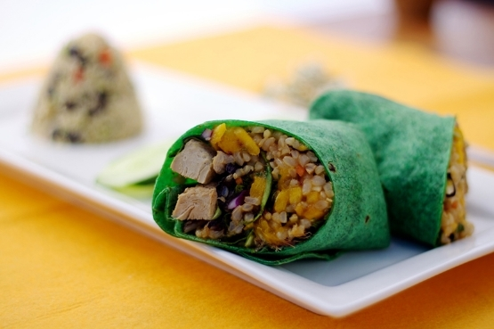
Menu
Urban Vejjie uses local, natural and organic ingredients to create our menu. Our café proudly represents care for our environment in everything from the reclaimed wood tables to our recycled & compostable take-out containers.
Our diverse menu is created with organic, natural ingredients that balance the whole body.
Our incredibly delicious Vegetarian and wheat-free pastries and cakes are baked fresh each morning by our team of very passionate chefs.
Our smoothies, juices and elixirs are made fresh from organic ingredients, each with a unique focus on whole body health.
The Menu mission is simple: serve delicious, affordable Vegetarian food that brings customers back, day after day, and week after week.

Slide 9
Menu Components
delicious
unique
fresh
fun
healthy
experience
consistent
affordable
quality
100% Vegetarian
Delicious

Slide 10
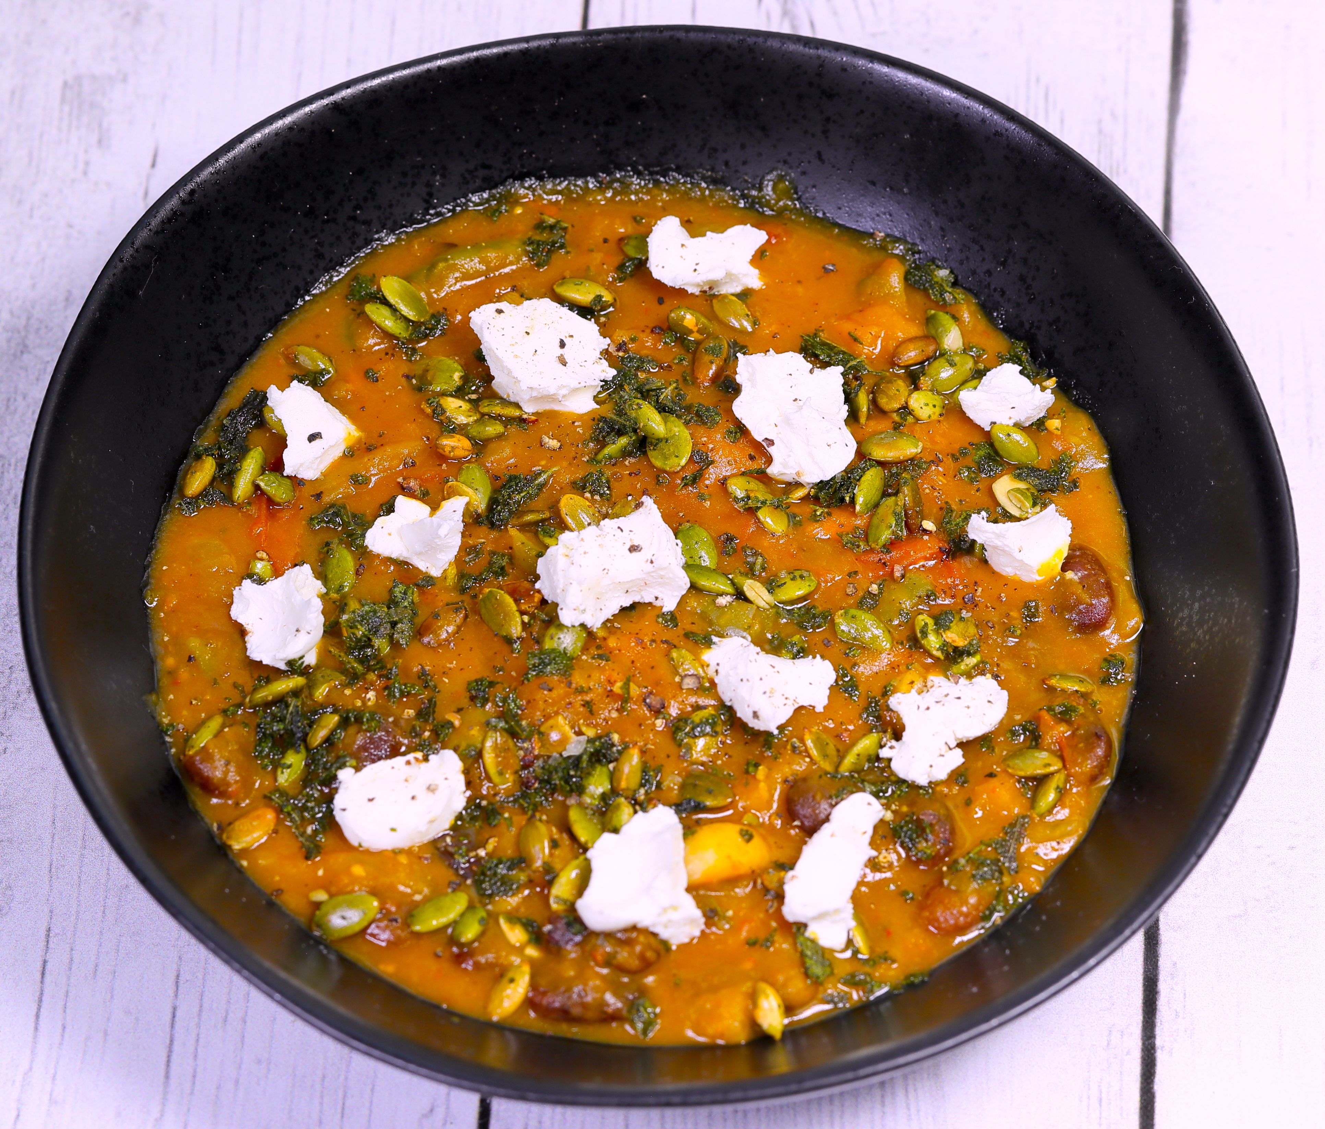
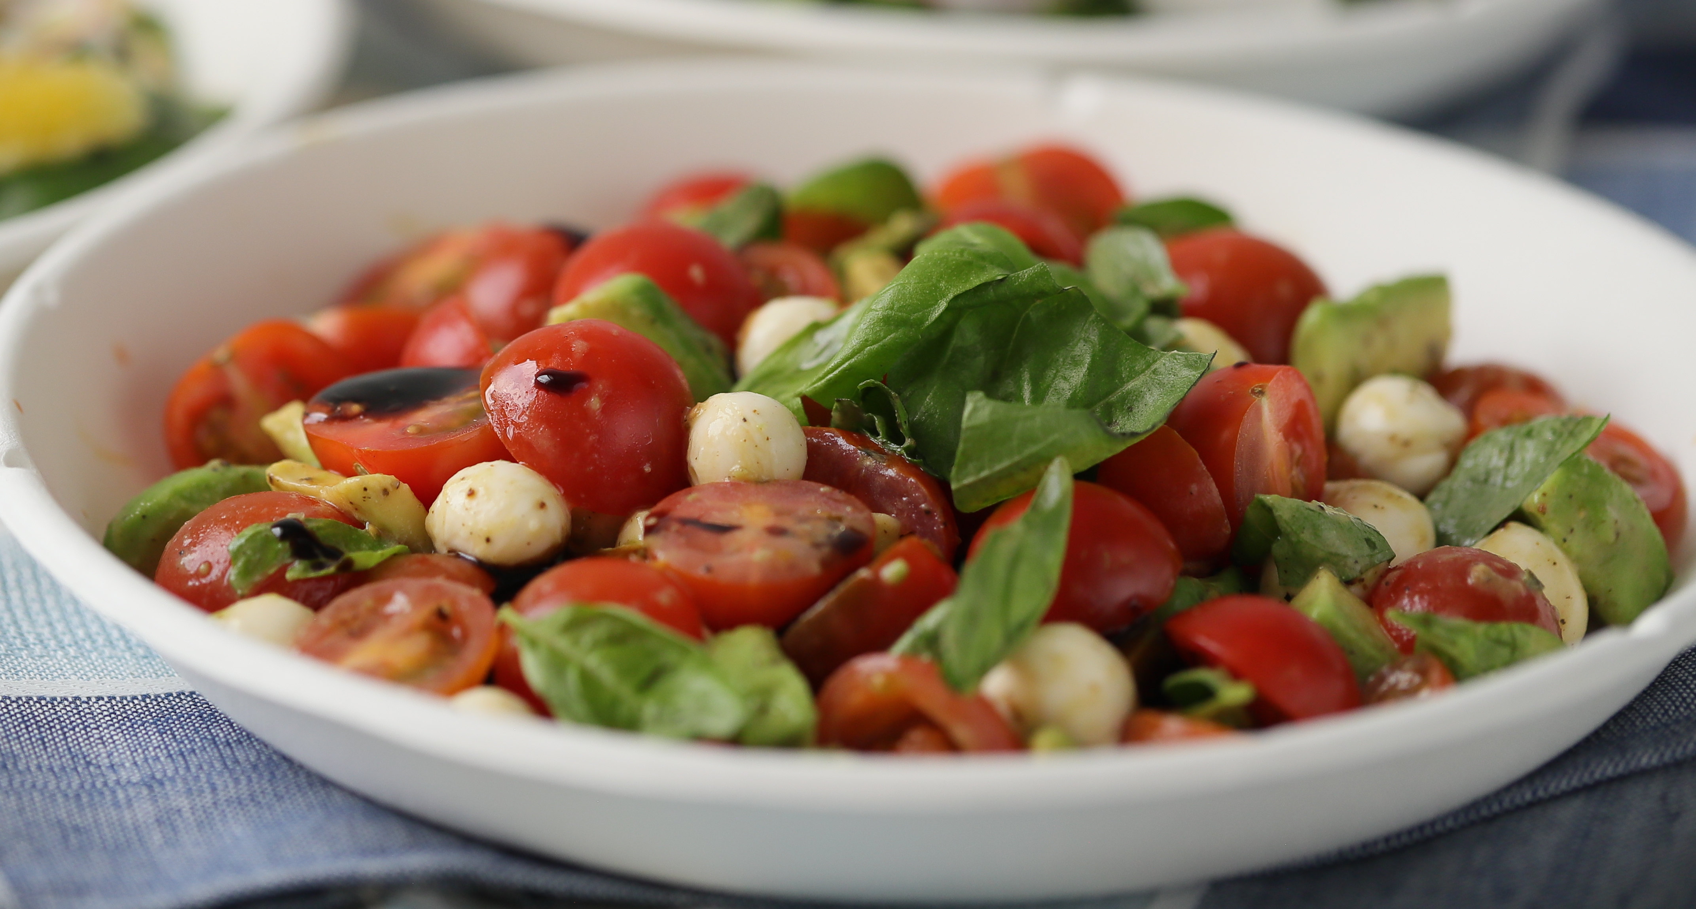

Slide 11
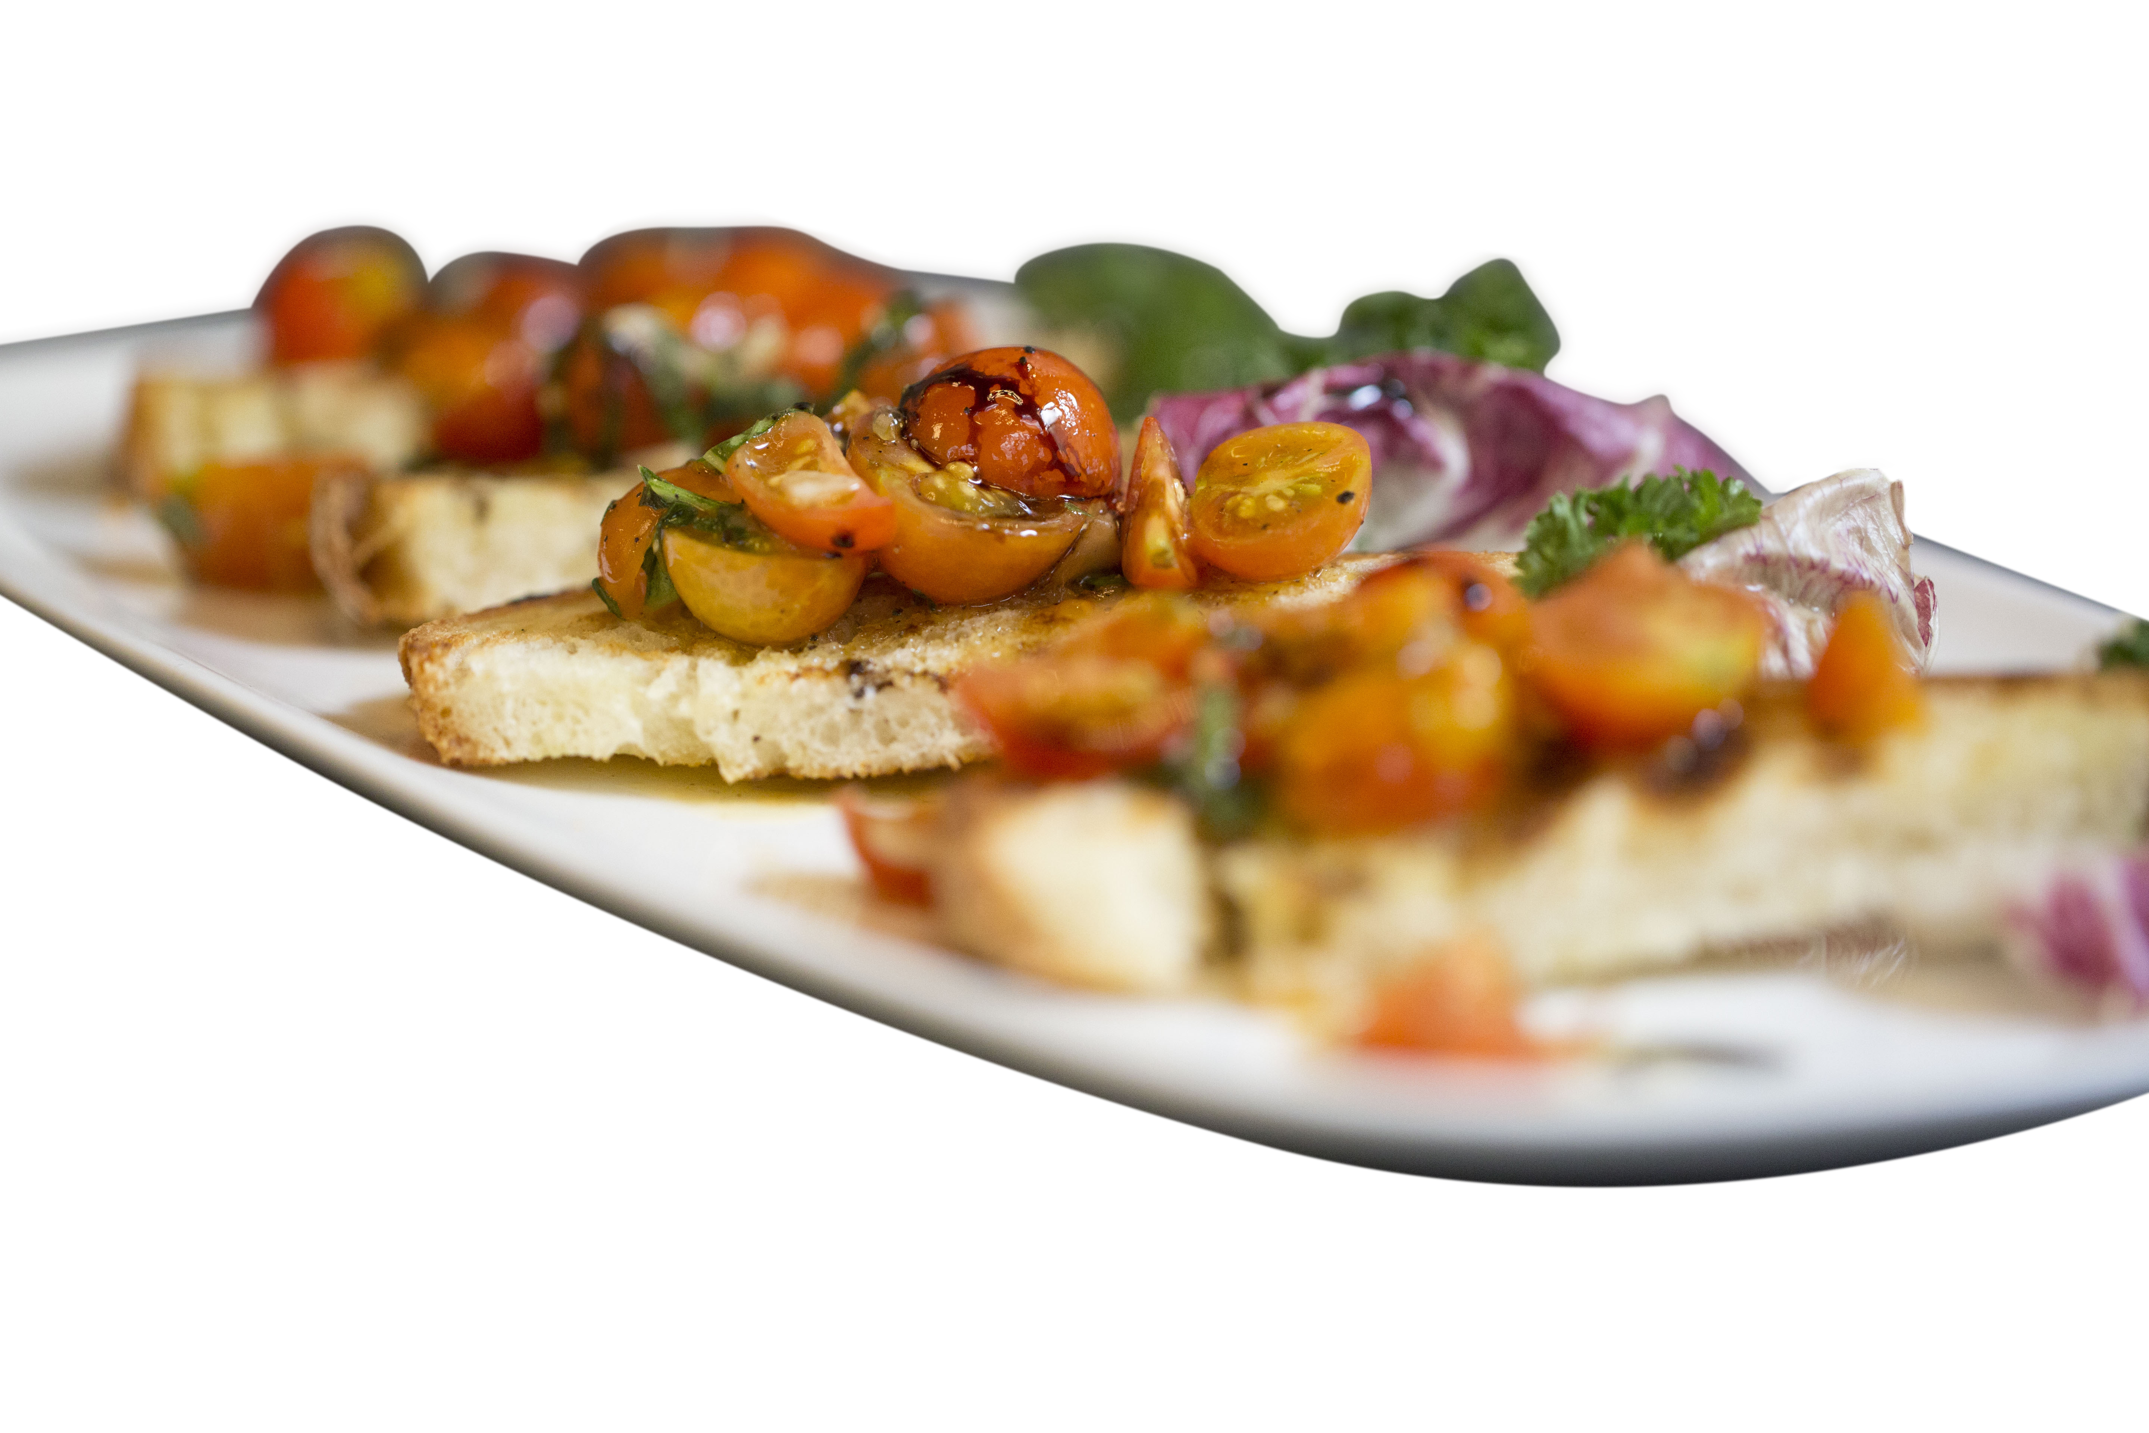
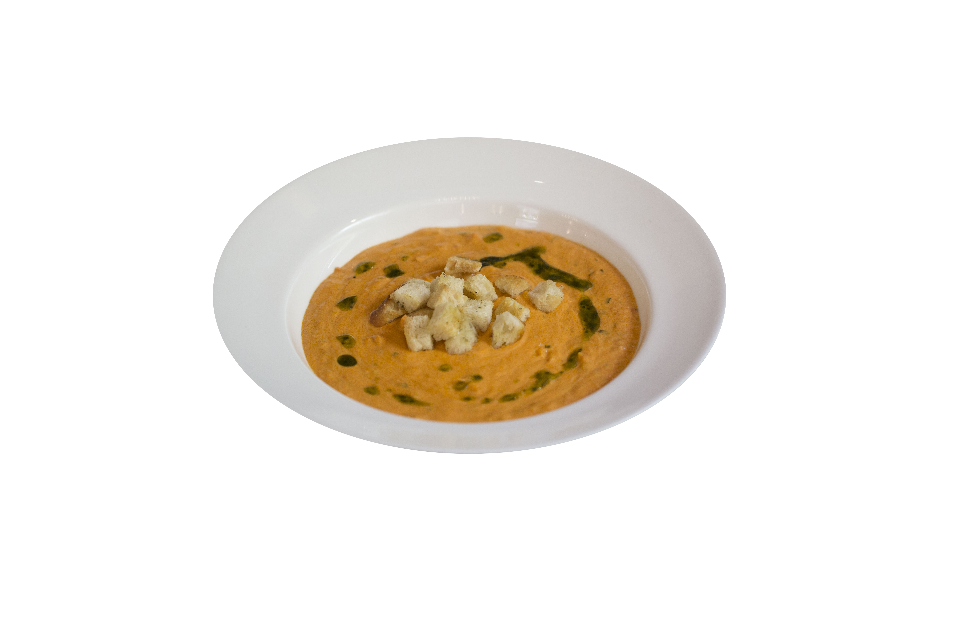
Sample Menu Ideas
Menu still under development, with pastry, and cake additions expected, along with tweaks on the ideas presented

Slide 12
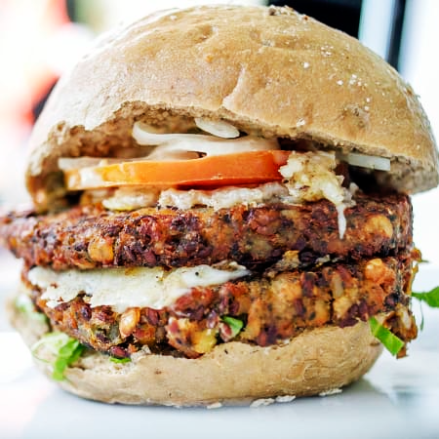
Signature Burger

Slide 13
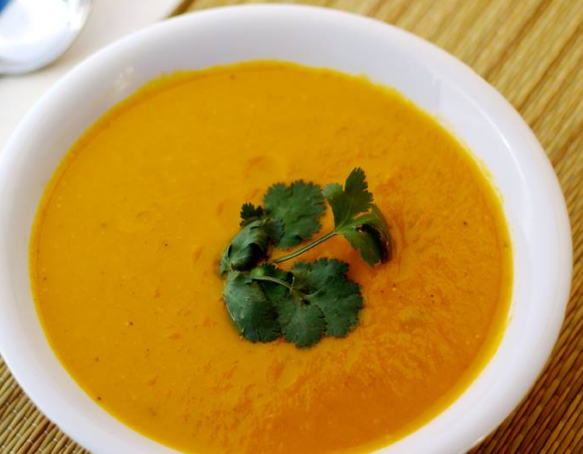
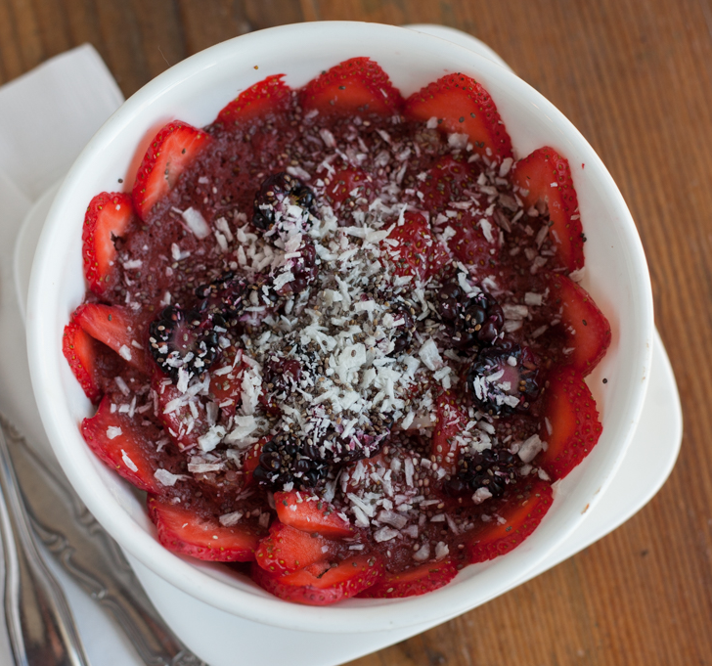
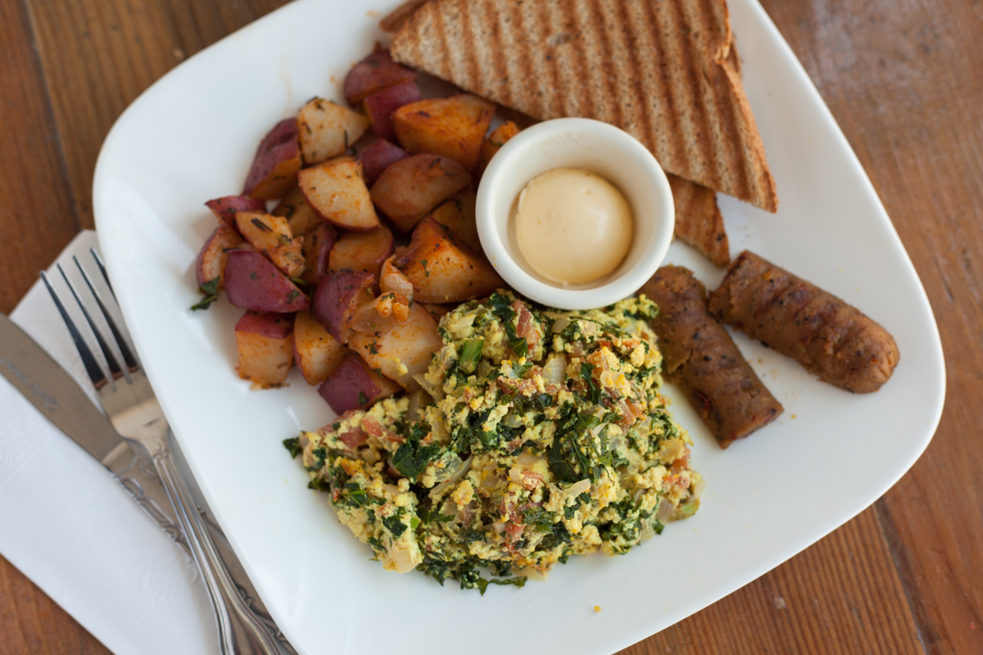
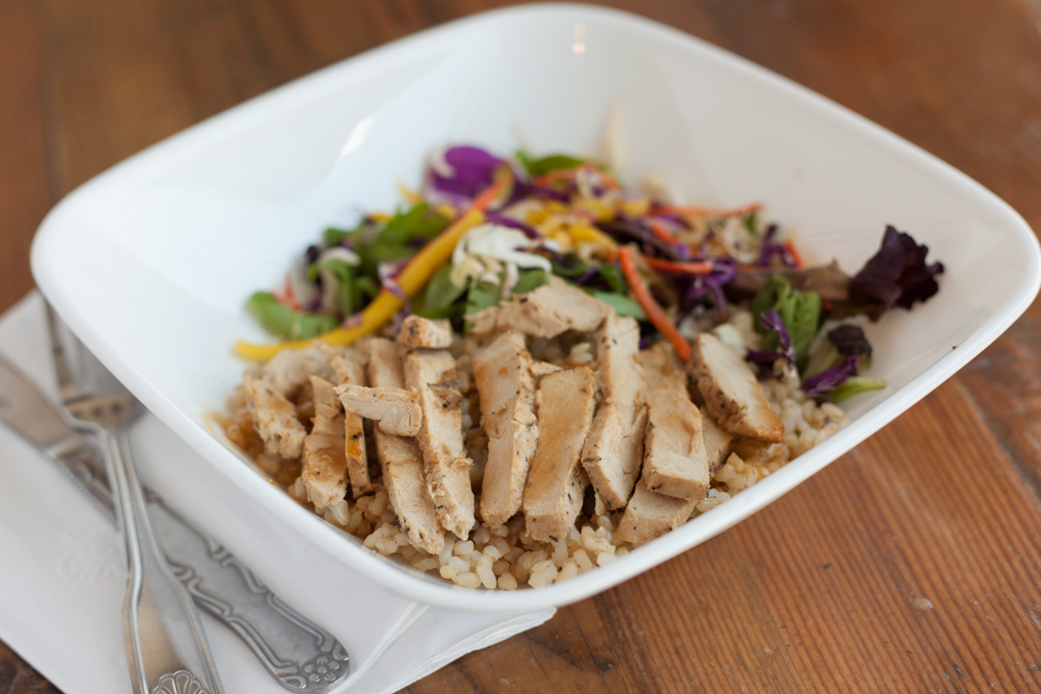
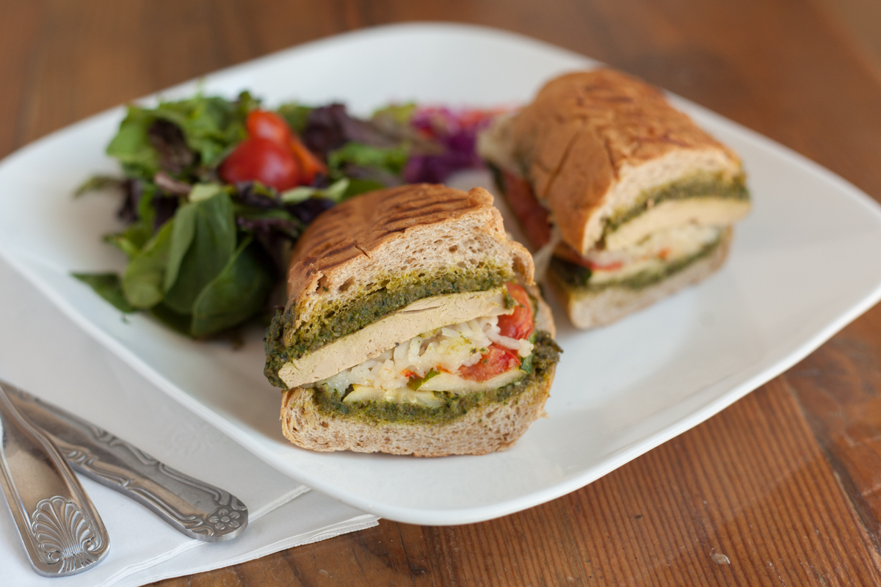
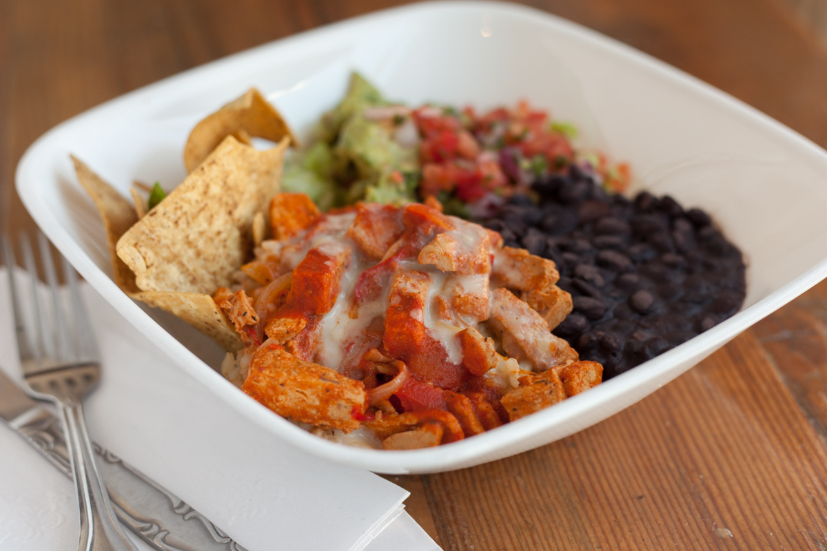
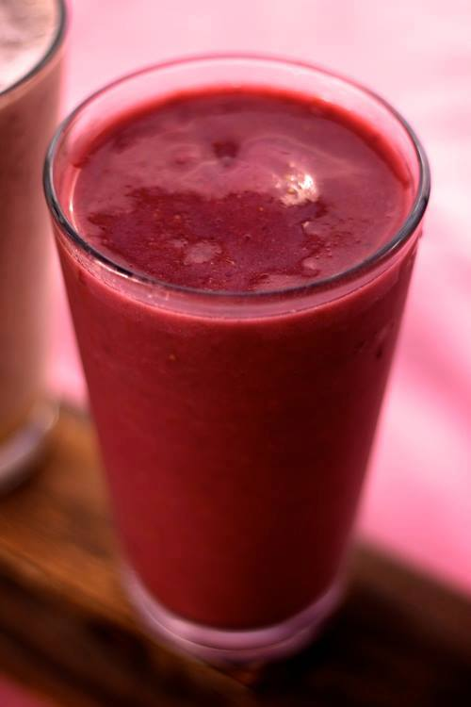
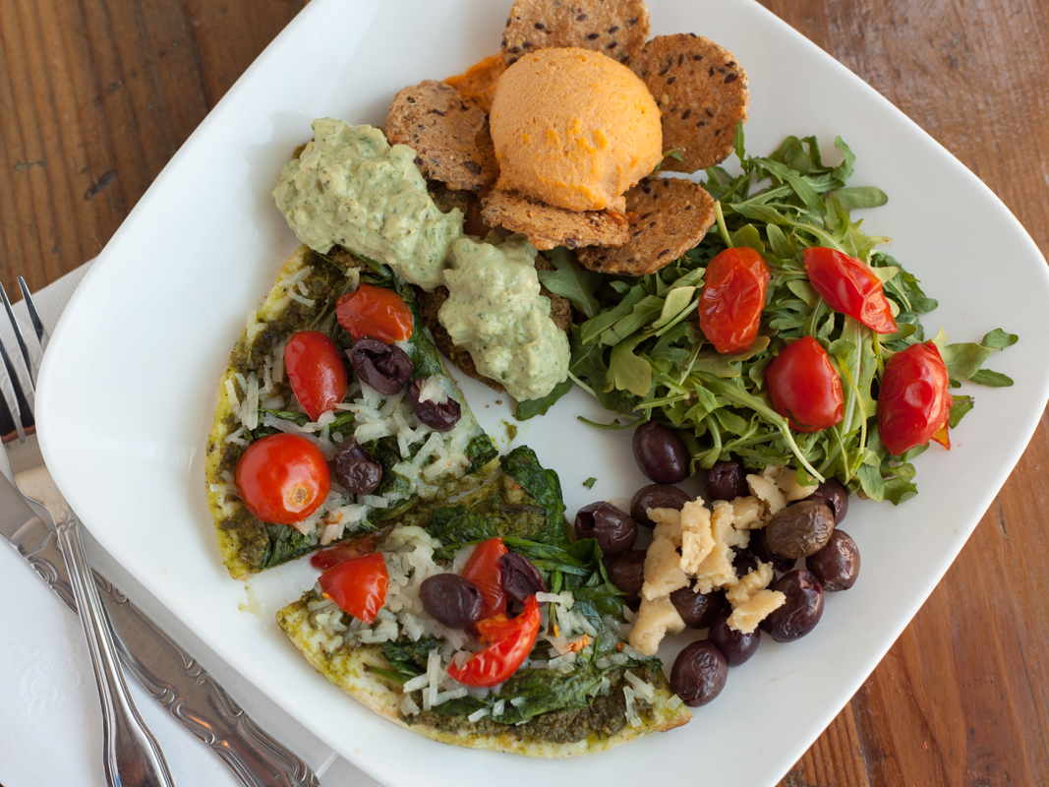
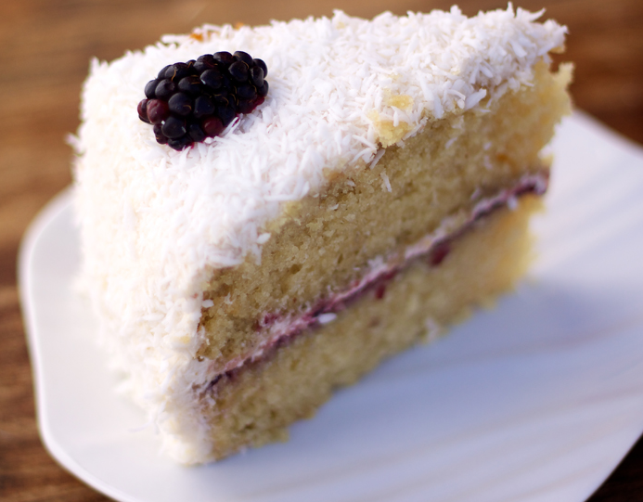
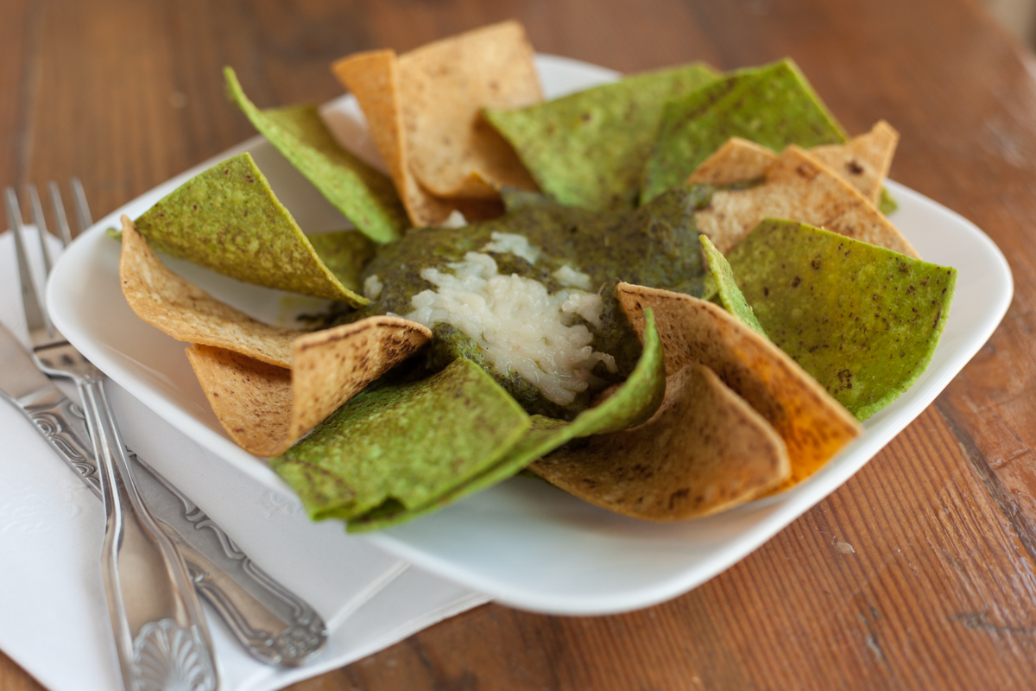
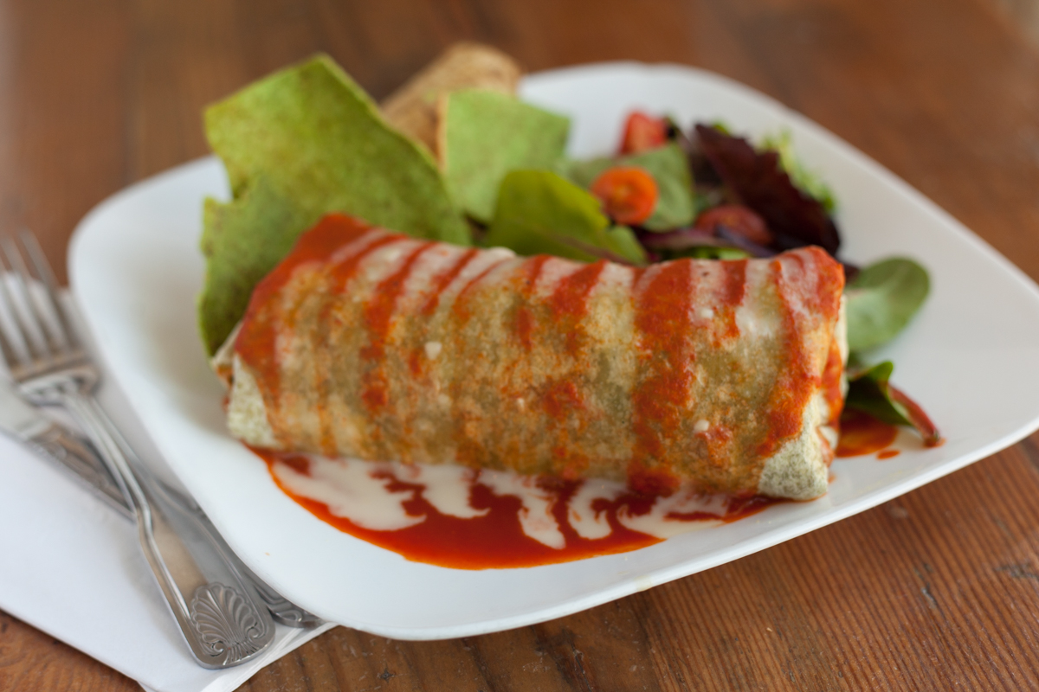
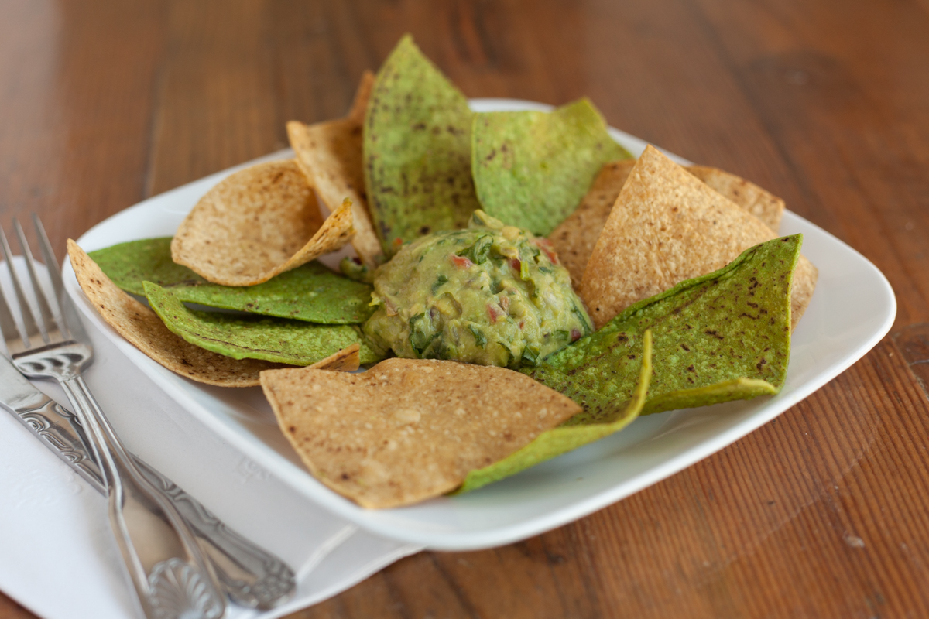
Menu Montage

Slide 14
The Vegetarian Marketplace
Over the last twenty years the interest in healthier, natural food has exploded in the US. One of the best ways to track this trend is through the growth of the organic foods sector which is tracked closely by a number of researchers and food consultancies. According to the Organic Trade Association, the sale of organic food and beverages grew from $1 billion in 1990 to $26.7 billion in 2010. By 2016 experts believe that organic sales in the US were $47 billion dollars, demonstrating a growth rate of approximately 8.4% from the previous year, considerably higher than .6% growth for convention food products.
Consumers are increasingly aware of the benefits of eating food that is GMO-free, less processed and made without the use of artificial colors, flavors and preservatives. Examples of this include the amazing growth arc of Whole Foods Market Markets (with over 470 locations and growing), the integration of thousands of natural food products onto the shelves of mainstream grocery stores and the emergence of healthy cuisine restaurant chains like Natural Café, Veggie Grill. Native Foods, Tender Greens, Eatsa & True Food Kitchen.
“From freshness to healthy ingredients to transparency of sourcing to eco-conscious business models, there’s no denying that today’s core consumer values increasingly center around what the natural and organic food and beverage market has been offering for years,” says David Sprinkle, research director of Packaged Facts’, a leading market research company covering the food and beverage industry.

Slide 15
The Vegetarian Marketplace
Motivated by various concerns ranging from personal health, the environment and animal welfare, a growing number of consumers have chosen to reduce the amount of meat and dairy in their diet. The restaurant consultancy group Baum & Whiteman said that plant-based foods will be a “mega-trend” in 2018. International delivery service Just Eat announced Vegetarianism as a top consumer trend in 2018 and according to data by Grub Hub, orders for plant-based food have reached a new high with users choosing vegetarian or vegan food 19% more in the first half of 2017 than in the first half of 2016.
The movement towards a plant-based diet is gaining attention through the growing number of well-known athletes including NFL stars Sydney Rice (Seattle Seahawks), Colin Kaepernick (San Francisco 49ers), Tom Brady (New England Patriots) and NBA players lWilson Chandler (Denver Nuggets), Marc Gasol (LA Lakers) and legend John Salley. Super endurance long distance runner Rich Roll. MMA fighter Nate Diaz and former boxer Timothy Bradley have all touted the benefits of a plant-based diet. So have a growing list of celebrities including Moby, Pamela Anderson, Woody Harrelson, Joaquin Phoenix, Miley Cyrus. Paul McCartney, Ellen Degeneres, Jessica Chastain, Mayim Bialik, Ariana Grande and many more. Even mainstream health organization Kaiser Permanente now recommends a plant-based diet as does the American Institute for Cancer Research.
According to research firm Global Data, there has been a 600% increase in people identifying as vegetarian or vegan in the United States in the last three years. In 2017, 6% of people in the US claimed to be Vegetarian; up from 1% in 2014. And in the UK, the number of people identifying themselves as Vegetarians has increased by 350%. Many believe that the data points to a worldwide explosion of interest in non-meat based food: Researchers predict a 17% growth of this trend in China between 2015 and 2020 and in Australia, the number of food products carrying a vegan claim rose by 92%. It is believed that there are now over 2000 independent Vegetarian or vegan restaurants in the US. And in the last 10 years the first national plant-based fast casual restaurant chains have begun to emerge: Café Gratitude (6 locations), Native Foods (15 locations), Loving Hut (20 locations) and Veggie Grill (32 locations). The most compelling part of the shift towards plant-based foods is a much larger segment of US consumers who have not chosen a strict plant-based diet but instead have elected to significantly decrease their meat and dairy consumption.
Known as “flexitarians” by food trend research groups, this segment is now believed to represent at least 25% of the population with some researchers suggesting that it may be as high as 41%.

Slide 16
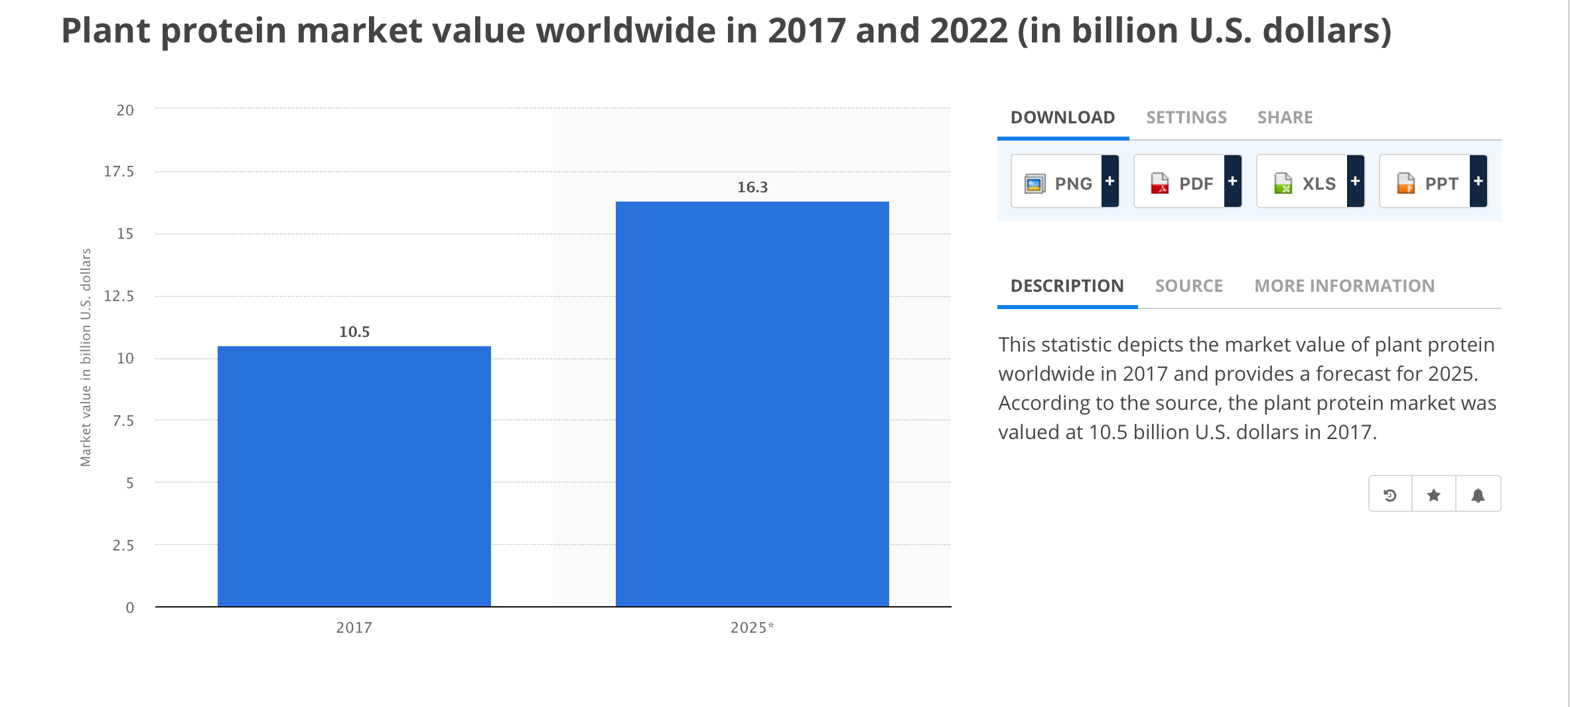
The Vegetarian Marketplace
Source - Statistica

Slide 17




Competition
Every restaurant represents competition for Urban Vejjie, especially in the fast casual and quick serve sector.
The chart beside focuses only on 100% puritan Vegetarian restaurants.
It is important to note that most restaurants are introducing Vegetarian options thus acknowledging the Vegetarian and flexitarian consumer trends.
This is good news and it endorses Urban Vejjie’s positioning and challenges the Urban Vejjie management to keep improving and remaining competitive.
USA restaurant-industry sales reached $798.7 billion in 2017, a 4.3% gain over 2016.
2018 and 2019 looks good too with similar growth predicted
Finally – while competition represents an enormous challenge – the good news is………………
Everyone Eats!
Primary Competition | Strengths All Competitors | Weaknesses | Urban Vejjie Difference
Veggie Grill Native Foods Follow Your Heart Plant Power One Off Vegetarian Concepts | Time in market Established # of Locations Market penetration Loyal customers Menu/price knowledge, Continuous improvement | All competitors are strong – although they are processing their ingredients more and more – main weakness is quality compromise as they grow | Higher quality food Service quality Food not institutionally purchased Homemade products Vibrant décor Counter service – made to order

Slide 18
Management Team
Wagih Doss – Owner and President
Charles J. Luster Jr is

Slide 19
Management Team
Robert Ancill CEO
Robert Ancill is the CEO of The Next Idea Group. Widely considered the ultimate restaurant authority on emerging and frontier markets, Robert is well known as one of America’s leading Global Restaurant Consultants.
Based in Los Angeles, Robert has overseen the creation and launch of over 89 new brands and 800 restaurant or café openings or remodels. He has worked or consulted with clients in over 24 countries, USA, UK, Kuwait, Dubai, Abu Dhabi, Saudi Arabia, Bahrain, Nigeria, India, Bangladesh, Thailand, China, Malaysia, France, Qatar, Tanzania and Pakistan.
Born and raised in Glasgow, Scotland, Robert joined the Glasgow College of Food Technology and graduated with the HCIMA qualification, and then subsequently attained his MBA. During his career, Robert worked for a range of well-known corporations including: Aroma Café Group, The House of Albert Roux, Planet Hollywood, House of Fraser, Safeway, Panera Bread and HMS Host.
In 2002 Robert founded The Next Idea, a high energy, innovative international restaurant consulting and management agency that simply provides – The Next Idea. The agency specializes in new restaurant concepts, re-positioning, cost efficiency, restaurant franchising, strategy and international growth.
Never wavering from The Next Idea’s core values of Creativity, Excellence, Client Service, and Integrity, Robert has built The Next Idea from a one-client agency to an acclaimed international boutique consulting group with a broad range of small, medium, and large clients, and an enviable project portfolio. The Next Idea operates out of two primary offices: Los Angeles (Corporate), and Trivandrum India, the agency also has a broad international network of brokers and representatives.
Robert, sits on several Company and NGO Board of Directors, and is regularly quoted in the Media on global restaurant and food trends as well as food & restaurant opportunities in emerging and frontier markets. He is regularly speaking at conferences on topics relating to international growth opportunities, restaurant concepts, food trends and consumer behaviour. The Next Idea have several brands under management in Los Angeles.
He is also active in the Non Profit world, supporting many good causes including, anti-slavery, cure and support for autism and child education in underdeveloped countries.
In his spare time Robert is an amateur photographer, whose work has been featured in multiple travel and food related articles.

Slide 20
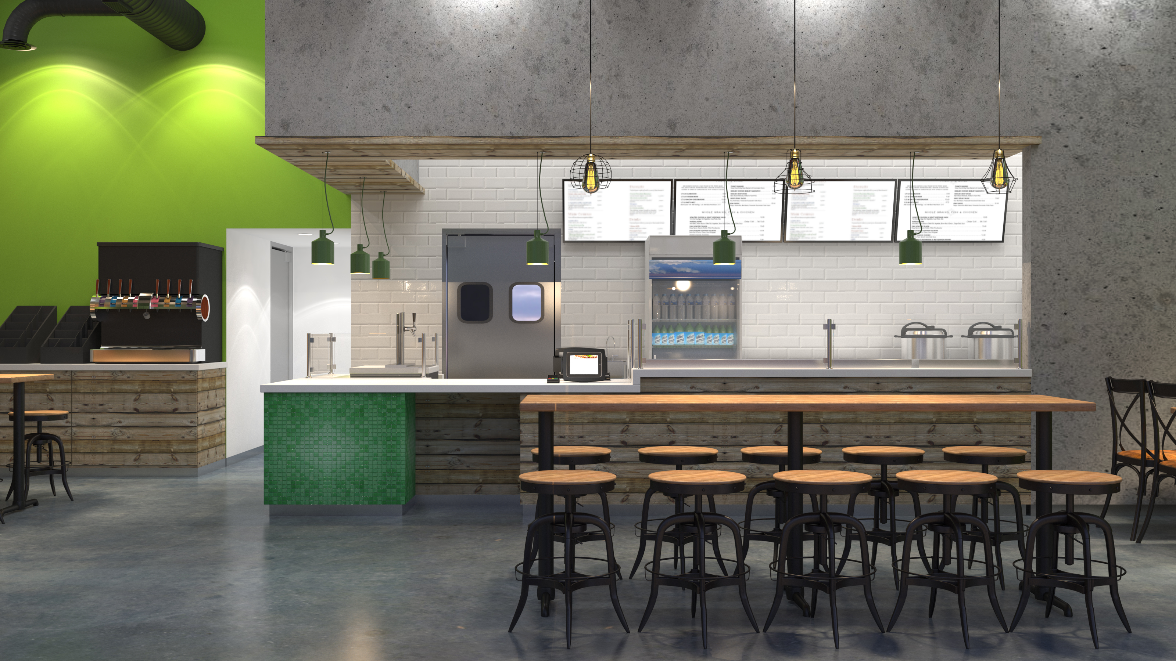
Interior Design Direction

Slide 21
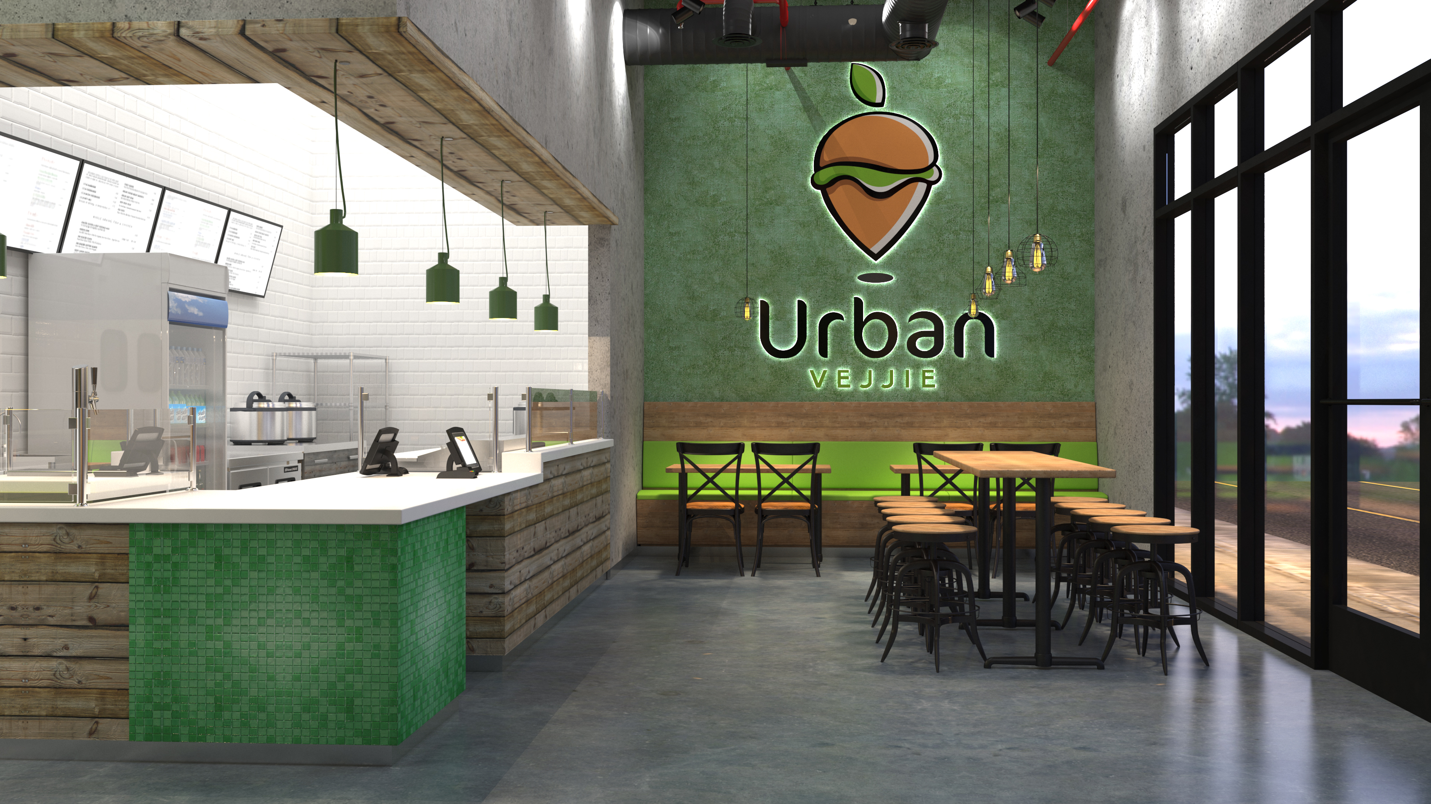
Interior Design Direction

Slide 22
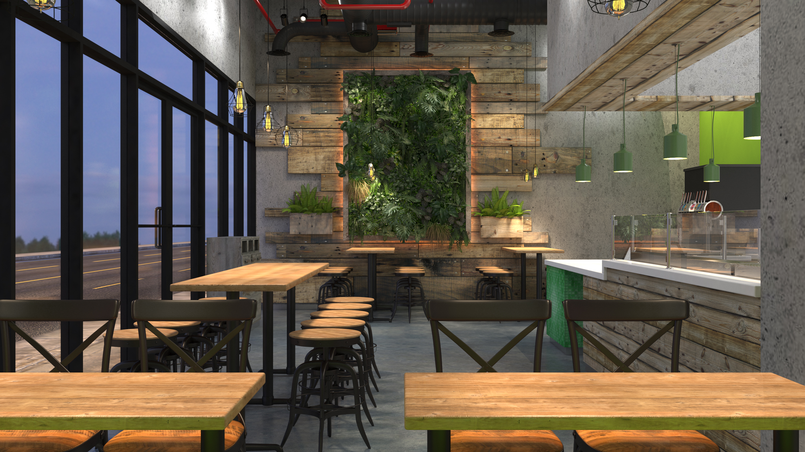
Interior Design Direction

Slide 24
Marketing Strategy
MARKETING STRATEGY
Management has invested a considerable amount of time creating a comprehensive marketing strategy enabling the business to target our three core guest profiles: Local Residents, Office Workers and Shoppers / Tourists.
We will introduce Urban Vejjie brand to infuse the message that we are ‘’revolutionizing the Vegetarian food experience’. We seek to accomplish this by setting elevated standards of service, using fresh, healthy, locally sourced ingredients, offering, hand-crafted, fresh, “Vegetarian” meals, snacks and desserts, and providing a truly welcoming ambiance for our guests. Additionally, we intend to review our product sales and guest feedback regularly, to keep abreast of upcoming trends to ensure we are providing an outstanding dining experience for each and every guest.
We are a small business and therefore, we can and will promptly respond to informative feedback or data that management believes will better serve our guests.

Slide 25
Tactical Marketing Strategy
E-COMMERCE / WEBSITE: Provide an internet-based e-commerce website where customers can order both catering and individual products online. This represents a sophisticated use of technology, as only a handful of food court operators have so far adopted such a method, placing Urban Vejjie in a strong position to ensure loyalty and first choice amongst its customer base.
SOCIAL MEDIA: Adopt social media sites such as Facebook and Instagram, to engage with interested guests sharing the experience and using their network to communicate the concept.
EMAIL CAMPAIGN: Launch an email campaign, beginning one month prior to store launch.
DISTRIBUTION OF SAMPLES: Actively distribute samples pre-opening and during the first four weeks of trading to local offices and community centers.
EMAIL DATABASE: Create own email database providing the opportunity to email to customers about weekly specials, local events, promotions, etc.
LOYALTY PROGRAMS: Introduce a variety of loyalty programs to ensure repeat visits.
ADVERTISEMENTS: Advertise our promotions and special events in local media.
CATERING MATERIALS: Provide a brochure and ordering forms, containing menus and services for prospective catering clients.
3rd PARTY PLATFORMA: List with all 3rd Party delivery platforms such as Grub Hub and Uber Eatz
SMS (TEXT) CAMPAIGNS: With special offers and information
LOCAL NETWORKING: Management is 100% committed to working within the community to drive trade and establish our business as a necessary facility for local residents and businesses. We will develop relationships with key businesses, schools, charities and community centers
PUBLIC RELATIONS: As with any eating establishment, word of mouth is the most important marketing tool available. We will seek to petition local journalists and food writers, encouraging them to experience Urban Vejjie first-hand with the anticipation that we will receive favorable write-ups and listings.

