Slide 1
my PEROSNIFY Workplace
Logo Request

Slide 2
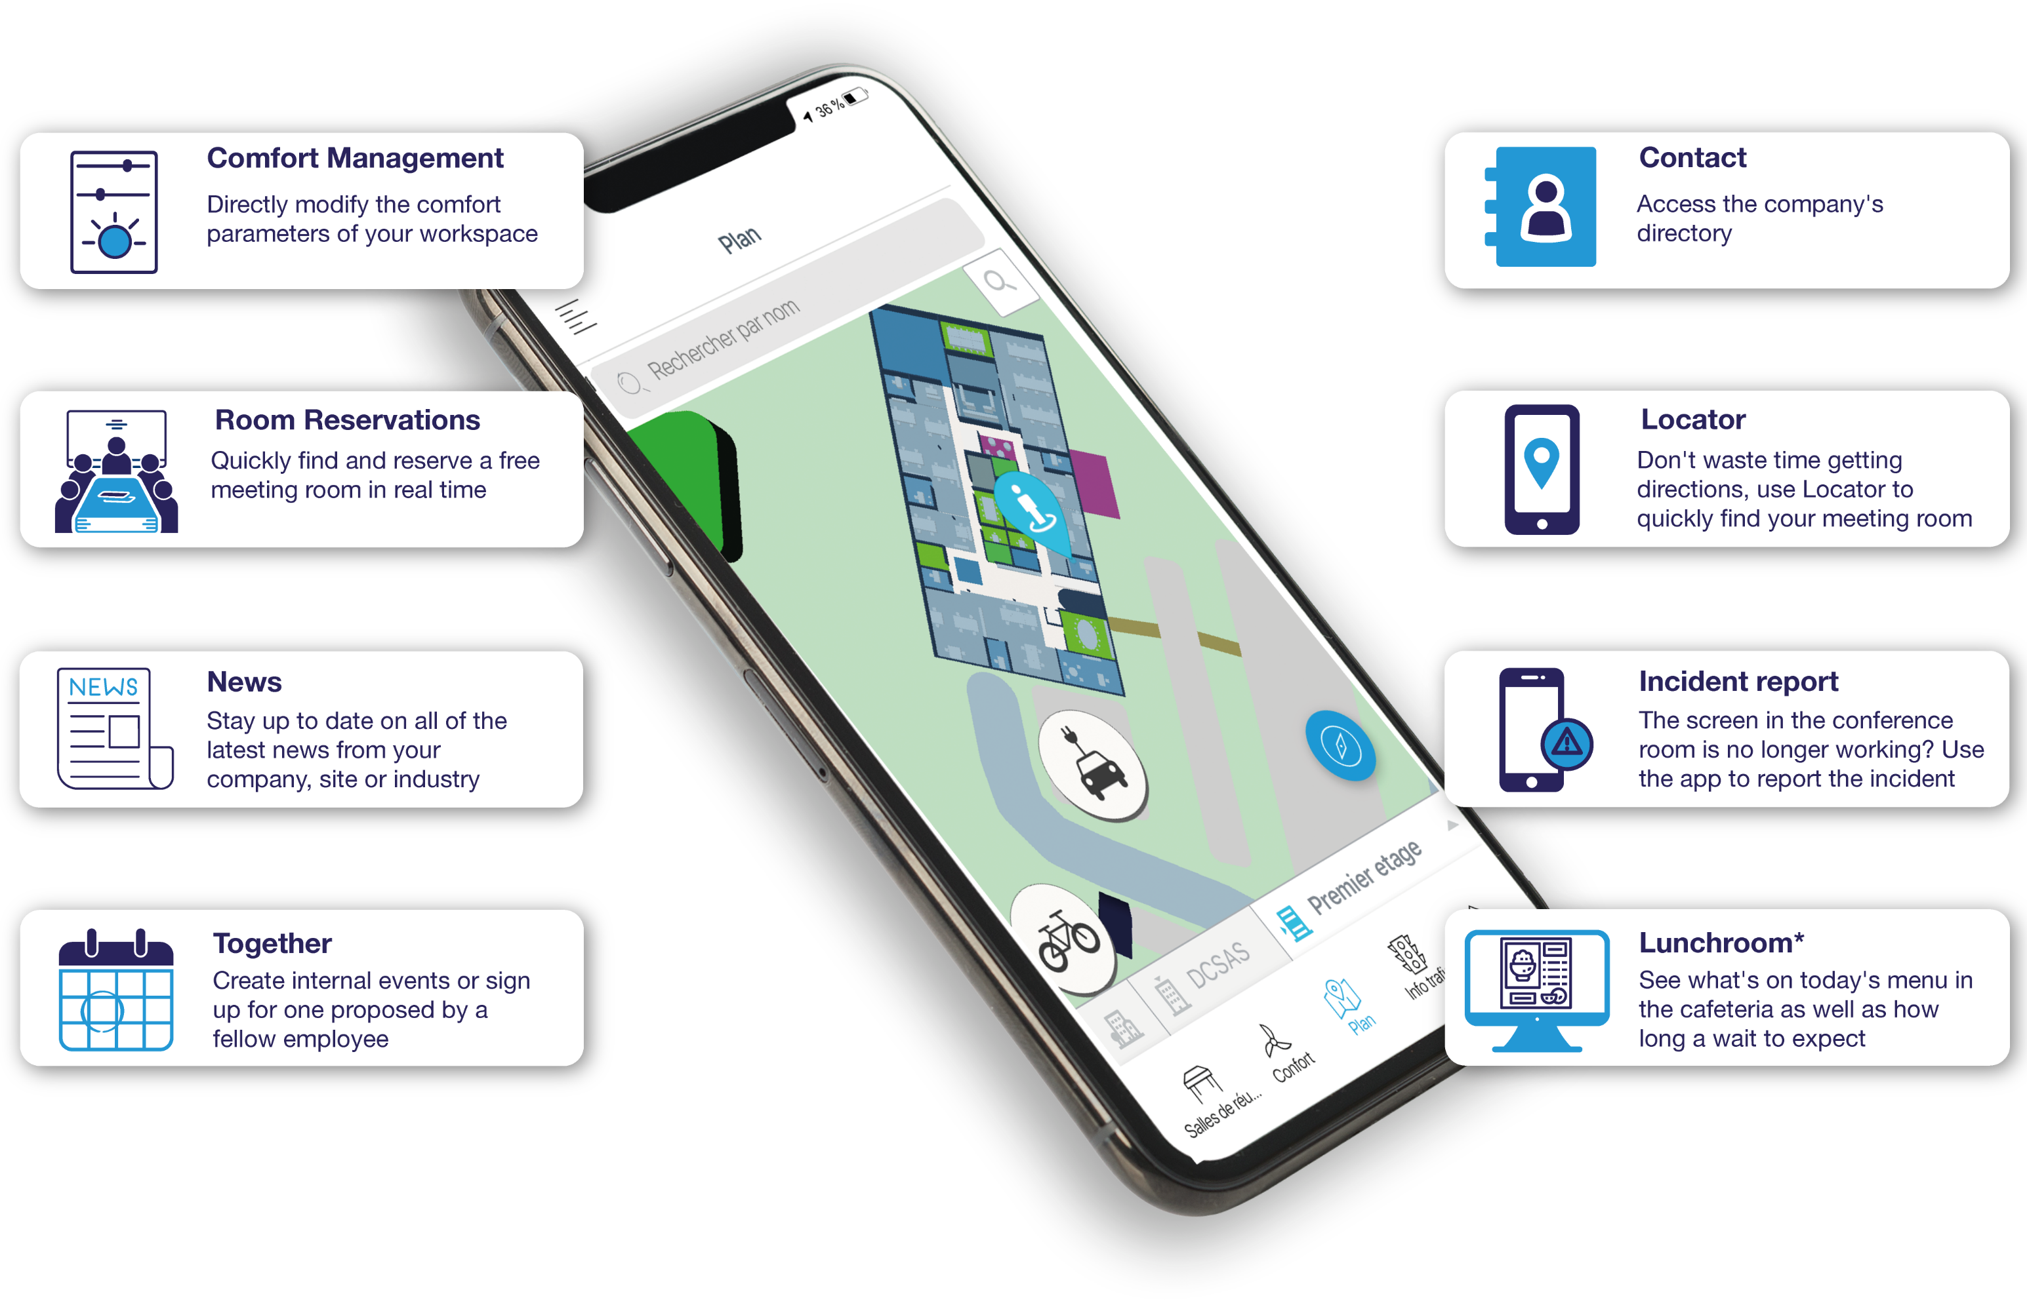
The App
Main Feature
Very Important

Slide 3
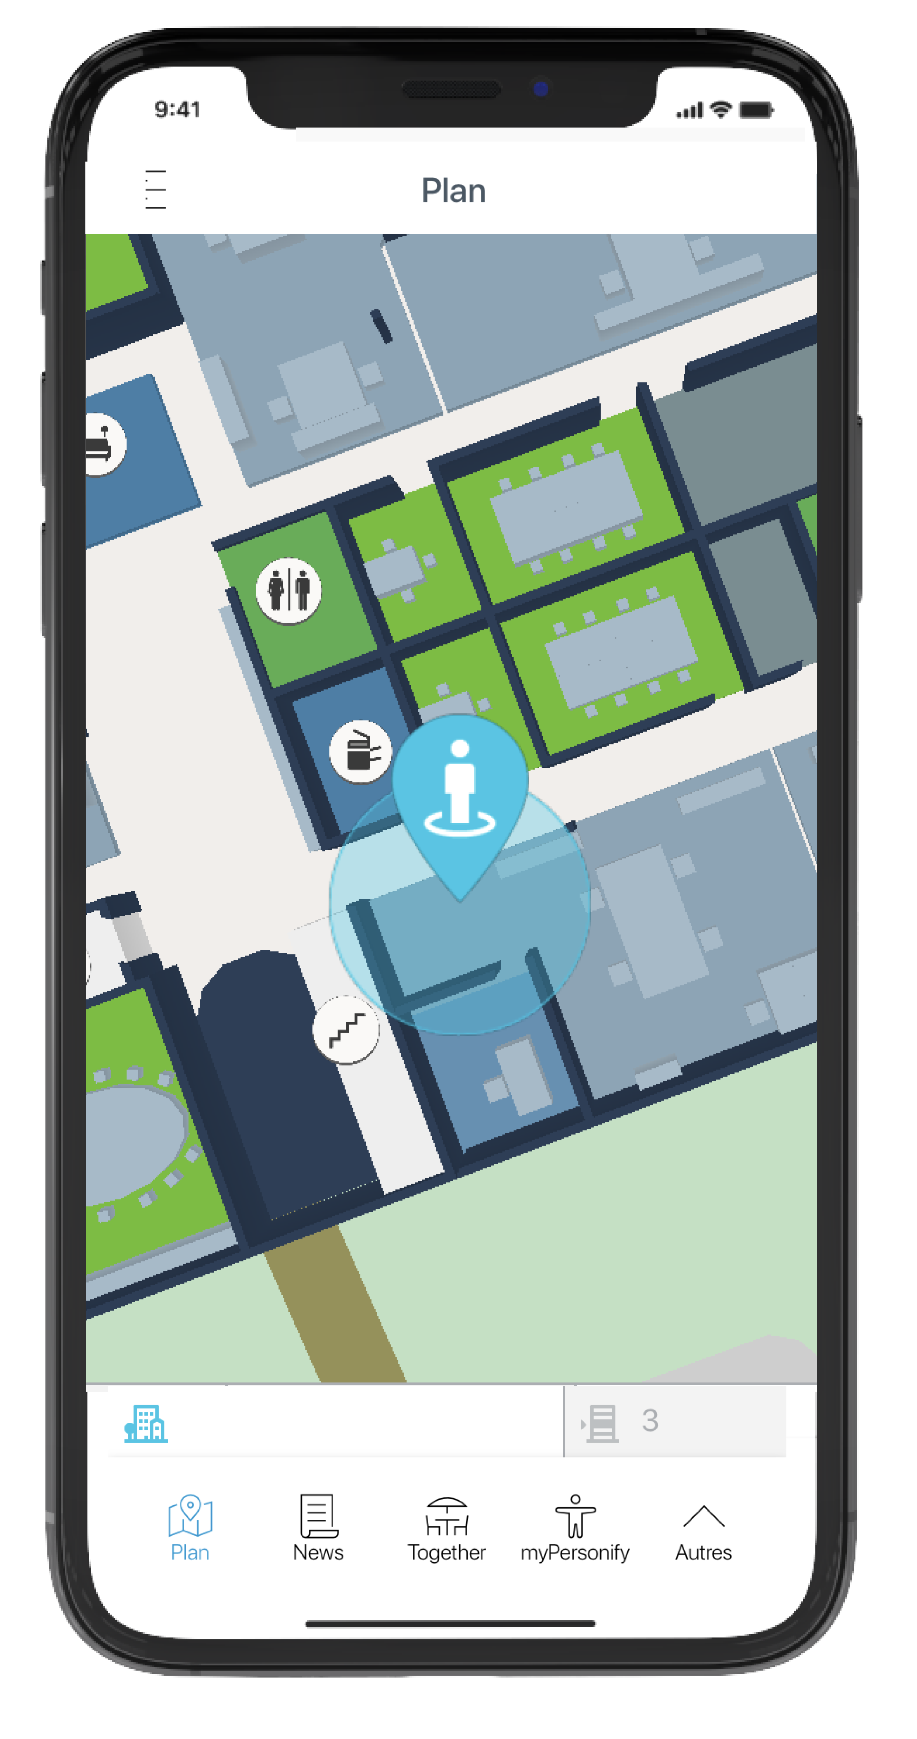
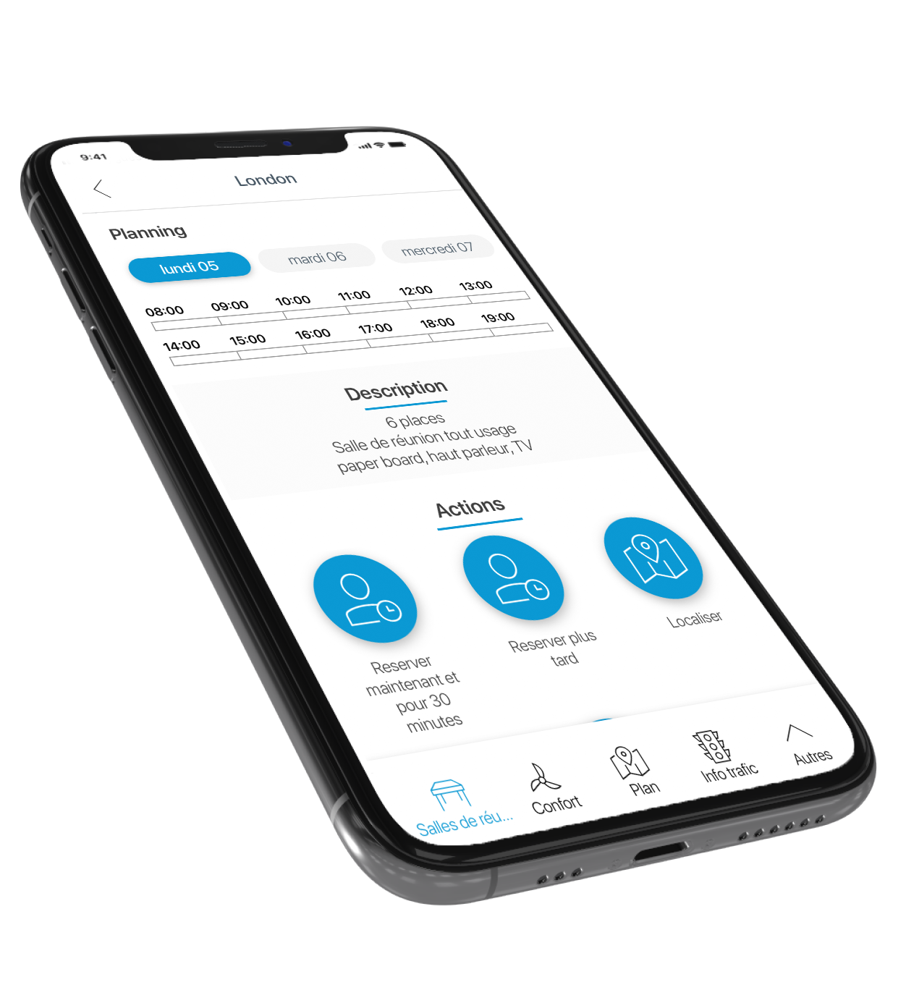
Look and Fell of the App

Slide 4
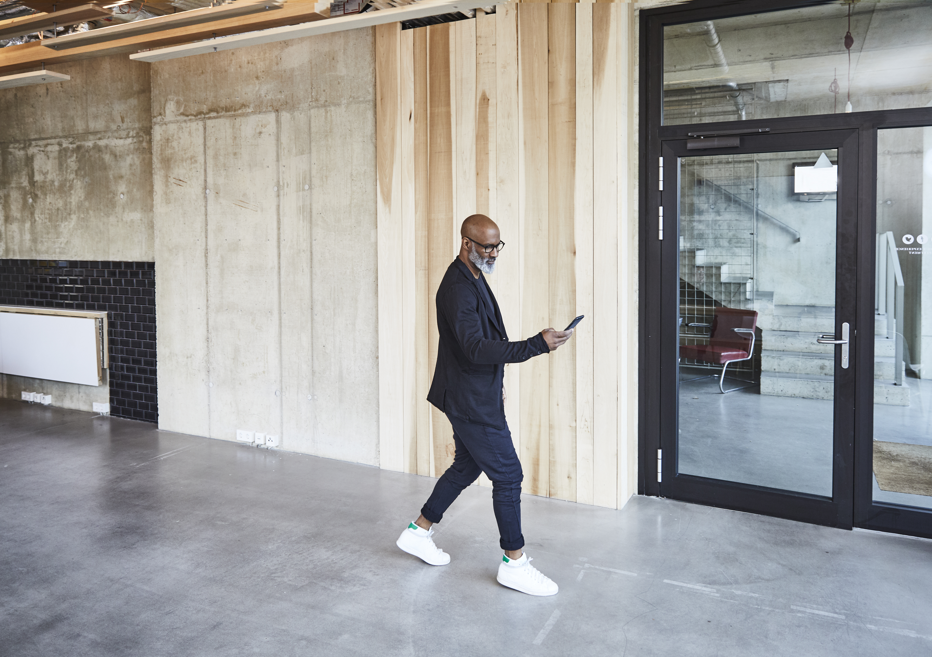
App info
Target : Employees in office buildings
Description: By connecting to Distech Controls Building Management System, my PERSONIFY Workplace app provides employees control over their workplace so they can comfortably do their best work.

Slide 5


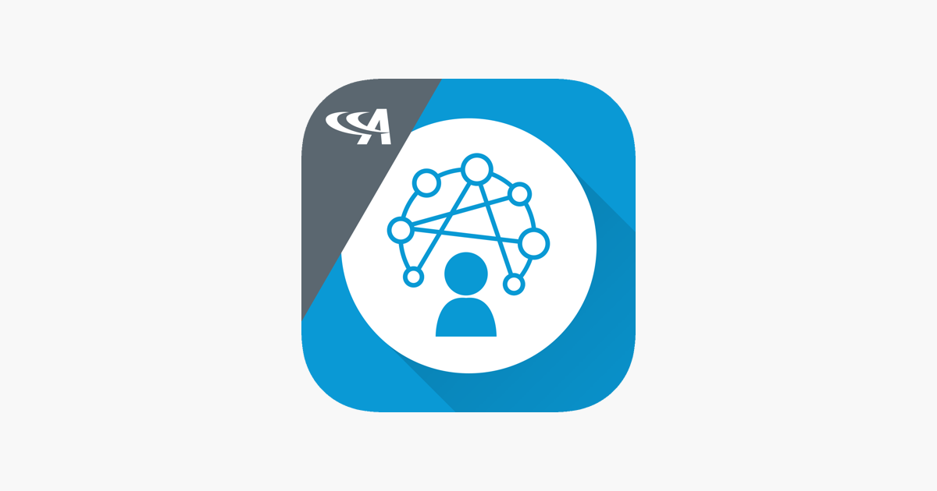
Ideas
Localisation
Employee services / wellbeing
An innovative logo
Ideas on the side
Must look like this logo without the A logo (on the top left corner):
Have provided the source files

