Slide 1
Index
The company
Key Staff
Our Prefabricated Noble Eco-pro wastewater treatment plants
Large/municipal wastewater treatment plants
Project executed

Slide 2
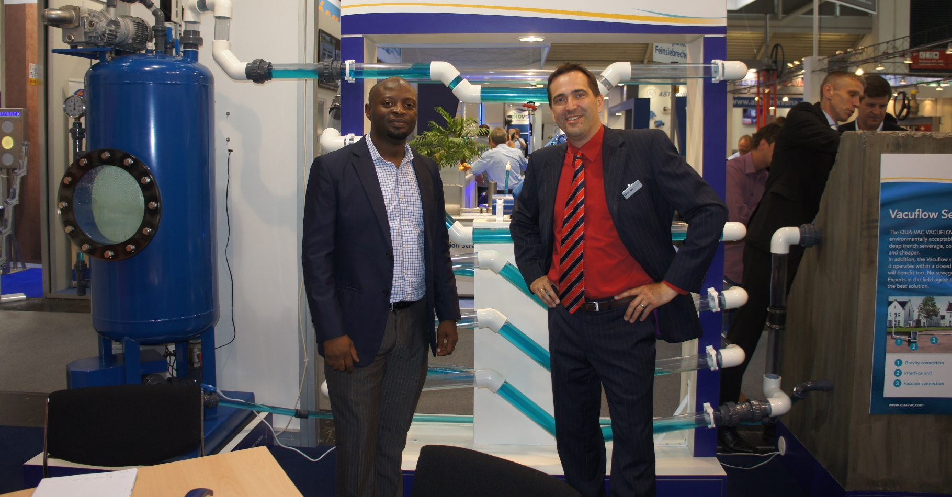
THE COMPANY
Noble Sovrano Ltd, an Engineering, Construction and infrastructure development Company, operating in Nigeria, amongst other engineering services is specialized in the construction of municipal and supply of packaged Domestic Wastewater/Sewage Treatment Plants our services include:
Construction of Municipal or Large Sewage Treatment Plants
Supply and installation of Packaged MBBR Noble Eco-pro wastewater/sewage treatment plant (MBBR technology)
Design Build and Operation of wastewater treatment plants
Retrofitting and revamping of existing wastewater treatment plants
Automation of existing wastewater treatment plants
Sewerage construction
Sludge management services
Over the years Noble Sovrano has acquired and accumulated special skills and rich operational experience in the field of Environment Management and Engineering, particularly related to waste water treatment and pollution Control. We have executed various large and medium sized projects in the related field. Our packaged Eco-Pro plant and Noble oil and scum are two examples of the results of R&D work carried out over the years, by adopting latest techniques used for the BioChemical Degradation Methods for treatment and reuse. Our Key work force includes Chartered and qualified Engineers, Accountants and other professionals with adequate infra-structure, Manpower and machinery to timely execute the Assignments.
Office

Slide 3

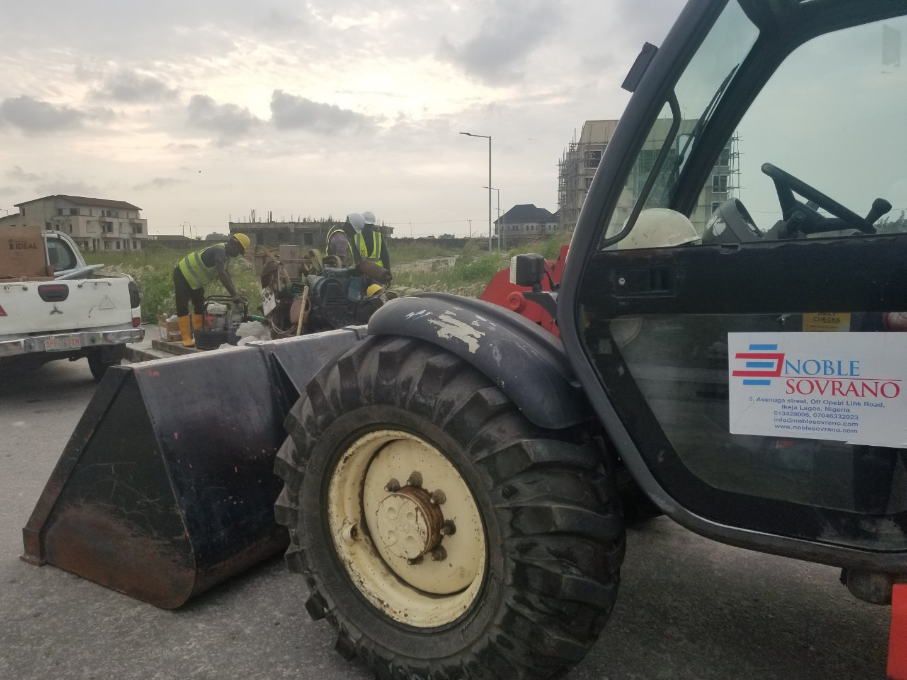
THE COMPANY

Slide 4
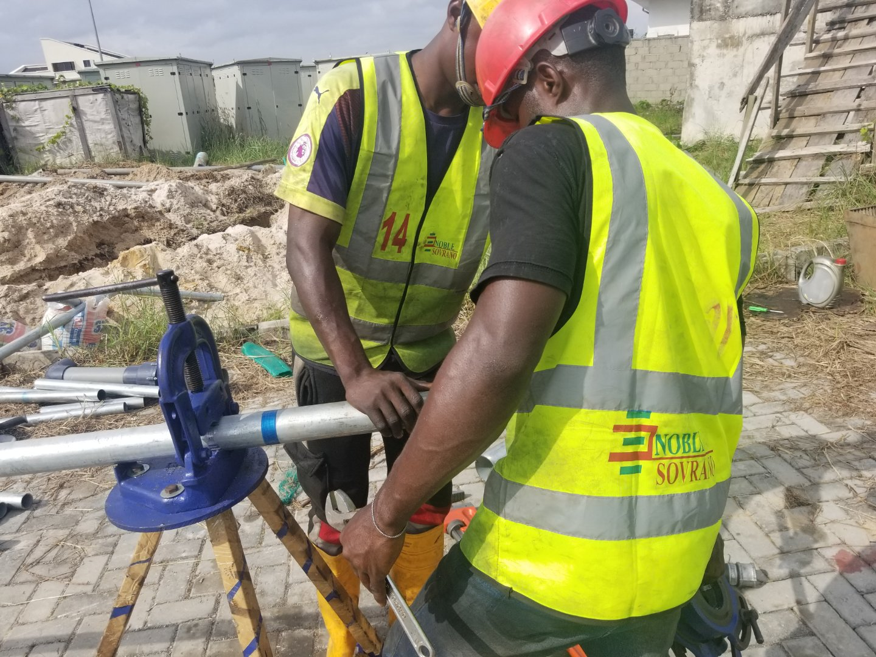
THE COMPANY

Slide 5
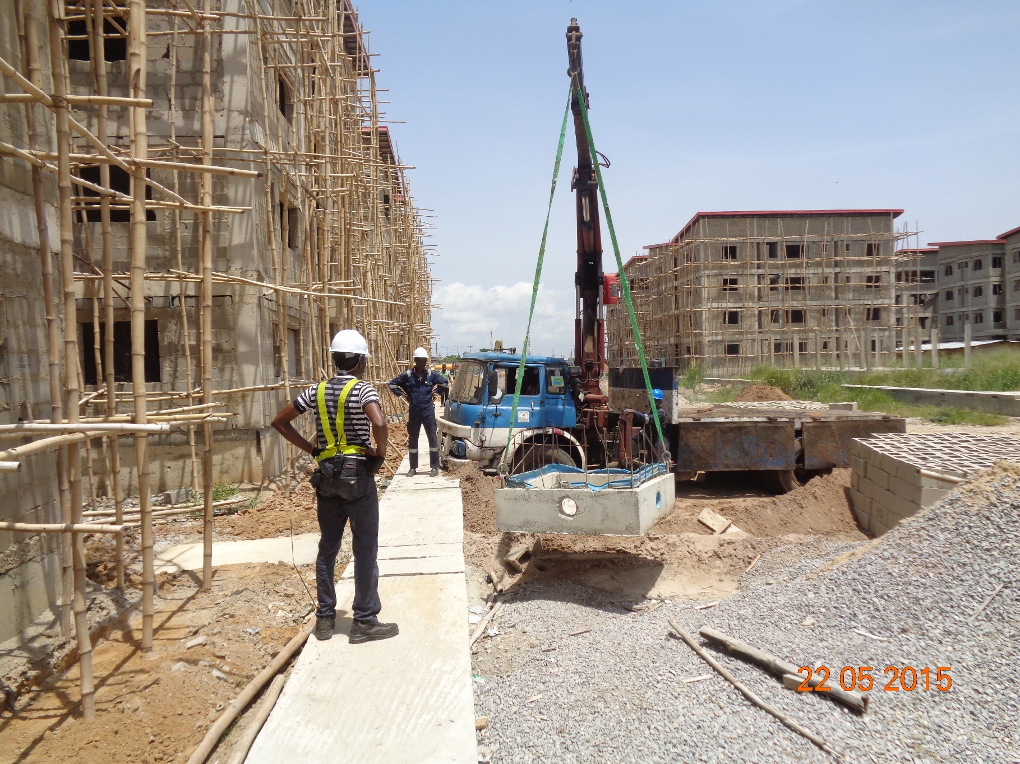
THE COMPANY

Slide 6
KEY STAFF
Engr. Olajide Dosunmu (MD.)
Engr. Olajide Dosunmu is a chattered engineer with COREN. He holds an MBA from the Lagos Business school, a Bsc. Degree in civil Engineering from the University of Lagos Nigeria and has over 15 years experience in Civil Engineering infrastructure design and development. Having worked in the oil and gas industry as a design and assessment engineer for offshore structures, he gaining wide experience in the design of structural elements, Olajide later specialized in the hydraulics and hydrology focusing on assessment and design of hydraulic structures and primary drainage systems and wastewater treatment systems.
In 2018 he was the guest speaker at the AGM of the Nigerian Institute of Town Planners, on the topic Planning infrastructure for Lagos Mega City. He also recently chaired an infrastructure committee to resolve storm water drainage challenges on the over 4000 hectares lekki free trade zone with operations both in Nigeria and China.
Mrs Jennifer Alohdia (Operations Manager)
Experienced Manager with demonstrated history of working in the construction industry. Skilled in feasibility studies, Operations excellence and construction management. A strong business development professional also with a degree in Accounting.
Aderibole Olajumoke (Accountant)
A trained and diligent Accountant with BSC degree fom Joseph Ayo Babalola university. She upholds our culture of accountability not only to the organisation but to the clients and partners also.
Adesumbo Ramon (Project Engineer)
Ramon is civil engineering Graduate from the university of Lagos with a masters degree in the environmental engineering in view. He is experienced in the construction of wastewater treatment plants and civil infrastructures.
Ayoyemi Oladimeji (Design Engineer)
Ayo, is a first class degree holder in civil engineering from the Kwame Nkruma university of science and technology Kumasi. He is a certified health safety and environment officer and a member of the british international safety organisation
Oyewusi Adeniyi (Project Engineer)
An excellent civil infrastructure construction supervision engineer. Holds a Bs. Degree in civil engineering and vast in the construction of civil infrastructure.

Slide 7
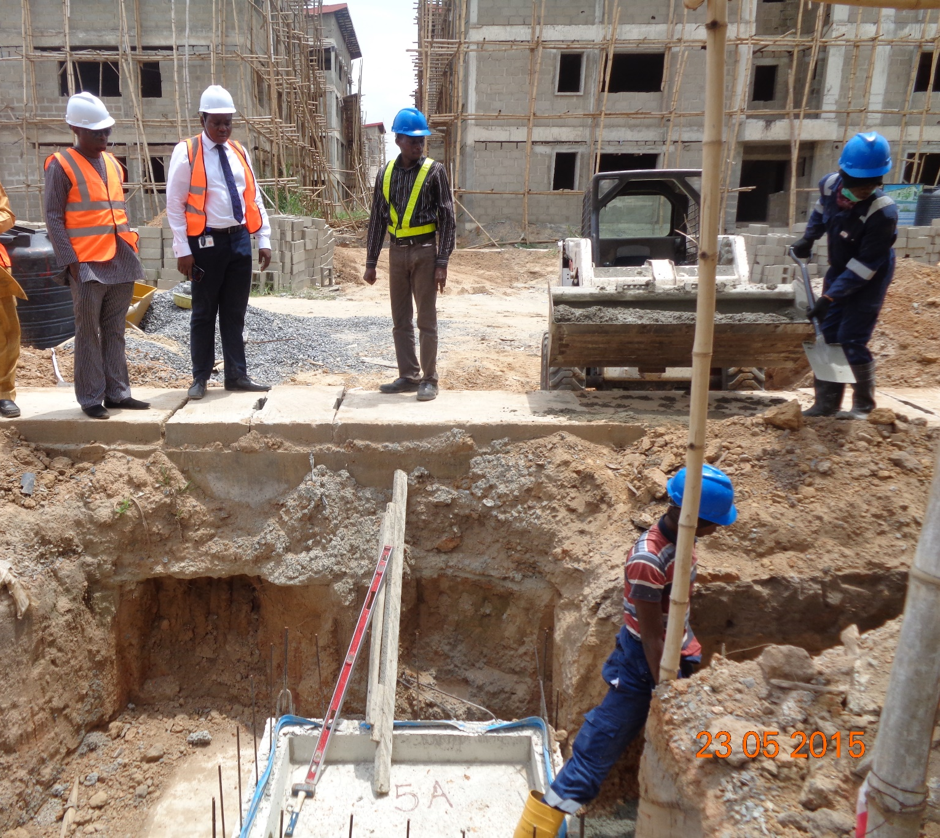
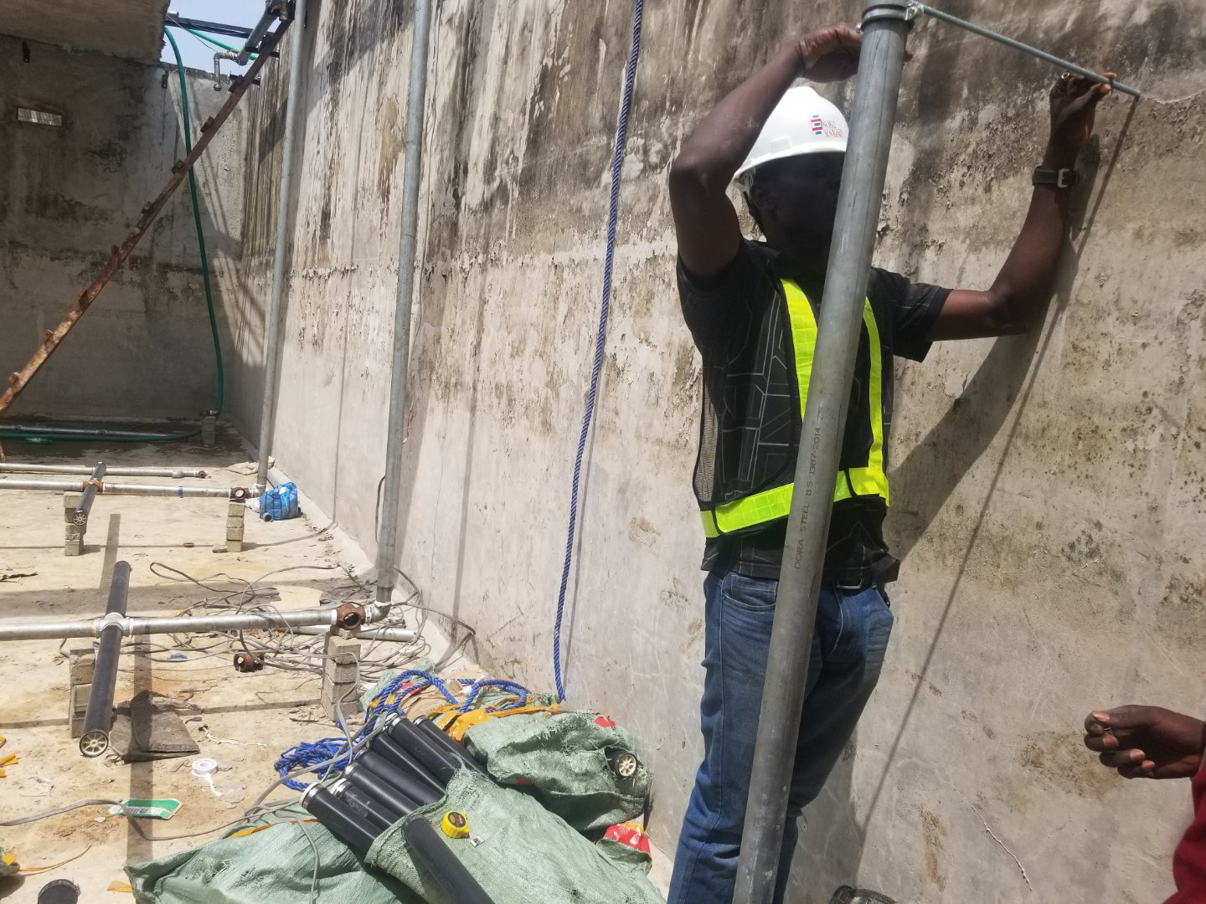
KEY STAFF

Slide 8
OUR PREFABRICATED WASTEWATER TREATMENT PLANTS (Noble Eco-Pro Packaged WWTP Plants)
Wastewater/ Sewage from small and medium large communities, shopping centres, commercial building facilities, office complexes, private lots, camping grounds, tourist villages not connected to the public sewer system require water purification treatment plants complete with biological total oxidation processes before such waters can be discharged into pubic drains. The Eco-Pro Series packaged wastewater treatment plants is very ideal for this. The Eco-pro WWTP comes in either surface type, sub surface type and partially buried type.
The Eco-pro is dimensioned as prescribed by projected wastewater flow from the supposed community or building facility. Through this process which is based on intense oxidation from special diffusers fed with compressed air, purification of the water is achieved along with the simultaneous stabilization of produced sludge.
Noble Sovrano execution program includes the following:
Off site Prefabrication of Monobloc Eco-Pro tank in multilayer treated and epoxy coated Steel with anodic protection from extreme conditions.
Onsite deployment of Eco-Pro tank and installation
Retrofitting of existing Septic tank into a Lift station or Construction of new Lift station.
Our Technology (MBBR)
The Eco-Pro is works with MBBR (Moving Bed Bioreactor) technology and has been specifically designed for effective and complete treatment of sewage. The treated wastewater meets the quality discharge standards as prescribed by government agencies, WHO and the Nigerian EPA and is fit for reuse for several purposes such as irrigation, Toilet flushing, Gardening and Landscaping etc.
The Noble Eco-Pro offers the following advantages:
Simple and cost effective installation
Easy operations and minimum maintenance
Reduced foot print or area for sewage treatment plant
Low operating cost
Eco-friendly with zero undesirable noise or odours.
Completely automated with no human interface
Optional Automated monitoring system\

Slide 9
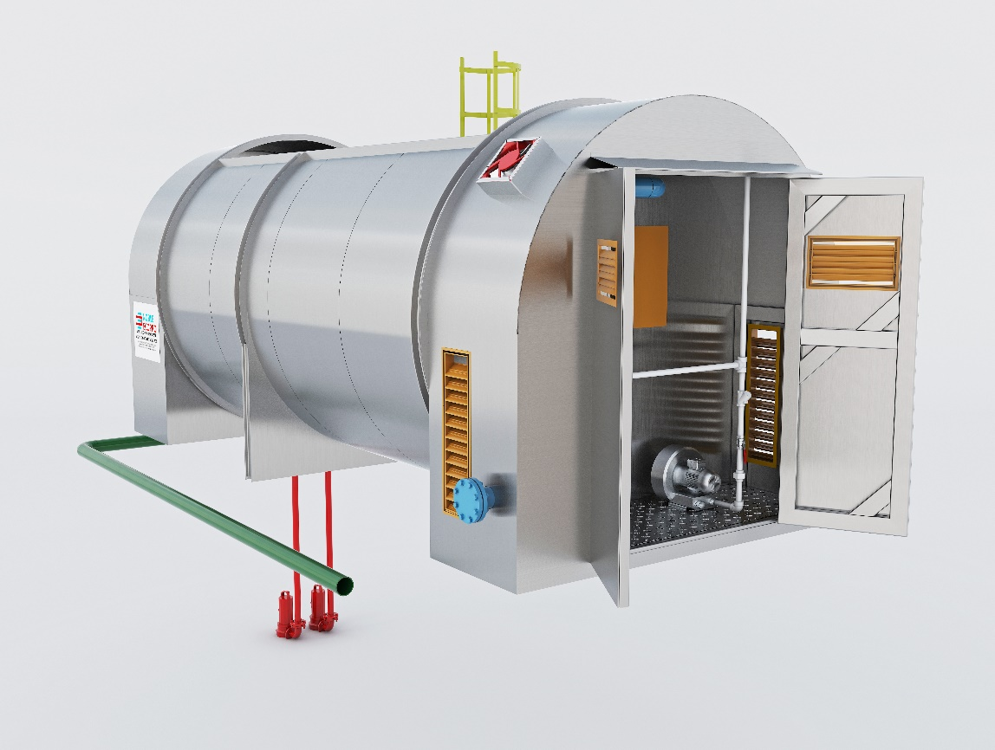
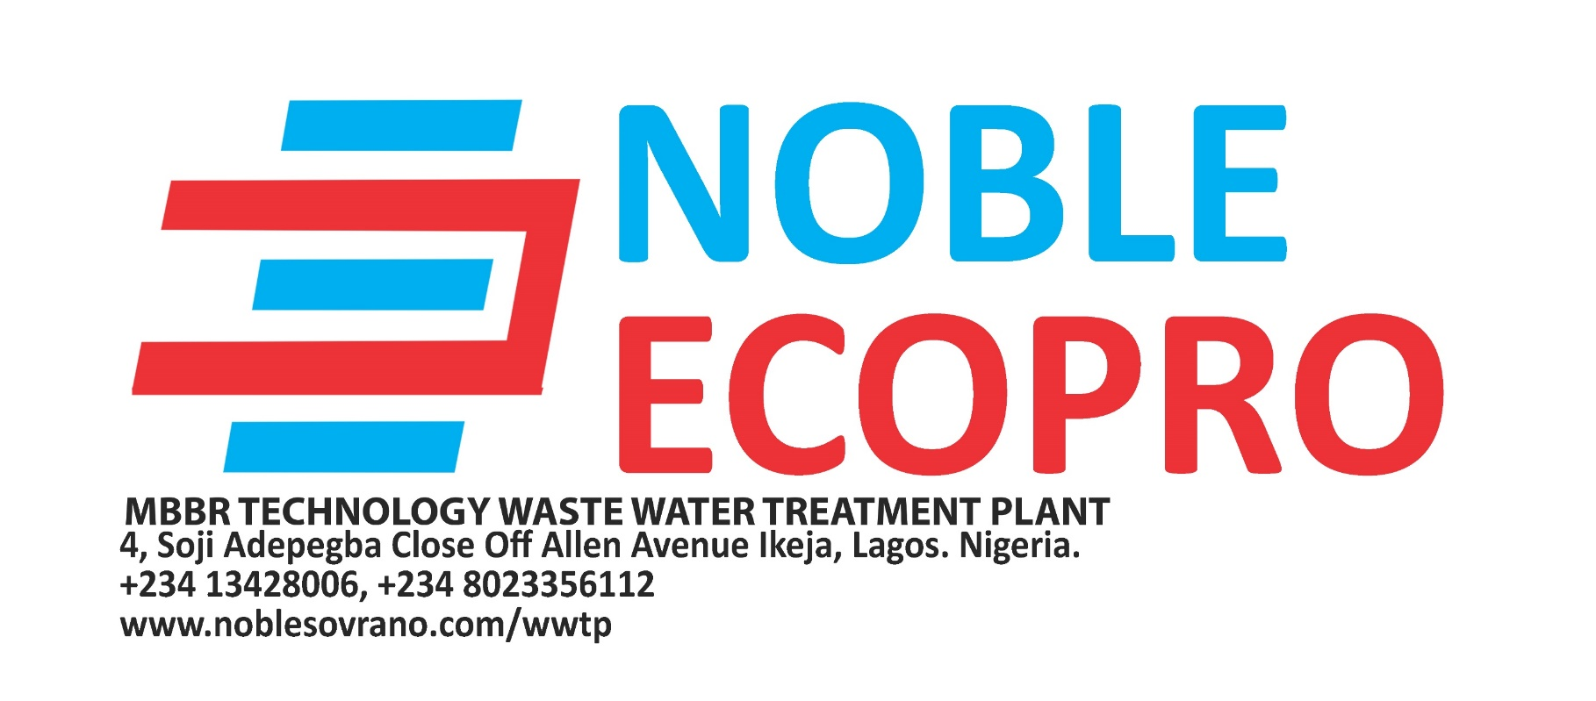
OUR PREFABRICATED WASTEWATER TREATMENT PLANTS (Noble Eco-Pro Packaged WWTP Plants)
Noble Eco-pro Surface model

Slide 10
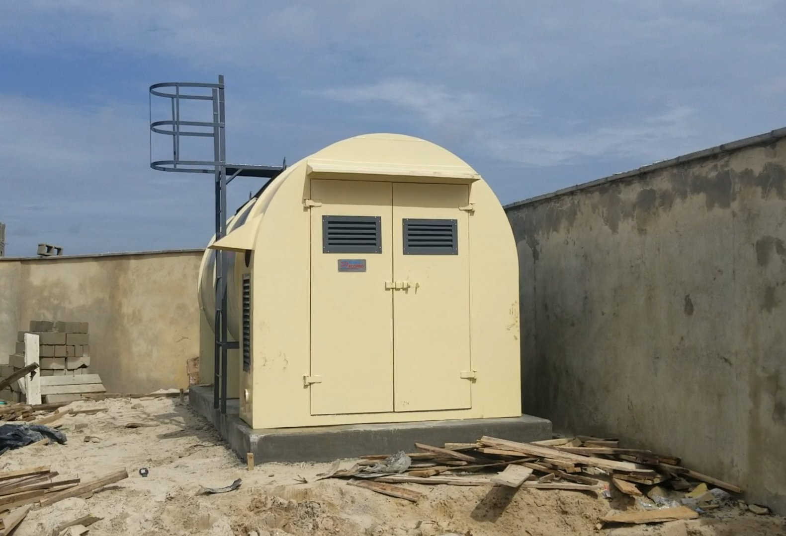
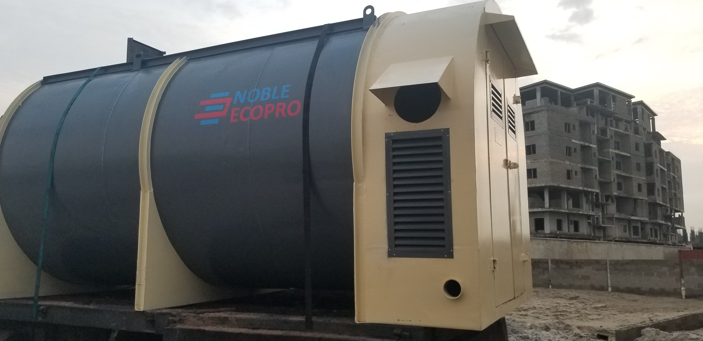
OUR PREFABRICATED WASTEWATER TREATMENT PLANTS (Noble Eco-Pro Packaged WWTP Plants)

Slide 11
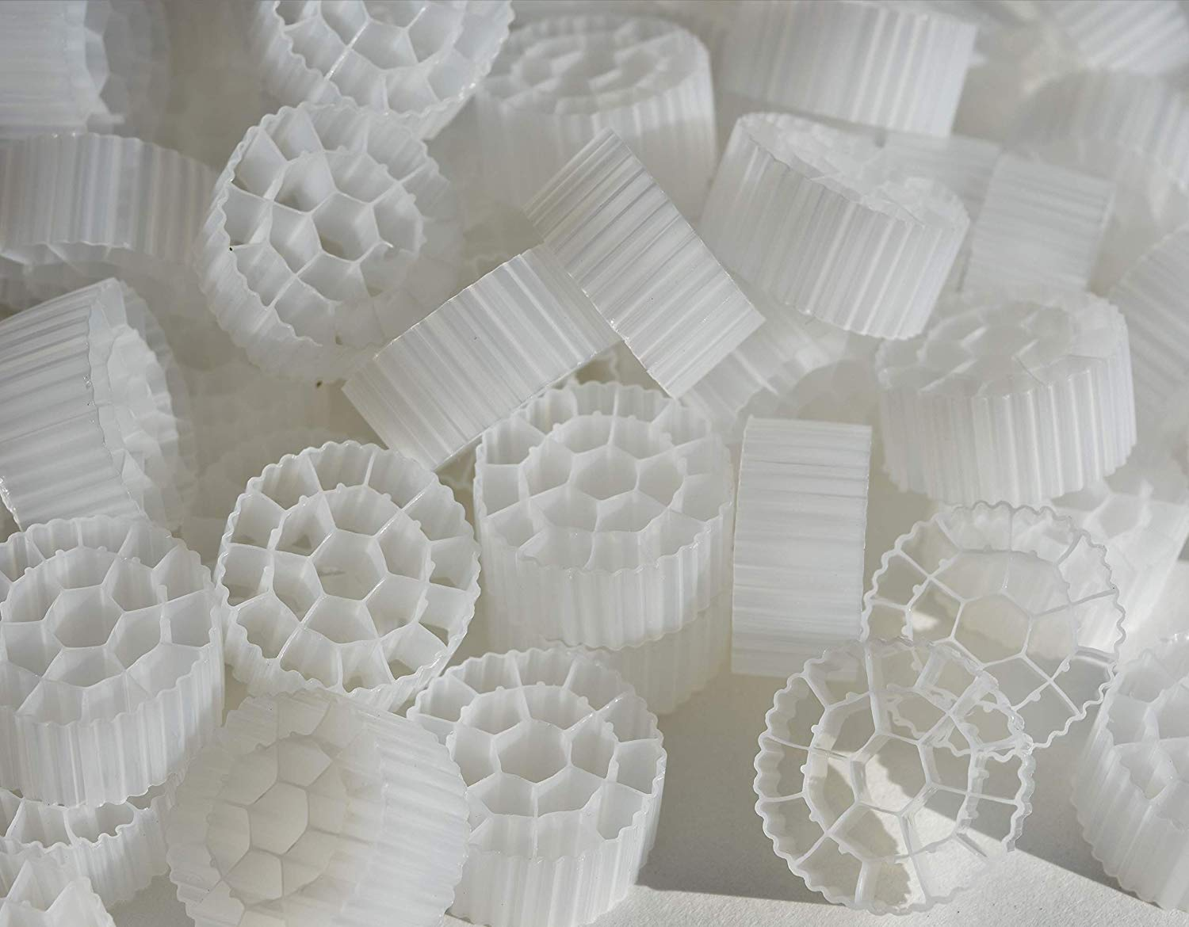
OUR PREFABRICATED WASTEWATER TREATMENT PLANTS (Noble Eco-Pro Packaged WWTP Plants)

Slide 12
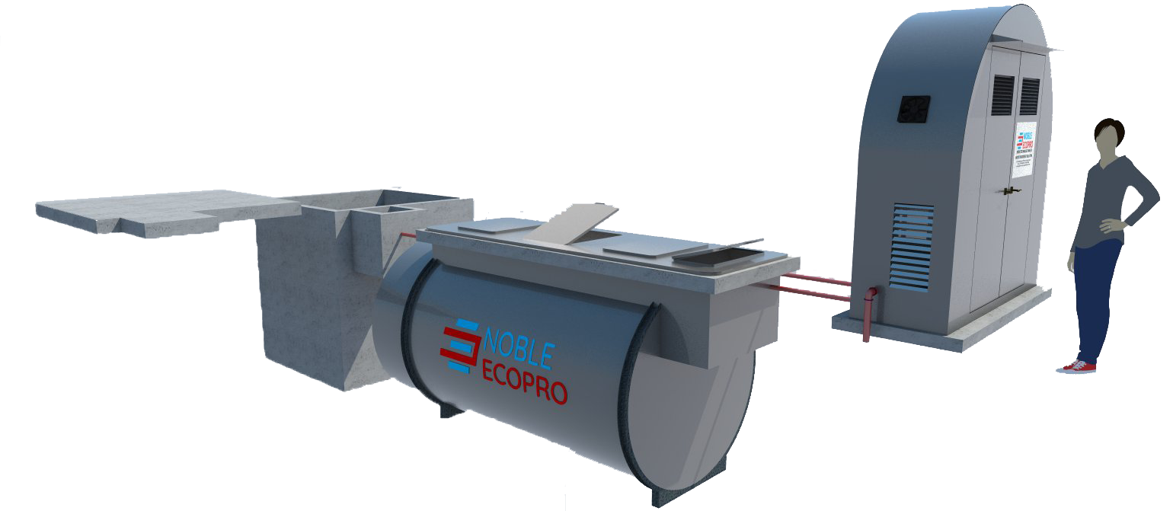
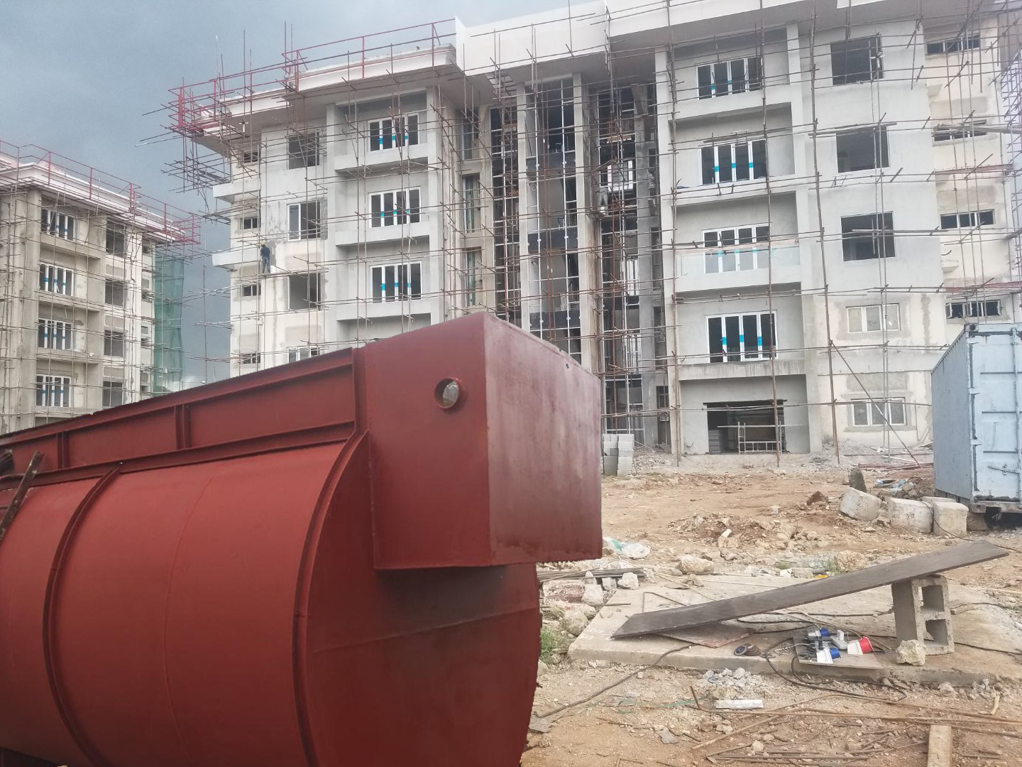
OUR PREFABRICATED WASTEWATER TREATMENT PLANTS (Noble Eco-Pro Packaged WWTP Plants)
Noble Eco-pro Underground model

Slide 13
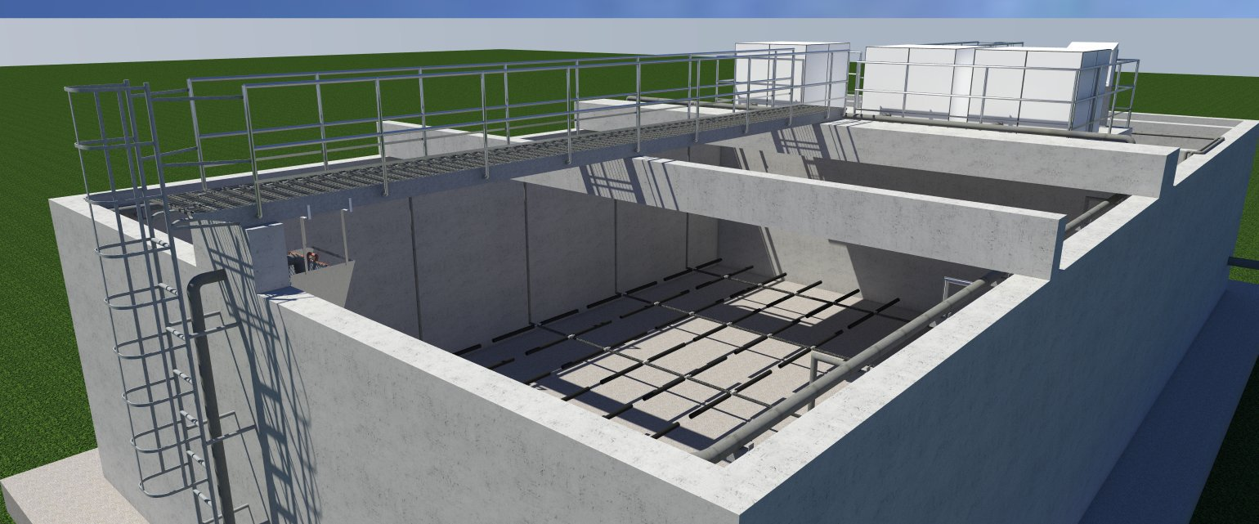
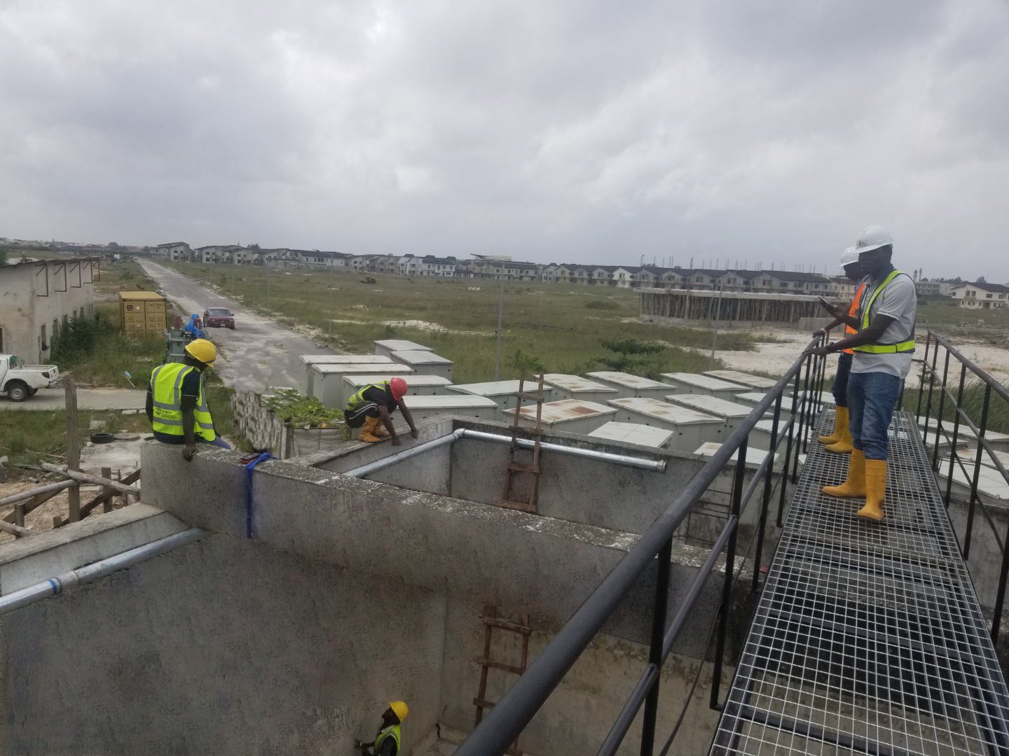
Large/Municipal wastewater /sewage treatment plants
We Design and construct municipal wastewater treatment plants of medium to large dimensions with innovative processes and technology developed according to environmental and normative standards. Activated sludge and fixed biomass process technologies with oxidization and Biomedia plants.

Slide 14
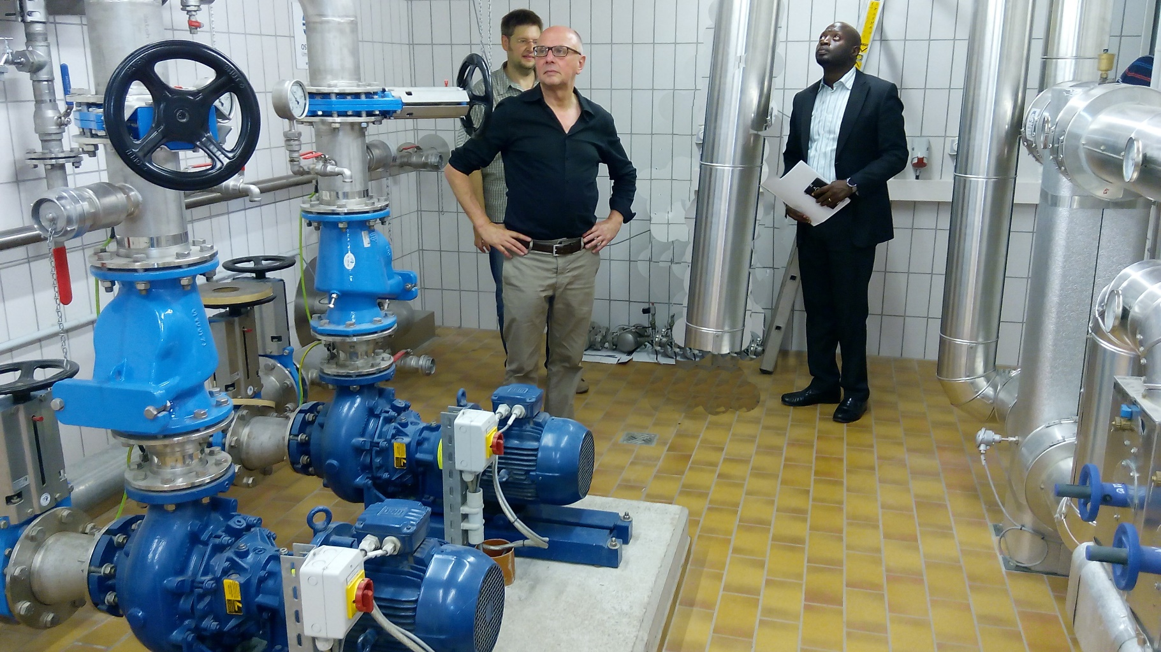
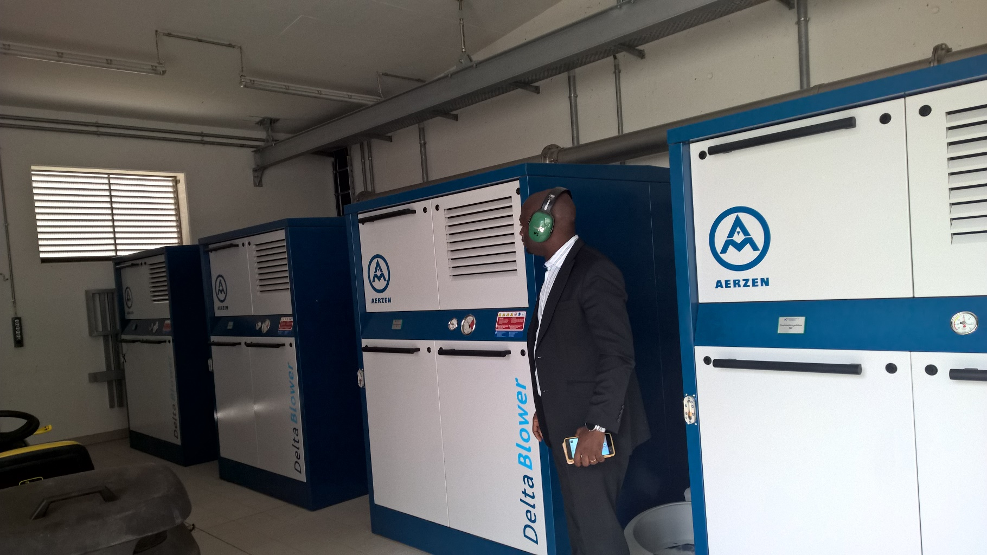
Large/Municipal wastewater /sewage treatment plants

Slide 15
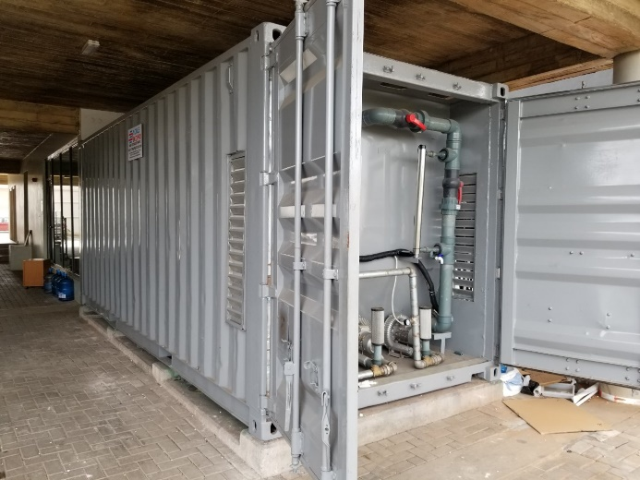
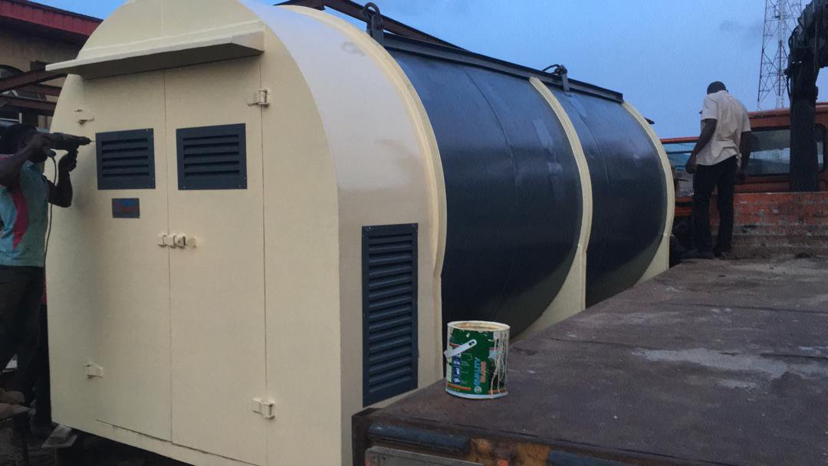
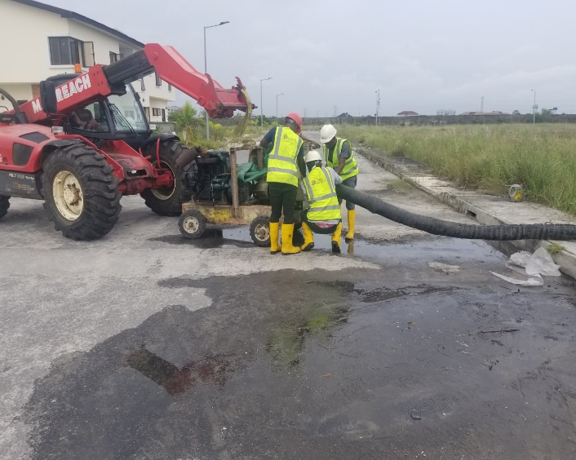

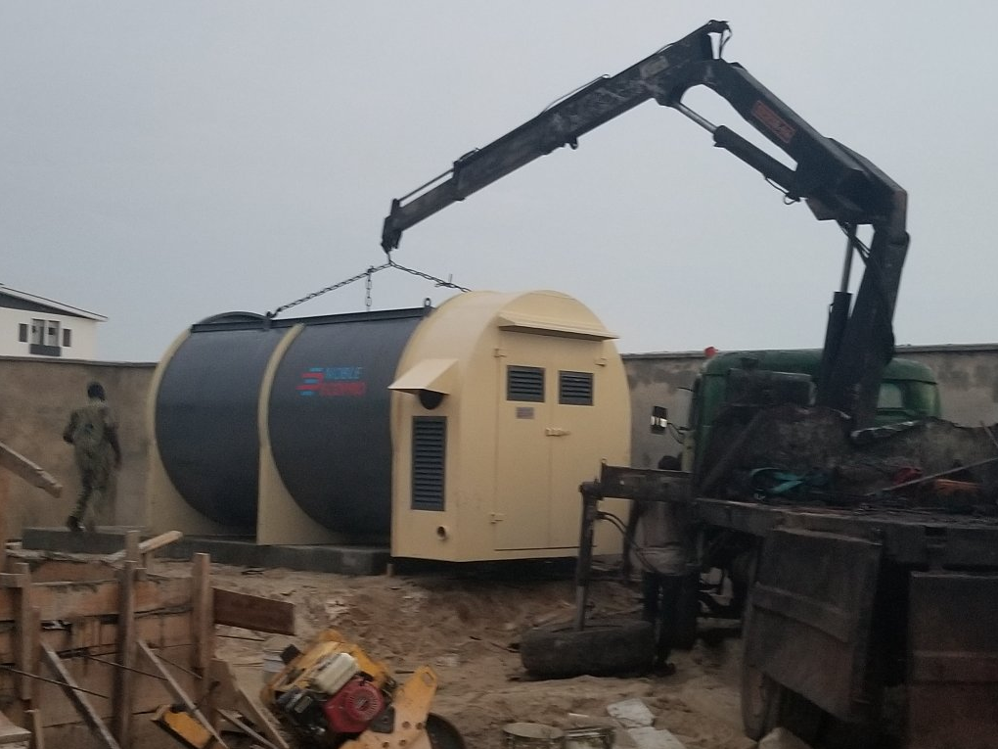

Project Executed
Eco-Box Packaged wastewater treatment plant FCMB Ikeja GRA Lagos.Client: Credit Direct Ltd, FCMB
Eco-Pro Packaged wastewater treatment plant Victoria crest estate bay2 Ajiran Lekki. Client: Nedcom oaks Ltd
Figure 1: Retrofitting 2km lift station sewer network for creek Haven VGC Lagos. Client: Delkot Ltd
Figure 1: Constructing municipal over 6000PE wwtp for creek Haven VGC Lagos. Client: Delkot Ltd
Eco-Pro Packaged wastewater treatment plant Victoria crest estate bay3 Ikate lekki. Client: Nedcom oaks Ltd
Eco-Box Packaged wastewater treatment plant Victoria crest estate VC4 lekki. Client: Nedcom oaks Ltd

Slide 16

Project Executed
Eco-Pro Packaged wastewater treatment plant Pro44 Flats GRA Ikeja Lagos. Client: Laguna Hunters Ltd

Slide 17
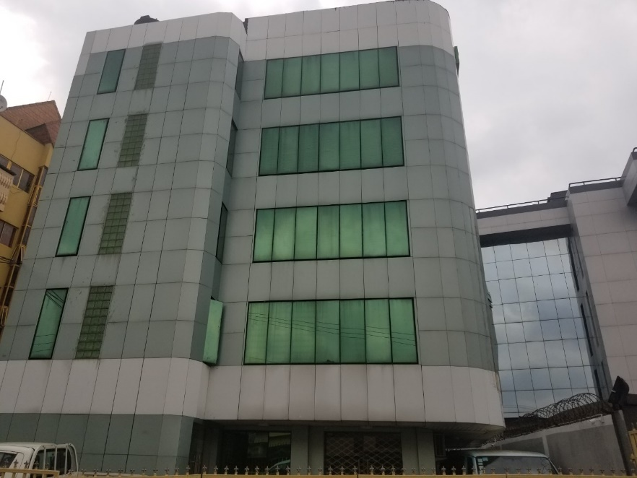



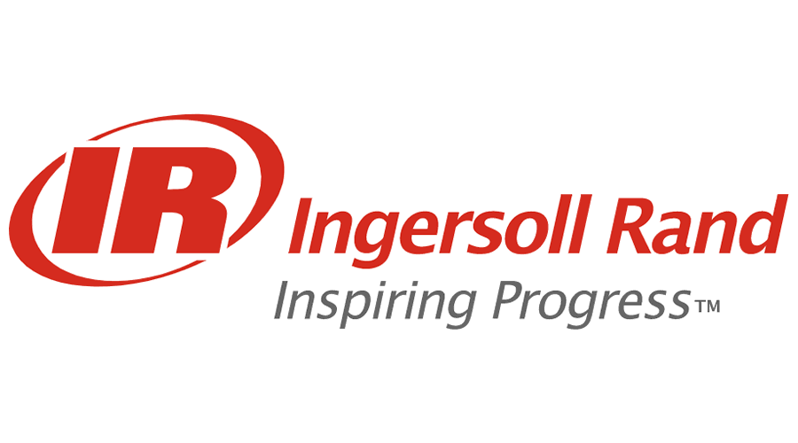


Office
Noble Sovrano Ltd
4, Soji Adepegba close off Allen Avenue Ikeja Lagos, Nigeria
Tel: +23413428006,
Mobile: +2348023356112
Mobile: +2347046332023
Info@noblesovrano.com
www.noblesovrano.com/wwtp
Partners

