Slide 1
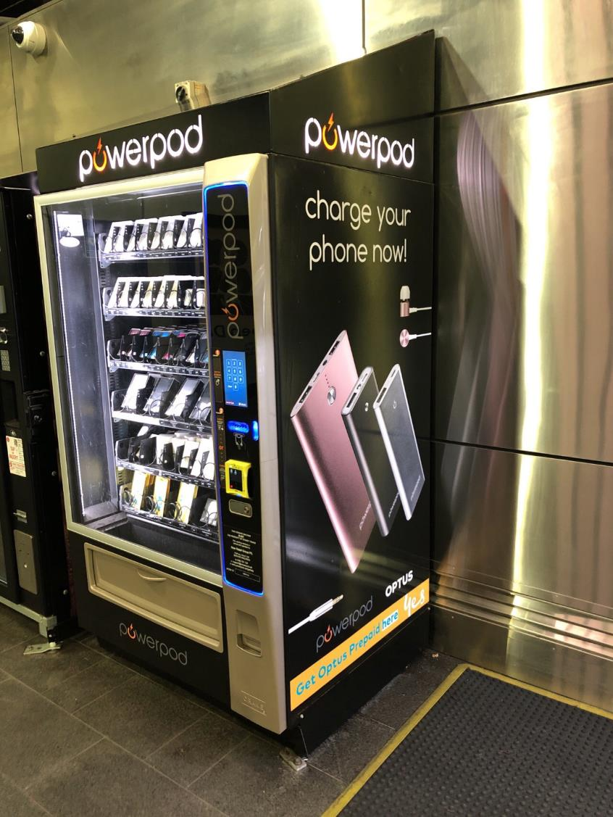
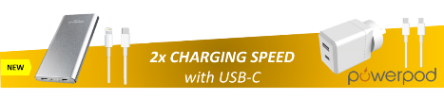


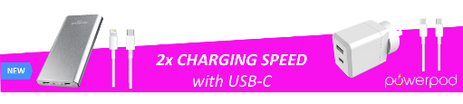
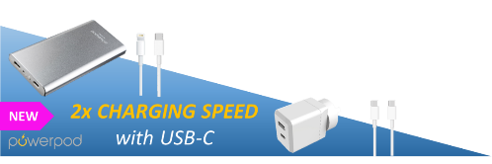


Mock-up
Use stickers below to see how they look on the glass of machines.
The area on the side panels between glass and shelves would be used to run a similar panel to tie in with sticker on glass front.
Complimentary design here (inside glass on cabinet side)

Slide 2


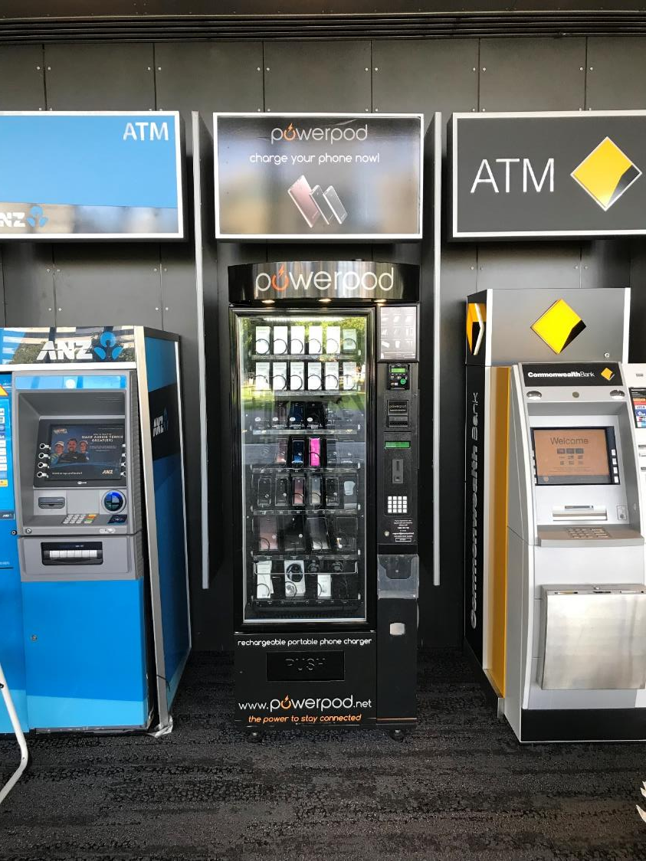
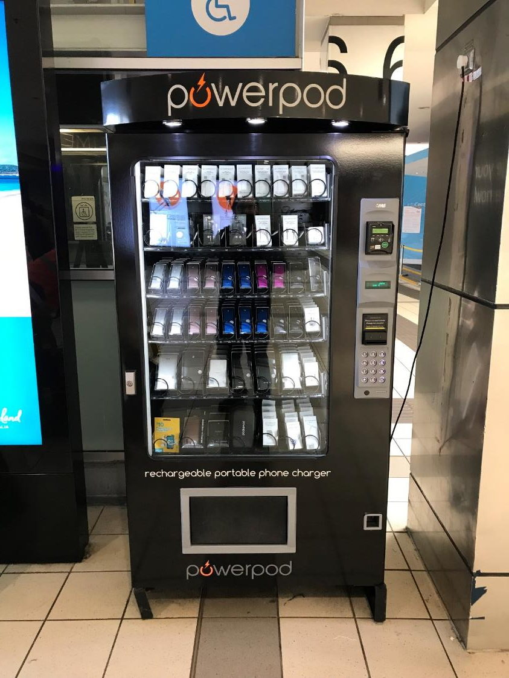




Slide 3
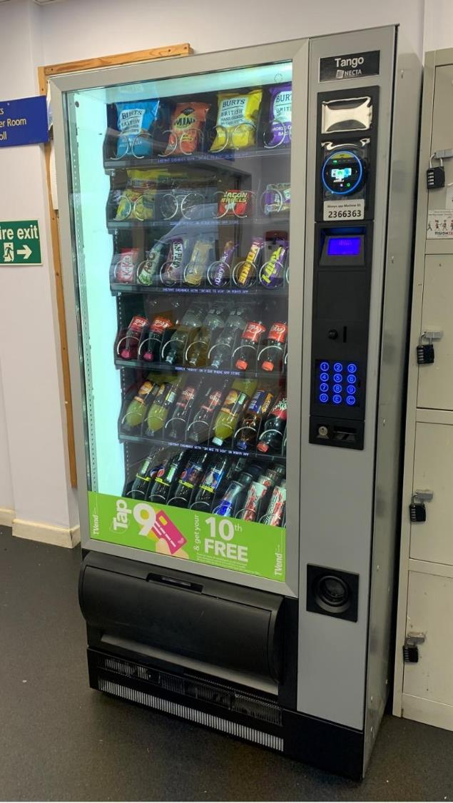
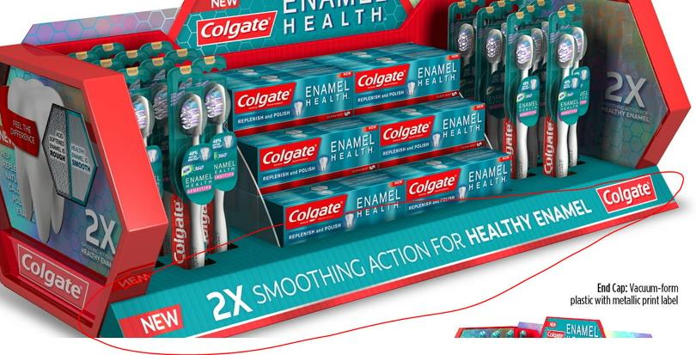
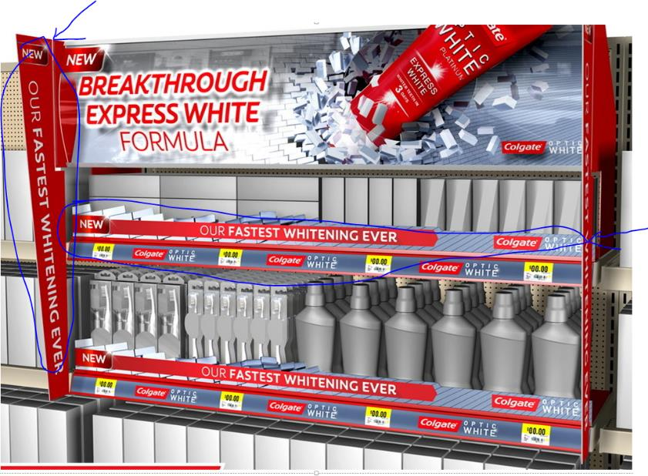
Inspirations

Slide 4
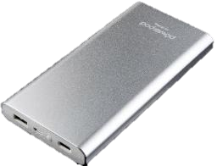
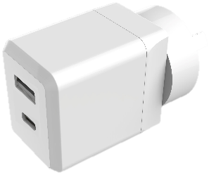




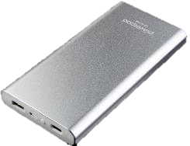








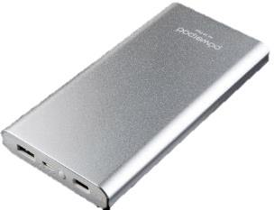


Source designs
2x CHARGING SPEED
with USB-C
NEW
2x CHARGING SPEED
with USB-C
NEW
NEW
2x CHARGING SPEED
with USB-C
2x CHARGING SPEED
with USB-C
NEW
2x CHARGING SPEED
with USB-C
2x CHARGING SPEED
with USB-C
NEW

