Slide 1

2020

Slide 2
Social Media (Facebook & Instagram)
We are looking for high energy social media assets to target Millennial age women
Making old new again – 1920’s nod
Style 1) Modern Art style incorporating water filter pitcher, women, shades of blues and yellows specifically (pantone 12-1064 and 19-4052) and incorporate a modern twist
Style 2) Hyper-symbolic still with the water filter as the focus of attention

Slide 3
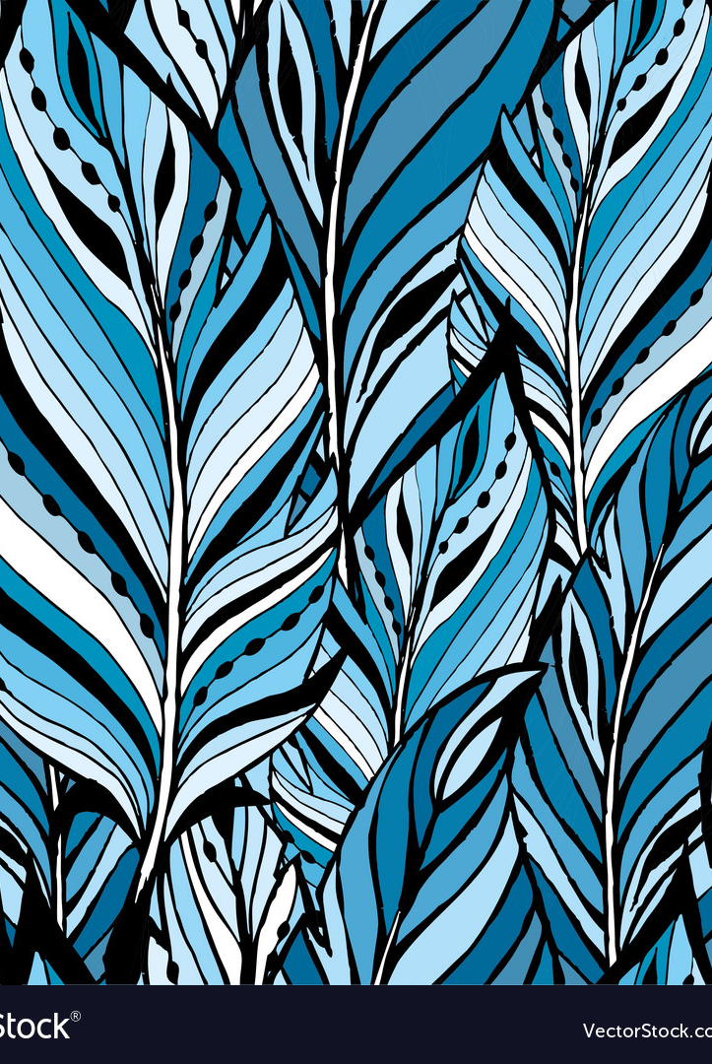
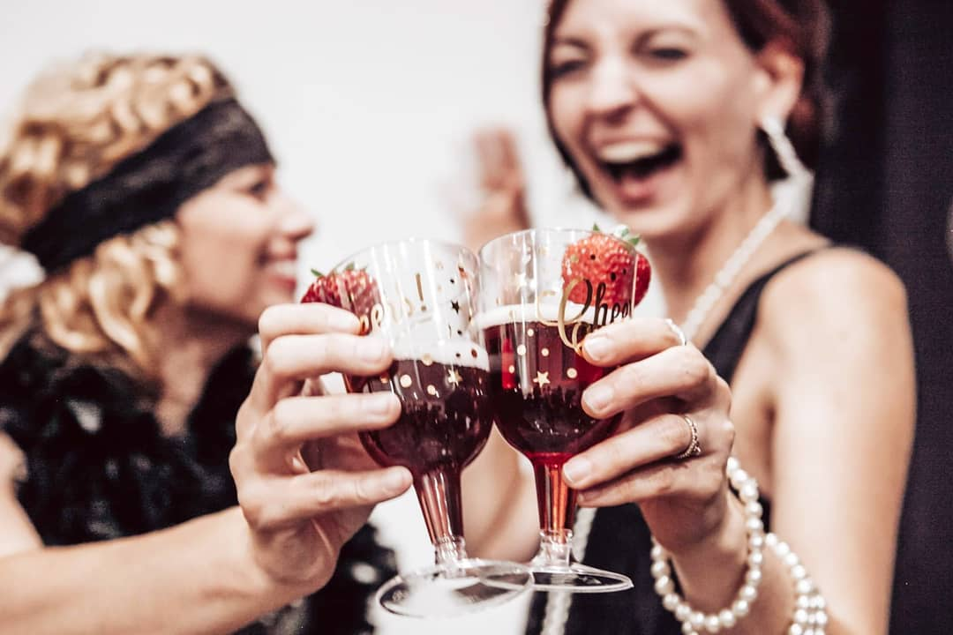
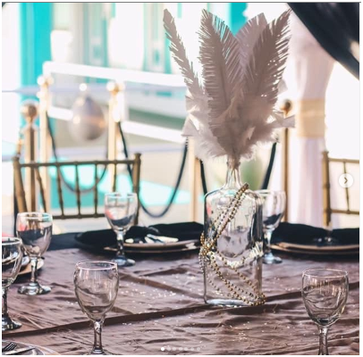
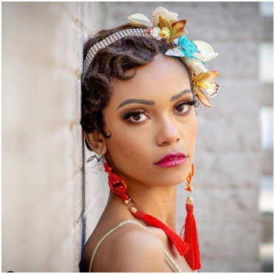
Modern Twist on Roaring 20’s high class art deco
Combine Modern technology with 1920’s style
High Energy (not gaudy)
https://vintagedancer.com/1920s/
Handbands/ Hats
Fringe
Sunglasses
Gloves
1920’s modern art twist

Slide 4
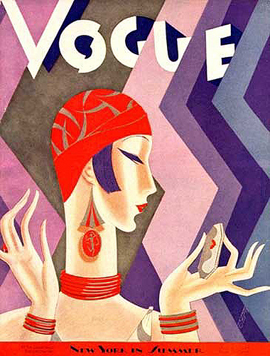
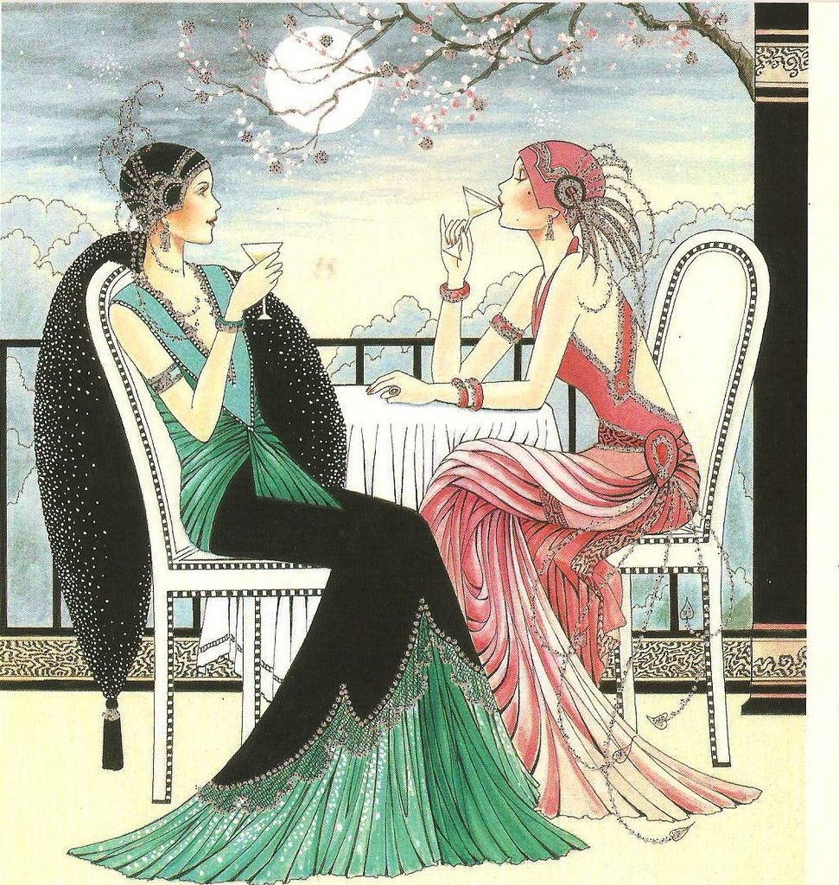
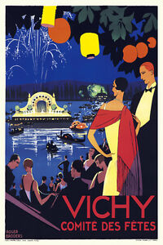
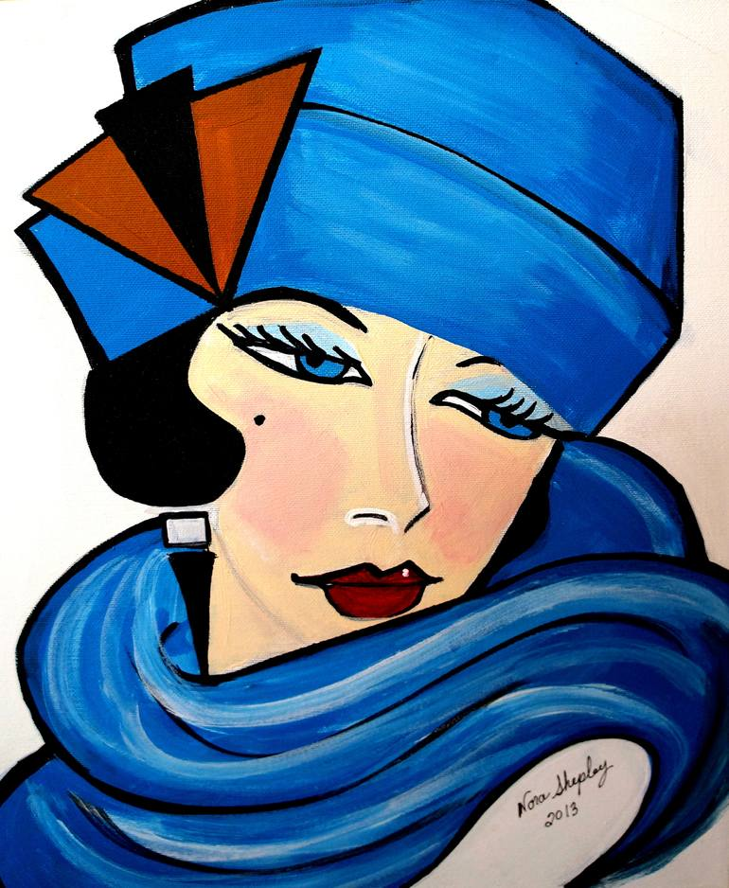
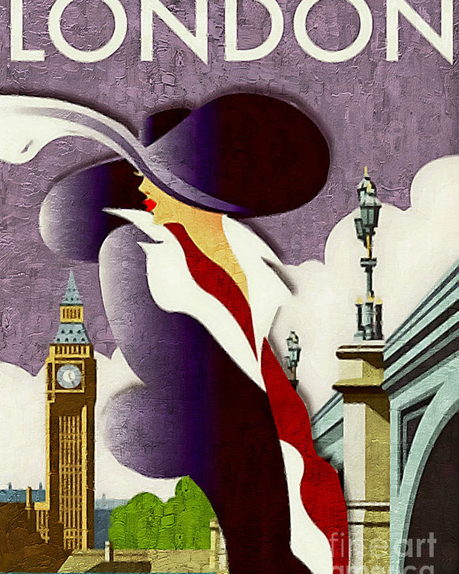

Slide 5
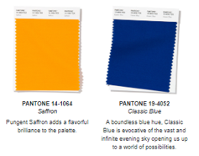
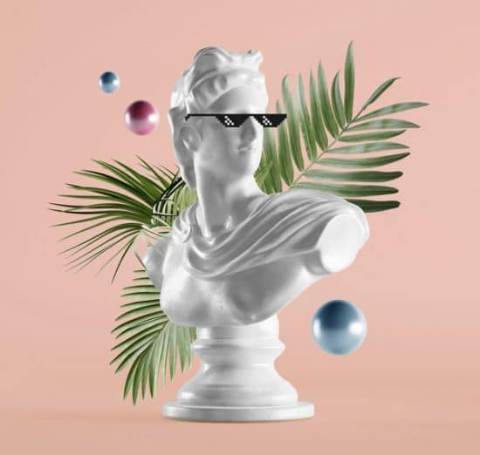

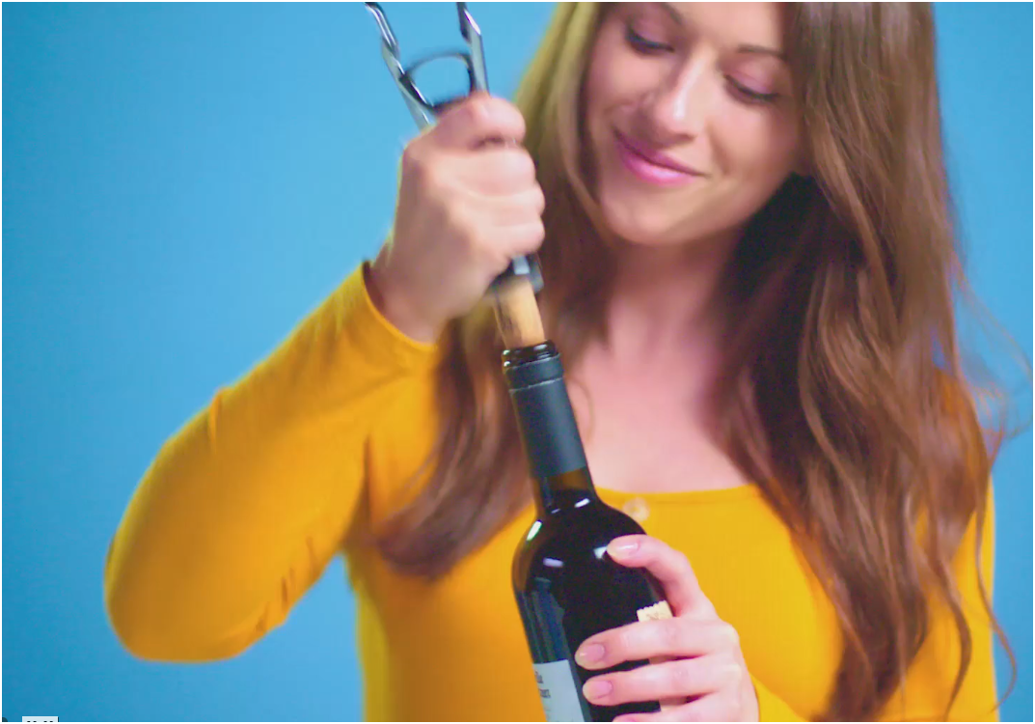
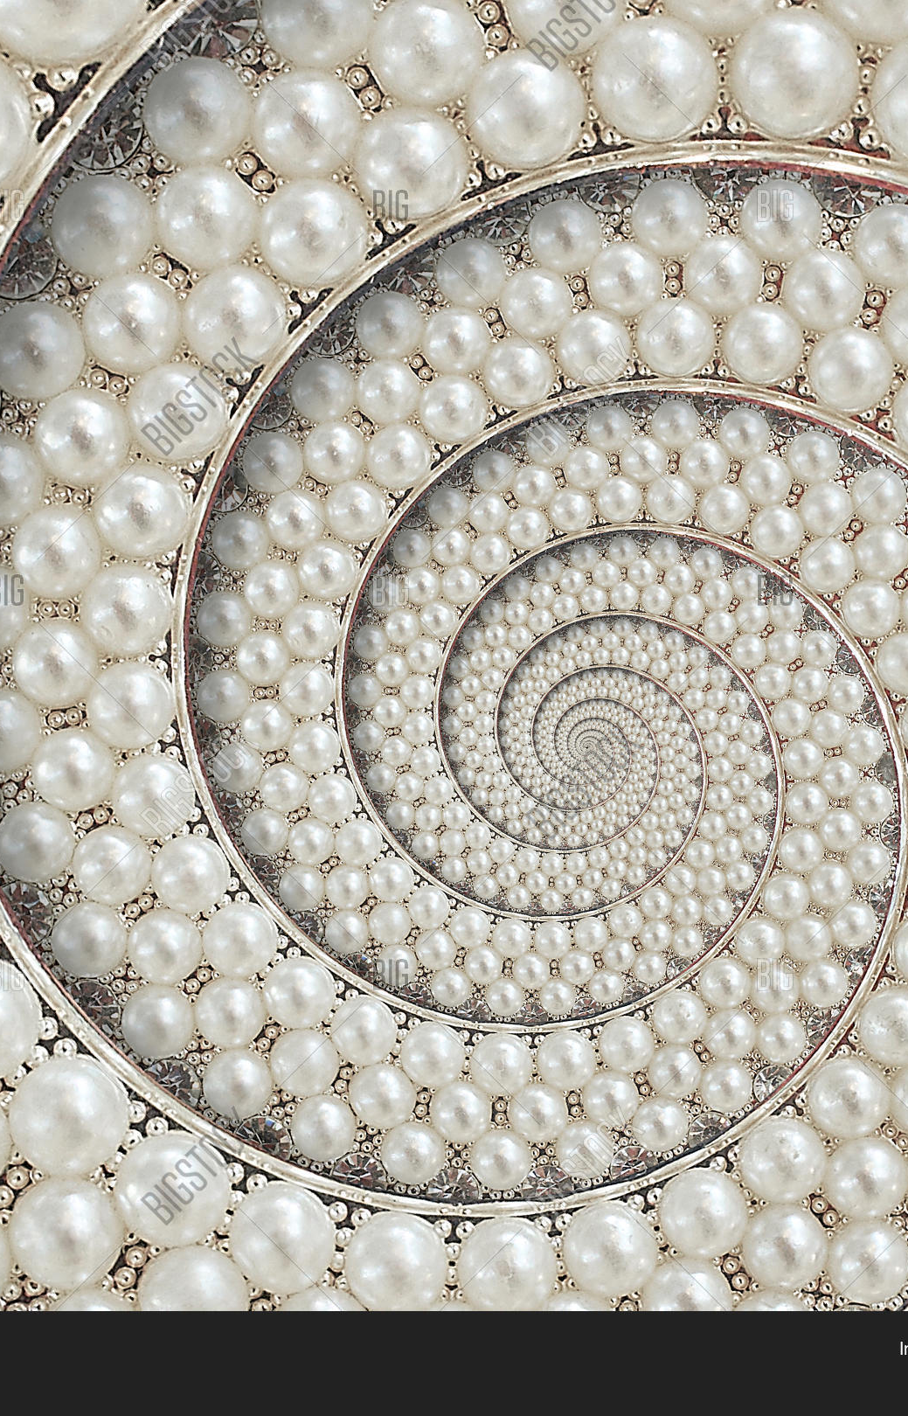
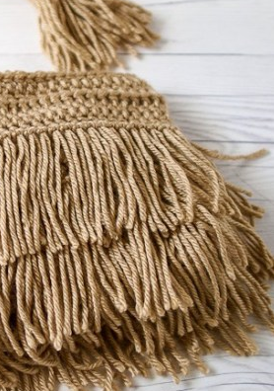
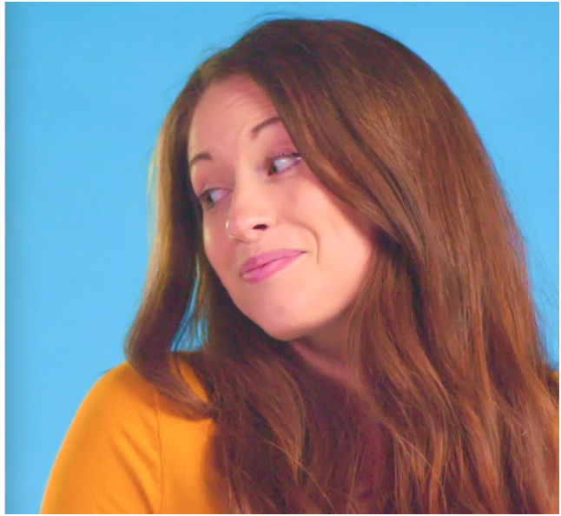
2020: Introduce visuals for Roaring 20’s theme
establish we’re not your mother’s…
colors
Products: Symbolic Hyper-Still
Artist to create “Modern Art” style featuring products
Trendy/ Upscale Images targeting millennials with a nod to the Gadsby Era
Fringe
Feathers
Pearls
Accessories Like headbands/ gloves
Support Visuals:
Wine Demo
Meter
stay within core colors with more gray/silver tones added
build on current illustration style but simplified & more fun
images that combine purity & motion
textures & shapes
voice
Not Your Mother’s Brand
New Issues. Performance Matters.
techie gradients and flow textures

Slide 6
