Slide 2


Comprehensive Coverage Of The Entire LNG & Export Infrastructure Spectrum
The Sector’s Best Coverage – Now On A Standalone Basis
LNG: Liquefaction Projects, LNG Carriers, Floating Regas & Power
Infrastructure: NGL Exports, Box Leasing, Containerships, Barges
Marine: Crude Tankers, Product Tankers, LPG
Industry-Leading Coverage of the entire Export Infrastructure universe – From the #1 I.I. Rated LNG & Marine Research team for the past 4-years
A Top Down, Thematic Focus – Constantly adapting to changing dynamics within Energy, Industrials, & Macro
LNG Deep Dives - Comprehensive global context, proprietary LNG Project Rankings, S/D demand models with +100 probability-weighted upstream & downstream (FSRU/Gas-to-Power) projects, multi-stage DCF-based LNG Carrier curves – striving to add real value for our clients
A Thoughtful Approach To The Entire Capital Structure - Leaning into special situations/cross-cap to add value & context
A Deep, Consultative Approach to Client Service - Including bespoke research projects
Differentiated Corporate Access Programs – Moving beyond cookie-cutter conferences, with on-location field trips, unique access to private and public decision makers, and specialized conference calls
Webber Research & Advisory: Export Infrastructure | LNG | Marine | ESG
1

Slide 3
Insight | Perspective | Context
Bespoke Data Points, Industry Sources, Consistent Sector Dialogue
Data Streams, Company Filings, Trade Press
Client Dialogue, Macro Narrative, Feedback Loop
Valuable Insights
Actionable Research
Critical Context & Perspective
Export Infrastructure
LNG Value Chain
  Upstream (Liquefaction)
  Midstream (Carriers)
  Downstream (FSRU/Gas-To-Power
NGL/LPG Exports
Equipment Leasing
Proprietary ESG Overlay

Slide 4
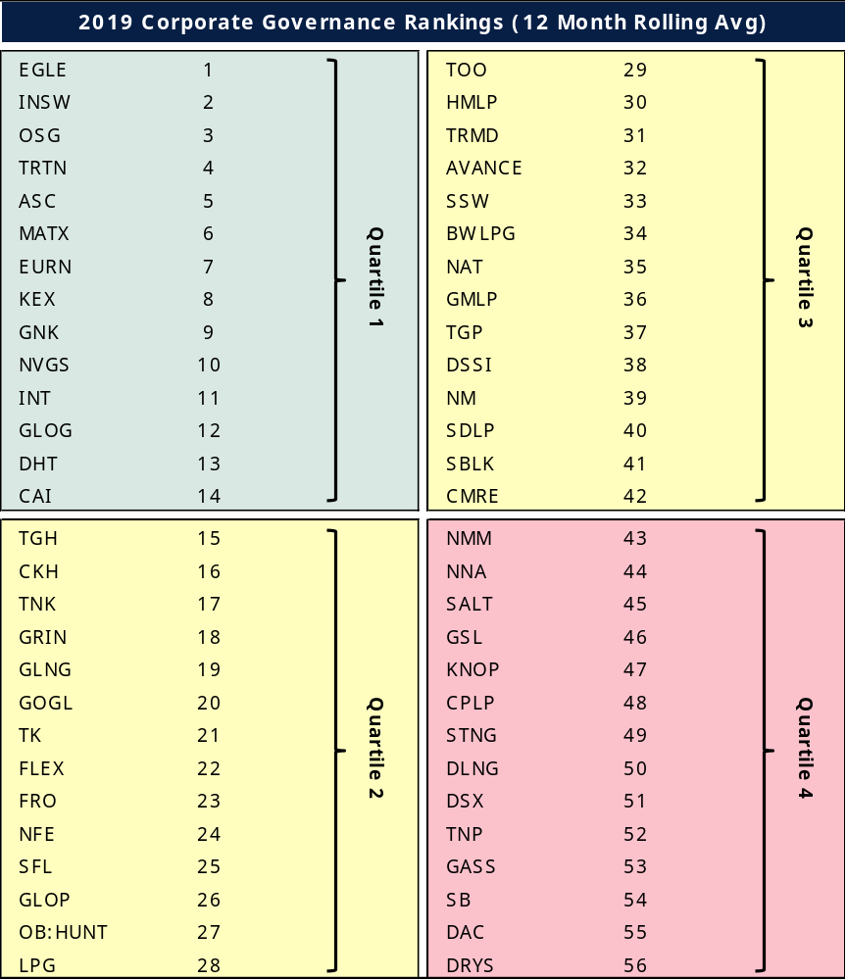
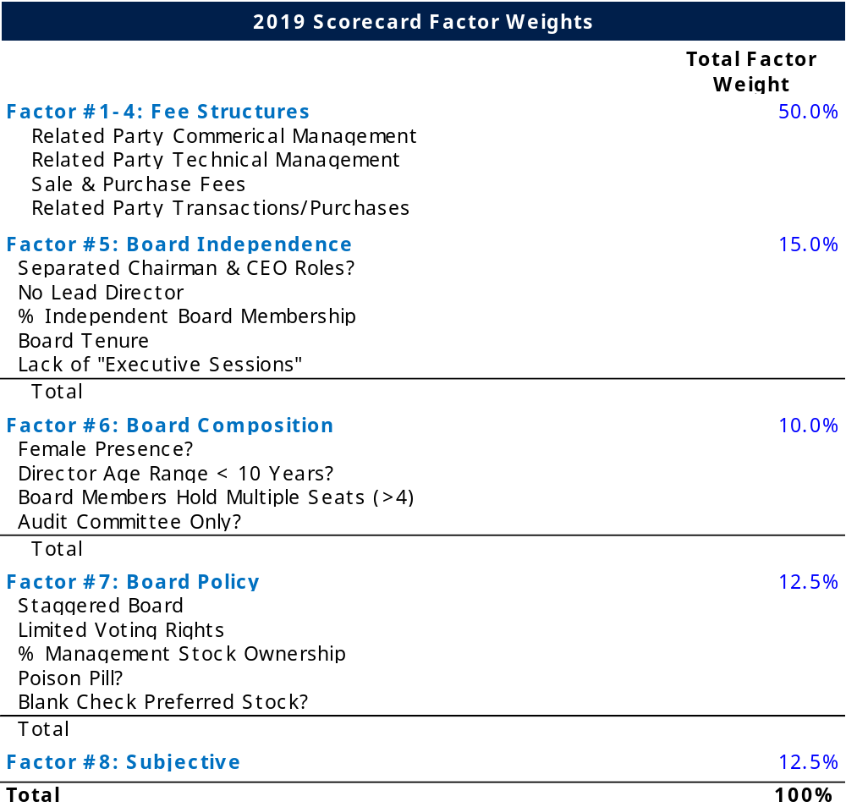
Pioneering ESG Focus With Our Proprietary Governance Model
Continued & Evolving Focus On Corporate Governance
  Our proprietary 18-Factor model compares & ranks ~60 stocks in our universe, with more to come
  Measuring carbon emissions disclosures

Slide 5
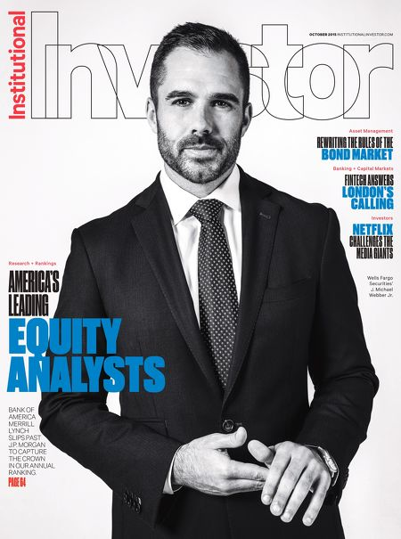
Michael Webber, CFA
12 Years Of Equity Research Experience (DB/Wells Fargo)
4x Institutional Investor (I.I.) First Team All-America Research - #1 I.I. in 2018, 2017, 2016, and 2015
#1 Stock Picker FT/Starmine in 2013, #2 in 2012, Top Earnings Estimator in 2014
Business Insiders: Rising Stars Of Equity Research Under 35
NAMEPA Award Winner for Protection Of The Marine Environment – Corporate Governance
University Of Virginia Graduate, CFA Charterholder

Slide 6
Our Bottoms Up LNG Coverage
Global Context Matters
Coverage of the entire LNG supply chain, with a unique emphasis on project-level economics & detail
A dynamic, proprietary S/D model fed by 140 probability-weighted gas-to-power projects
DCF-Based LNG Carrier curves
Downstream
Regas/Gas-To-Power
Golar, Hoegh, Excelerate, Exmar, BWLNG, New Fortress
Midstream
LNG Carriers
GasLog, Golar, Teekay, Dynagas, Flex, Capital, Cardiff, Nakilat
Upstream
Liquefaction
Cheniere, Tellurian, NextDecade, LNG Limited, Golar, Venture Global, Sempra, Freeport, IOCs, NOCs

Slide 7
LNG Perspectives: Expert Call Series
Salient Data, Read-Throughs
JKM vs Brent Arbitrage
Proprietary
LNG Buyer Book
Existing Supply Agreements
Buyer Profiles
US Export Destinations & Economics
LNG Carrier Rates & Implied Forward Curves
Emerging Chinese Buyers
LNG Buyer Database, Detail
Global Shipping Weekly
Salient Data, Read-Throughs
Global Natural Gas Prices
Crude/Product Tanker Rates & Asset Values
Containerized Trade Metrics
US Oil Movements
LPG Rates & Asset Values
IMO 2020 Progress
Oct: Gary Smith, Former Golar CEO, Poten LNG Head
Nov: Alan Tonsend, Gas-To-Power Specialist, World Bank/IFC
Dec: TI Tanker Pool, IMO 2020 Read-Through
Unique Events
Gastech (9/16-9/19)
8th Annual London LNG & Shipping Energy Client Field Trip (10/7-10/9)
Vancouver/Whistler Canadian LNG Tour
Proprietary Bottoms Up LNG
Detailed Thesis On Upstream, Midstream, and Downstream
Supply/Demand Dynamics & Model
Global LNG Project Rankings
US Pipeline Access
FSRU Coverage
LNG Weekly
Differentiated Research & Access

Slide 8
Potential Coverage
  Asset Level Granularity
  Dominant Coverage of Traditional and Non-Traditional Verticals
  Global Themes: Staying Ahead of the Curve On IMO 2020
Crude Tankers
EURN
Product Tankers
LPG
NVGS
Box Lessors
DHT
FRO
ASC
STNG
LPG
TRTN
CAI
TGH
Containers
SSW
CMRE
US Marine/Barge
KEX
MATX
INSW
NAT
BWLPG
AVANCE
MAERSK
OSG
TNK
Marine MLP/GP
TK
TOO
CPLP
DAC
GSL
CKH
KNOP
NM
TRMD
TNP
SFL
GASS
LNG Upstream
LNG Midstream
LNG Downstream
LNG
CQP
TELL
NEXT
LNGLY
GLOG
GLOP
TGP
DLNG
FLEX
GLNG
GMLP
Hoegh
NFE
DSSI
VG

Slide 9
Compliance & Pricing
Commitment to compliance with custom framework and compliance oversight services provided by Tim Biggins, Nephron Research LLC’s Chief Compliance Officer.
Robust policies and procedures which address, among other things, restrictions on the use and receipt of material non-public information (“MNPI”), investment contacts, government officials.
Adoption of our own Code of Ethics and Compliance Manual to further illuminate our standards of business conduct and integrity.
We are happy to provide our Firm Policies and Code of Ethics upon request.
Please contact us for pricing & access details at info@webberresearch.com

Slide 10

Michael Webber, CFA
Managing Partner – Export Infrastructure
michael.webber@webberresearch.com
W: (646) 993-0693 M: 434-409-8909
Greg Wasikowski, CFA
Associate Partner – Export Infrastructure
greg.wasikowski@webberresearch.com
W: (646) 993-0694 M: 717-919-3367
info@webberresearch.com
Tim Biggins
Nephron Research CCO, Director of Research
tim@nephronresearch.com
O: (646) 876-0109 І M: (917) 502-1714

