Slide 1
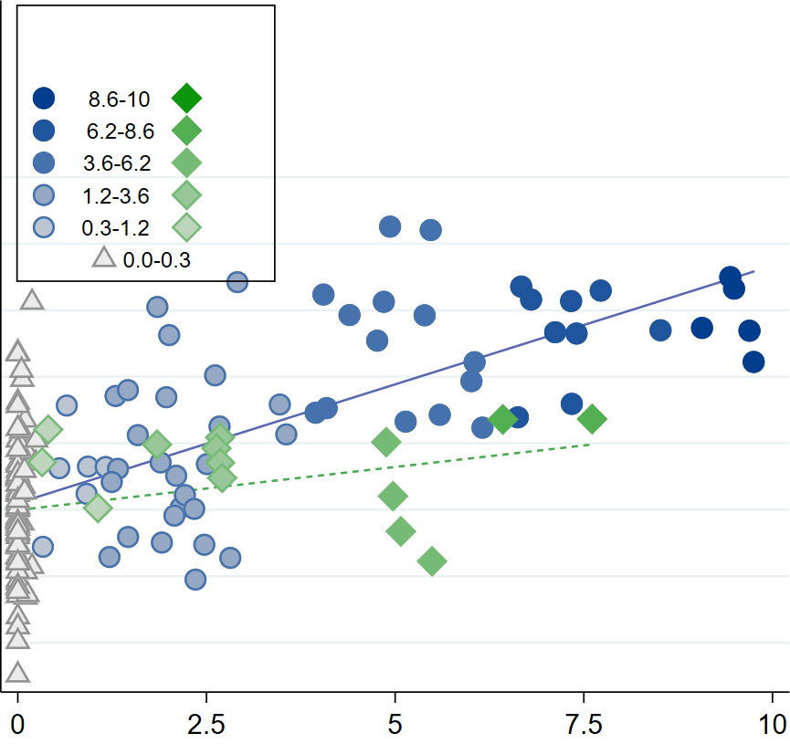
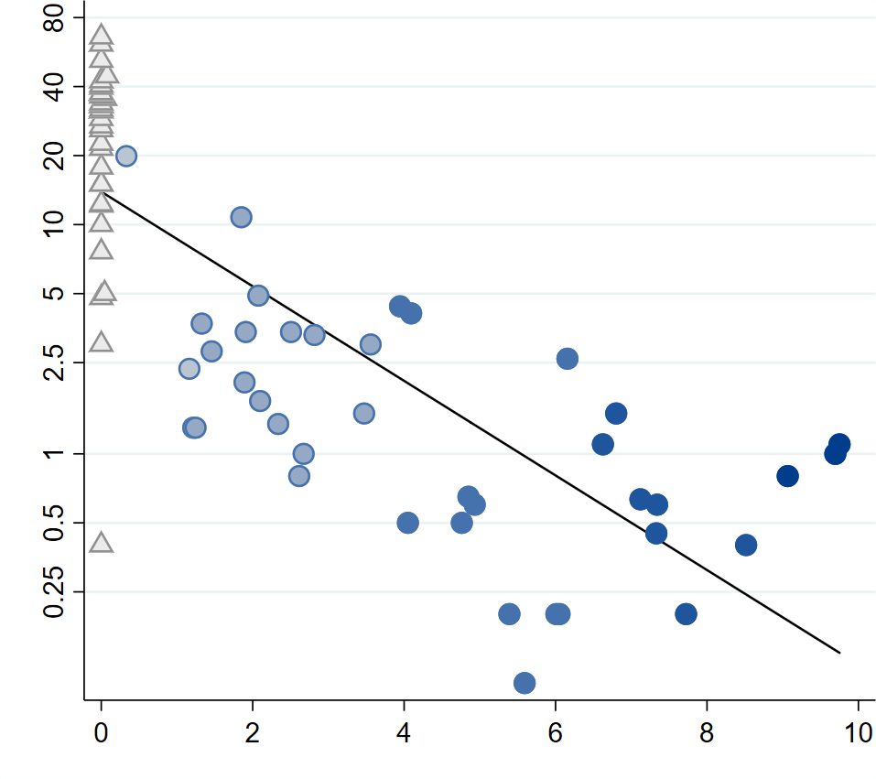
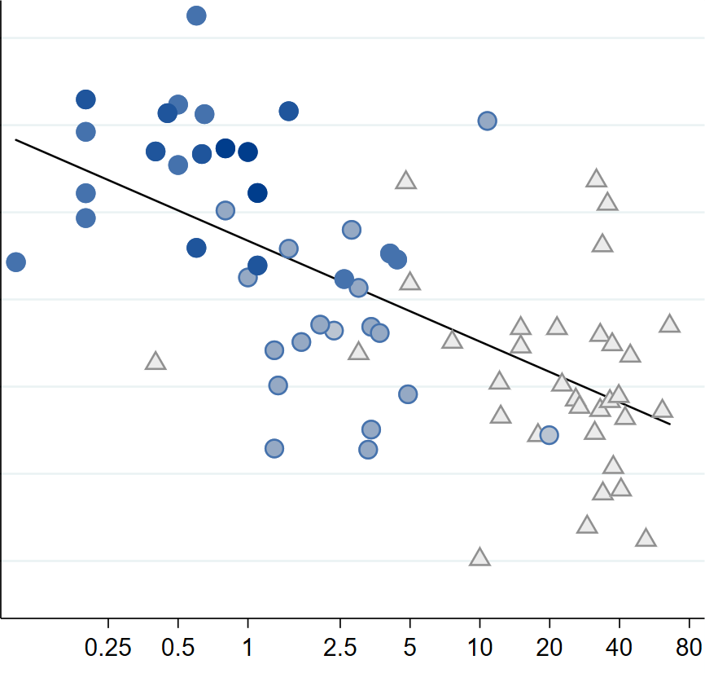
Church exposure
West East
Individualistic-Impersonal psychology
The Catholic Church Family Policies
(e.g., bans on cousin marriage
polygamy)
ρ = 0.63, P < 0.001
Psychological Change
More individualism
Less conformity
Greater fairness with strangers
ρ = 0.31, P = 0.004
Cousin Marriage Rate (%, log scale)
Centuries under the Medieval Church
Individualistic-Impersonal psychology
ρ = -0.82, P < 0.001
Kinship intensity plummets
with transformation to monogamous nuclear families
ρ = -0.63, P < 0.001
Centuries under the Medieval Church
Cousin Marriage Rate (%, log scale)

