Slide 1


TM
Overview
Updated September, 2019

Slide 2








Problem Definition
“It’s cheaper to keep a client then acquire a new one!” Many B2B companies have worked to automate sales and marketing, but there remains a void in the market to automate retention. Companies spend 5-10X on marketing and sales as compared to retention, when a mere 3-5% increase in retention can generate an incremental 25-75% in net income.
Marketing Automation
Sales
Automation
Retention Automation
A newer generation of companies that automate the outbound email campaigns and workflows, enabling companies to nurture leads
Companies that continue to pursue CRM and sales force automation, driven by the success of Salesforce
The first and industry leading platform dedicated to automating the retention process

Slide 3
Setting The Context
Stonegate provides data solutions, licensed software products, and market intelligence to help our clients better acquire and retain their customers, fueling top line growth.
The Market Need
Less than 5% of companies systematically check the pulse of their customers.
When it comes to retention, companies usually spend the most time on their largest customers or the ones that make the most noise, ignoring the rest. Most are leaky buckets trying to acquire new clients to outpace the loss of current ones.
Even if Customer Relationship Management (CRM) software (e.g. Salesforce, Microsoft Dynamics, etc.) is used, feedback entered in to these systems is self-reported by sales and account managers – often resulting in biased and inconsistently entered data.
While market research surveys can be used, they are often not consistently deployed, only provide results at the summary level (not client by client), and can be time consuming and expensive.

Slide 4
Our Solution – STAMP™
STAMP – A Retention Automation SaaS platform that assesses B2B customer sentiment, significantly improves clients’ ability to retain accounts, increases recurring revenue, and maximizes customer lifetime value.
Helps You Systematically….
Determine what is most important to customers and channel partners;
Measure performance against importance / expectation;
Provide real time alerts on under performance against client expectations;
Identify key playbook actions to improve customer sentiment and retain accounts;
Track trends over time with benchmarking against peers and competitors;
Integrate additional corporate data, fueling predictive analytics and continuous learning; and
Synchronize with selected Sales/Marketing Automation Platforms.

Slide 5






The STAMP Engine
STAMP combines existing customer data with objective customer feedback to create actionable insights.
STAMP ENGINE
Assessment
engine captures
customer feedback
CUSTOMER DATA
Customer information
Account metrics (e.g., annual revenue)
Transactional data from CRM or other systems
INSIGHTS
Profile dashboard for each participant
Aggregated reporting (e.g., all responses or by segment)
INPUTS
OUTPUTS
Analytic engine identifies opportunities
Visualization engine creates dynamic dashboards
CRM integration enables simplified work flows
Notes:
Customer Data:
Customer information: Whatever you typically segment on employers on: Small group vs. large group, fully-insured vs. self-insured, ppo vs. hmo, white collar vs. blue collar, industry type, etc.
Account information like annual revenue or other measures of account profitability
Insights:
There are a variety of reports that come out of the system…
A “Participant profile” is created for each participant. It’s a simple report that shows how he participant responded to each question. You’ll receive the profile for each of our accounts.
Aggregated reporting is a traditional market research report and will help highlight key findings– e.g., How satisfied are customers overall – and how does satisfaction vary by segment (large vs. small group)? What capabilities does Geisinger need to develop to improve satisfaction over time?

Slide 6
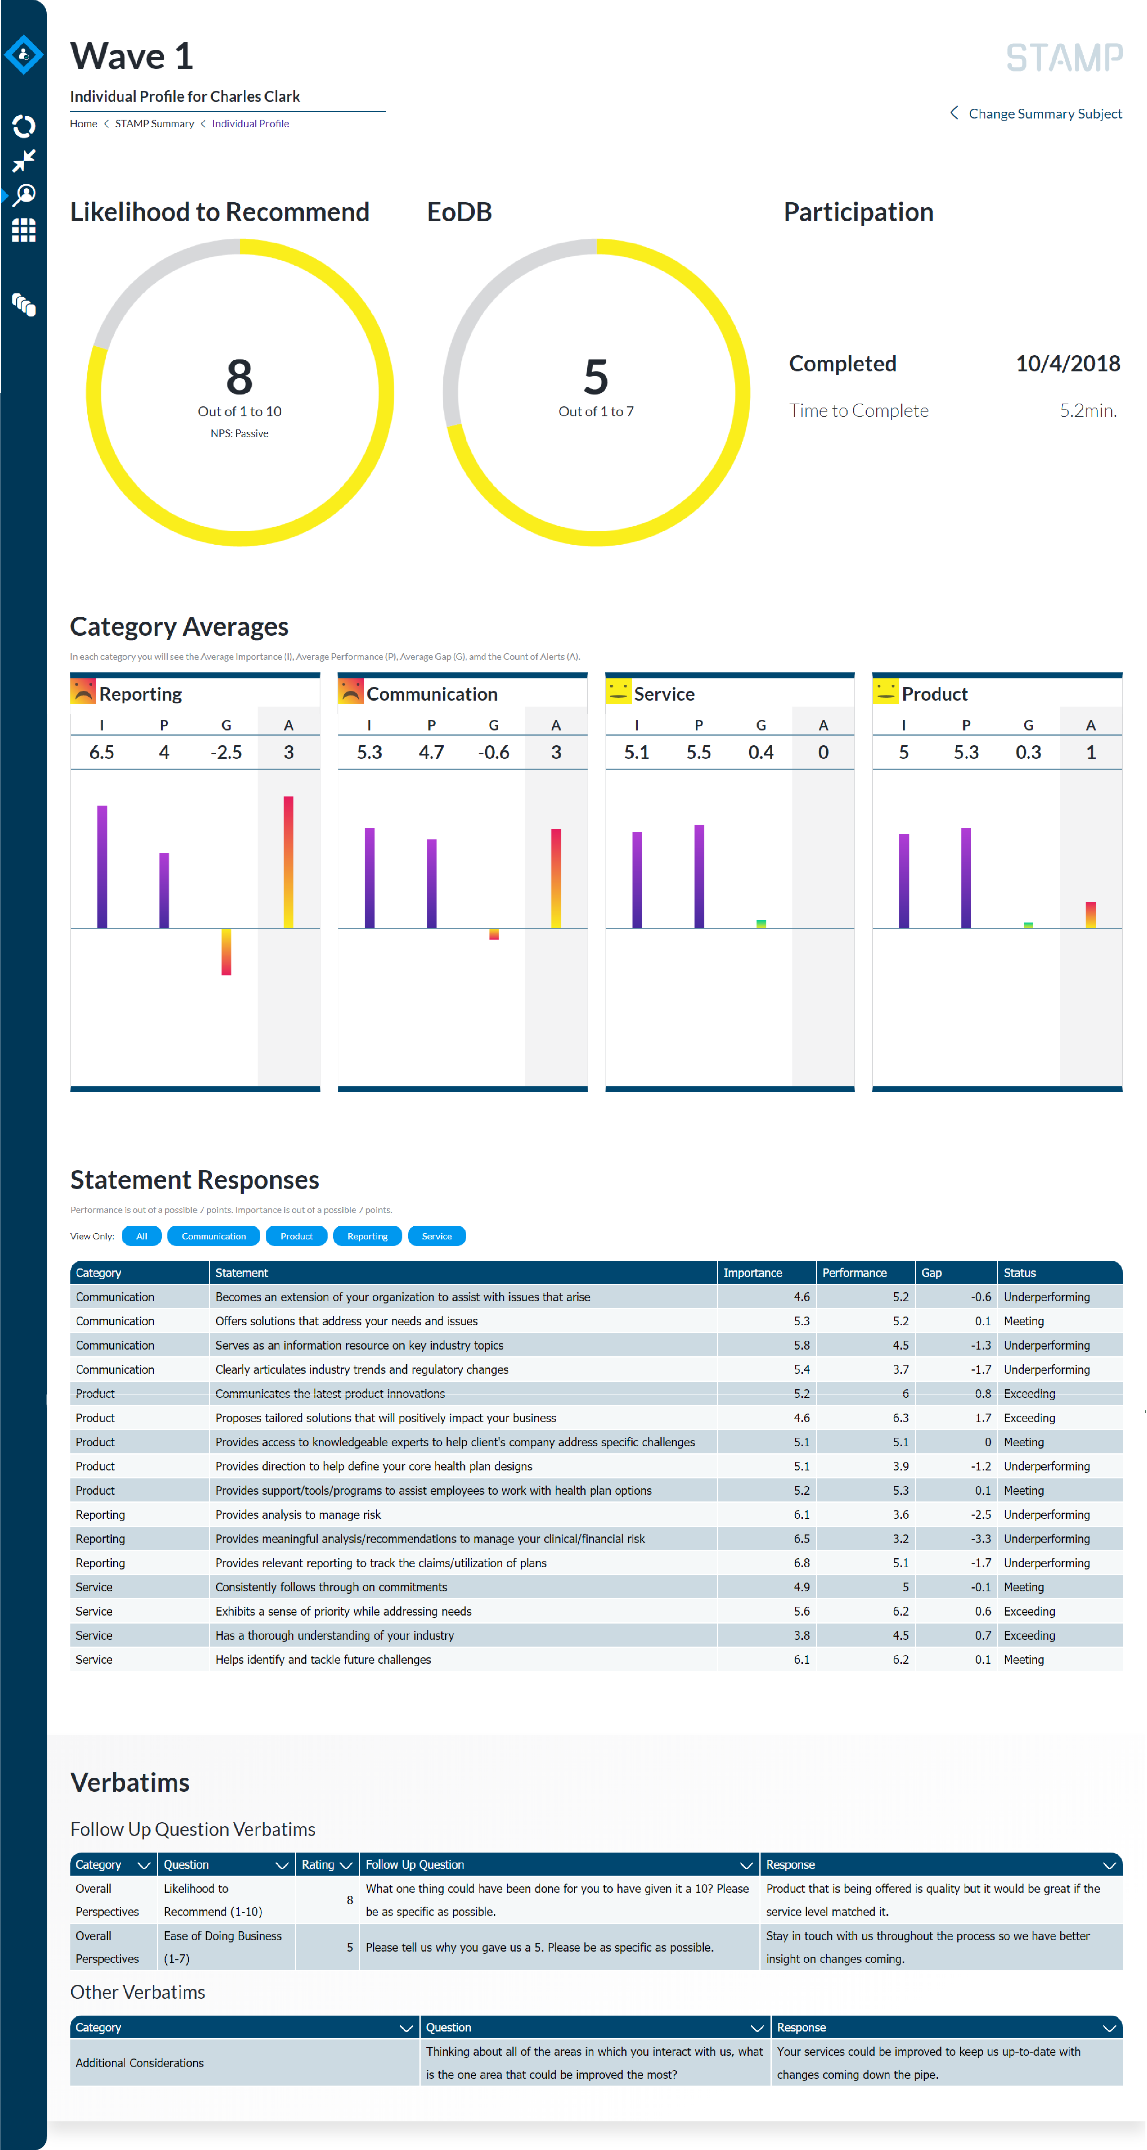
STAMP Dashboard Hierarchy
STAMP allows you to view results on multiple levels, starting at the individual respondent level and rolls up to the company level and segment level. You can also view dashboards at an Account or Sales Manager level.
4 Cascading Views
Individual: Shows the results for each individual respondent
Company: Roles individual assessments in to an aggregate company view
Account Manager: Provides a dashboard view by account or sales manager enabling you to see how well each account owner is delivering against the needs of their book of business.
Segment: Aggregates companies together with like characteristics to view segments (e.g. by region, by company size, etc.)

Slide 7






How will we use STAMP?
The STAMP ‘Customer Retention Process’ is iterative and designed to used throughout the lifecycle or your customers.
CUSTOMER RETENTION PROCESS
Prepare
Defines STAMP intent and cadence: Calendar, Event, Transactional
Adapt
Defines top 3-5 areas or improvement across all clients
Assess
Measures performance against customer expectation
STAMP ENGINE
Act
Identifies account where performance is below expectation and defines playbooks
Visualize
Visualizes customer sentiment in real time, within and across customer base
Notes:
Closing the loop…
There are many more assessments now than ever before.

Slide 8
Your Primary STAMP Dashboard (1/2)
Overall Perspectives
Provides high-level summary of account performance on key indicators such as Net Promoter and Ease of Doing Business. An overall “customer sentiment” score is also provided, based on STAMP’s proprietary algorithm.
Category Averages
Visualizes average importance and performance scores showing how your company is meeting the needs of customers and accounts in key categories, while providing alerts when client needs are not being met.
You can have as few as 3 or as many as 6 categories.

Slide 9
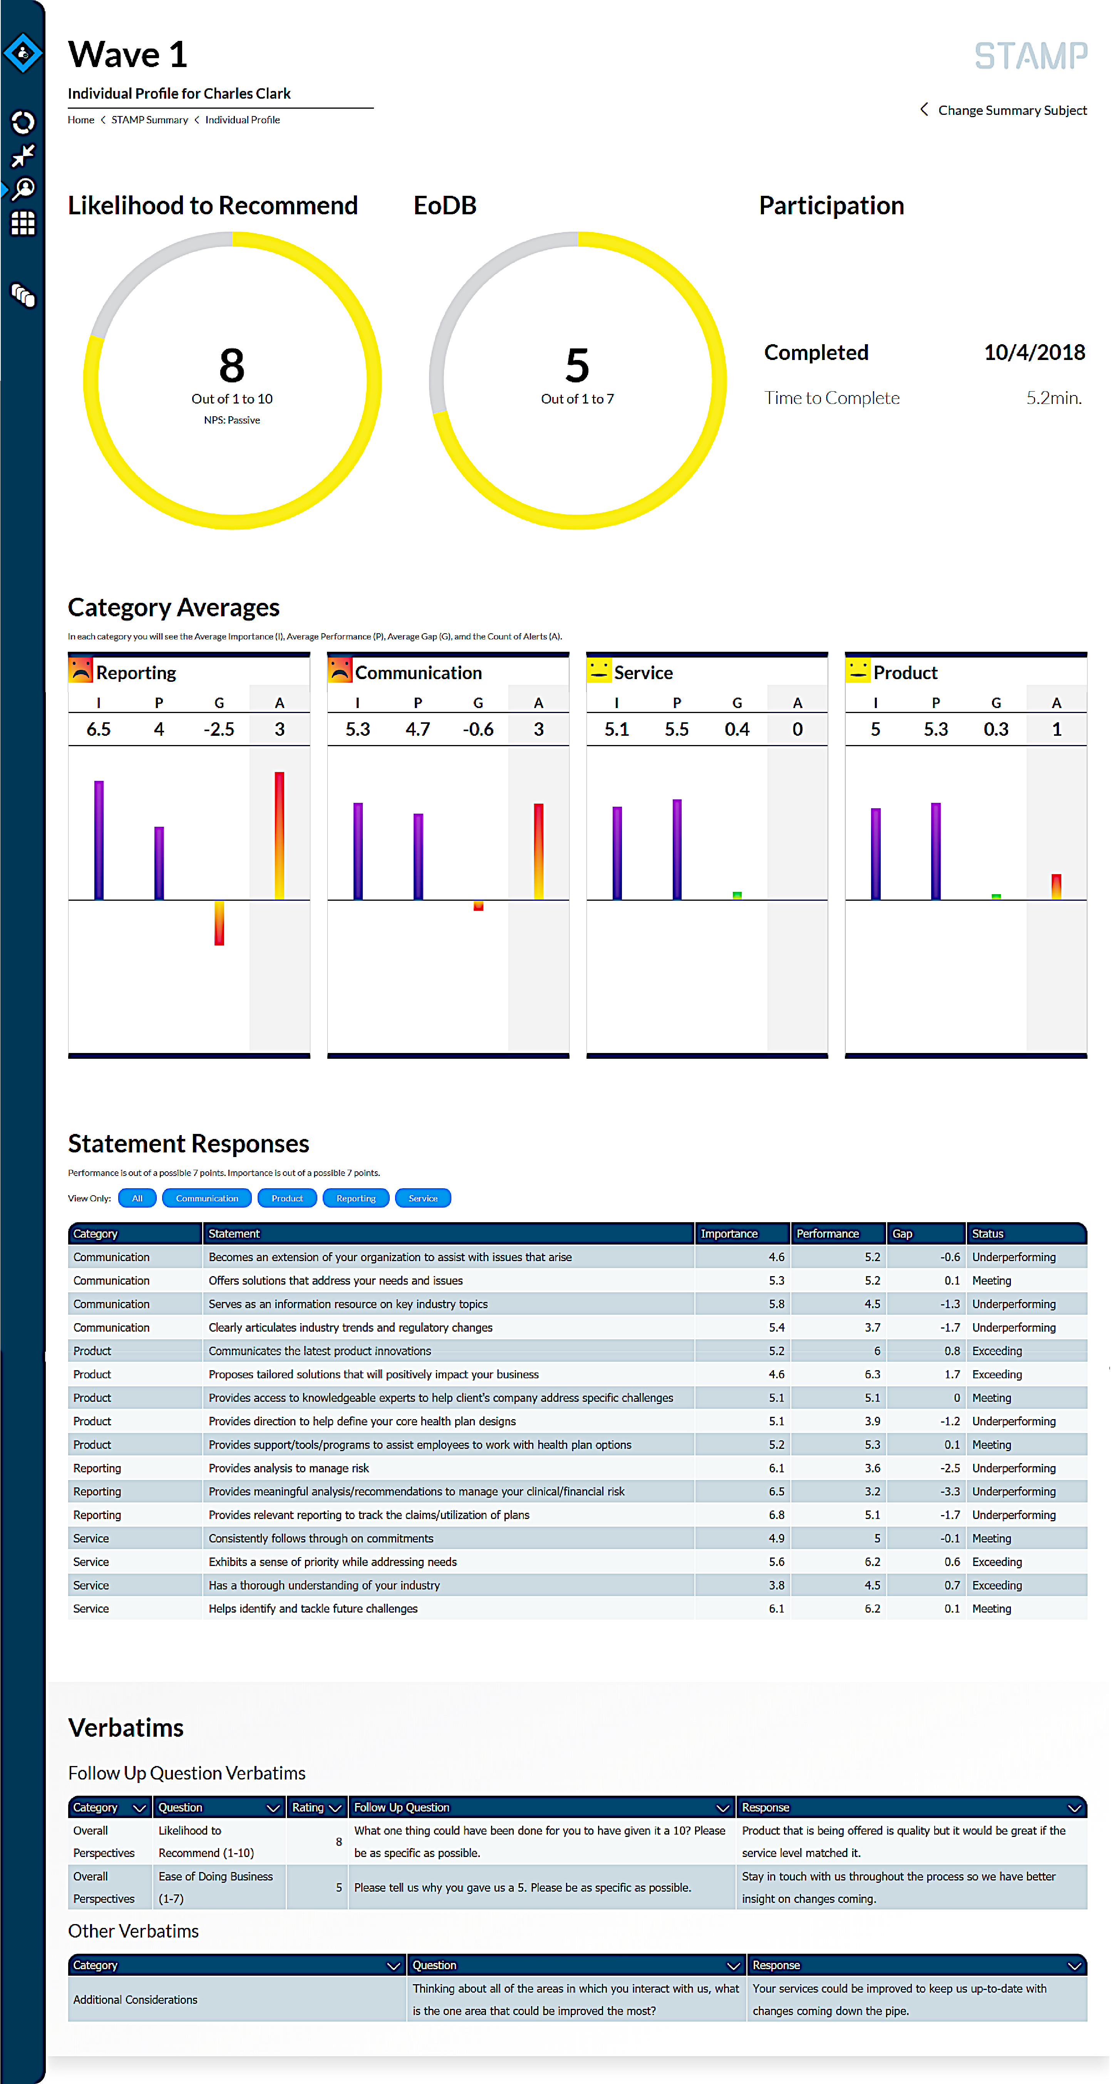
Your Primary STAMP Dashboard (1/2)
Statement Metrics
Each category is made up of a series of statements. This section shows performance versus importance for each statement, quantifies the gap, and identifies whether you are exceeding, meeting or underperforming.
Verbatims
All verbatims for open ended questions are captured and displayed on each individual dashboard.

Slide 10
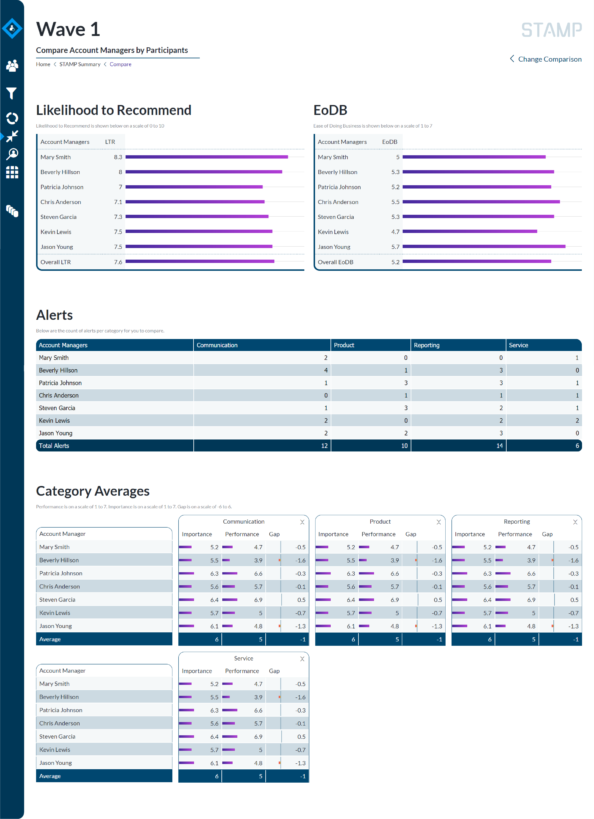
The Internal View: Account Manager Dashboards
STAMP also produces performance management dashboards to compare each account manager against his or her peer group to see who is leading, at parity, or lagging.
Likelihood To Recommend
Summarizes each account manager’s Likelihood to Recommend and Ease of Doing Business scores, relative to their peers.
Alert Overview
Summarizes the number of alerts by account manager relative to the total.
Category Performance
Shows each account manager’s category average scores relative to their peer group, including the gap and alert status.

Slide 11
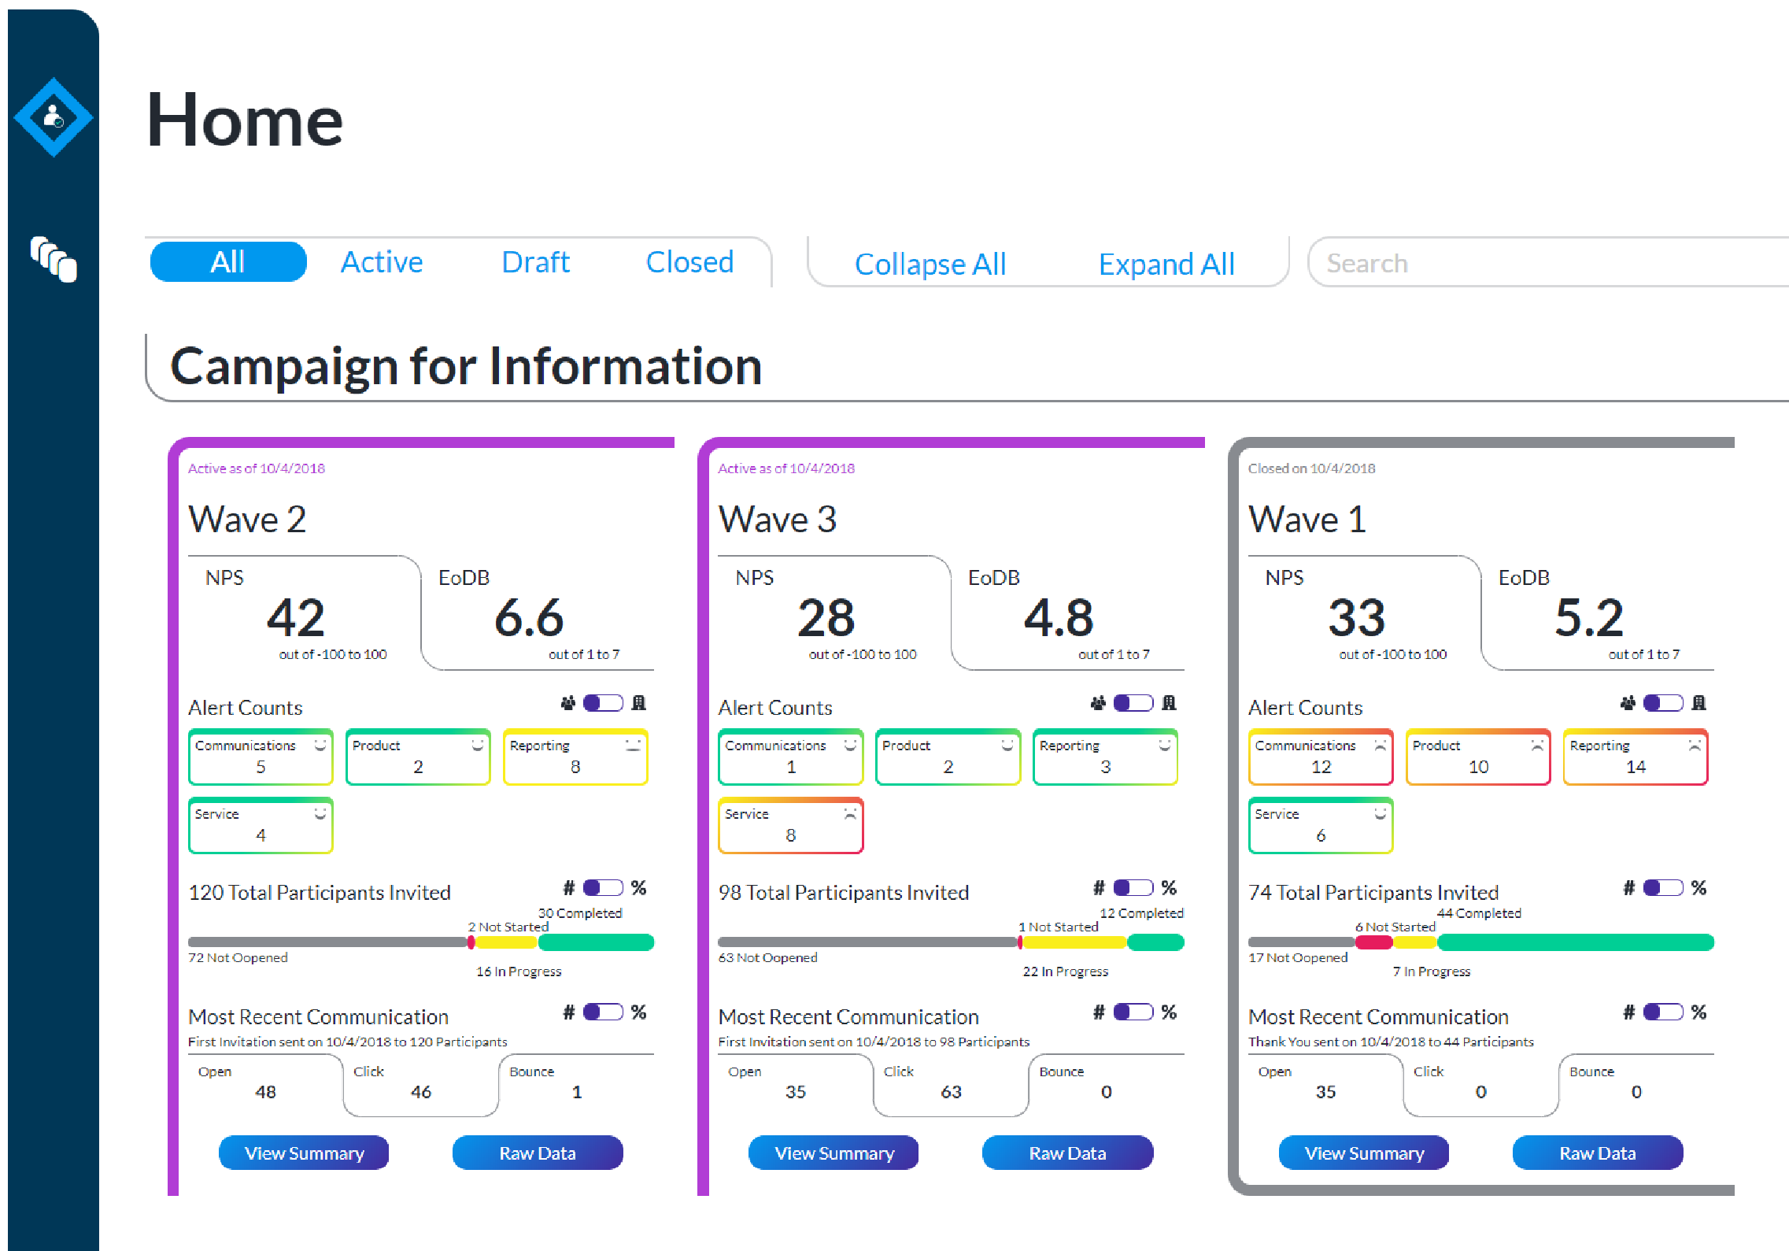
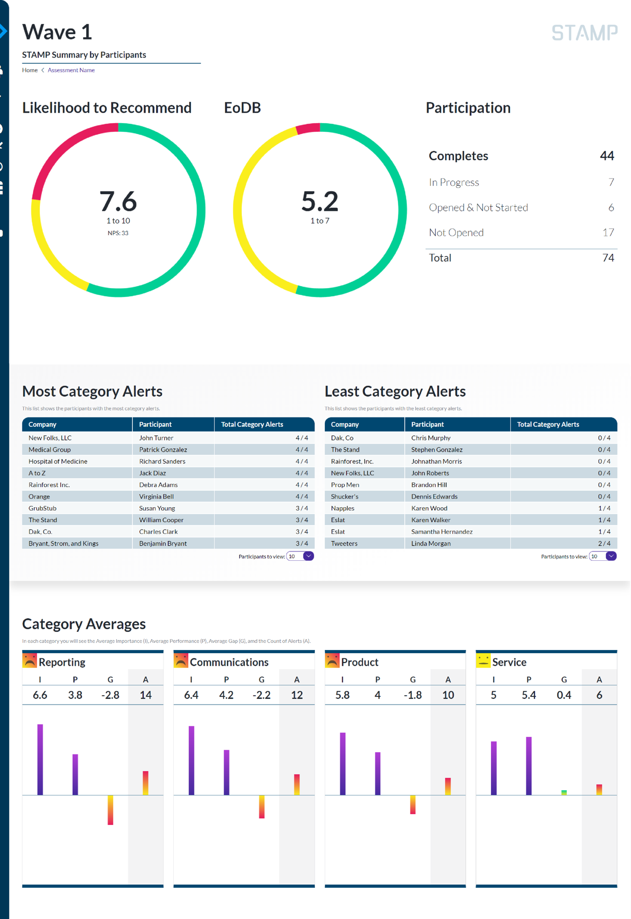
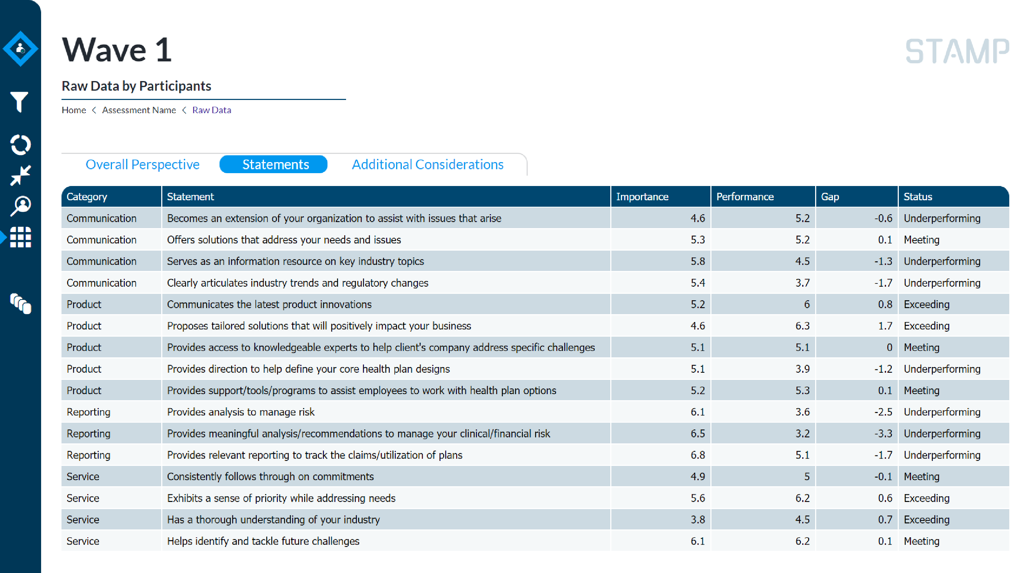
The Aggregate View: Summary Dashboards
For any campaign, STAMP provides aggregate dashboards visualizing customer sentiment, NPS and other overall perspectives, category metrics, and alerts by segment.
Summary view of all campaigns
Summary view of all selected campaign
Raw data per participant

Slide 12
Our Playbooks
The Playbook specifically addresses actions to be taken coming out of the visualization phase – namely those that importance is high and performance is low. ACT addresses clients on alert status. ADAPT addresses cross client issues.
Immediately after visualization, STAMP customers should consider 2 key steps
ACT: Immediate outreach to clients that are identified on alert status
ADAPT: Pursuit of the top 3-5 strategic initiatives to address issues where STAMP clients are underperforming across all clients
CUSTOMER RETENTION PROCESS
IMPORTANCE / PERFORMANCE GRID
LOW
Possible Opportunity For Improved Sentiment
Best Opportunity For Improved Sentiment
Prepare
Adapt
Assess
Performance
STAMP ENGINE
Requirement For Sustained Sentiment
Act
Visualize
HIGH
LOW
HIGH
Importance

Slide 13
Example Dashboard
Perf. Avg.
5.6
LOW
Importance Avg. 6.16
Performance
HIGH
HIGH
LOW
Importance
Size of the bubble represents gap between Perf. and Imp.
Member Experience | Product | Service | Technology
Indicates which statements have the highest gap between Perf. And Imp.

Slide 14
Typical STAMP ROI
Most STAMP clients realize a positive ROI within the first campaign by having STAMP help retain just 3 B2B clients!
Average Annual Cost of STAMP
$30,000
Average Number of B2B Accounts Per Client
After the first 100 B2B accounts, the cost to deploy each STAMP drops to $45-$75 per account, further accelerating the positive ROI!
100
Cost to deploy STAMP per client
$300
Average annual revenue per STAMP Client’s B2B customer
$50,000
Average profitability per STAMP Client’s B2B customer (20%)
$10,000
% of B2B customers STAMP typically flags as “at risk” and saved by STAMP
20% or 20/100 accounts
# of ”at risk” flagged accounts retained to break even on STAMP
3 of 20 “at risk accounts” or
3 * $10k profit/customer = $30k STAMP investment

Slide 15
Summary Of Benefits
STAMP should be used by EVERY vendor or supplier with business customers. Here are the Top 5 reasons why.
STAMP Top 5
Don’t wait until renewal time to find out you haven’t been meeting the needs of your customers. Let STAMP systematically obtain unbiased feedback from your business customers, provide real time dashboards on how you are performing, and alert you when there is an issue.
Differentiate yourself in the marketplace. Demonstrate to clients your commitment to meeting their unique needs by sharing their scorecards and developing customized action plans to continually improve your relationship. Also use STAMP to help pitch a new account by showing your prospect clients how well their current supplier is performing, illuminating opportunities for you to do a better job than the current incumbent.
Boost satisfaction across your entire book of business. STAMP uses its advanced analytics engine to assess all your data to identify and prioritize the 3-4 actions you need to take to improve satisfaction across your entire book of business.
Significantly improve account management. By providing a dashboard for each sales or account manager, STAMP helps to ensure that you have the right individuals assigned to each account. STAMP is also a critical input to performance management and helps you identify specific areas for training and skills improvement.
Benchmark yourself against your peers and track progress over time. STAMP is a learning tool and enables you to not only track your performance over time, but also benchmark yourself against your industry peers and competitors.

Slide 16
Contact Information
View Our Video At http://www.stampcsm.com
Contact Information
Marc E Pierce
CEO / Founder
Mobile: 847-612-7995
mpierce@stonegateadvisors.com
Stonegate Advisors, LLC
120 Newport Center Drive, Suite 244
Newport Beach, CA 92660
Office Phone: (312) 981-2102

