Slide 1




The future of hospitality training
Notes:
Paul: Introduce ourselves (credibility)
What we will say

Slide 2
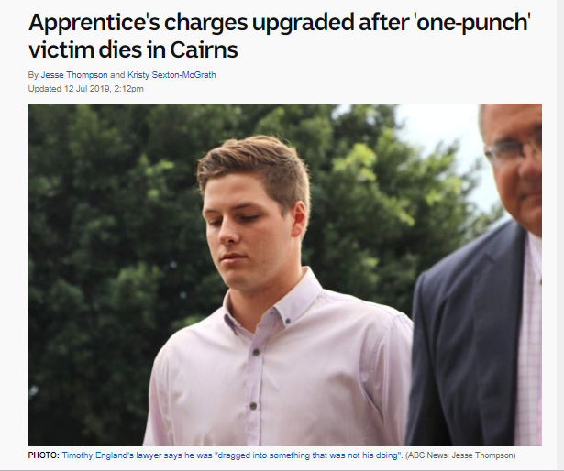
Mary’s story…

Slide 3


The problem
Business model is important. You probably don’t know all the details yet, but you should know a lot of them. Lay it out. If you need more space to dig into something complicated, add slides.
Traditional training does not prepare staff
to be
Job Ready
Notes:
Dianne
Difficult situations eg… refusing service

Slide 4

Traditional training
Notes:
Dianne
hands up who finds classroom or online training EXCITING?
boooring and teeedious!
Low knowledge retention

Slide 5

A YesVR preview
Notes:
9. PLAY VIDEO… YesVR preview – 30 secs
Lets preview what YesVR has to offer.

Slide 6


Tell the investor what makes you so special, what makes this work, what your insights are. This might take more than one slide
Virtual reality training
Retention of knowledge
Real-life experiences
Immersive & engaging
Notes:
Paul

Slide 7
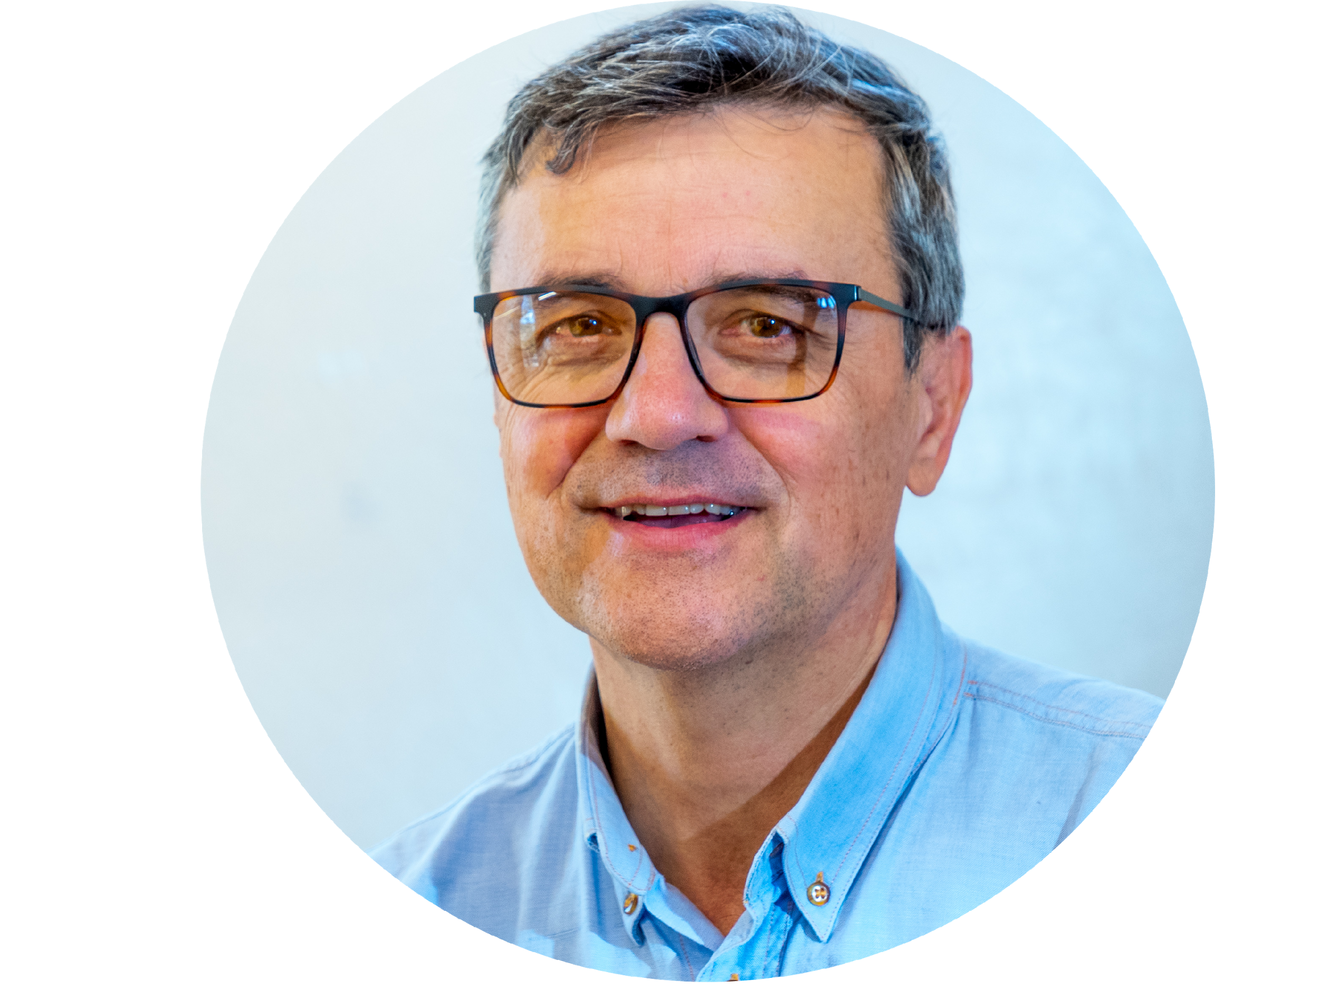

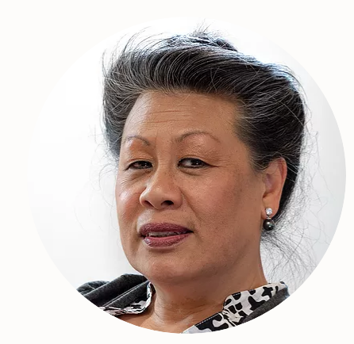

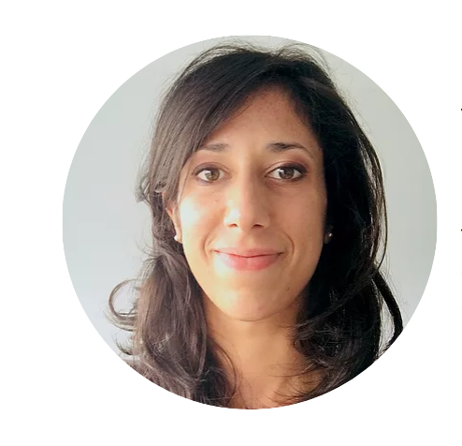
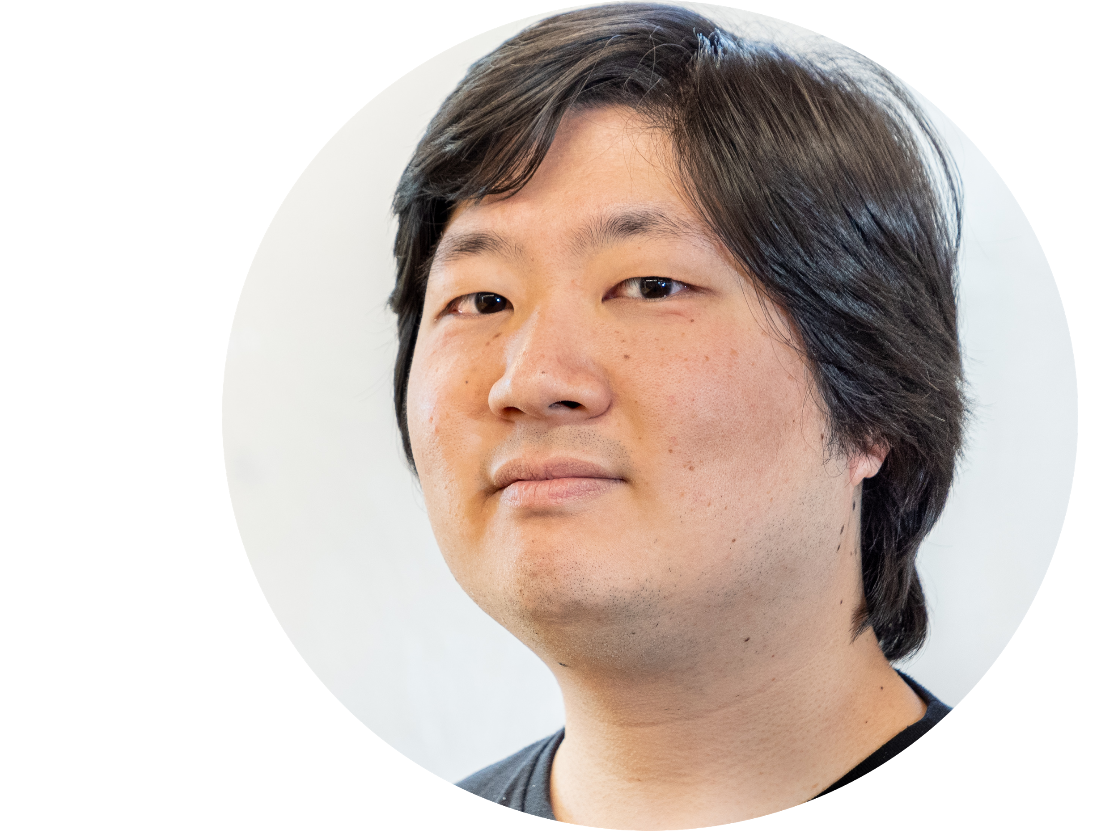
What makes us unique?
PAUL KING
Co Founder and CEO
DR MELISSA BORDOGNA
Learning and Development Strategist
DIANNE FLAKUS
Co Founder, Education and Content Director
DANIEL IACOBBE
360 Film and Post-Production Expert
VALENTINA TODORO
Learnng Designeri
TAKA KUMAZAWA
Programmer and Game Developer
Notes:
Paul
Award winning …
business philosophy: Quality all the way through..

Slide 8
Our Process
Research topics
Create Content
Learning Design
360 Film Production
360 Post Production
Interactive Gaming Development
Testing
Release

Slide 9


Business model
Subscription based with new content released monthly
Partnerships with training providers

Slide 10
Our ask
Introductions
Funding
Investors
Notes:
Introductions to decision makers in large training orgs
Funding to continue developing our content and platform
Investment from those that can add value and are like minded

Slide 11
Questions
?
Business model is important. You probably don’t know all the details yet, but you should know a lot of them. Lay it out. If you need more space to dig into something complicated, add slides.
Notes:
10. Questions...

