Slide 1
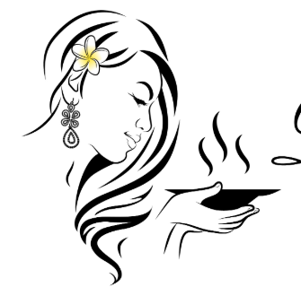


Change font to Rage Italic
Dapura Mia
Fill rice paddy with yellow, keep rest green

Slide 2


Remove this hair
Move up a little bit

Slide 3

Reduced hair
example for illustration

