Slide 1

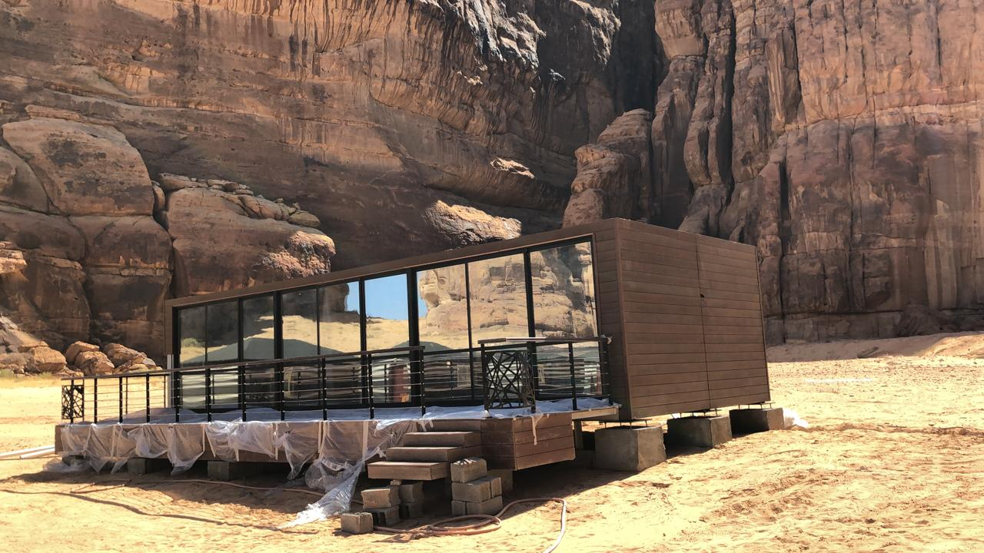

Slide 2

The Engineers Company is managed by a professional expert Saudi engineers that focuses on bringing an innovation, affordable, environmental housing to the country. The Engineers Company aims to provide a solution for housing complexity in the country whether it’s for construction companies, hospitality and residency. Owning a living space is not a life dream anymore. We simplified complexity of housing to assure that innovation exists to Impact your way of living.
WHO WE ARE?

Slide 3
WHO WE ARE?
VISION
To inspire and develop the concept of fast Saudi housing solutions
MISSION
To provide a portable housing solutions through an innovative modern design with an expert build up engineers.
VALUE STATMENT
We believe in boundless potential of Saudi economy. We share the passion for better future, respect the saudi environment and eco, celebrate, harness the desire for partnership and citizenship and create robust opportunities for housing designs.
STRATEGIC THEMES
Promote tourism
Promote a new experience of camping
Support hospitality
Promote construction site communities
Promote Business Partnering

Slide 4

Our Services
Construction
Operation
Designs
Our
Services
Hospitality Services
Maintenance

Slide 5




Our Clients

Slide 6

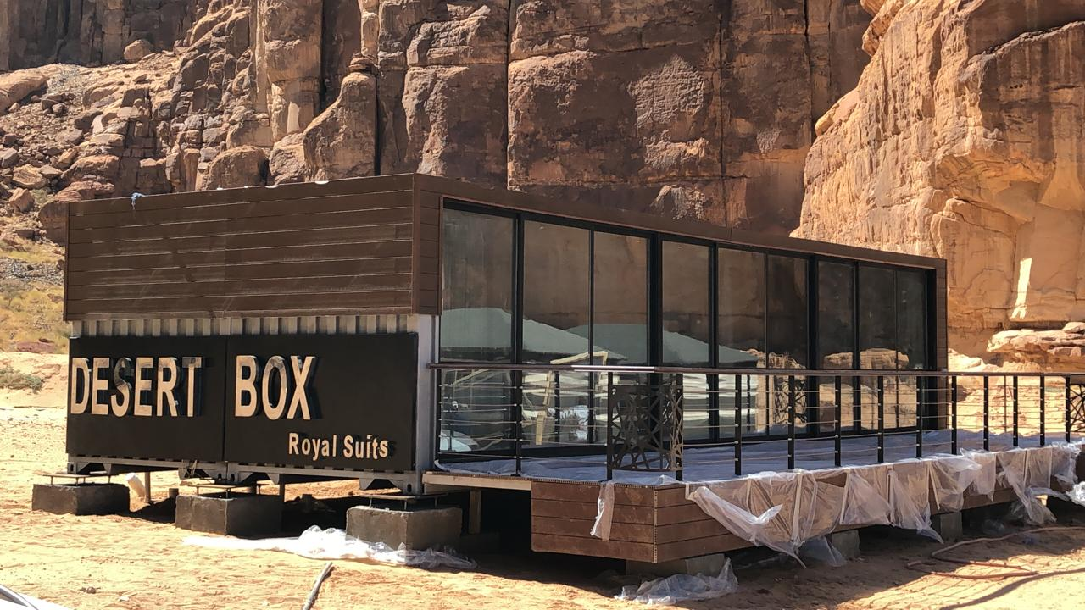
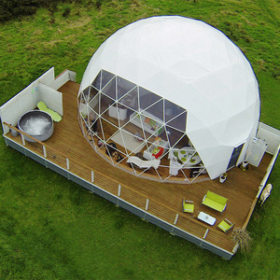
HOUSING SOLUTION PRODUCTS
Desert Box
Dome Unit
Luxury residential unit made by shipping Containers
Innovative residential unit for larger view sights

Slide 7
Desert BOX
The most luxurious Unit

Slide 8
Desert BOX – EARTH 53
Earth - 53

Slide 9
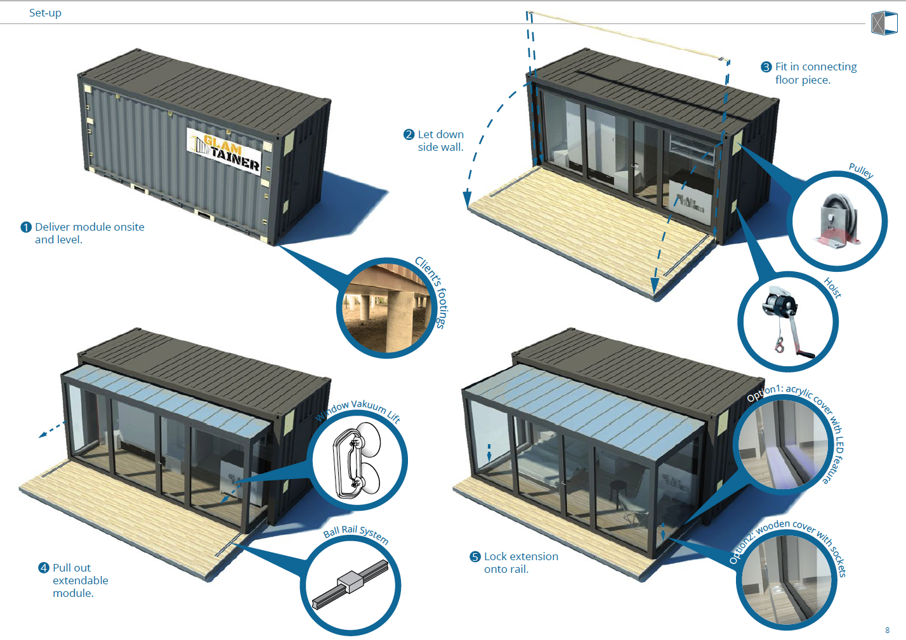
Desert Edge

Slide 10
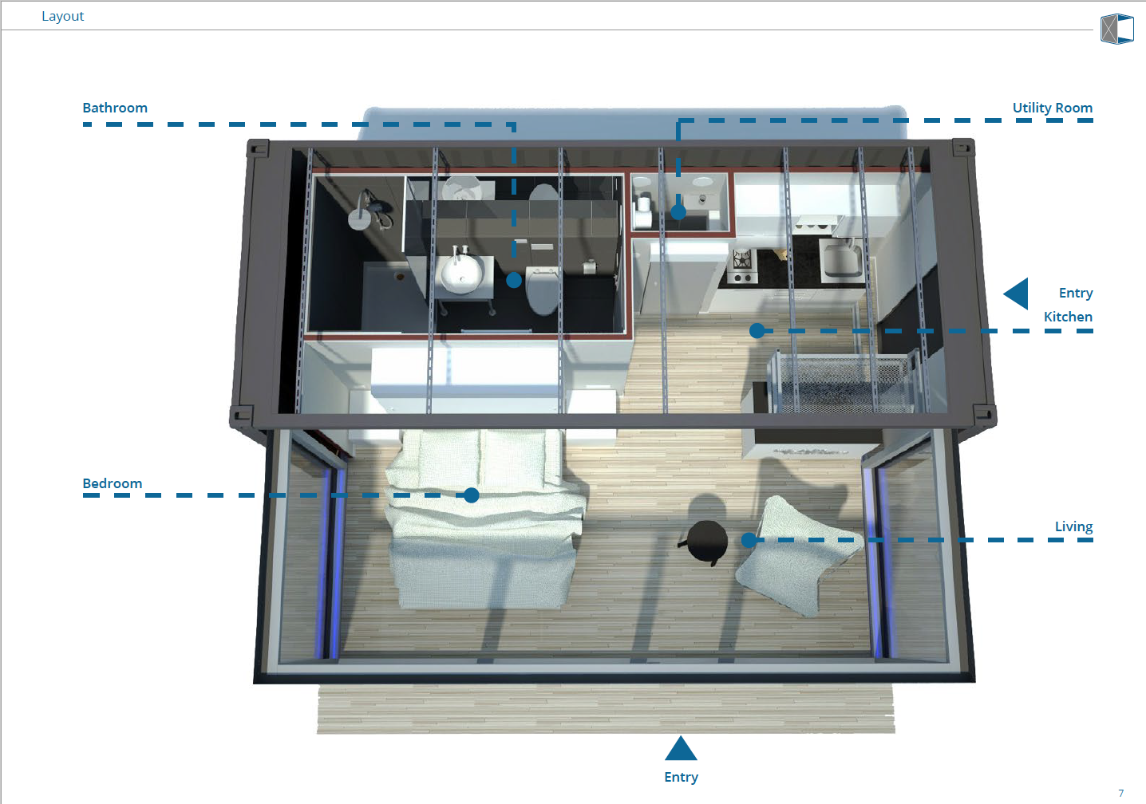
Desert Edge

Slide 11
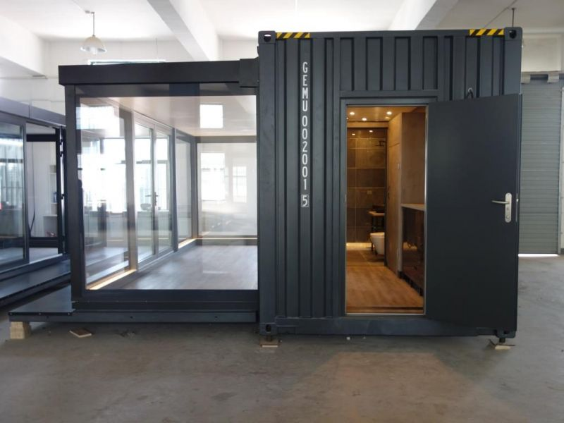
Desert Edge

Slide 12
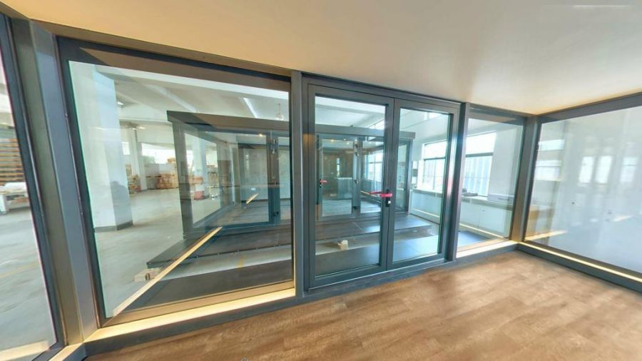
Desert Edge

Slide 13
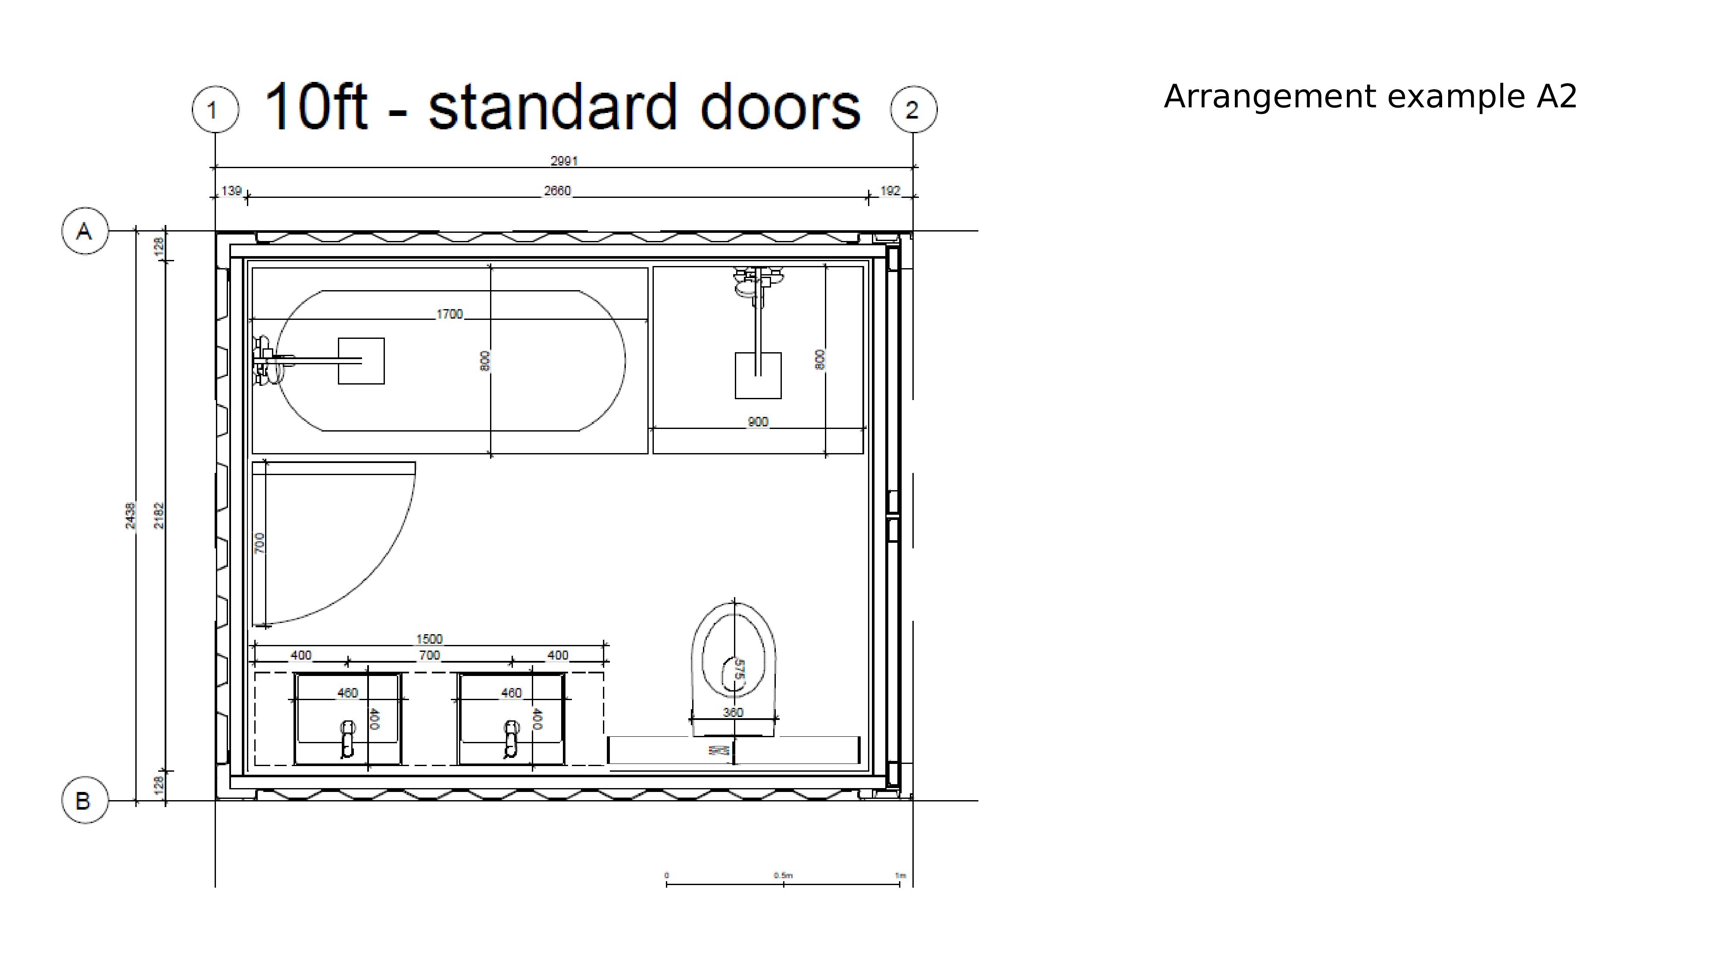
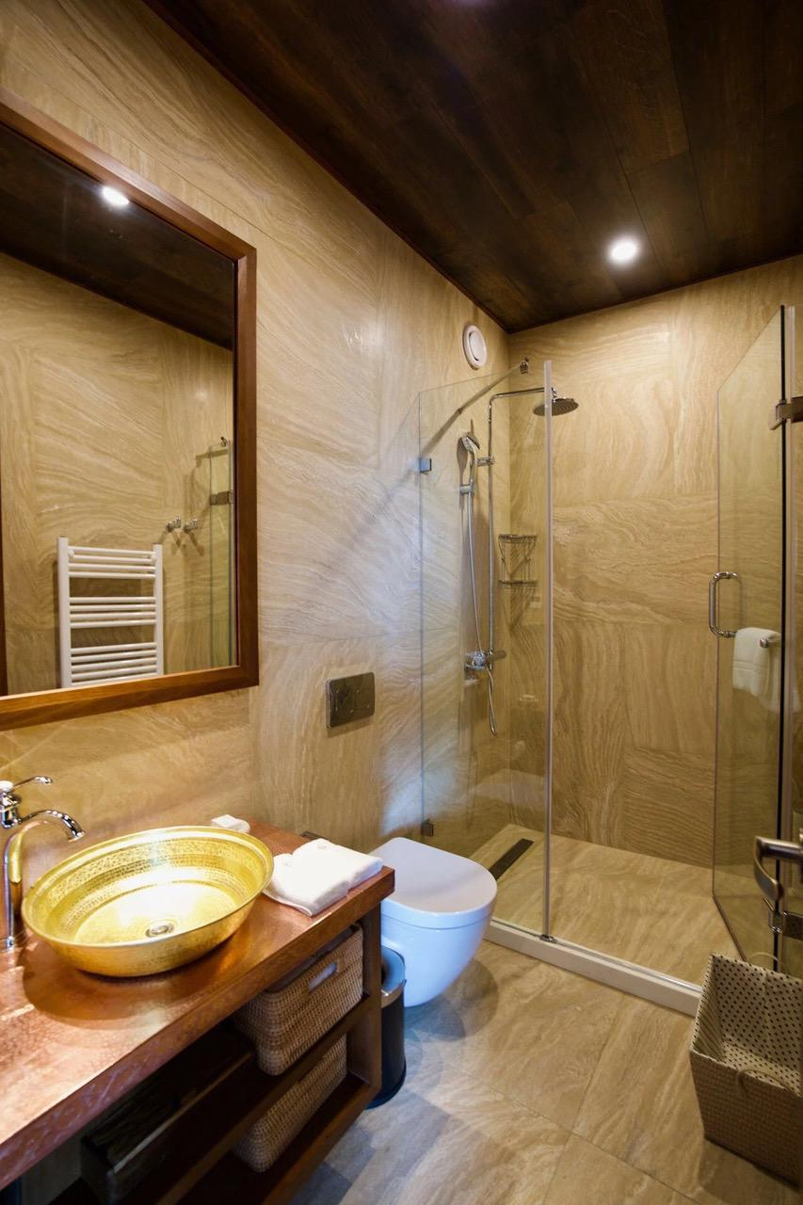
Desert Edge

Slide 14
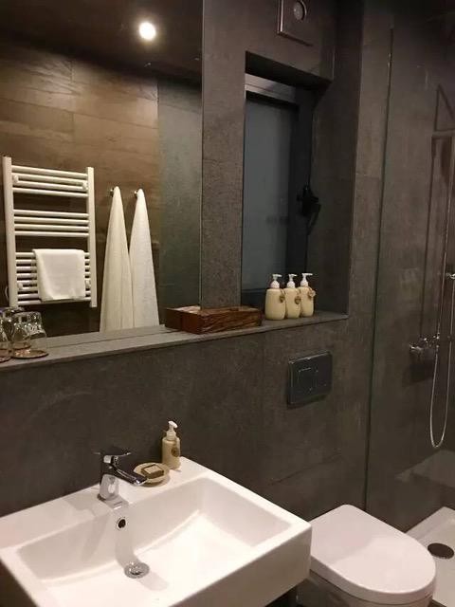
Desert Edge

Slide 15
Desert Dome

Slide 16
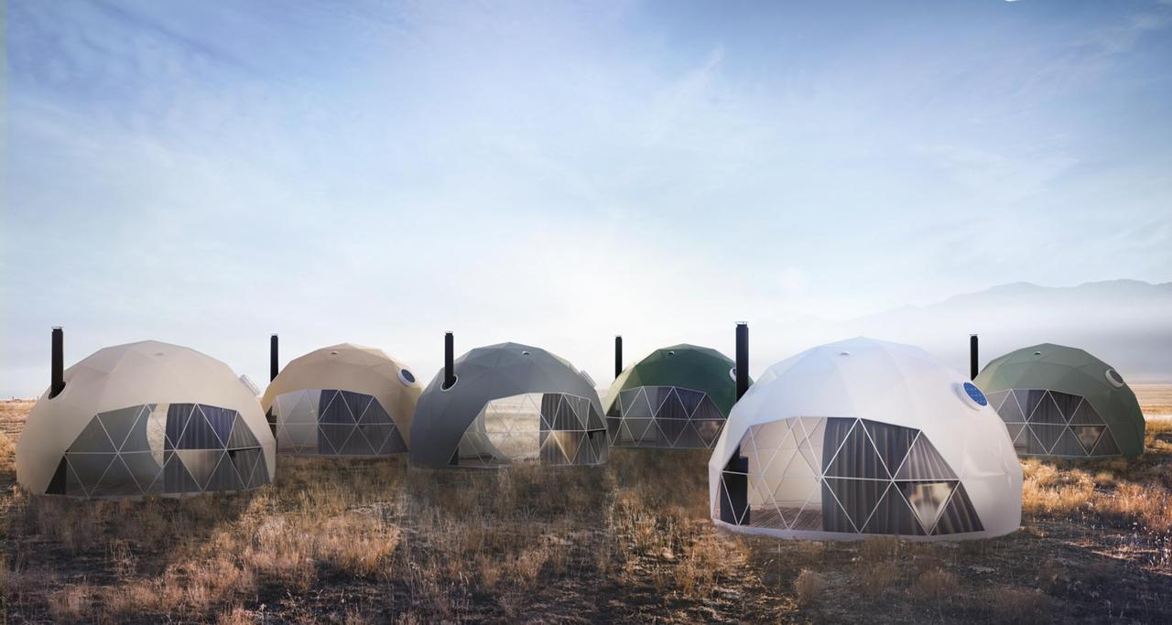

Slide 17
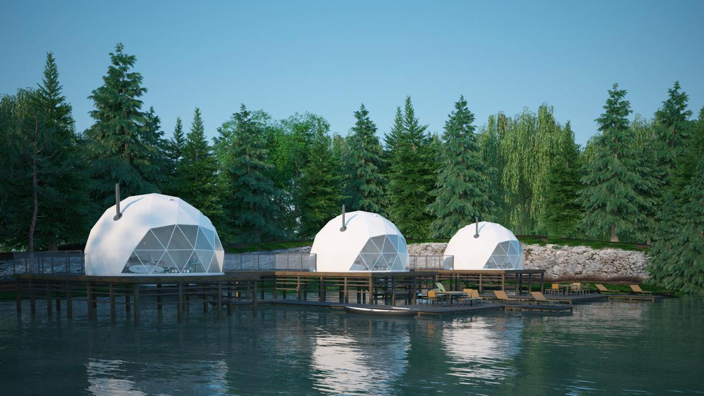
Dome - Exterior

Slide 18
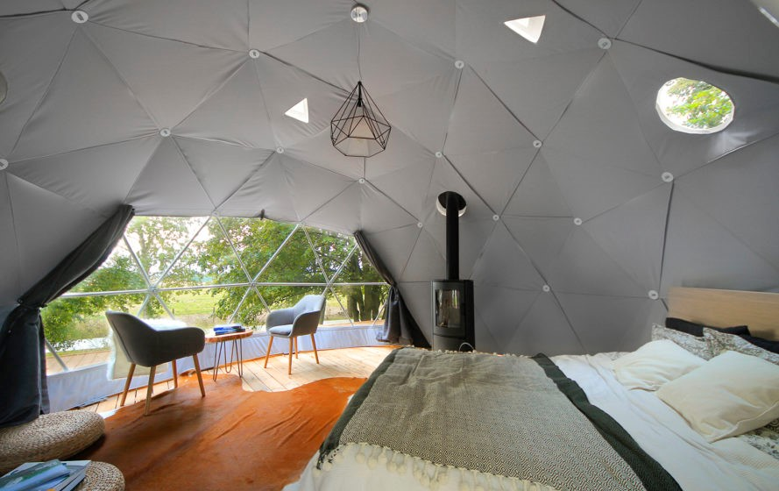

Slide 19
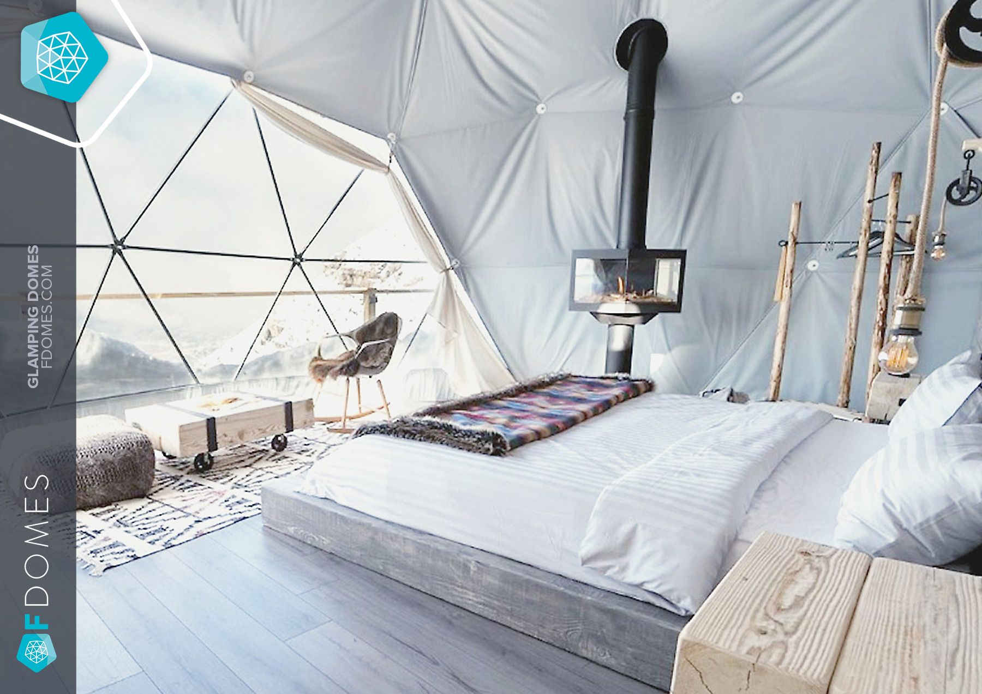

Slide 20
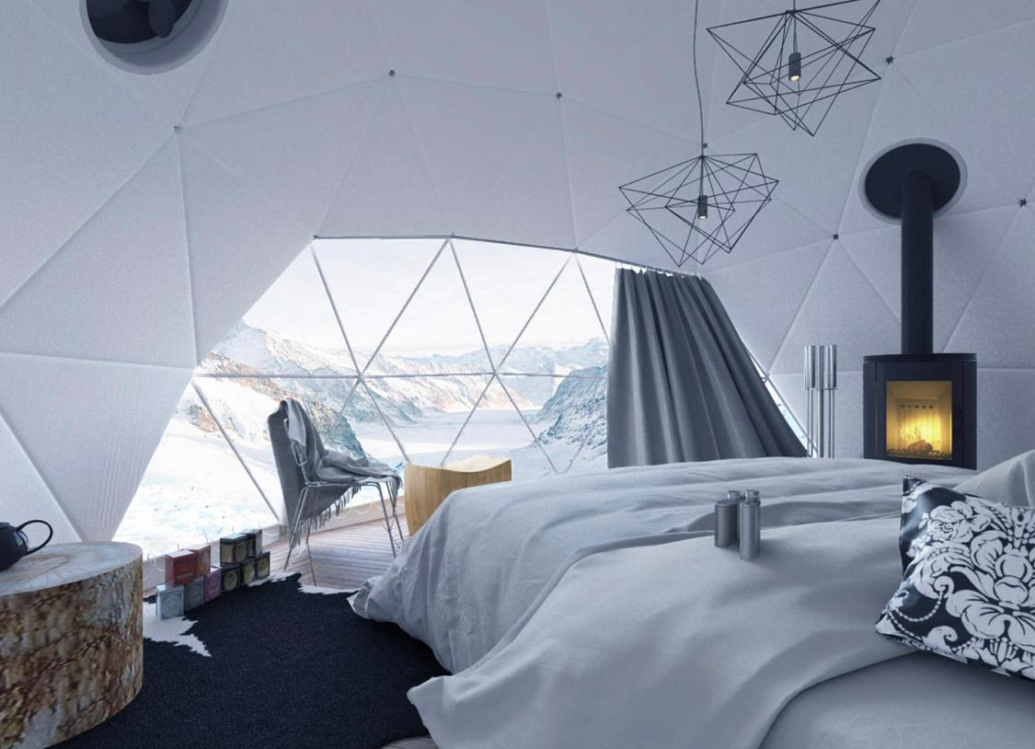

Slide 21
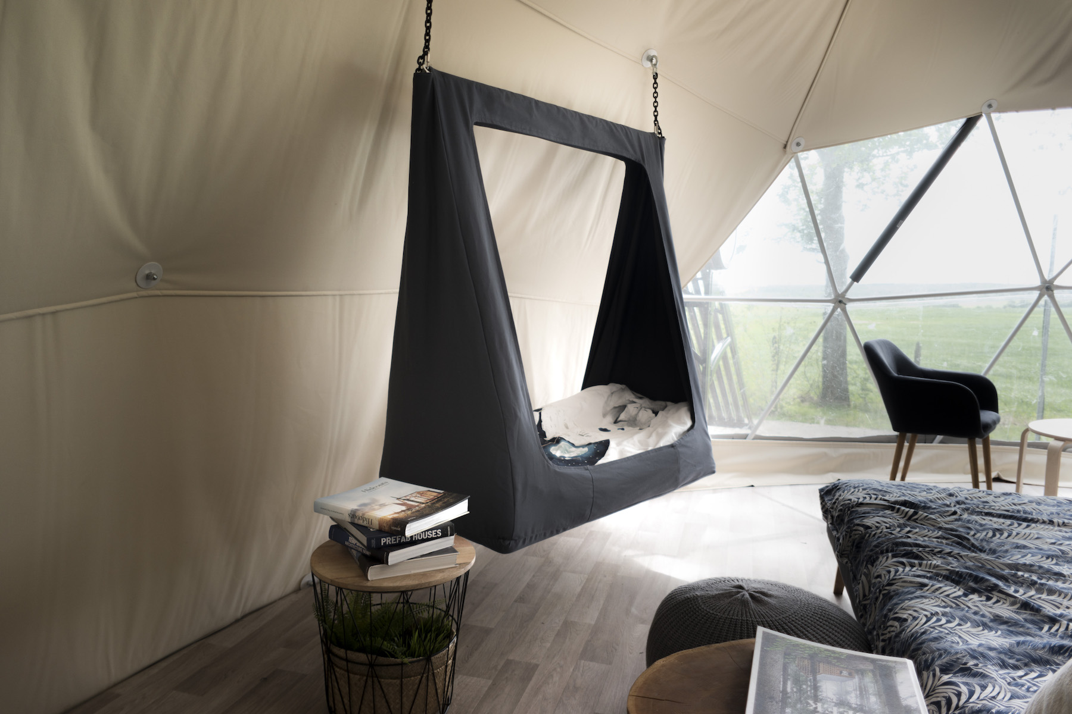

Slide 22
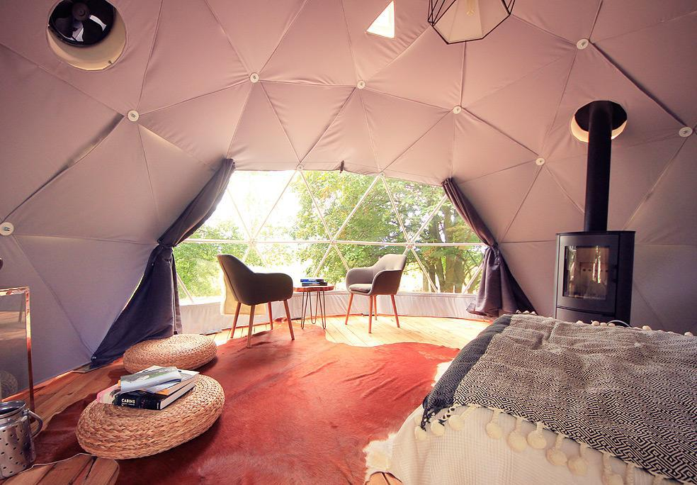

Slide 23
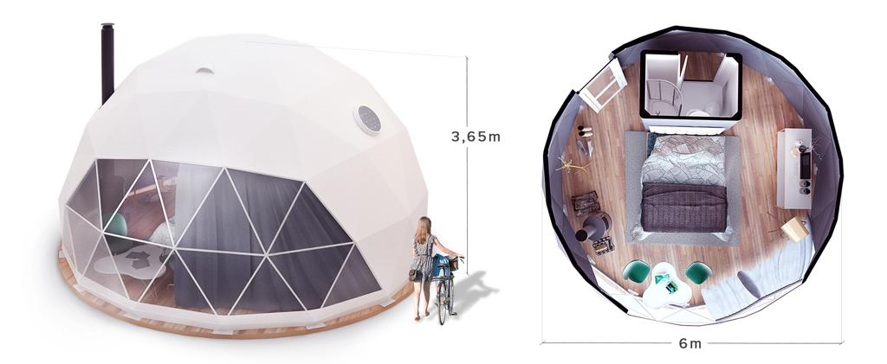
Desert Dome - Specifications

Slide 24
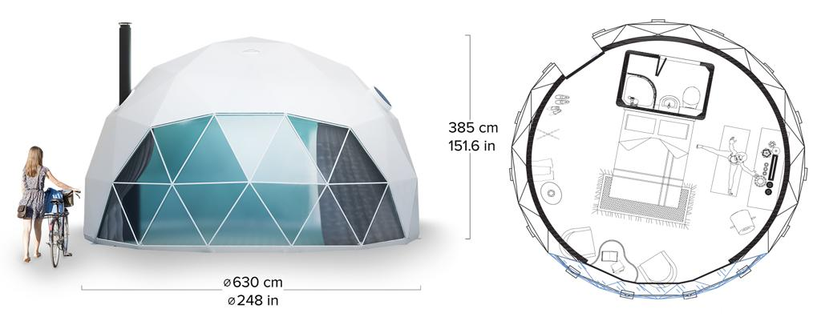
Desert Dome - Specifications

Slide 25
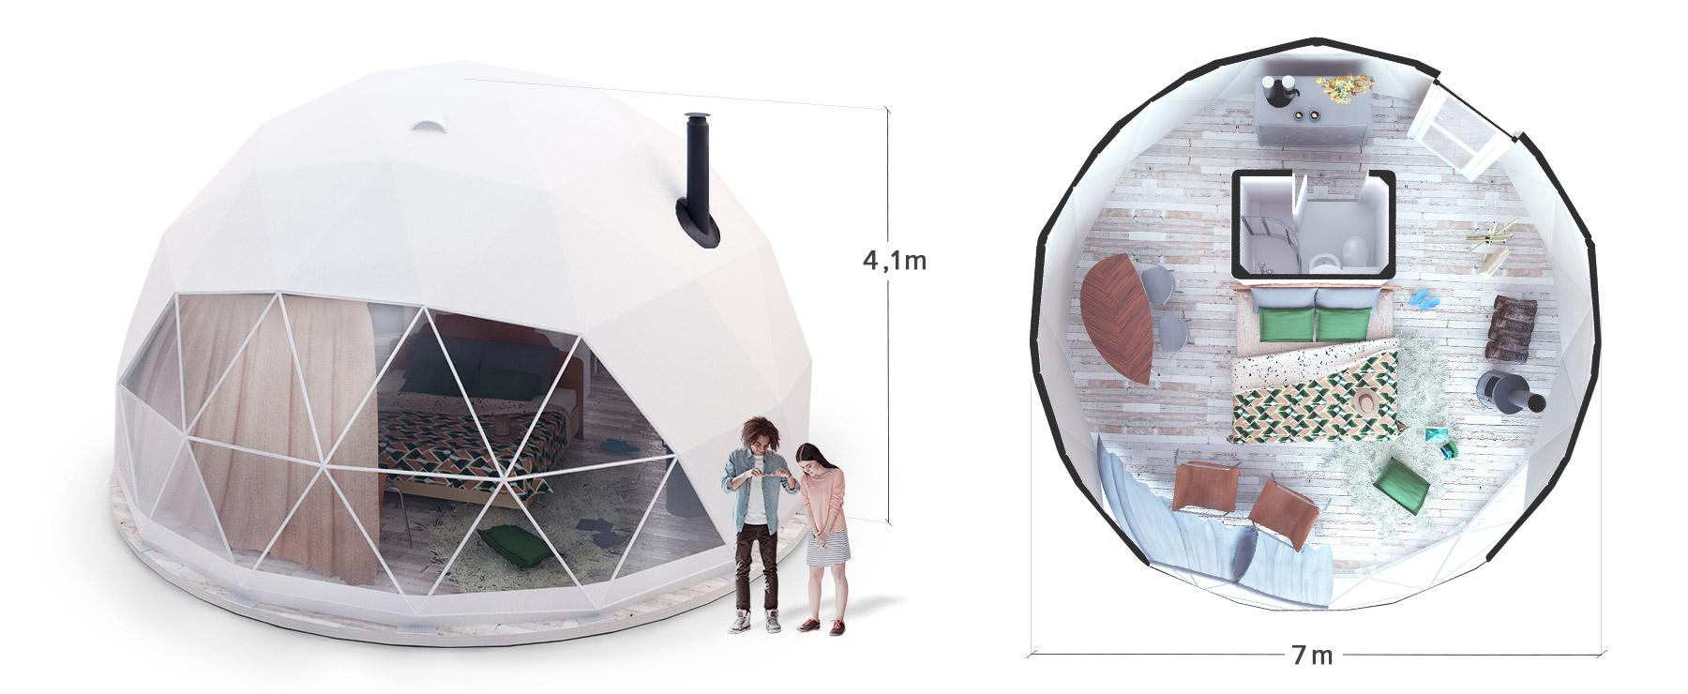
Desert Dome - Specifications

Slide 26
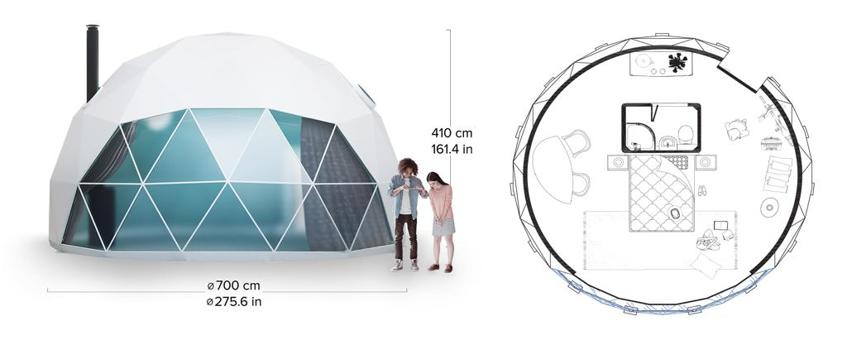
Desert Dome - Specifications

Slide 27
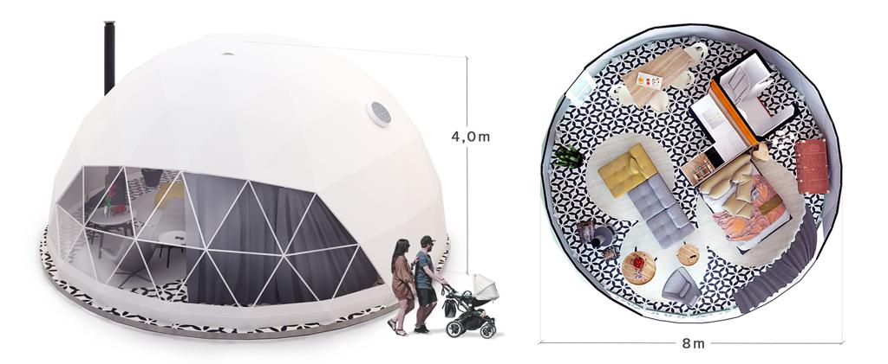
Desert Dome - Specifications

Slide 28
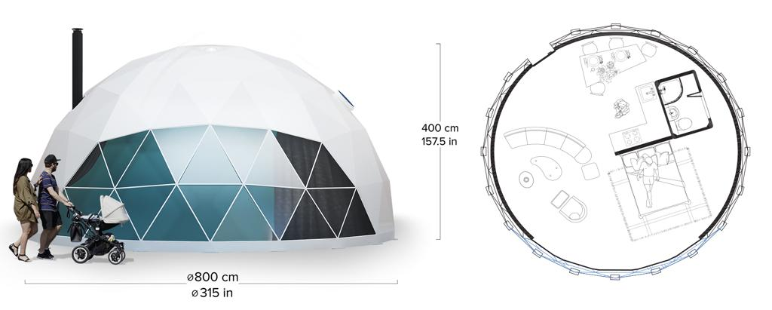
Desert Dome - Specifications

Slide 29
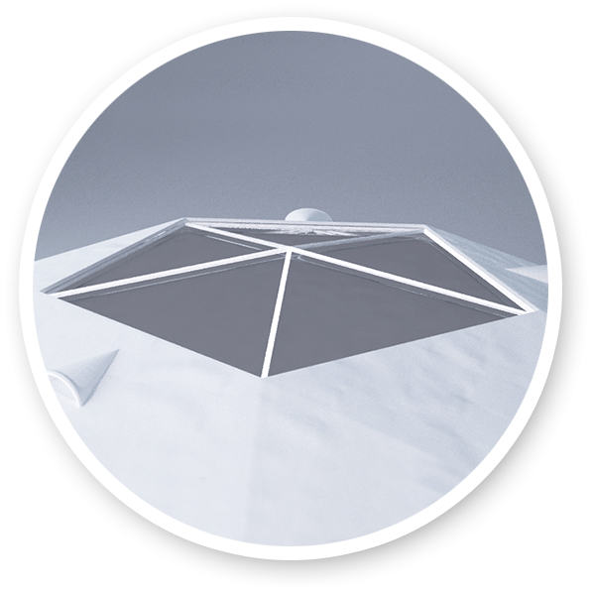
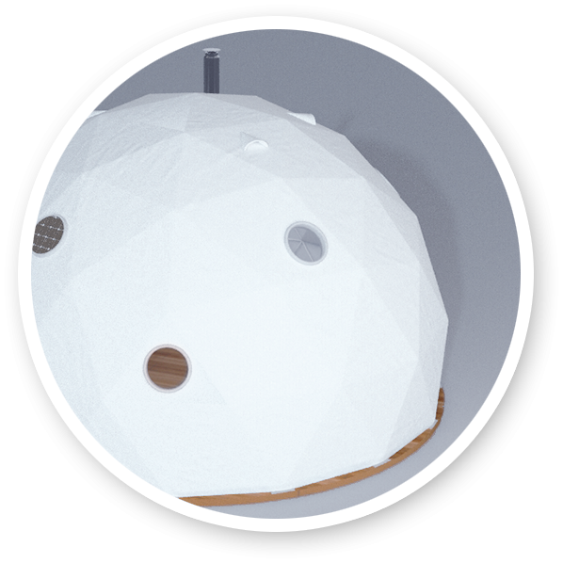
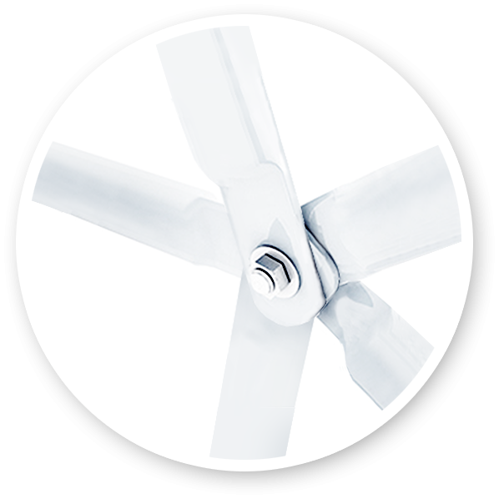
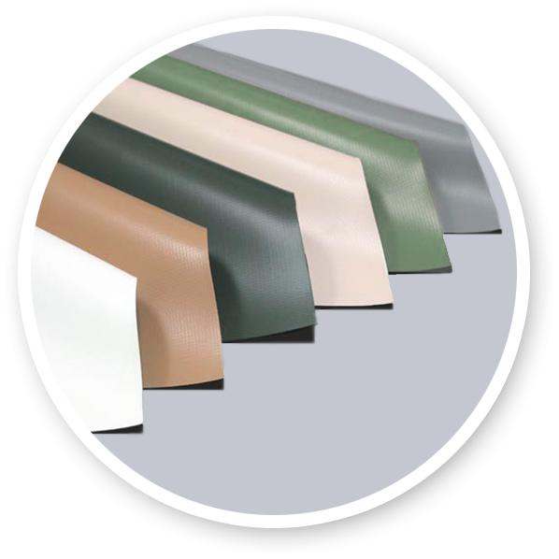
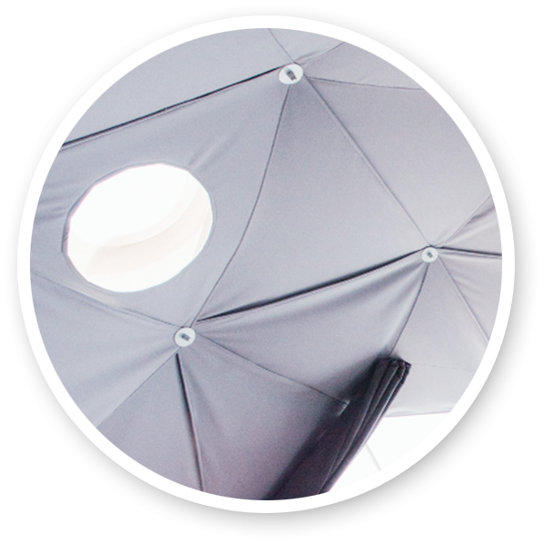
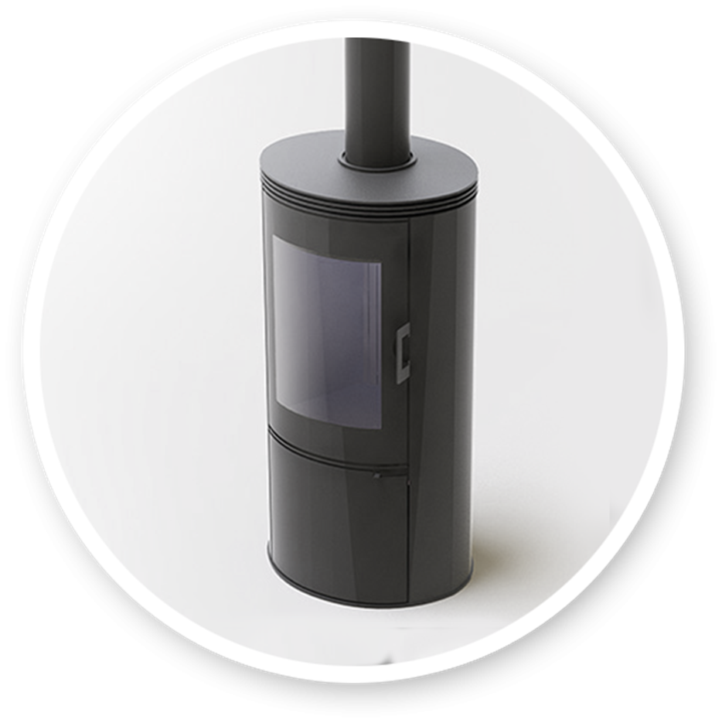
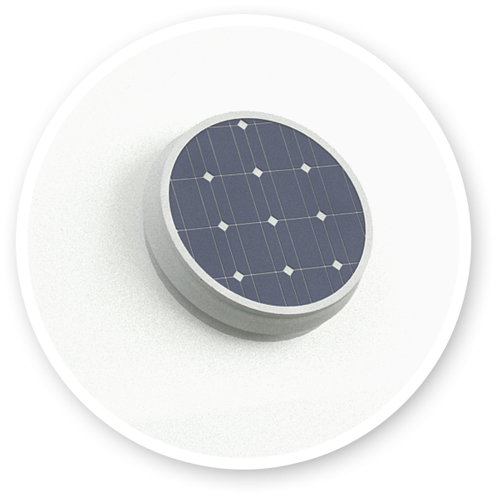
Desert Dome - Features

Slide 30
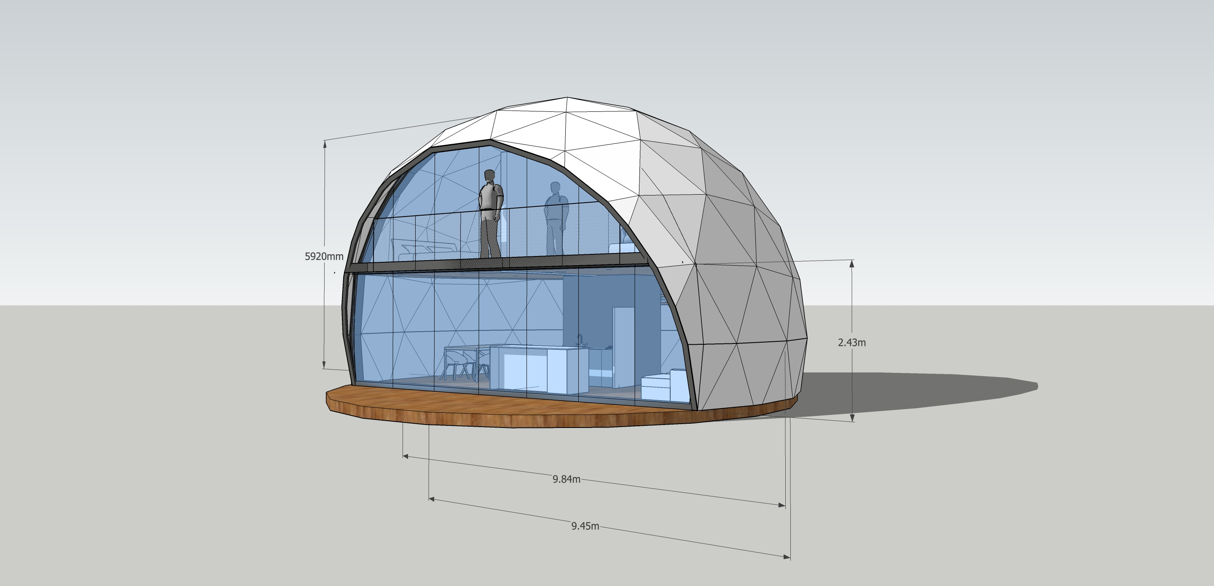
Desert Dome - Two Floors Concept
fdsfsdfdsfsdfds

Slide 31
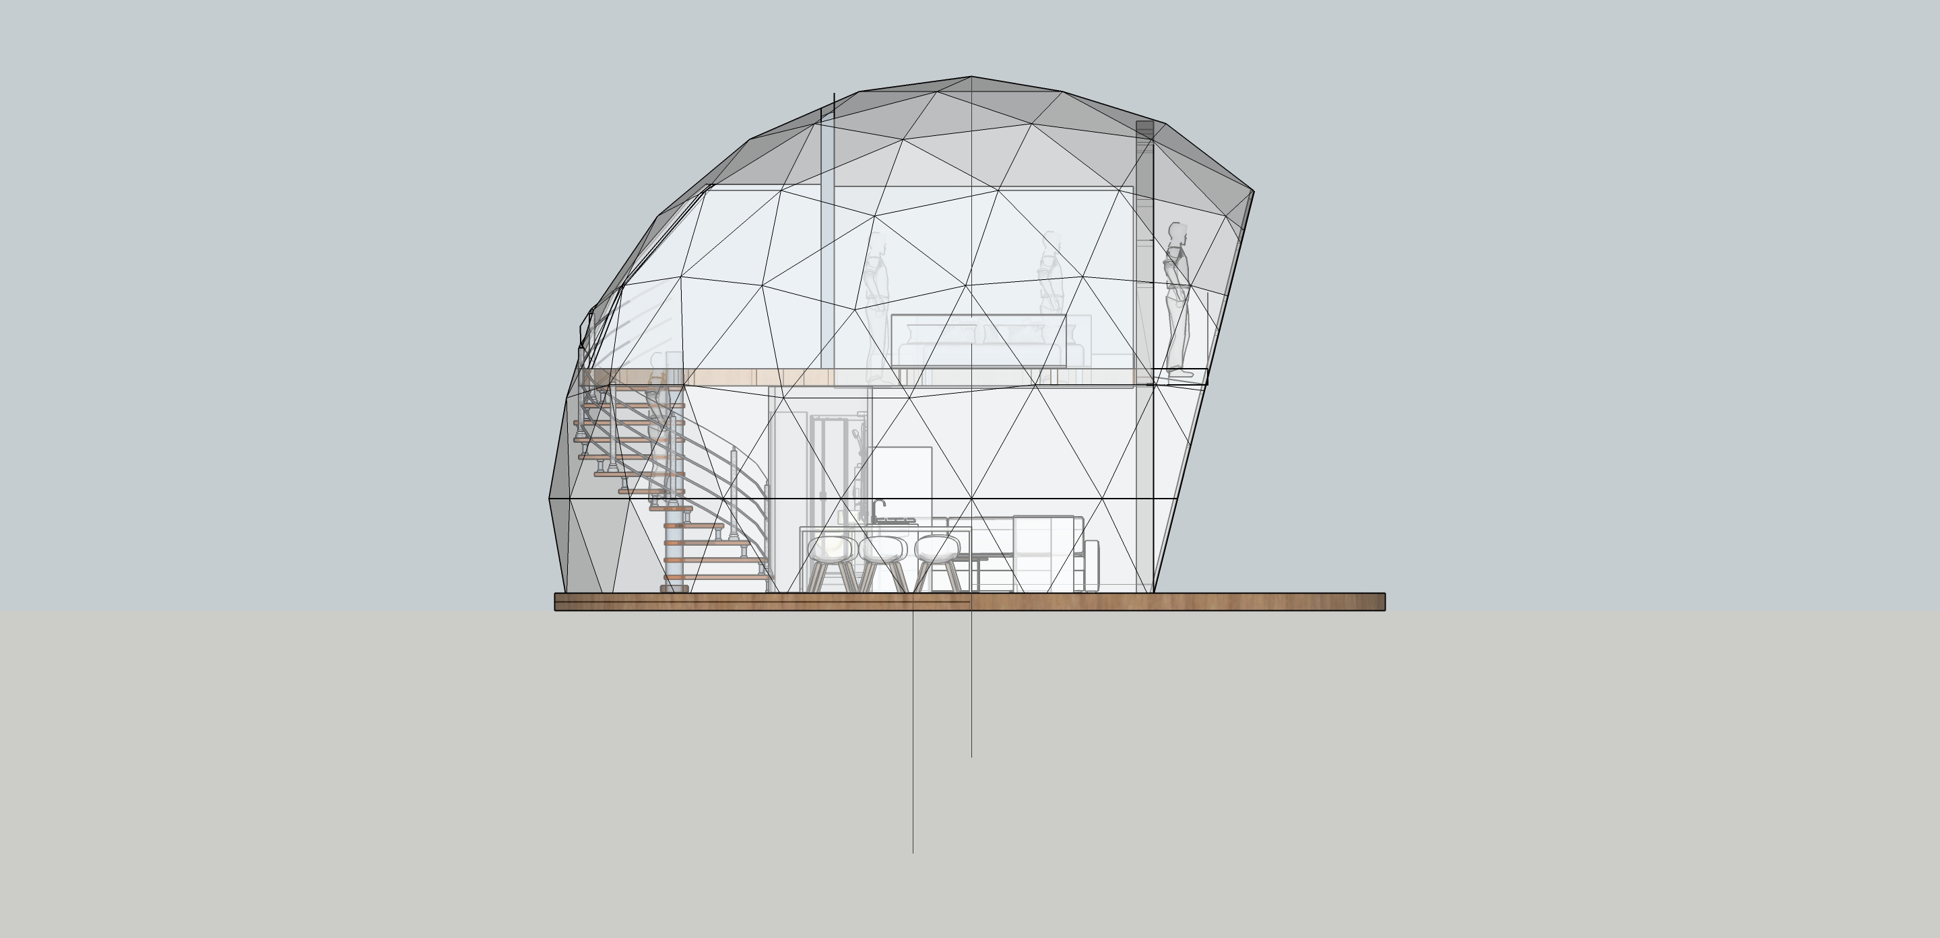
Desert Dome - Two Floors Concept

Slide 32
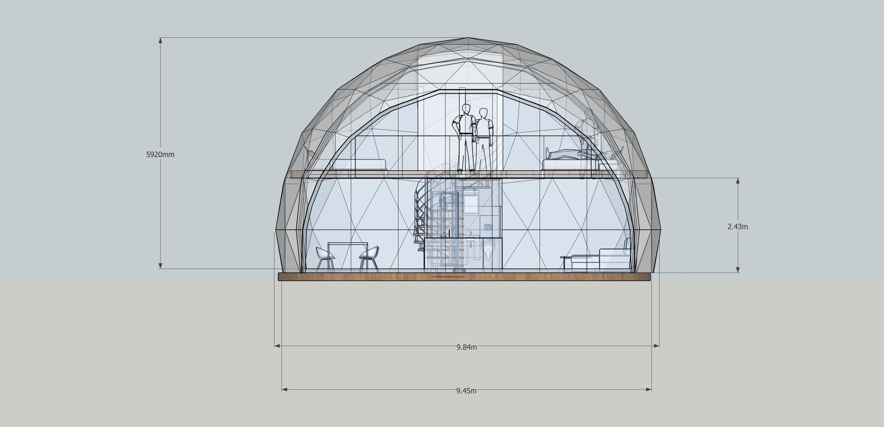
Desert Dome - Two Floors Concept
fdsfsdfdsfsdfds

Slide 34

A shipping container home makes the construction process much simpler and more efficient than ever before. So why spend months building when it could be weeks? Imagine them as life-size LEGO blocks and you will start to see the vast possibilities and opportunities. Build a single level or multi-levels building. Place one in your backyard and then 10 years later move it somewhere new. When it comes to construction methods and building materials there are few alternatives that are as durable, portable and sustainable.
Desert BOX
Why Shipping Containers?

Slide 35
Durability - A Desert BOX unit is built with an engineered commercial grade Streamlined - Simultaneous site development and building construction at the Desert Box facility. Reducing project schedules by 30-50%. Environmental – Desert BOX is an environmental housing unit that does not need to have a foundation on the ground. Efficiency - Every Desert BOX is equipped with proven all electric systems which allows for renewable energy sources to offset some or all of the energy usage. Movable - Desert BOX unit is a movable unit and can be easily transfered from location to another.
Desert BOX
Movable - A movable unit and can be easily transferred from location to another.
Durability - is built with an engineered commercial grade a longer lifespan.
Environmental - Does not need to have a foundation on the ground.
Streamlined - building construction reducing project schedules by 30-50%.
Steel Framed - Providing superior strength.
1
2
Why Desert Box?
3
4
5

