Slide 1
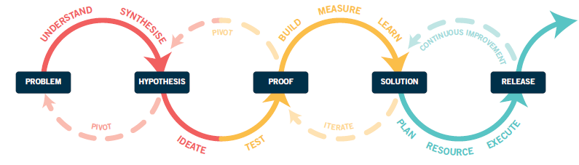
Our draft innovation process
DISCOVER
DEFINE
DELIVER
INSIGHT
TEST
ITERATE
DELIVERY PLAN
CHALLENGE
OPPORTUNITY STATEMENT
CONCEPTS
SOLUTION
LAUNCH
(IN)VALIDATE
ITERATE
IDEATE
NB: It needs to be clear which steps link to each of the 3 phases (discover, define, deliver) – we did this with colour
- The Discover phase (challenge → ideate)
The Define phase ((in)validate → solution)
The Deliver phase (delivery plan → lauch )
NB: the process is not always linear and sometimes you may have to go back a step – we have shown this with the dotted lines.
NB: The black boxes are outputs and act like gates, once you have defined these things you can move onto the next step (see next slide for more explanation)

Slide 2
Innovation Process – explained
We are working on training materials to explain the steps – but here is a quick brain dump of the beginning of the process to help bring it to life:
Challenge – at the beginning of the project you need to define your challenge (i.e. How might we ……………… (what you want to accomplish), for …………………… (to whom your impact will matter most to), in a way that ………………. (describe the approach, mindset, or values you want to apply), so that ……………….. (the big impact you want to create).
Insight – you need to understand your users, and the context the problem exists within by gathering insight. There are many tools that can be used for this depending on the challenge you want to solve e.g. interviews with customers, competitor analysis, analysing current customer journeys. Once the challenge is well understood, it’s time to synthesise your learnings and insights to uncover the patterns, themes and principles that will direct your way forward. Here you will also prioritise the insights you want to tackle.
Opportunity statement – now you will be able to articulate a prioritised problem or list of problems you want to solve (we like to phrase them in a more positive way – hence the use of the word ‘opportunities’ rather than ‘problems’) Without a clear opportunity statement, it’s time to pivot back to redefining your problem.
Ideate - Otherwise, it’s time to move onto ideation, where the goal is to go wide in exploring all manner of solutions to your problem in the pursuit of the desired change you’ve outlined. It’s ok to get adventurous here; that’s how some of the best ideas emerge.
(in) validate – this is all about evaluating the ideas you have, doing some quick testing to see what will work and prioritising …
Concepts: 1-3 ‘concepts’ to test (i.e. prototype/pilot)
…

Slide 3
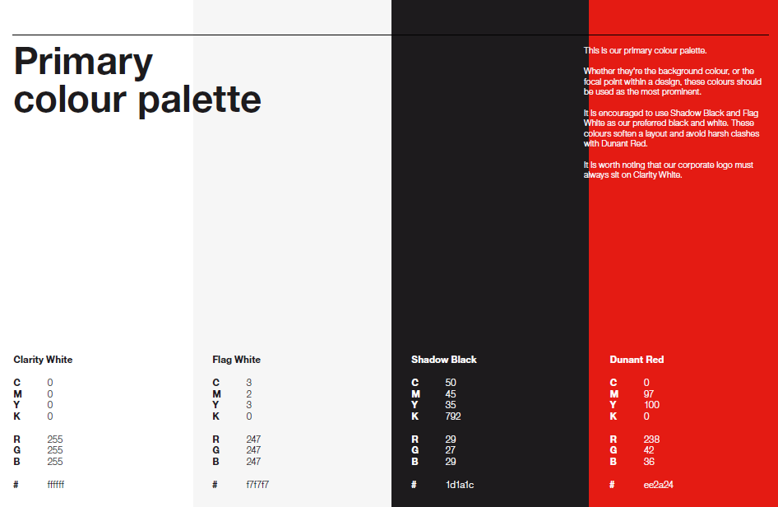
Brand Colour pallet
NB: we’d rather not have any harsh black – e.g. we don’t like our black boxes with white writing in

Slide 4
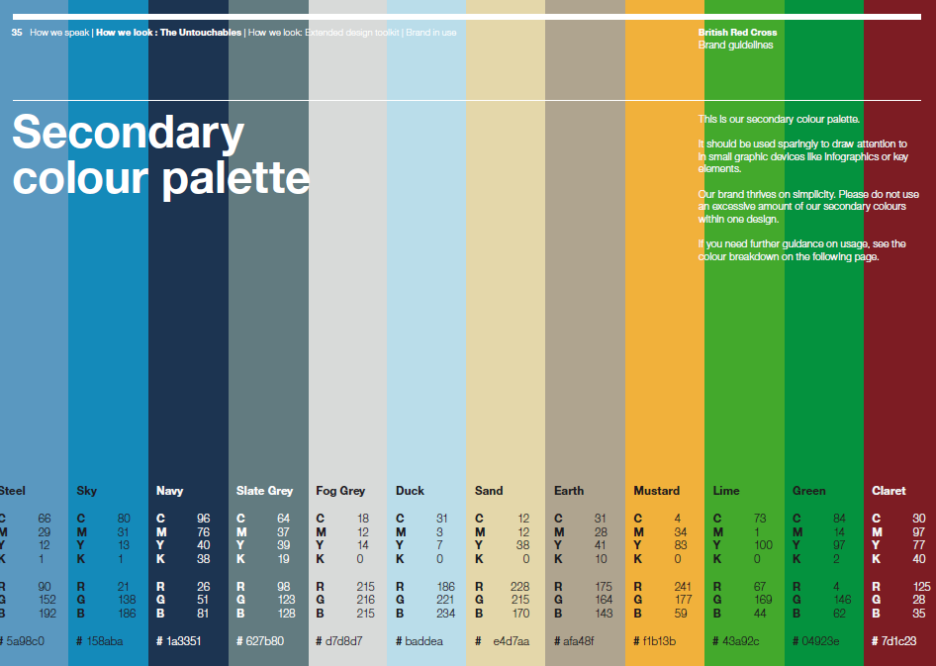
Brand Colour pallet

Slide 5
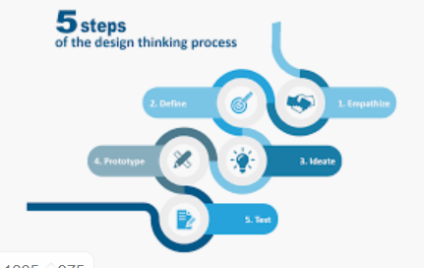
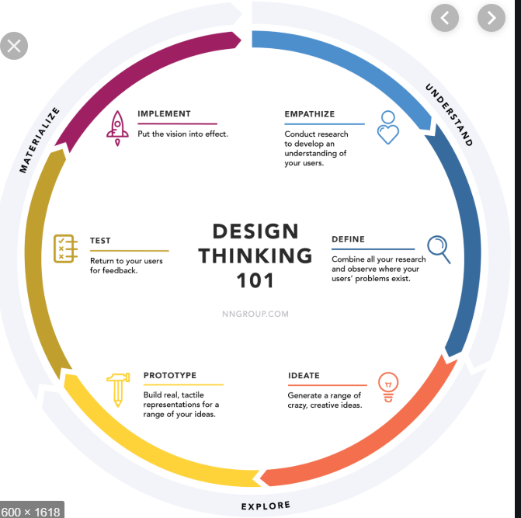
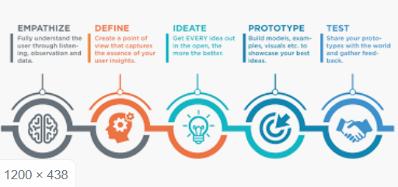
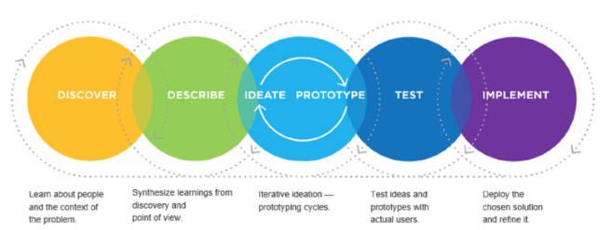
Other innovation process we like:

