Slide 1
KEYA Cure
CBD Full Spectrum Oil

Slide 2
Product Label
KEYA Cure
2 Products: CannFocus and CannRelief
Full Spectrum CBD Oil
30ml | 1000 mg
Mint flavor

Slide 3
Label 2
Use: Shake well. Take 1 dropper to the mark twice daily. Hold under the tongue for 30 seconds. Use every day for best results. Start CBD use with a half dose and work up to full dose after 7 days.
Discuss CBD use with a physician if taking other medications. Do not exceed 5 doses in a day
Food Supplement Contains: Full Spectrum CBD, hemp oil and natural flavor
CBD derived from Cannabis less than 0.025 THC
Store in a cool, dark place
Logos for non GMO and Organic

Slide 4
Label 3
Derived from Cannabis as a full spectrum oil.
Add a box here for expiration date
Space for a QR code
Manufactured in Colorado, United States for KEYA Cure, The Netherlands
KEYAcure.com

Slide 5
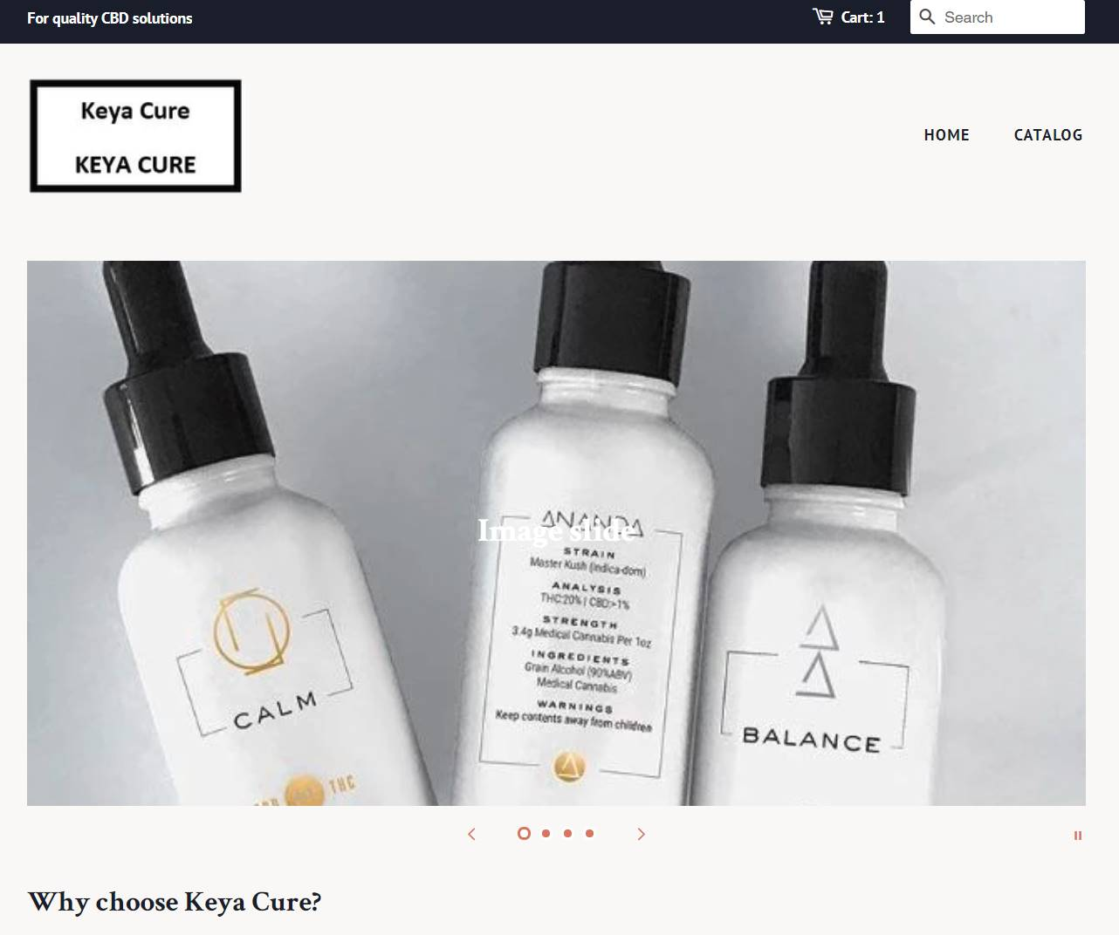
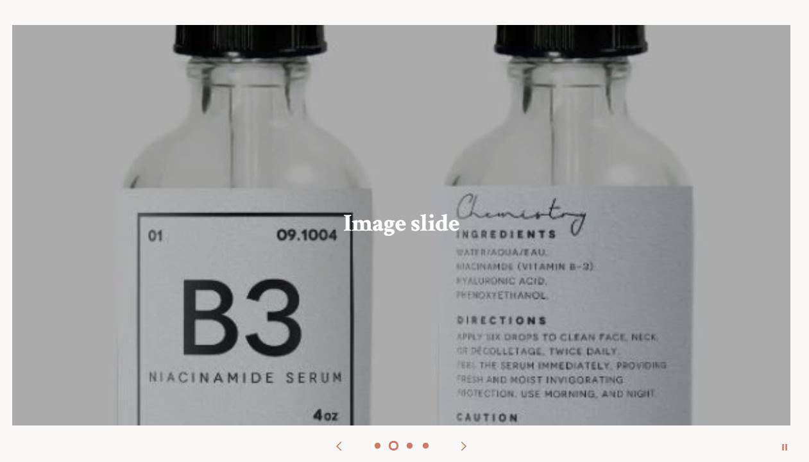
IDEA board

Slide 6
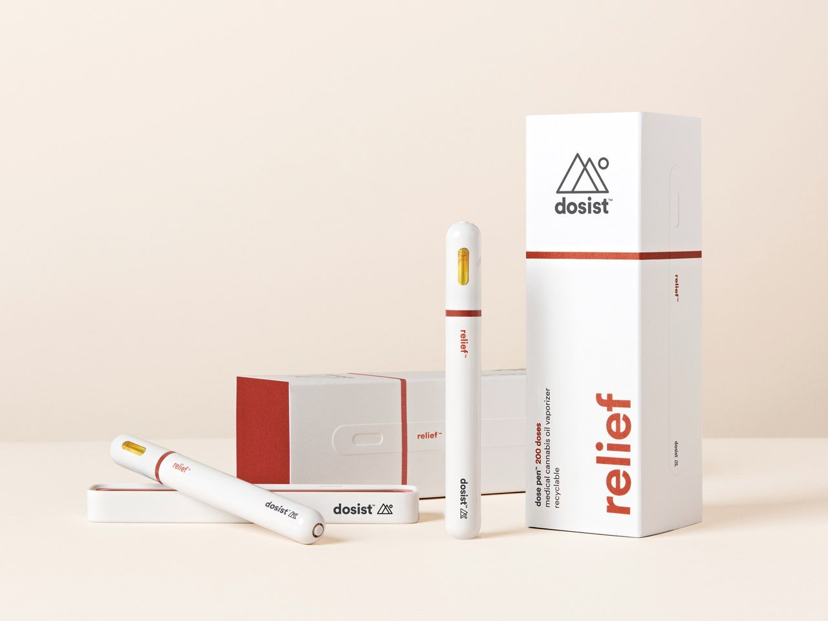
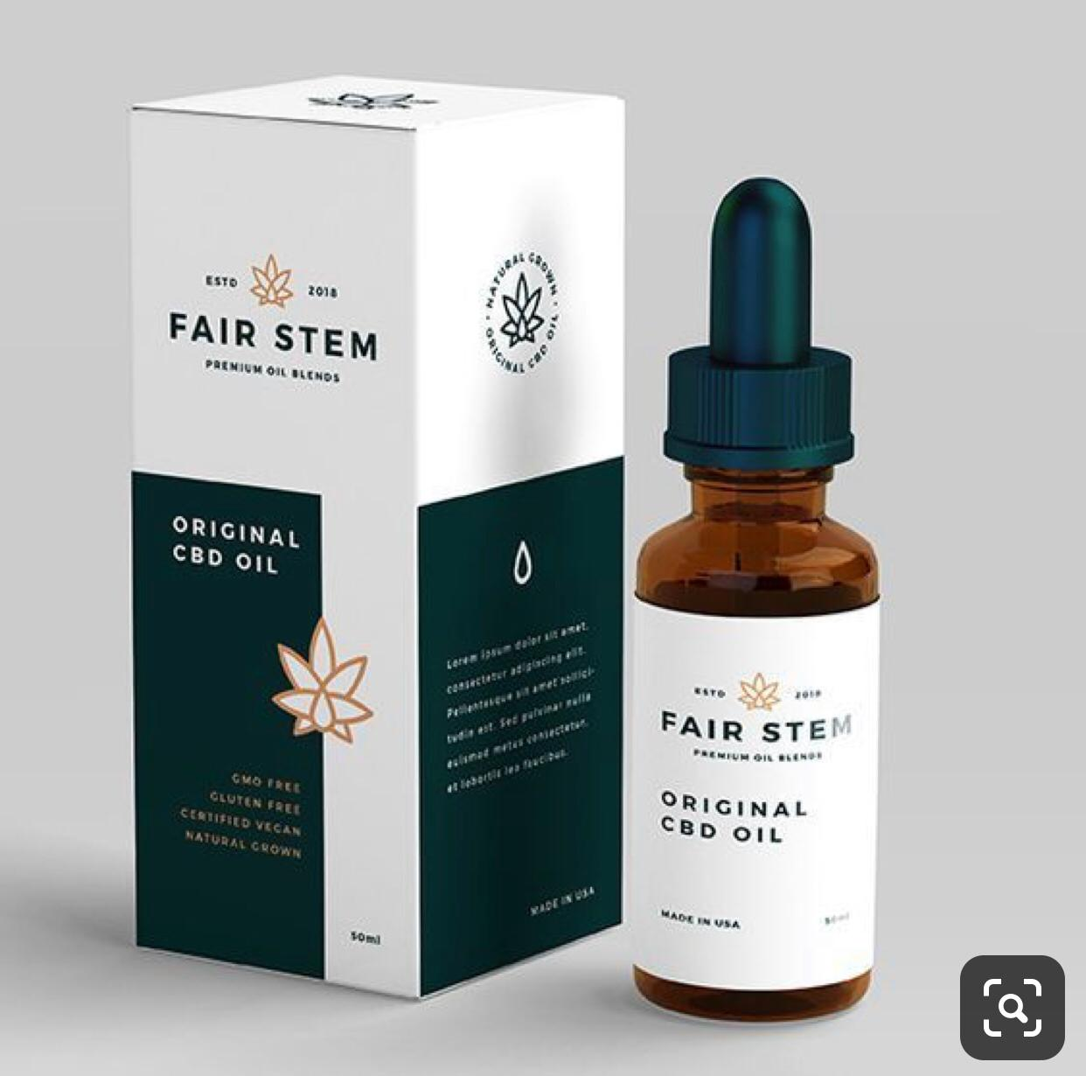
Idea Board

Slide 7
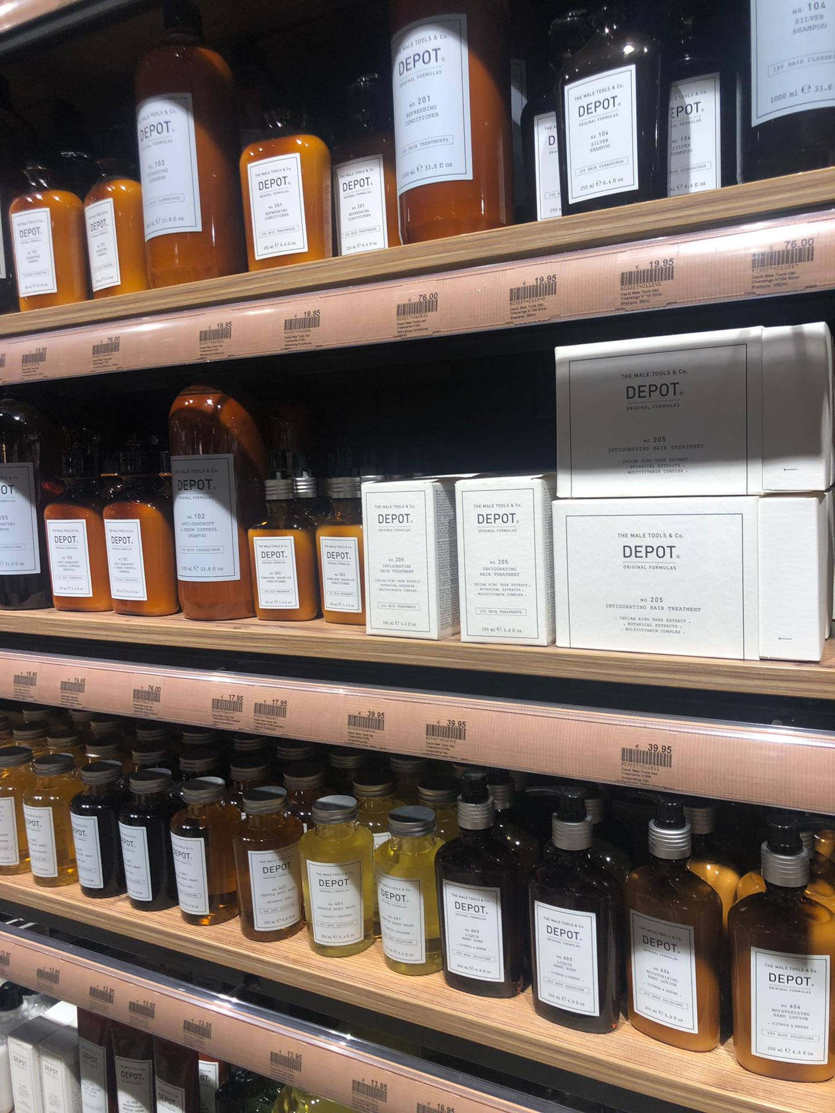
Idea Board

