Slide 1




Slide 2
The HERPORT Group
Registered in 1991
French SME with a global dimension
Consolidated 2017 Turnover : €222 Million
270 staffs in France, 500+ worldwide
Global network
3 Main services
  Freight forwarding for General Cargo under the name Herport
  Textile Warehousing activities under the name SC2
  Time Critical deliveries under the name EAS
“ WE TAKE THINGS PERSONALLY ! ”
For Us, Every Client is Unique,
Every Shipment is Personal.

Slide 3
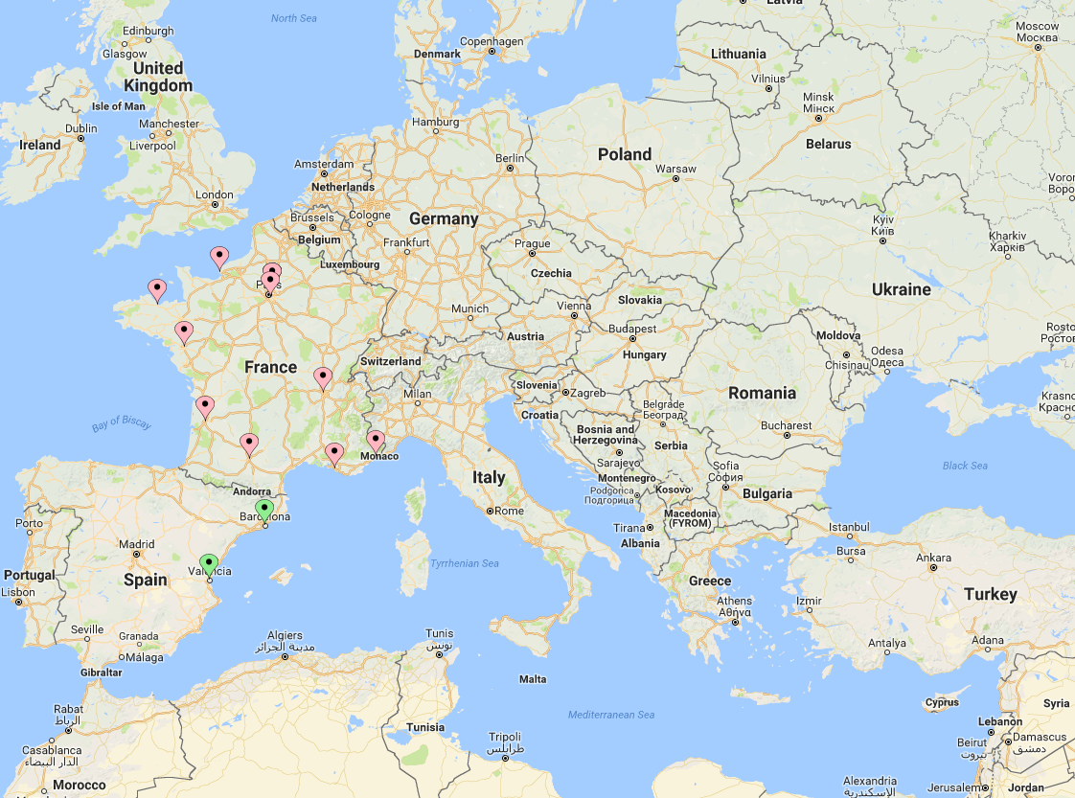


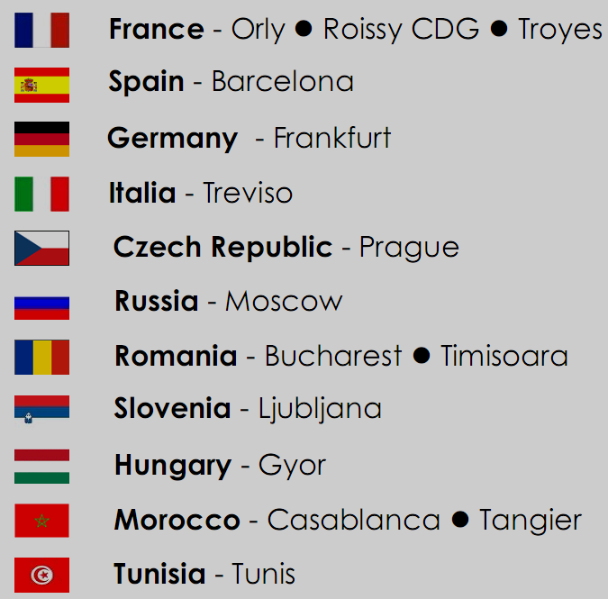


Herport Europe
France
Roissy
Le Havre
Lille
Orly
Toulouse
Bordeaux
Marseille
St-Brieuc
Lyon
Nantes
Nice
Barcelona Valencia
Time Critical Stations
France
Moissy

Slide 4
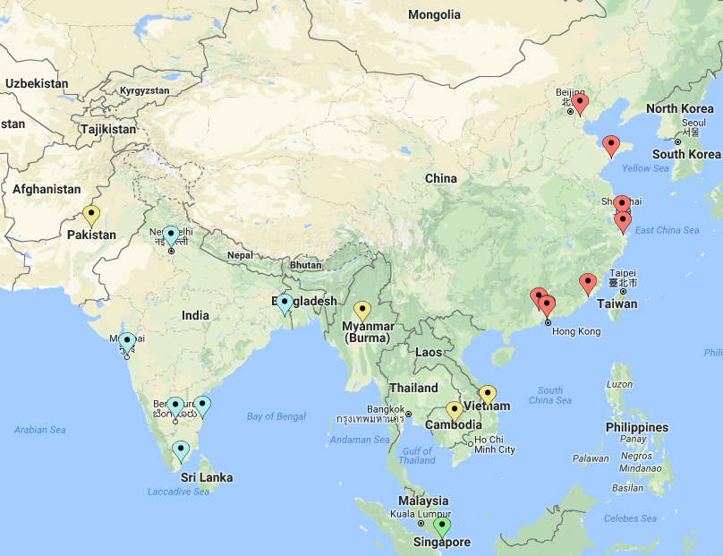

Herport Asia
China
Hong Kong
Shanghai
Ningbo
Shenzhen
Guangzhou
Xiamen
Tianjin
Qingdao
Singapore
India
Bangalore
Chennai
Mumbai
New Delhi
Turicorin
Kolkata
JV
Vietnam
Myanmar
Cambodia
Pakistan
China
Shenzhen

Slide 5
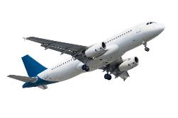






Air Freight Services
General Cargo
Delivery within 1 to 5 days
Door to door or Door to airport services
Flexible service with best-in-class value
Competitively-priced alternatives for your needs
Customs expertise
Unusual cargo handling (oversized, hazardous etc.)
Follow-up in real time
Secured boarding and control
A worldwide network Thru 2 major networks
Agreements with major airlines and airline operators
Cargo & Passengers flights
Freight Agent
certified IATA
Notes:
Insert a map of your country.

Slide 6
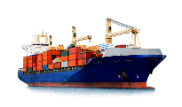
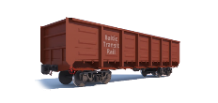


Sea Freight Services & Alternative Services
FCL / LCL
Regular Lines Europe / Asia
& Europe / America
Negotiation with steamship lines for cost effective transport
Agreement with major global carriers (Maersk, MSC etc.)
Secured Allotment & cross-trade consignment
Letter of Credit management
Buyer consolidation services from main Asian ports
Rail Freight
China - Europe
3 departures a week
Transit time around 24 days
Zhengzhou -> Hamburg - 2 trains a week
Wuhan -> Duisburg - 1 departure per week
Cheaper than air, faster then Sea freight,
Shipper owned container
Sea-Air service
From main Chinese ports
For overseas service
Speeding up transit time in regards to sea freight
Cheaper than airfreight service
Secured hubs in China
Deliveries to EMEA countries and America
Notes:
Insert a map of your country.

Slide 7
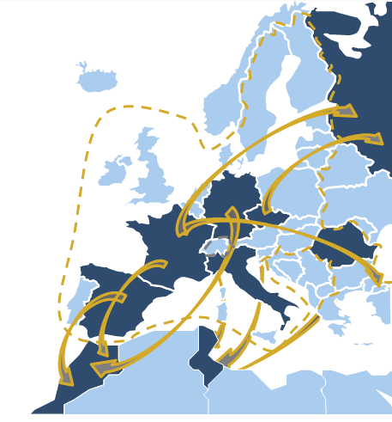
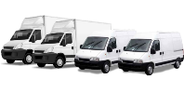
Road Services
A large fleet of vehicles all over Europe
Small van to heavy trucks
Secured & Approved vehicles
Vehicles on loading within 1 hour
Customs formalities if required
Regular Courier
Delivery as scheduled
Regular lines - Cost-effective service with scheduled pick-up & Delivery
Dedicated vehicle
Pick-up & delivery on request
Dedicated means - Possibility to speed up shipment with additional driver
Full, Part and Co-loads
Delivery within 24/48 h in Europe
Chartering vehicles with
scheduled pick-up & Delivery
Reactivity
Availability
Notes:
Insert a map of your country.

Slide 8

Customs
25+ Years of Custom Expertise
HS Code assessment service in Europe and China
Consulting in complex set up
Authorized Economic Operator (AEO) : HERPORT’s AEO type F n° 00000446 (customs simplifications / Security and Safety)

Slide 9
In-House Tracking System
We have our own Track & Trace
You can check the status of your consignment in real time.
In-house developed, the system can be customized to your specific requirements.
The system is available thru a secured web portal, therefore you can be connected from anyplace.

Slide 10
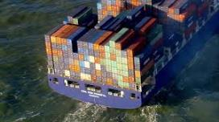

Asia Import
Ocean Freight Import :
35.000 TEUs
Main PODs: Le Havre, Fos, Bassens, Anvers, Hamburg…
Service contract with major Global Carriers
Secured allotment
Air Import :
2000 Tons per month
Service contract with the main airlines out from Asia
Masterloader in Hong Kong, Guangzhou and Shanghai (Direct service contract with the airlines) – Secured allotment
Weekly consolidation service from the major Chinese airports on the route China / France.

Slide 11







We also do
Textile Wood Live animals
Fresh food/ Vegetables Wine Medics
http://www.herport.net

Slide 12

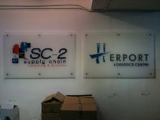
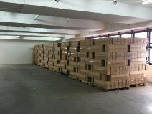
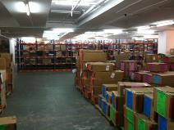
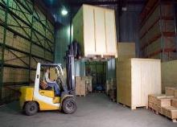
Warehousing Solutions
SC2, is the Logistics department of the Herport Group and offer Supply Chain solutions
P.O management system 100% developed in House, WMS, 100 % on-line. Custom made web portal
Real time access from anywhere in the world
Simplification and standardization of documents

Slide 13
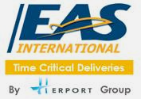






Time Critical Service
Just-in-Time Deliveries
Next Flight Out
Delivery D+1
Door to Door
Door to Airport
Special Handling
On Board Courier
Accompanied Luggage
Road Services
Express all over Europe
Air Taxi
Dedicated planes & Helicopters
Reactivity
Availability
Quality & Environment
ISO 9001/ ISO 14001
Customs Formalities
Import / Export
Freight Agent
certified IATA
Notes:
Insert a map of your country.

Slide 14
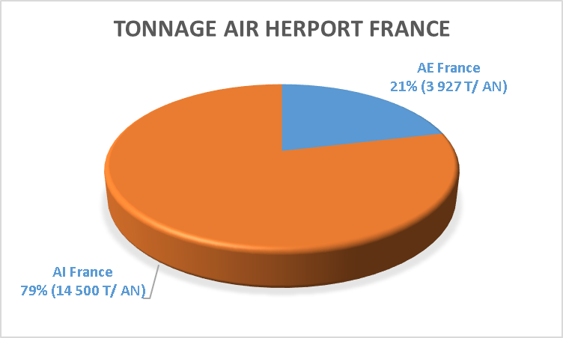
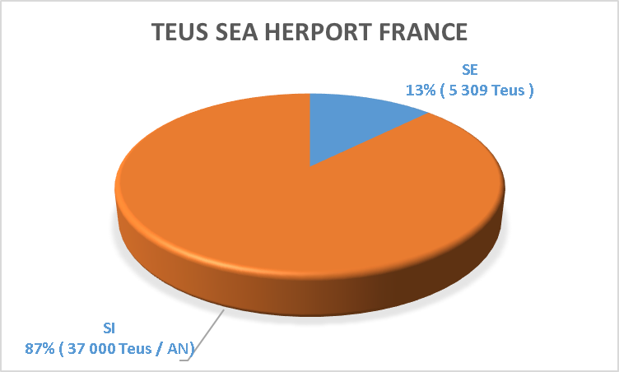
Global Statistics

Slide 15


Thank you !

