Slide 1
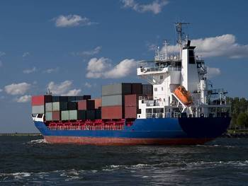
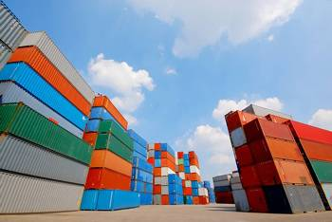
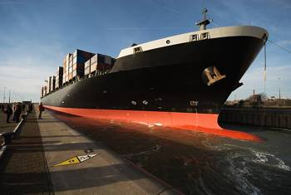

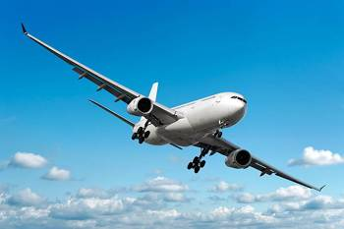
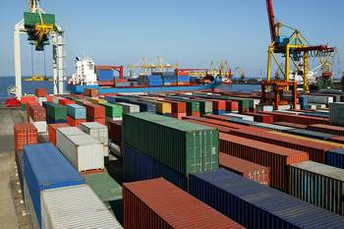
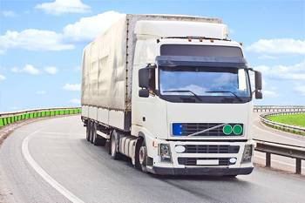

Overseas by Herport

Slide 2
Sommaire
Our company
Our offices in France
Our network
Our strenghts
Our tools for supply-chain

Slide 3


Created in : 1991
Turnover : 65 Millions €uros
100 Employees in France
300 Employees in Herport grouponde

Slide 4


Our offices in France
Airfreight
  Paris Roissy CDG
  Paris Orly-St Brieuc
  Lille
  Marseille
  Toulouse
  Bordeaux
  Lyon
  Nantes
Seafreight
  Le Havre
  Marseille

Slide 5

Overseas Network
Asia Pacific
Americas
Middle East
Africa
Europe

Slide 6

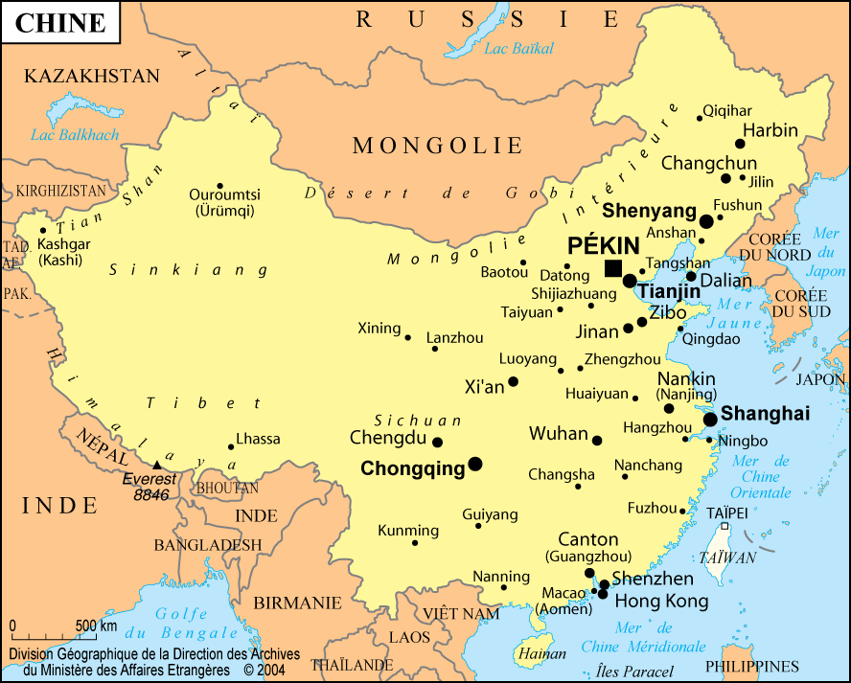


Our organization in China
Hong Kong
Shanghai
Qingdao
Dalian
Fuzhou
Ningbo
Tianjin
Xiamen
Shenzen
Guangzhou
Beijing

Slide 7
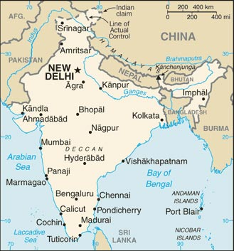

Our organization in India
New Delhi
Chennai-Madras
Mumbai-Bombay
Bangalore
Tuticorin
Cochin

Slide 8
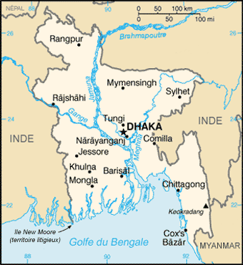

Bangladesh
Our strong knowledge in the textile market along with our partner DART DGL makes Bangladesh a major trade for Herport group.

Slide 9
Partneship in Asia
Vietnam, Cambodia
Indonesia, Malaysia, Thailand
Pakistan
Philippines
Singapour
Taiwan
South Korea, Japan

Slide 10

Partnership in Asia
Africa
  South Africa
  Madagascar
  Mauritius
America
  Usa : Los Angeles, San Francisco,
  Chicago, Washington, New York.
  Canada : Toronto, Ottawa, Montreal ,Vancouver
  Brazil, Peru, Chili, Argentina, Guatemala
Europe : Belgium, UK, Germany, Italy, Spain
Middle East / Maghreb
  UAE
  Turkey, Morocco, Tunisia, Egypt
Australia : Melbourne, Sydney, Brisbane

Slide 11
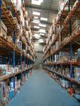


Our strenghts
Our know-how in the textile and fashion industry
Our services
References

Slide 12
Our Know-how
A very strong and professional knowledge of the textile & fashion market especially on the following trades :
- India
- China &Hong Kong
- Bangladesh
- Vietnam
- Pakistan, Indonesia, South Korea, Thailand …….

Slide 13
Our services

Slide 14

Airfreight
HERPORT offers :
Regular consolidations inbound & outbound
dedicated services ( full aircrafts, chartered )
HERPORT is IATA agreed since 1995 -

Slide 15
Seafreight
HERPORT offers :
LCL & FCL services inbound & outbound
Dedicated buyers consol boxes
Very strong and competitive agreements with the major shipping lines.

Slide 16

TRACKING
HERPORT created his own « tracking-tracing » system, that allows our customers to be connected « live » with their shipments and very efficient supply-chain moduls via SC-2.
.

Slide 17

Custom Clearance
Our offices are fully custom integreted, with dedicated team, specialized in textile & fashion industry.
Agreed Economic Operator : HERPORT is registered under AEOF n° 00000446 ( custom agreement that offers quickly clearance and simplified process.

Slide 18
Our values 1/2
Customer’s satisfaction is our aim.
To bring immediate and complete feed-back, with professionalism and advices.
Availability.

Slide 19
Our Values 2/2
The human being is an essential value who is the root of the company, his present and future.
Our family company is founded on the close relationship between all their members, professionalism and rigor.

Slide 20
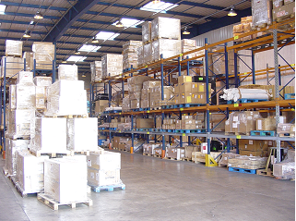
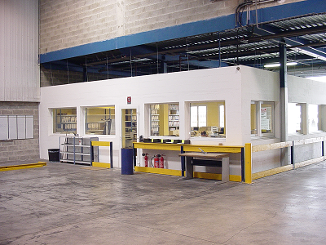
Our Paris Cdg Airport office 1/2
Storage capacity : 3000 palets
5000 sqm area
BUP / palettizing facilities

Slide 21
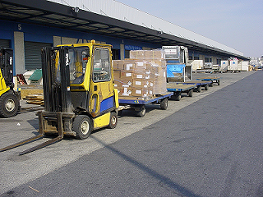
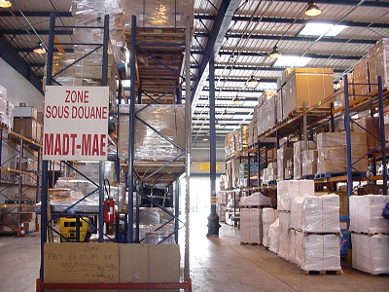
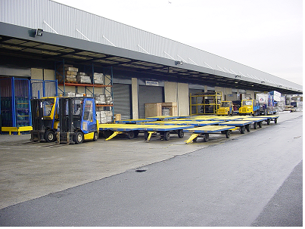
Our Paris Cdg airport office 2/2
16 truck access doors
We load/unload 200 trucks/day

Slide 22
Our main references
Billabong Complices The Kooples
Jacqueline RIU Paul and Joe Maje
Celio Bill Tornade Kaporal
Armand Thiery Zadig et Voltaire Ripcurl
Lee Cooper Apostrophe Orchestra
Comi (Intermarché) Barbara Bui Kappa
DPAM Tout compte fait CWF
Sergent Major Christine Laure Airness
Gérard Darel Folia Longchamp
Manoush Jennyfer Bent Criss
Le bon Marché Sandro Eram Gemo
Morgan / Beaumanoir Temps des Cerises Kickers
Sud Express Behring Converse
Best Mountain Sinequanone New Balance

Slide 23
Offices-France
PARIS CDG ROISSY ( +HQ) 8 Rue du NOYER ZAC du Moulin BP 16364 95706 ROISSY CDG CEDEX  : 01 34 38 58 20 Chairman : René PORET – rene.poret@herport.fr Managing Director : Guy VIELZEUF – g.vielzeuf@herport.fr | ORLY Rue du Tri – Bat 293 BP 638 – LOCAL 101 94393 ORLY AEROGARE  : 01 74 22 05 01 Roland FROIDEVAL – r.froideval@herport.fr
LILLE Bâtiment France HANDLING Bureau 216 59810 LESQUIN  : 03 28 82 94 74 J.Michel BACHELET –jm.bachelet@herport.fr | BORDEAUX 19 Chemin de la procession 33700 MERIGNAC  : 05 56 35 02 20 Christophe LEROUX – c.leroux@herport.fr
TOULOUSE 7 Avenue Didier DAURAT BP 30044 31702 BLAGNAC CEDEX Christophe CABROL – c.cabrol@herport.fr | MARSEILLE Technoparc du Griffon 511 route de la SEDS 13127 VITROLLES  : 04 42 77 73 04 Lionel CABROL – l.cabrol@herport.fr

Slide 24
LYON
Bâtiment Fret Extension
Est Cargoport
Zone de fret
69125 LYON ST EXUPERY
 : 04 72 22 81 15
R.POMMIER – r.pommier@herport.fr
SAINT BRIEUC
30 Avenue des Chatelets
Parc d’activité des Chateliets
22950 TREGUEUX
: 02 96 76 50 49
O. MORIN – o.morin@herport.fr
NANTES
4 Rue Jack London
Parc d’activité Oceane
44400 REZE
02 51 78 74 72
M.LANDREAU– m.landreau@herport.fr
F.CHATRY f.chatry@herport.fr

Slide 25
LE HAVRE Parc de l’estuaire Rue du Mont Cabert 76700 HARFLEUR  : 02 32 74 61 61 Managing director : Pascal SAUNIER – p.saunier@herport.fr

