Slide 1
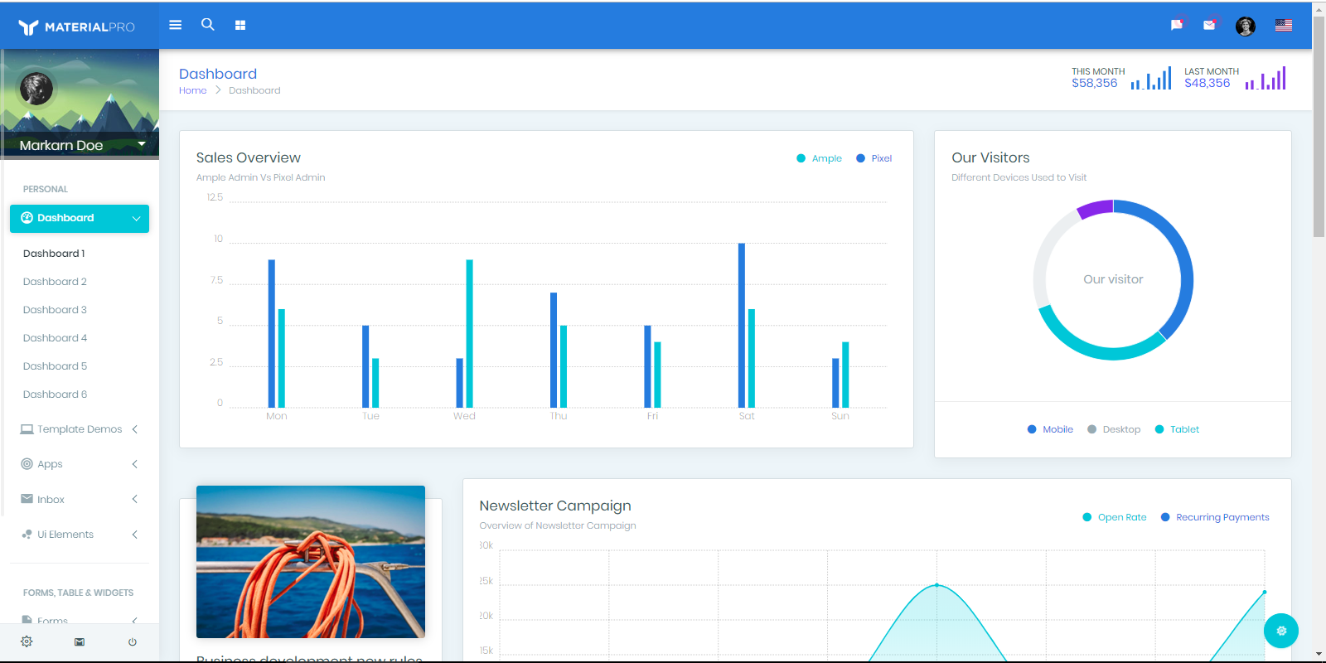
Logo somewhere here
For sure, not same size

