Slide 1

Strategic Financial Planner
Yemi Orogbemi
yemi1979@gmail.com
973-974-9990

Slide 2
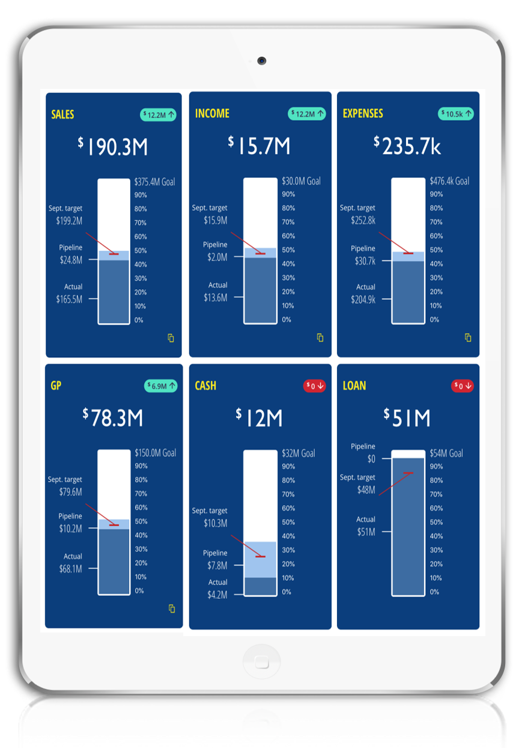
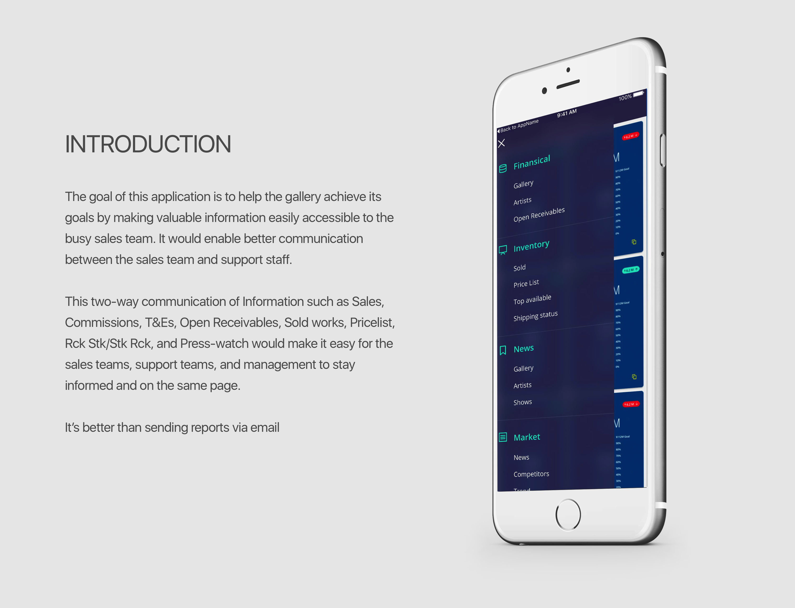
INTRODUCTION
The goal is to provide sales leaders with affordable strategic financial planning and analysis (FP&A).
Most growing businesses can’t yet afford the price tag associated with an full-time FP&A professional and they don’t have time or the expertise to carefully manage this function. Thus, they fail to plan strategically.
As a result, they suffer with costs overruns, poor pricing, cash flow crisis, mounting debt, and low overall performance.
With Rulr, we’re attempting to make FP&A affordable for growing businesses through a combination of automation and expert planners.
This can be accomplished because 95-97% of FP&A is data analysis which a computer can process faster with higher accuracy.
Rulr pulls data from multiple systems (QuickBooks, Xero etc., bank accounts, credit card, CRM), cleans and organizes the data, analyzes data, and publishes report to users.
Monitor in real-time:
Sales, Expenses, Income, Cash, Debt, Objectives, etc.
Simple for non-finance professionals

Slide 3

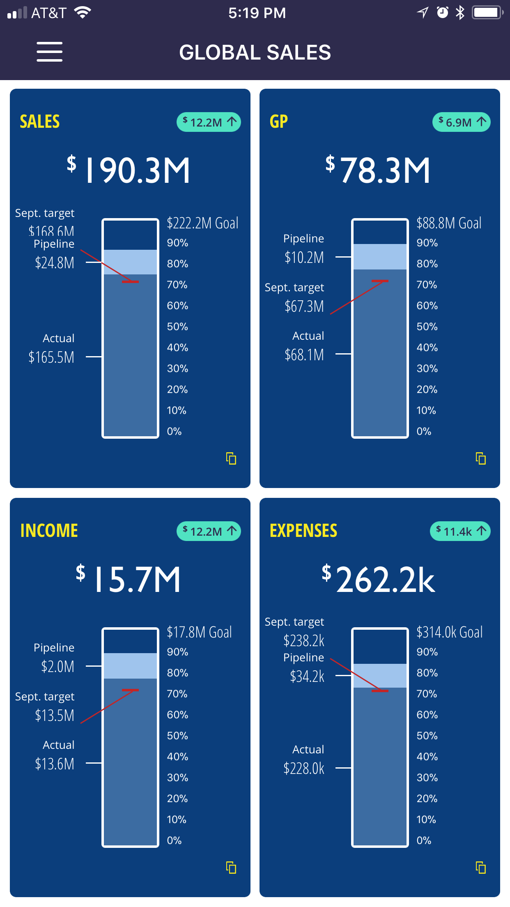
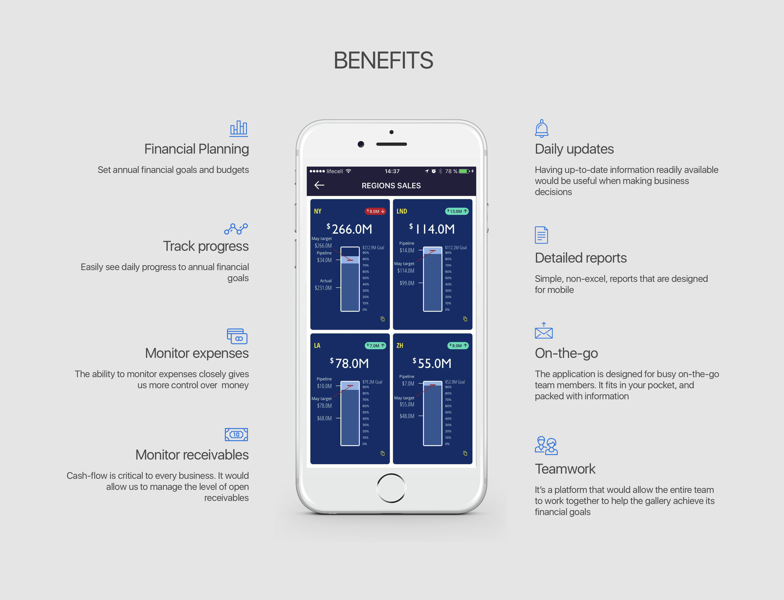
Real-time updates
Monitor cash

Slide 4
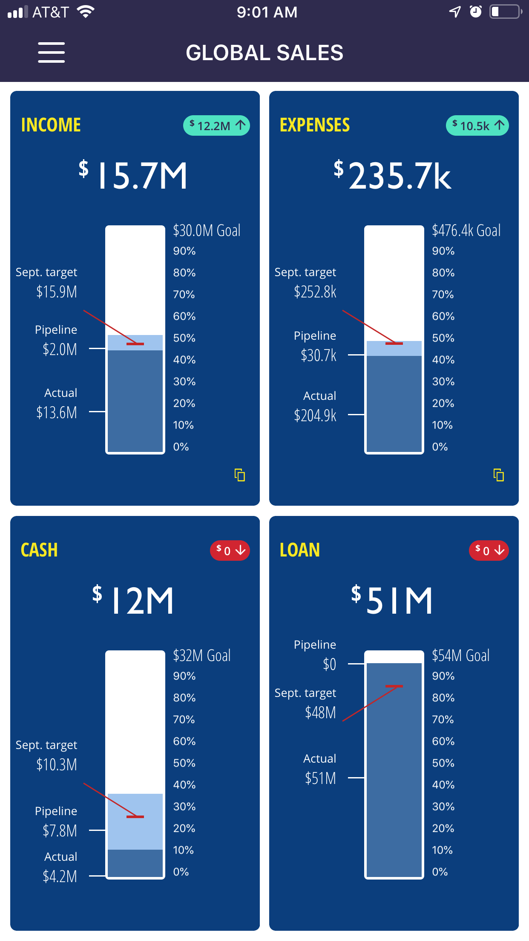
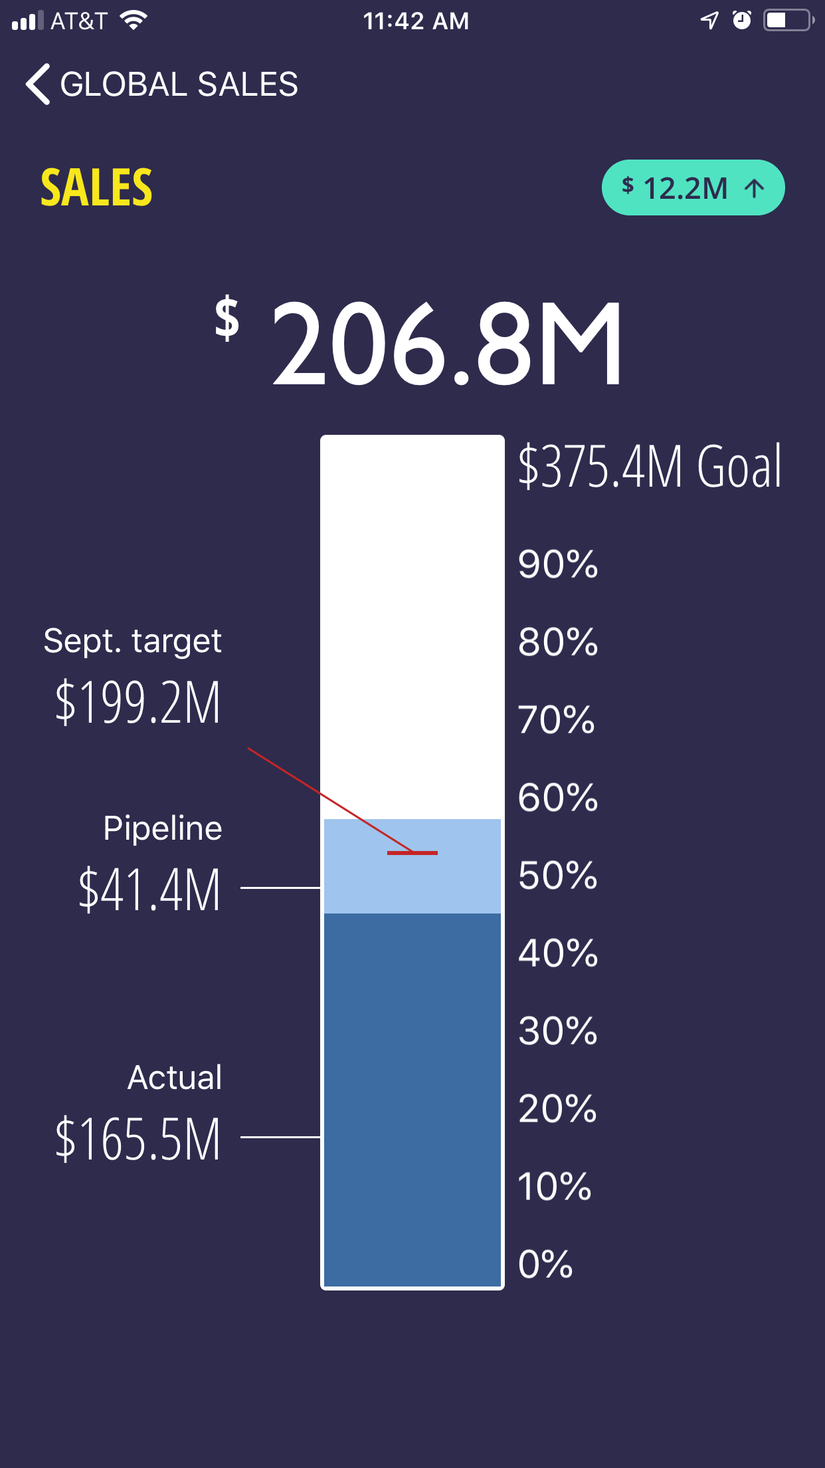
SCORECARD
Detailed but easy to consume
Account
Variance to last year
Year-to-date actual
Annual goal (budget)
a
b
c
Current month’s target
Forecast or Unpaid
d
e
Industry Avg. (Benchmarking)
Year-to-date actual
Percentages
Variances:
a – forecast to budget
b – target to budget
c – year-to-date actual to budget
d – forecast to target
e – target to actual
- Industry Avg. vs actual
- Industry Avg. vs target
- Industry Avg. vs forecast

Slide 5
Financial Analysis
The application would make it easy to monitor the financial health of the business.
It would allow users to track progress against budget in real-time and also forecast based on historical data to allow users to spot risks and opportunities early.

Slide 6
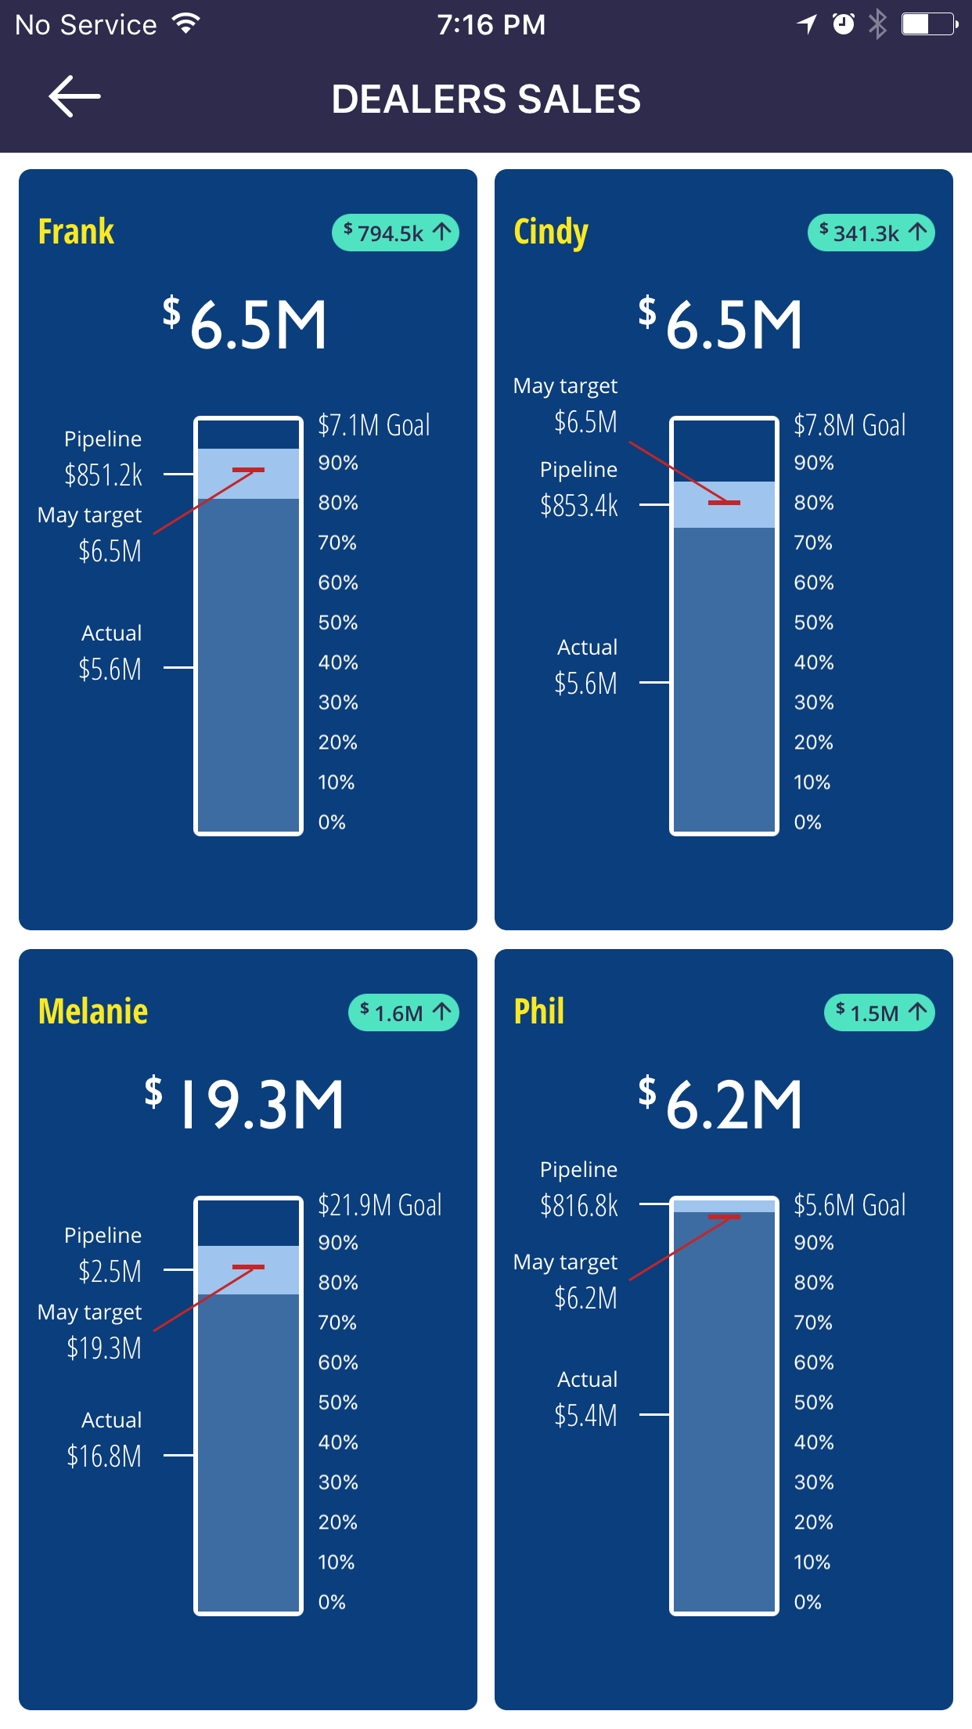
Employee/Department performance
Monitor performance of each department to their objectives and budget. We’ll tie each employee’s performance to the organization’s performance.
Each employee would see their impact on the organization’s performance which would force them to improve their performance—no employee wants to have a negative impact on the organization’s performance.

Slide 7
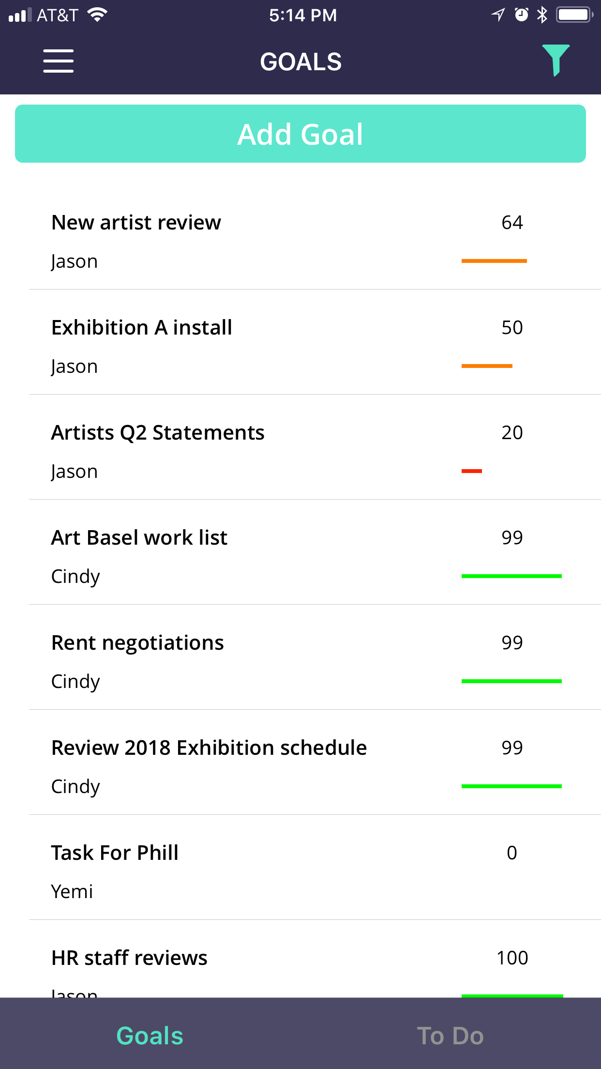
Objectives
The application also provides a central location to help keep track of execution of strategies.

Slide 8
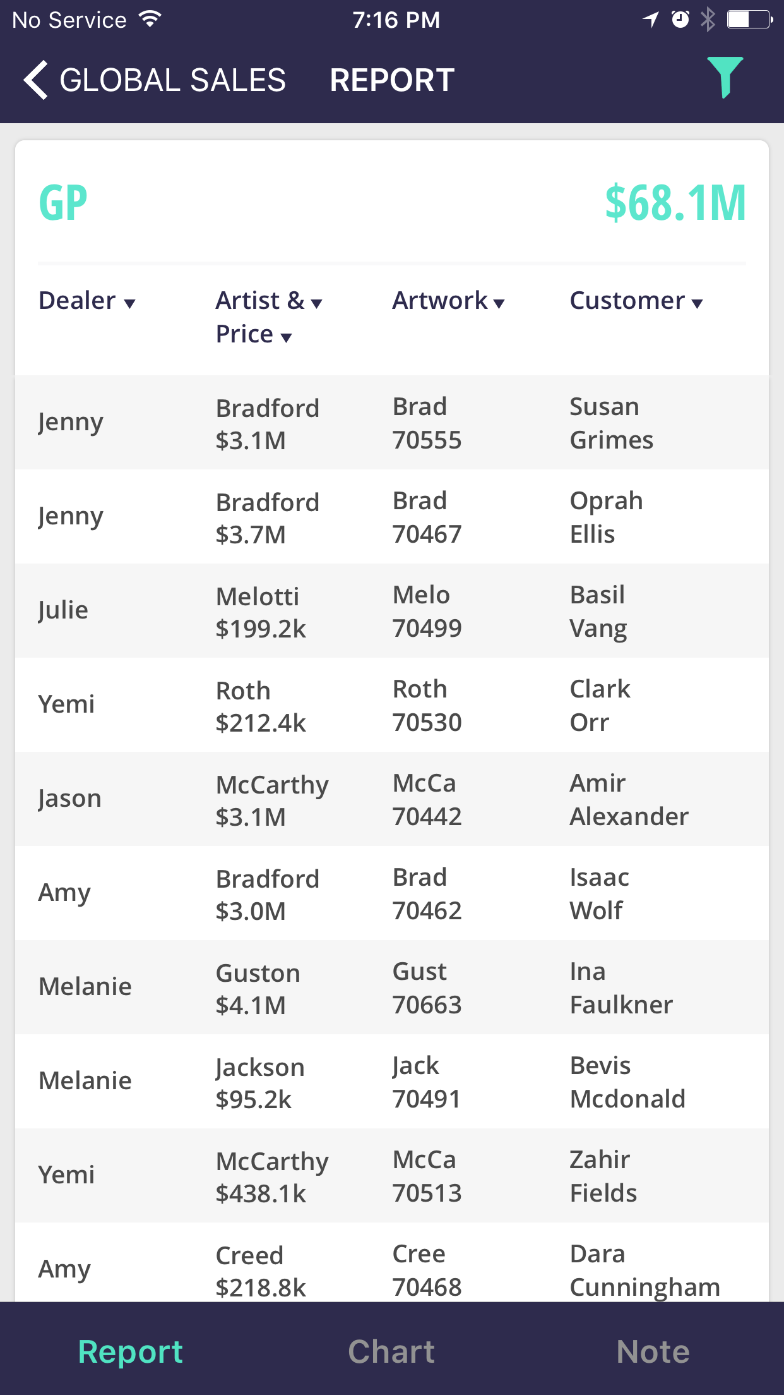
REPORTS
Standard reports on-the-go!
Example of reports that could be generated:
  Sales by person
  Sales by product
  Sales by customer
  Sales by month
  Expenses by department
  Expenses by category
  Open receivables
  Bank transactions
  And so much more

Slide 9
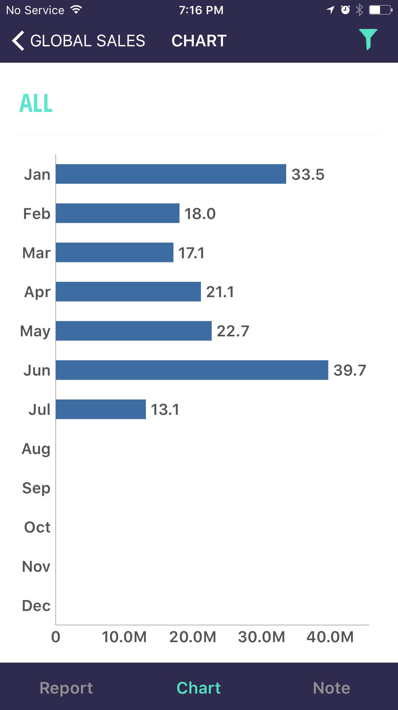
CHARTS
Standard charts on-the-go!
The chart can be updated to communicate the same information in different ways:
  By month
  By department
  By person
  By year
  By customer
  By product

Slide 10
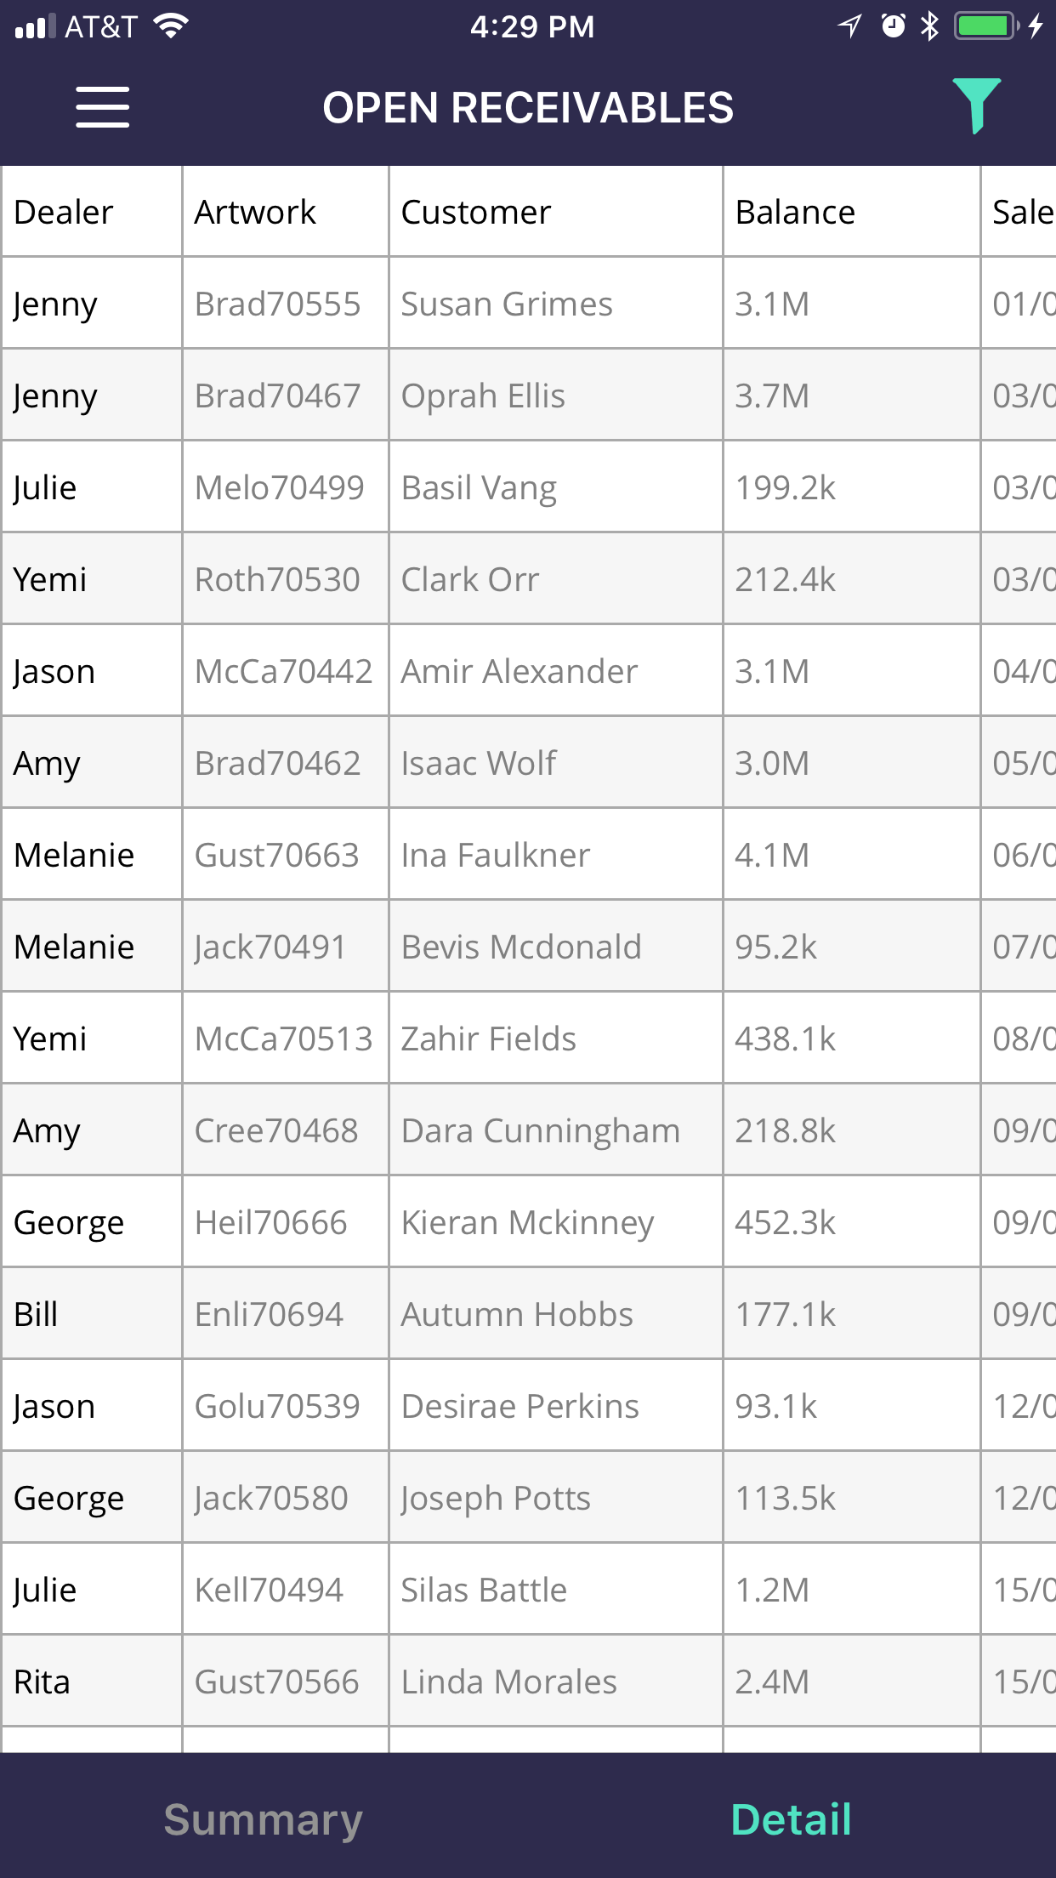
OPEN RECIEVABLES
Updated open receivables on-the-go!
The report can be filtered by client, region, or person.
The report will be updated when payments are made and new invoices are generated.

Slide 11
FUTURE PLANS
Estimated Cash Runway:
Market Share:
7.16 mo.
.012%
~215 Days
~2.16%
5 Days
Cash Out Date:
Regions:
~NOV 15, 2019
North America 3.4%
Europe 1.6%
Asia 1.9%
Central America 0.6%
Nov 20, 2019
Others:
Avail. LIC: $51M / $49M
Mo. Burn rate: $990K / 900K
Receivables: $1.2M / $950K
Payables: $880K / $800K
Liquidity ratio: 1.2 / 1.1
Quick ratio: 1.5 / 1.3
Others:
Revenue: $190.3M
ARR: $20.79M
Avg. Order: $7,853
Payables: $880K
New Clients: 35
# of Sales: 212

Slide 12
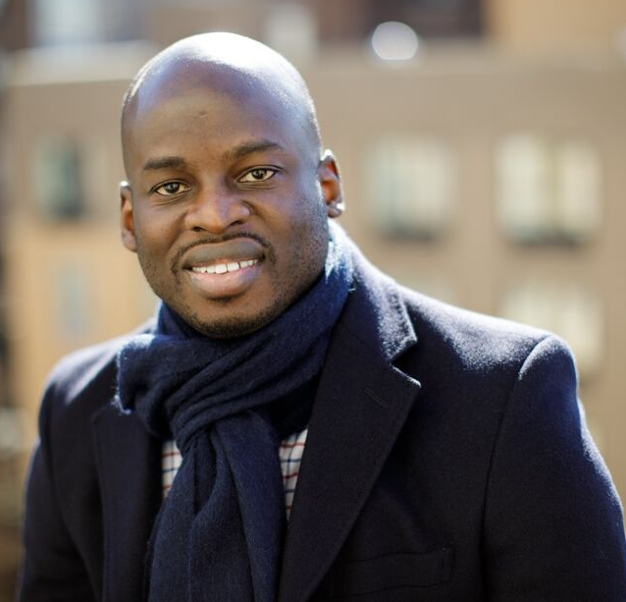
About Me:
Yemi Orogbemi, Experienced Strategic Financial Planner, Analyst, Controller, and Manager
My 14 yrs. corporate finance experience has included: Accountant (staff & senior), Financial planner & Analyst (junior & Senior), Finance manager and Sales controller.
Through it all I’ve specialized in helping teams improve productivity, which included automating financial reporting for Macy’s, Coach, Christie’s, Pace, and Hauser & Wirth and creating financial applications for Macy’s and Coach.
Qualities:
Extremely driven
Hyper-focused
Fearless
Ethical/high integrity
Disciplined
Fast learner
Fire fighter
Competitive
Goal oriented
Problem solver
Great listener
Big picture thinker
High performer
Skills:
Excellent MS excel skills
Data scientist
Programming skills
Financial Modeling
14 yrs. FP&A
Report automation
Leadership/people skills
Strategist
Costs controlling
Communication
Accounting
Creative
Top Accomplishments:
Developed (Rulr) my proprietary KPI app
Built P.O. application for Macy’s
Promoted in 6 months, twice (Macy’s/BLJ)
Saved Macy’s $400k via deal with FedEx
Managed $600M Macy’s Marketing budget
Automated Macy’s marketing reports to daily
Performed VP role as analyst at Macy’s
Go to finance person for Macy’s CMO
Helped build Christie’s finance dept/processes
Built 2 Financial reporting software for Coach
Saved Coach $2M on bulk buying deal
Improved cash-flow for Pace and H&W
Yemi Orogbemi
yemi1979@gmail.com
973-974-9990

