Slide 1

YOUR PITCH
OPTERRE BASECAMP STEP 4.3

Slide 2
Your Path to Success
Discovered Your Unfair Advantage
Showcase Your Authority in that Niche
AAA
01
03
05
02
04
Focus
Purpose
Mission
Found Your $1M Customer Niche
Making a Pitch to Interested Prospects
Notes:
You’ve reached the final step of the overall program that will get you started as a consultant business owner.

Slide 3
AGENDA
Purpose of the “Pitch?”
Why it’s important
Styles of Pitches
Whom do you pitch to?
Build your pitch

Slide 4
AGENDA
Deliver your pitch
Your next meeting
Objection Handling
“Secrets” of Selling

Slide 5
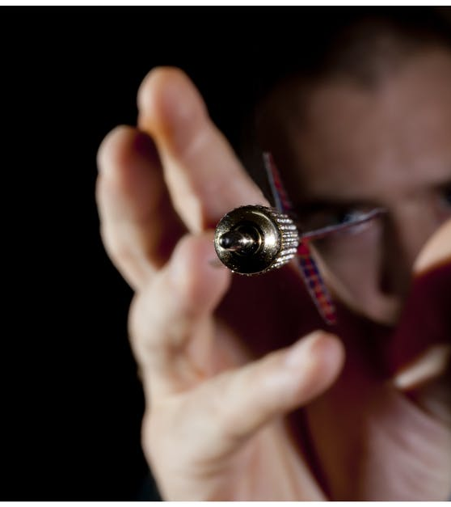
The Purpose of the Pitch

Slide 6
For YOUR Profession
Your pitch is the TECHNIQUE to get someone to consider you to solve their problem
We rarely have the opportunity to pitch for investment in our business.

Slide 7

To get them wanting more
Don’t bore them with technical details about your product. I’ve heard many investors say that if they walk away from meeting and can’t remember anything. If this happens to you, then you’ve failed.

Slide 8
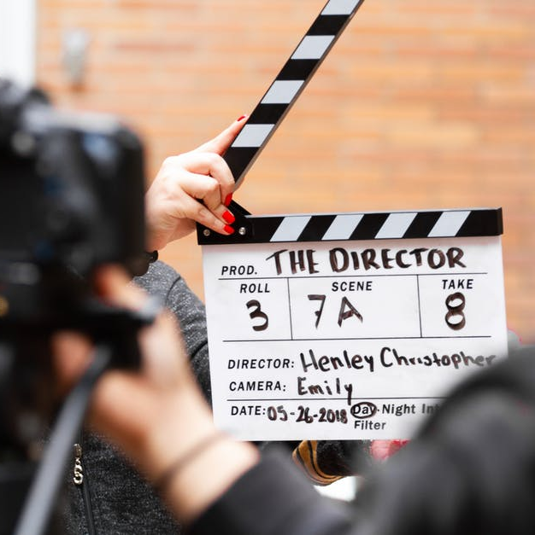
With the goal to Take Action
Connecting the dots between a prospective clients need for pain relief to your solution to makes that pain go away.

Slide 9

Do so by telling them a story
Purpose is to show you’re relatable. Connect with your audience. It’s most effective when it connects emotionally.

Slide 10

Enhance your story with enthusiasm and confidence
People buy (or invest) in those who really want to help the customer. You don’t need to gush like a sports caster; nor should you act cheesy, like a used car salesman; nor should you act like you can’t be bothered.

Slide 11
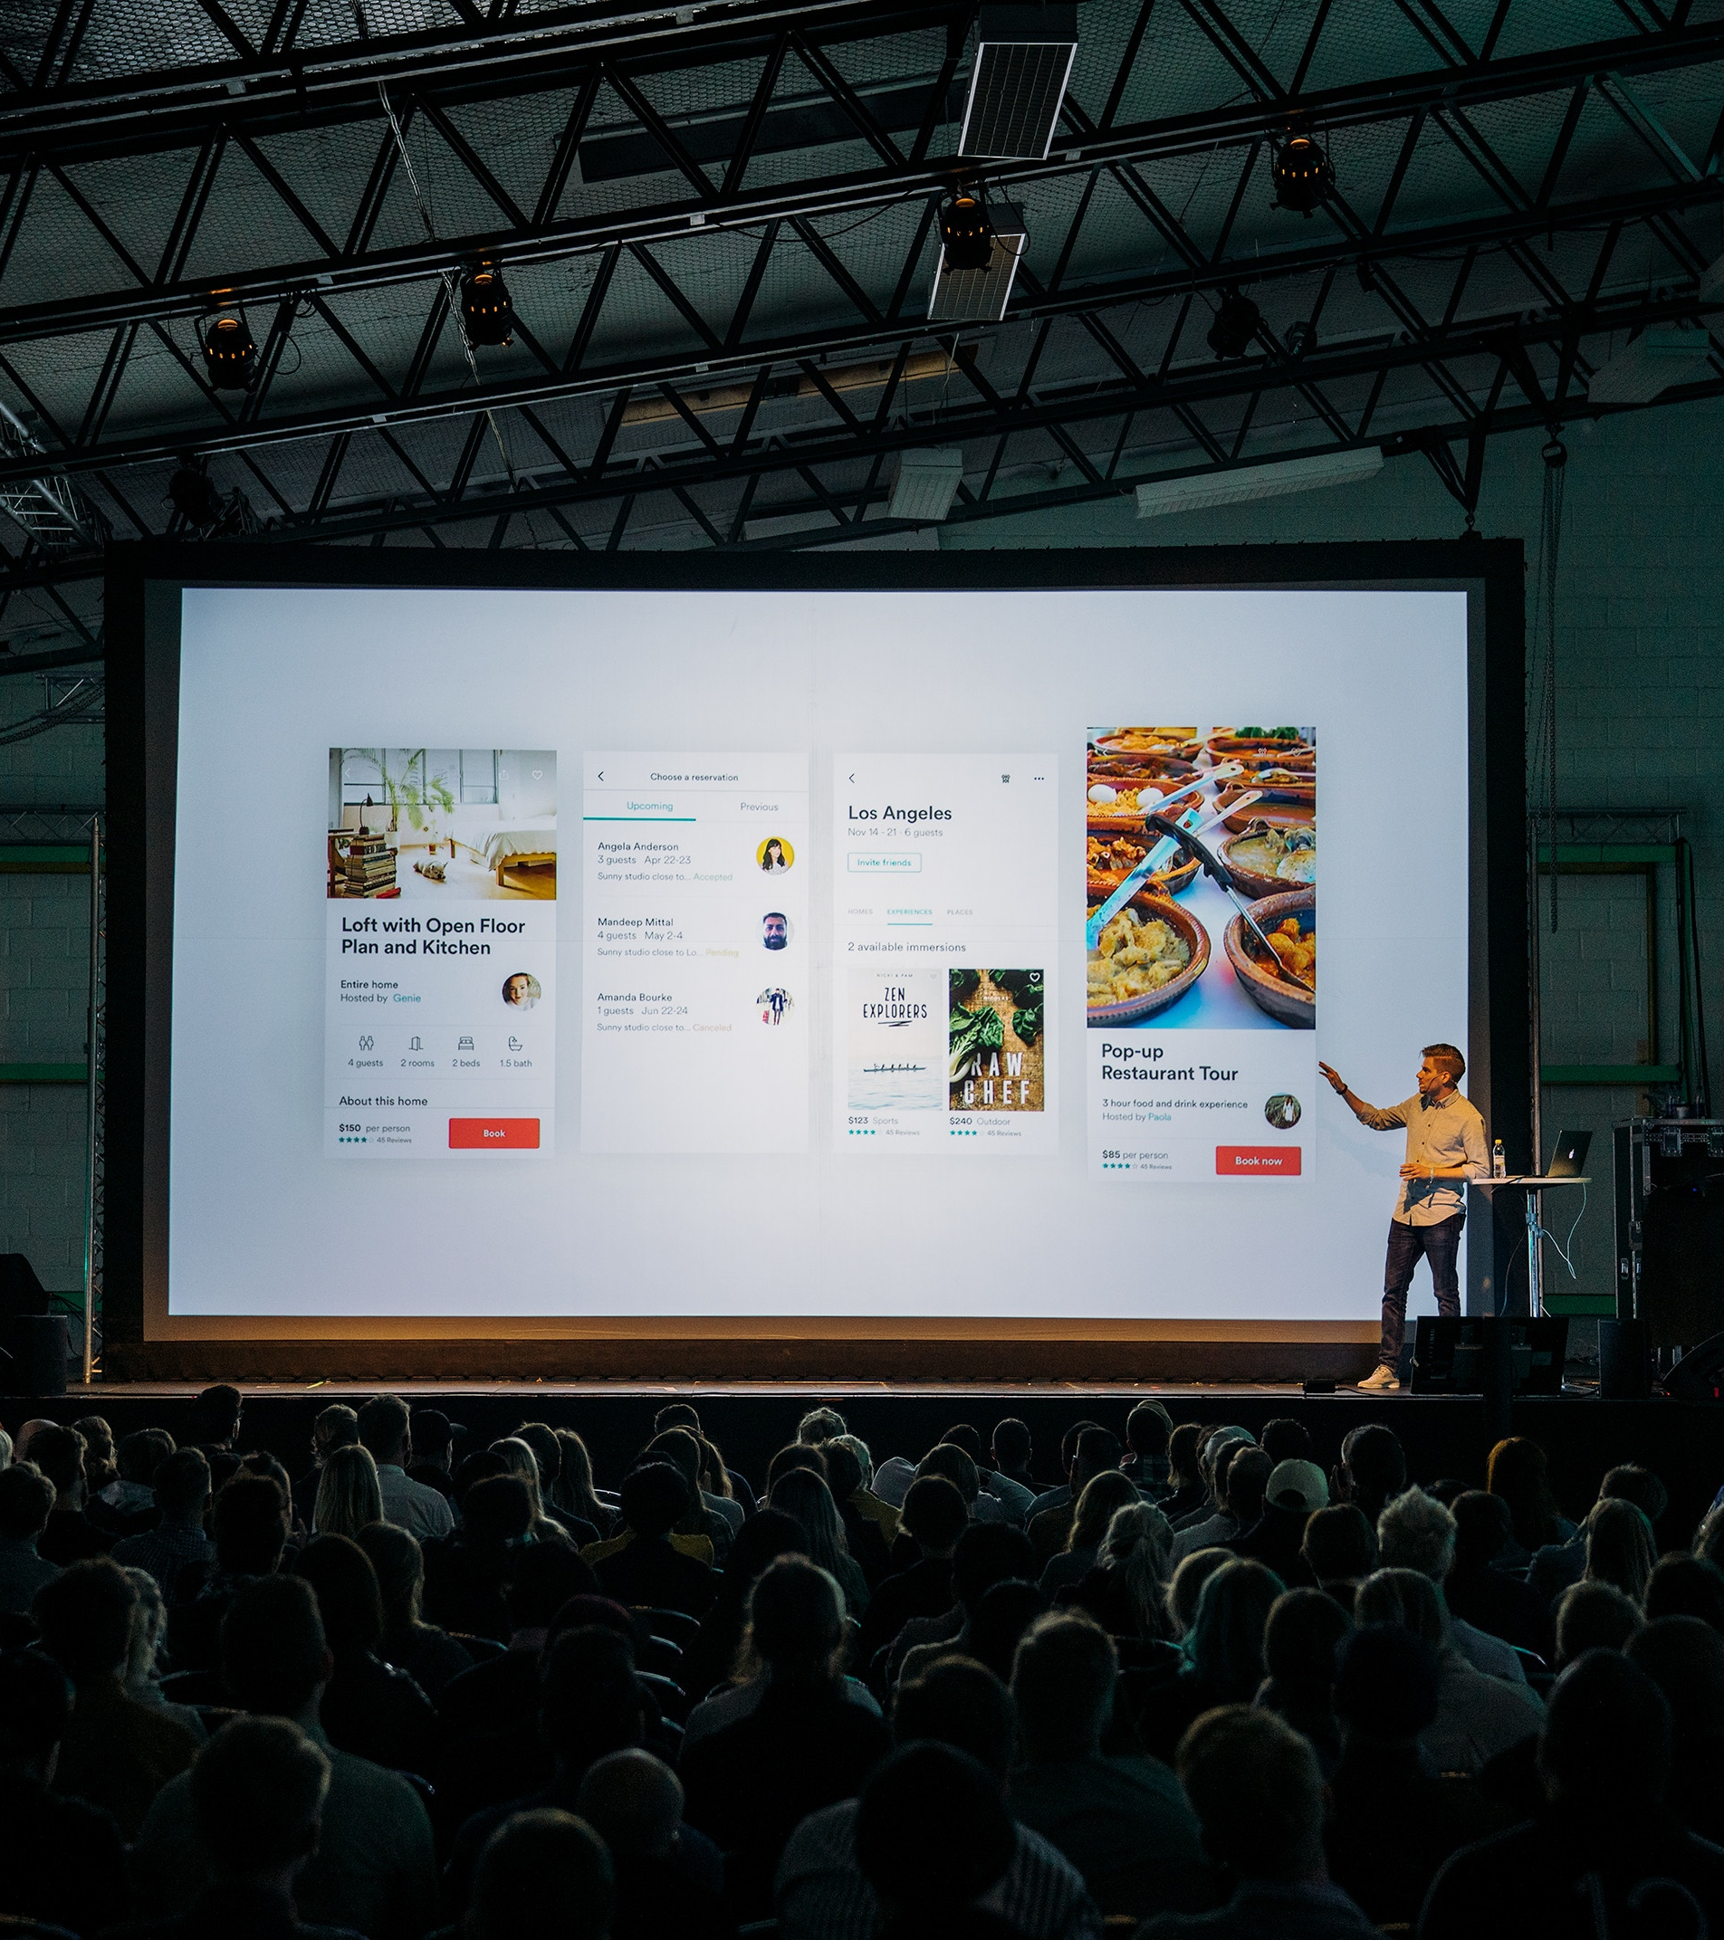
The Styles of Pitches

Slide 12
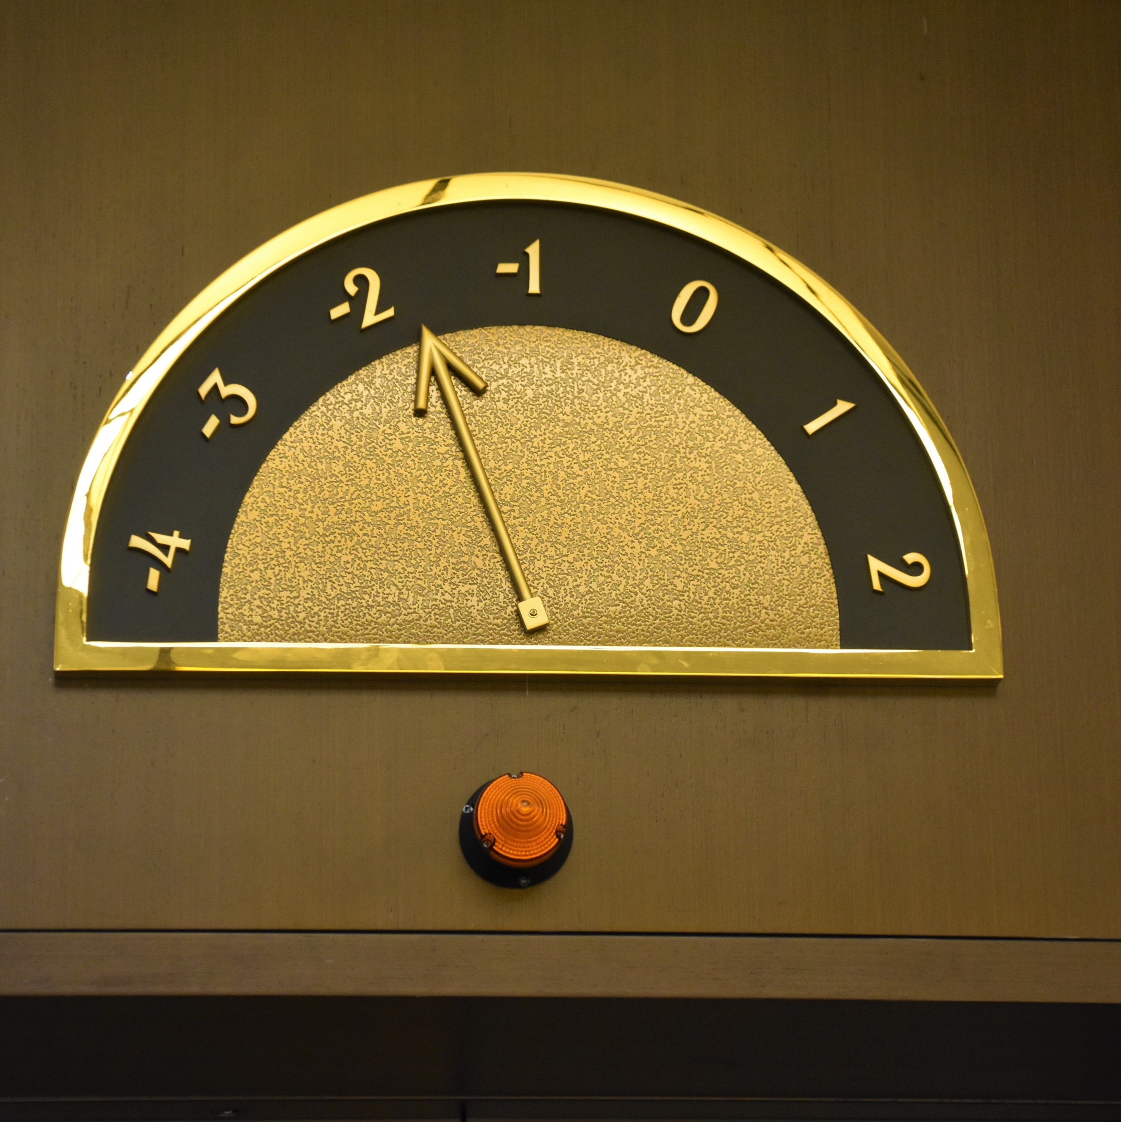
The “elevator pitch”
Don’t bore them with technical details about your product. I’ve heard many investors say that if they walk away from meeting and can’t remember anything. If this happens to you, then you’ve failed.

Slide 13

The “video pitch”

Slide 14
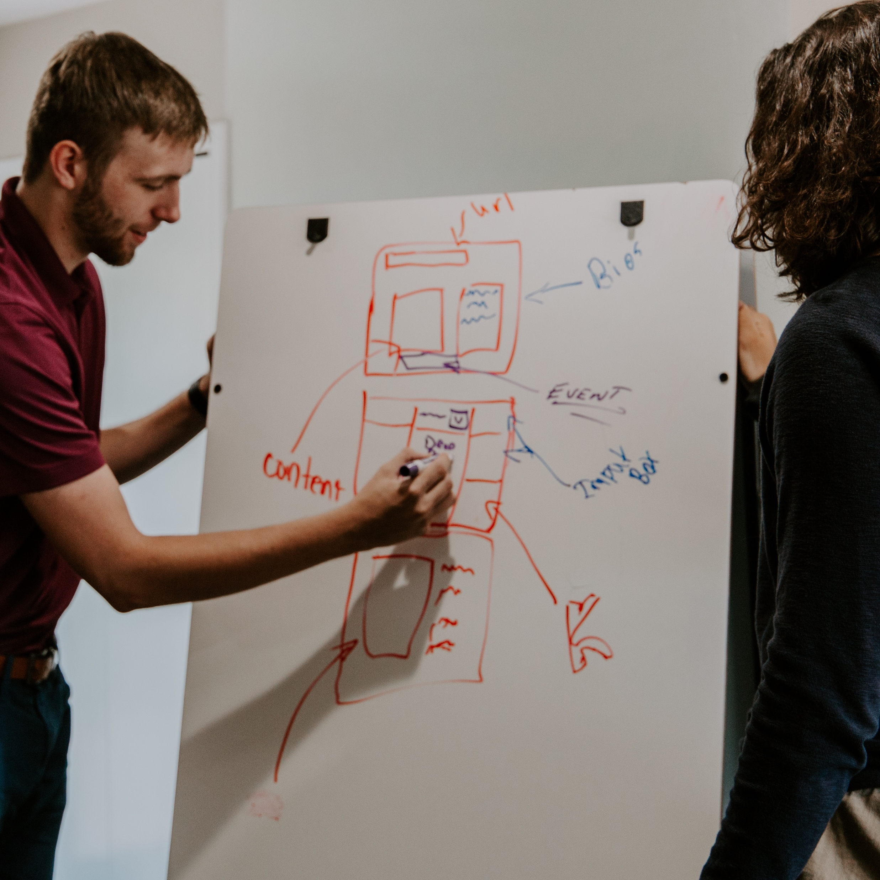
The “one-page pitch”
Also like a summary proposal

Slide 15

The “e-mail pitch”
Also like a summary proposal

Slide 16

The question pitch

