Slide 1

www.candesic.com ∣ +44(0) 20 7096 7684 ∣ jtaylor@candesic.com

Slide 2
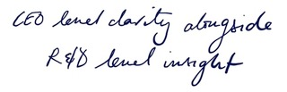






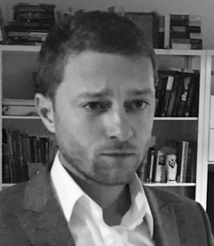



OUR TEAM AND PHILOSOPHY
Candesic provides a comprehensive range of consultancy services spanning transactional processes, strategic positioning and growth, and investment support. The unifying theme in our work is a commitment to working with businesses and investors who share our values in improving care and wellbeing.
“The Candesic team combine strategy with real life healthcare experience – they have their finger on the pulse and provide invaluable insight, vital for any investment thesis.”
- Dr Tim Ringrose, CEO, Cognitant Group
Candesic leads industry thinking and brings unrivalled expertise to client issues. Our healthcare and life sciences practice is the leading provider of commercial due diligence for private equity transactions and business growth strategy.
Our team is composed of medical doctors and life science academics with business experience. For more than 17 years clients have retained confidence in our advice, analysis, access and deep expertise.
We help businesses grow and support their decisions in which services to offer and in which geographies, to benchmark performance, streamline operations, reorganise management, and re-invent how they deliver value to the marketplace.
Candesic's Senior Team, Managers and Consultants have backgrounds in life sciences research and medical practice from world leading universities and hospitals.
Combining high level strategy with deep understanding of regional economies sets Candesic apart.
The Candesic team founded our office in the North West, at Alderley Park, to support the journey of so many businesses and providers who have made the region their home.
“We have worked with Candesic for over 10 years. The depth of analysis and insights they delivered in our last project together was outstanding and far exceeded even our high expectations.”
- Bruno Ladrier, Partner, Ardian
“The expert evidence Joe and his team were able to put together for me transformed our case and the Candesic team provided clear and robust advice that meant we were able to deliver a superb outcome for our client and their business.”
- Lisa Tye, Partner, Shoomiths, Manchester
We look forward to conversations, collaborations and working alongside your teams in the North West.
OUR COMMITMENT TO HEALTHCARE AND LIFE SCIENCES IN THE NORTH WEST
Candesic has extensive experience working in the North West, both with local business and others from across the world as they grow in our region.
We also work for regional investors as they build their healthcare and life science portfolios.
Our team have been key advisors the NHS as the shape of our regional care delivery has changed.
“This part of the country is where I grew up, where my family and friends live and is my home. I love my job – supporting the NHS, businesses and investors in the North West to improve care and develop world class life sciences.”
- Dr Joe Taylor, Principal, Candesic
“Dr Joe Taylor and Candesic have proven to be very accommodating in educating the Ardenton investment team across the healthcare sector. Healthcare is an exciting and compelling sector and Candesic have gone the extra mile in order to invest time with Ardenton, enabling us to make a better appraisal of the opportunities and complexities of the space.”
- Michael Bradbury, Director at Ardenton Capital
Candesic’s North West team is led by Dr Joe Taylor. Joe was brought up in Greater Manchester before qualifying as a medical doctor and subsequently undertaking his doctoral research in neurophysiology at the University of Oxford. Joe has more than a decade of experience working with companies to secure investment and to drive growth.

Slide 3
















CANDESIC’S MODEL OF SUPPORT ACROSS INVESTMENT AND SECTOR STRATEGY
CDD of Envision Pharma across Europe and North America to support Ardian’s acquisition of this international group
VCCD for Brookdale Care evaluating comparative care quality of learning disability serves
Vendor side consideration of Indiba’s technology, developed out of the Hospital Ramon y Cajal
Opportunity identification
Commercial &
technical diligence
Post-acquisition strategy
Positioning for exit
Vendor commercial & technology diligence
Identification & diligence of bolt-ons
Clinically oriented site visits and impartial service review for Swanton Care
Pan-European identification of medTech M&A opportunities for Phoenix Capital
Helping Fishawack evaluate the acquisition of Carling Communications
Enabling BioLight to raise capital beyond Israel for commercialisation of ophthalmology technologies
Development of an interoperability strategy for Servelec following investment by Montagu
A full portfolio review of elderly residential care homes for HC One
Support in
fundraising
Support for Clinova in raising capital through the LSE ELITE platform
Comprehensive review of community learning disability services for NHS England
National
Facilitating communication between the CQC, NHS England and service providers to identify gold standards in learning disability care
Joining up acute and mental health NHS provision with independent providers to deliver integrated care in Cambridgeshire and Peterborough
Regional
Development of the strategy for Healthcare at Home to deliver discharge services for NHS trusts
Providing a clinical opinion to successfully challenge a CQC registration decision for Kingsley Healthcare
Strategic review of cardiac care in acute and community settings resulting in new models to improve to improve population health for University Hospitals South Manchester
Local

Slide 4
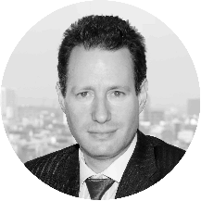
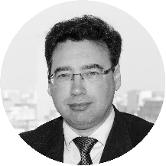
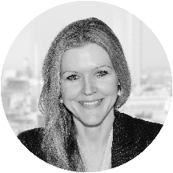

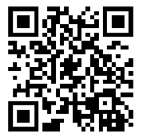




WHY WE DO OUR WORK
”The entirety of the Candesic team is on hand to support businesses and investors in the North West. Together we bring decades of experience working in life sciences and care across the world.”
- Dr Leonid Shapiro, Managing Partner, Candesic
“We look forward to supporting collaborations between businesses in the North West and our continental European clients. The region will continue to be attractive for international life sciences businesses.”
– Marc Kitten, Partner, Candesic
“This is an exciting time for the North West and we look forward to supporting continued growth and success in sectors close to our hearts. Let’s improve patient outcomes together.”
- Dr Michelle Tempest, Partner, Candesic
CLIENTS & PARTNERS VALUE US
“Candesic is a growing part of our healthcare and life sciences ecosystem in Manchester. We’re very happy that Candesic has chosen to develop its presence in the North Wests and looking forward to working alongside them as the region continues to grow in these sectors.
- Charlotte Lewis, Senior Associate, Mills & Reeve
WE SUPPORT INVESTORS
“We were able to leverage Candesic’s specialist knowledge in healthcare and technology to support a Montagu portfolio company in developing its strategic plan regarding software interoperability. The Candesic teams' presence in the North of England makes them a great partner for us”
- Thomas Peyer, Full Potential Plan Principal, Montagu
Candesic supports investors to make the best decisions in life science and care sectors.
We are able to use our sector knowledge and experience to quickly bring investment teams up-to-speed in areas where they are not specialists.
Our large sector network allows us to flag investment opportunities and we are always happy to meet for discussions on broader sector trends as well as specific assets.
Candesic works with global investors, and international banks rely on our work to make their investment choices; in the North west we support regional investment.
“We value Candesic as an important partner in the North West as Lucid continues on our growth journey. Deep sector expertise combined with a commitment to great quality bioscience and healthcare businesses means the Candesic team share our values and are a pleasure to work with.”
- Rob Apollo, Director at Lucid Group
“Over the last 2 years I have worked closely with the team at Candesic seeking their expert advice on behalf of a wide range of promising SME’s in the life science sector. Throughout that time I have been impressed with not only their professionalism, expertise and agile approach to problem solving, but also their market and industry knowledge and unique insights they have across the sector.”
- Colin Callow, Head of Programmes,
Innovation Agency - North West Cost
Working with the Candesic team in the North West we have the best chance of making progress to deliver the best quality community support for people with Learning Disabilities. Candesic has a brilliant group of people who really understand the challenges in community care and, together, we’re making progress to develop new service models fit for our time.”
- Sir Stephen Bubb, Director, Oxford Institute of Charity

