Slide 1

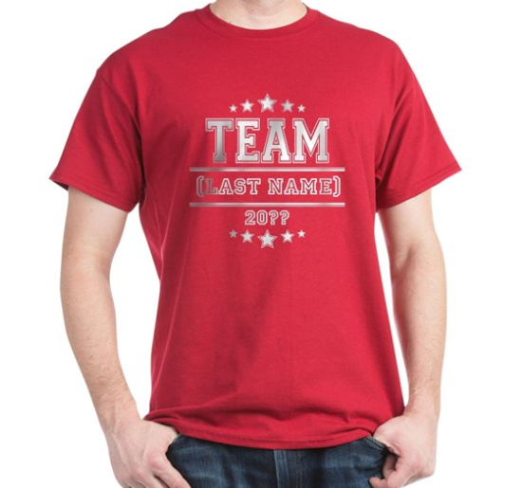
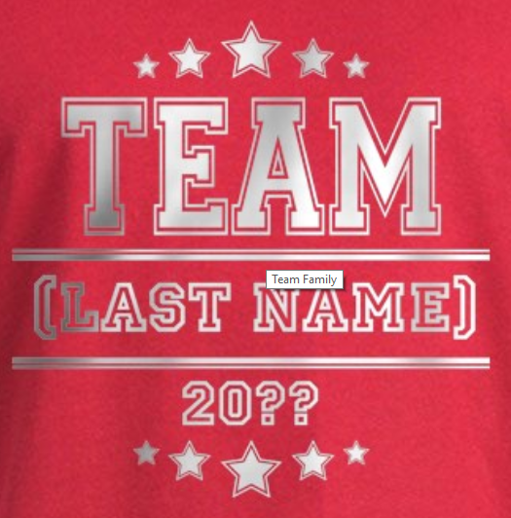
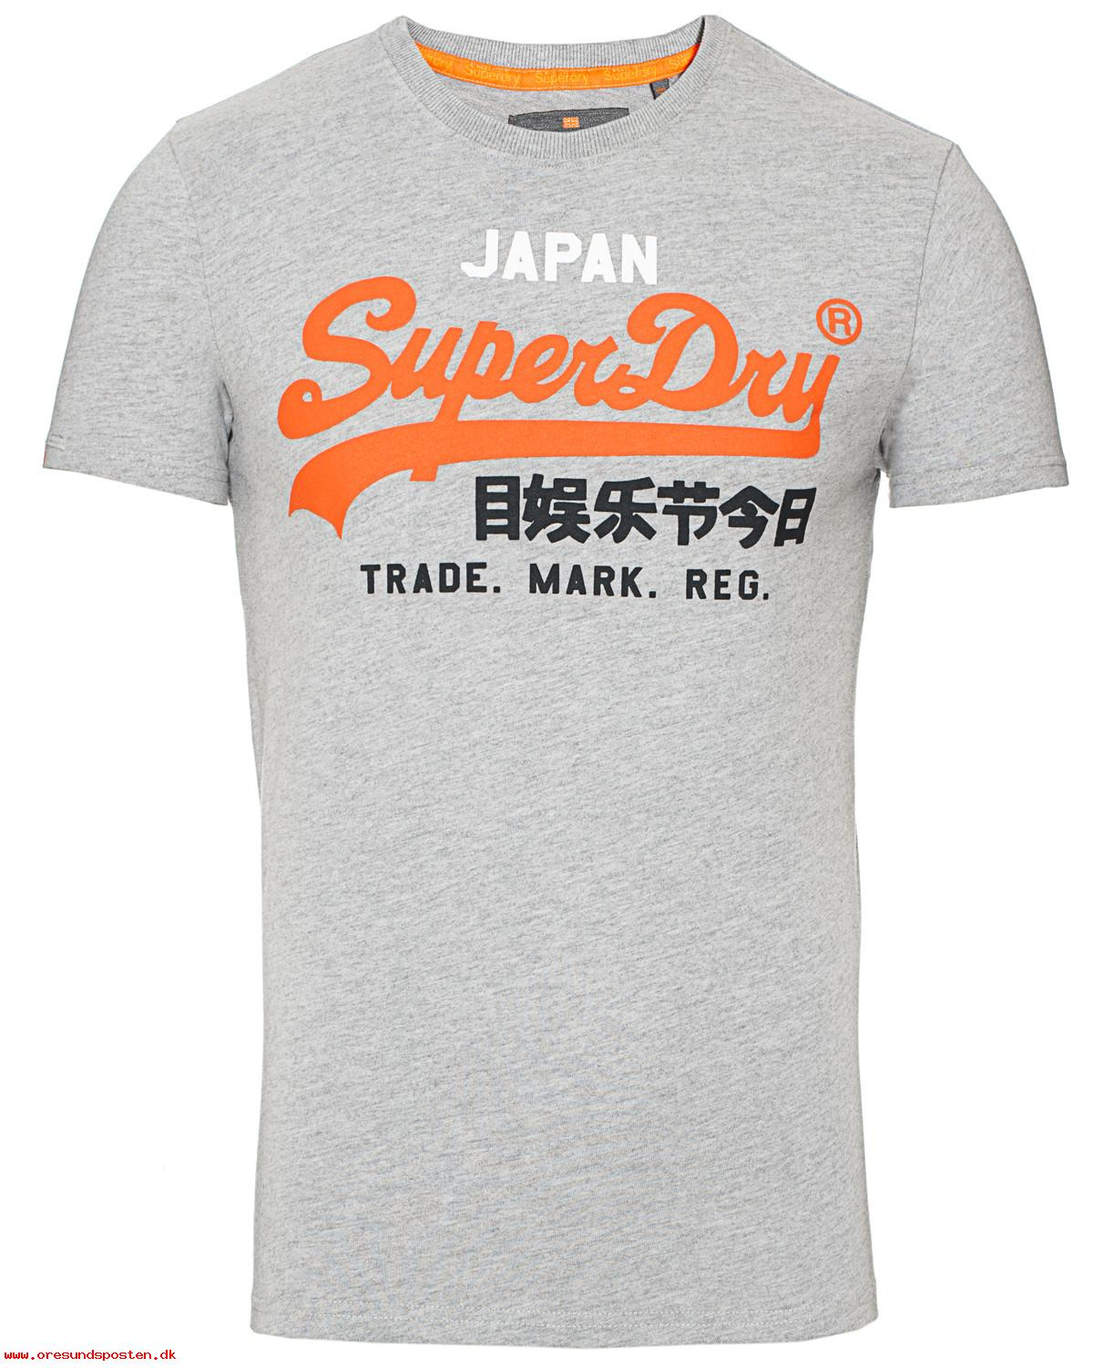
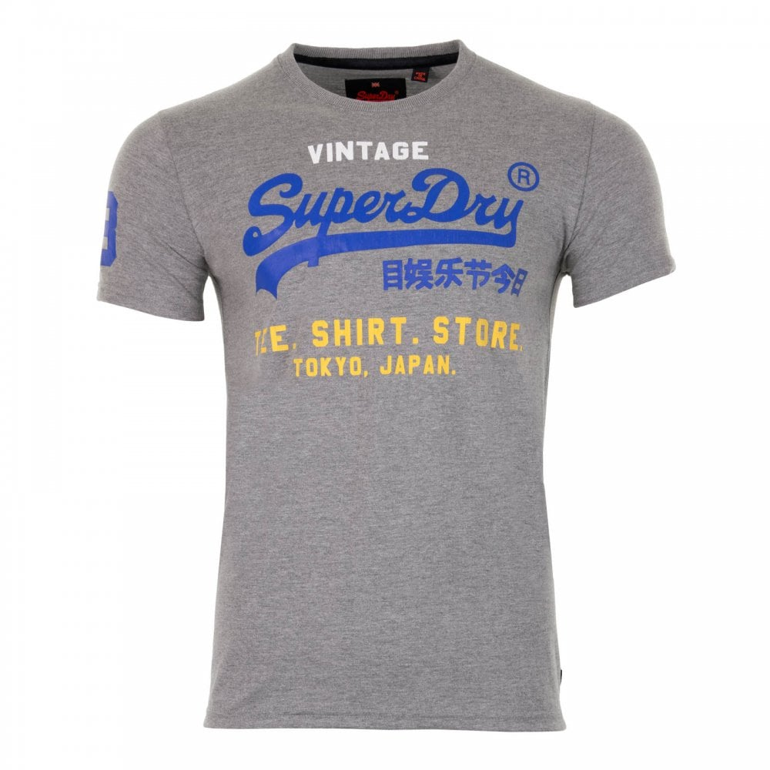


T-shirt color?
Grahpics?
Inspiration
TEAM
VISIOLINK
2019
Graphics color?
Slogan?
Visiolink-logo
Either:
“We're on a mission together”
”On a mission together”
“We’re in it together”

