Slide 1
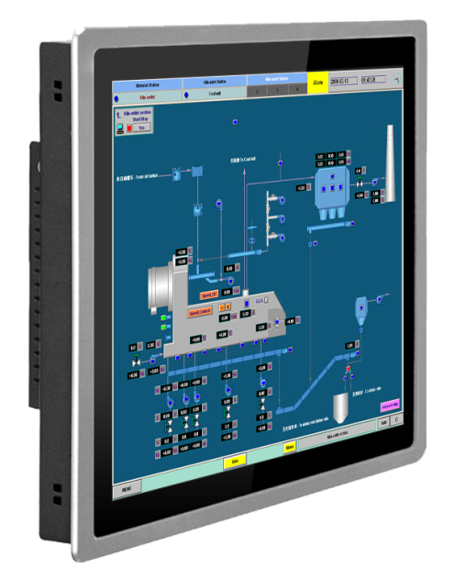
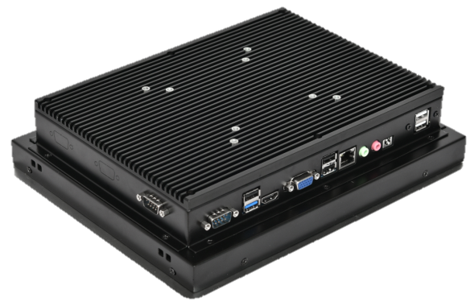
NZS-1201
12” LED Touch Screen with Intel Celeron Processor
Specification
General
BIOS AMI UEFI
Certification CCC, CE
Cooling System Fanless design
Dimensions (WxHxD)
Enclosure Back housing
Mount Options Wall/Panel
OS Support Windows 7, 8, 10(32/64bit)
Power Consumption 50W (Typical)
Weight (Net) 4.5kg
System Hardware
CPU Intel Celeron Processor
Memory 4GB DDR3 (Up to 16GB)
LAN 100M/1000M Base-T
Storage MSATA2 HDD *1 (32G SSD)
I/O 1*RS232
  1*RS232/RS422/RS485
  1*USB3.0
  3*USB2.0
LCD
Display Type TFT LED LCD
Display Size 12”
Max Resolution 1024*768
Max. Colors 16.7M
Luminance 450cd/m2
Viewing Angle (H/V) 160/140
Backlight Life 50,000 hours
Contrast Ratio 1000:1
Touch Screen
Lifespan 30 million touches at a single point
Resolution Linearity
Light Transmission Above 90%
Type Capacity
Environment
Humidity 20%-90%
Front Protection IP65
Operating Temperature -10 – 60
Storage Temperature -20 – 70
Vibration Protection With SSD: 1Gms
Last Updated: Jul 24, 2019

Slide 2
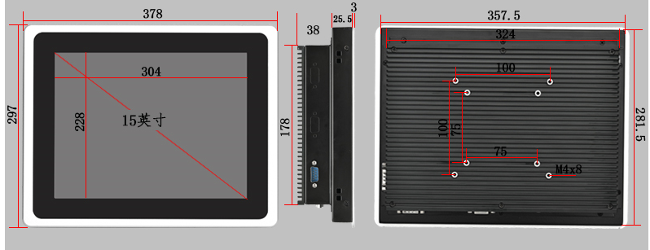
NZS-1201
12” LED Touch Screen with Intel Celeron Processor
Dimensions
Order information
NZS-1201-P-4G-32G-WiFi
Optional: WiFi
32G SSD. (64G/128G)
4G RAM. (8G/16G)
P: Panel; W: Wall
12”
NeZha Industrial Touch Panel

Slide 3
NZS-1501
15” LED Touch Screen with Intel Celeron Processor
Specification
General
BIOS AMI UEFI
Certification CCC, CE
Cooling System Fanless design
Dimensions (WxHxD)
Enclosure Back housing
Mount Options Wall/Panel
OS Support Windows 7, 8, 10(32/64bit)
Power Consumption 50W (Typical)
Weight (Net) 4.5kg
System Hardware
CPU Intel Celeron Processor
Memory 4GB DDR3 (Up to 16GB)
LAN 100M/1000M Base-T
Storage MSATA2 HDD *1 (32G SSD)
I/O 1*RS232
  1*RS232/RS422/RS485
  1*USB3.0
  3*USB2.0
LCD
Display Type TFT LED LCD
Display Size 15”
Max Resolution 1024*768
Max. Colors 16.7M
Luminance 450cd/m2
Viewing Angle (H/V) 160/140
Backlight Life 50,000 hours
Contrast Ratio 1000:1
Touch Screen
Lifespan 30 million touches at a single point
Resolution Linearity
Light Transmission Above 90%
Type Capacity
Environment
Humidity 20%-90%
Front Protection IP65
Operating Temperature -10 – 60
Storage Temperature -20 – 70
Vibration Protection With SSD: 1Gms
Last Updated: Jul 24, 2019

Slide 4
NZS-1501
15” LED Touch Screen with Intel Celeron Processor
Dimensions
Order information
NZS-1501-P-4G-32G-WiFi
Optional: WiFi
32G SSD. (64G/128G)
4G RAM. (8G/16G)
P: Panel; W: Wall
15”
NeZha Industrial Touch Panel

