Slide 1
Need your instruction video for tell us how to manage the content of ,Product category, product specification, video

Slide 2
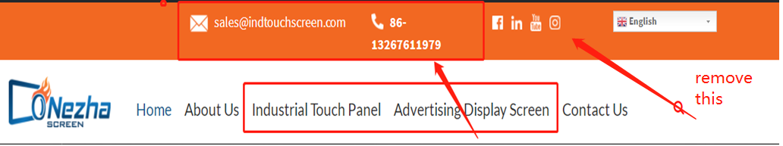
1st Change:
Wrong layout here
Can remove the social media,
These are already all listed in the bottom

Slide 3
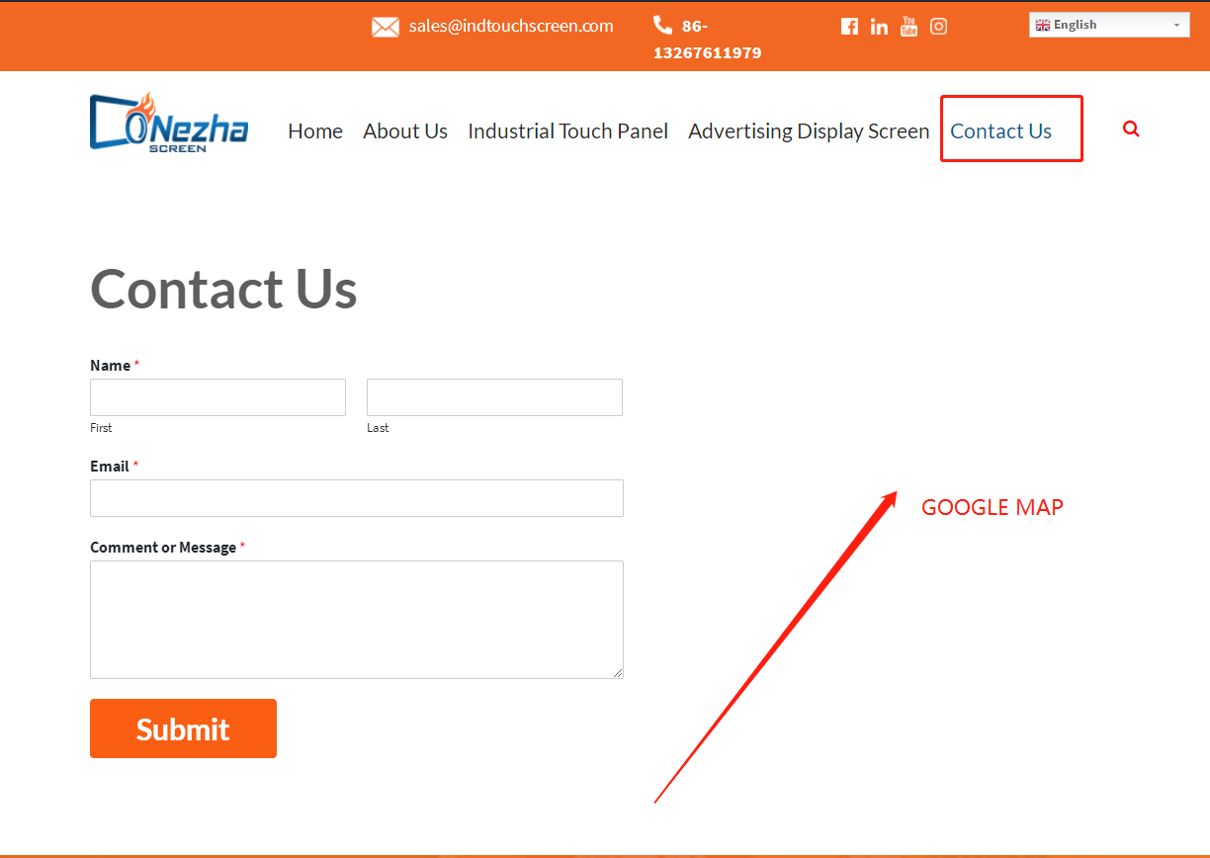
2nd Change:
There is not a Google Map on the "Contact Us"

Slide 4
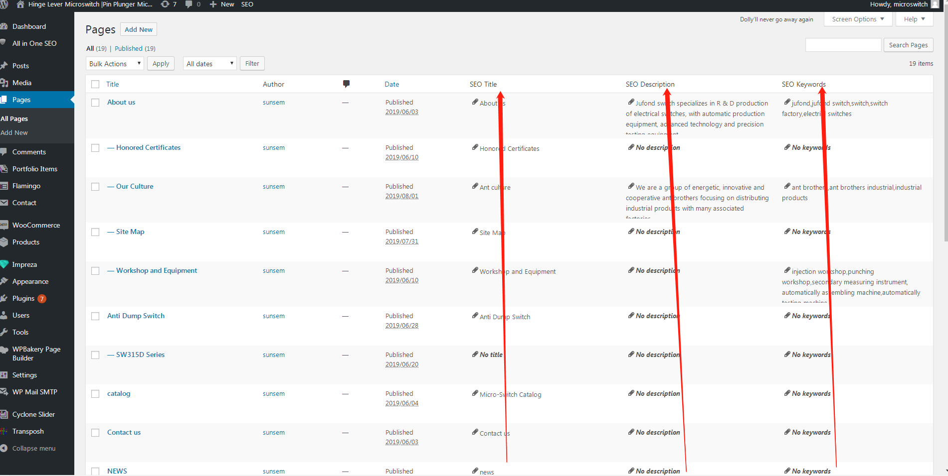
3rd Change:Need SEO TOOL in Dashboard
This is our another website’s dashborad with All in One SEO tool for pages

Slide 5
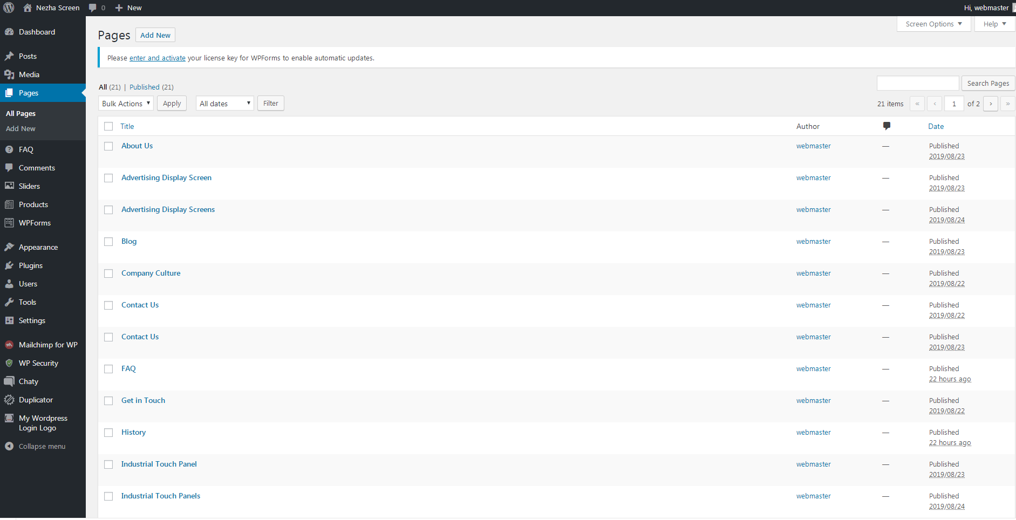
3rd Change:No SEO TOOL in Dashboard
We need SEO tool for pages in Nezha Screen Dashboard

Slide 6
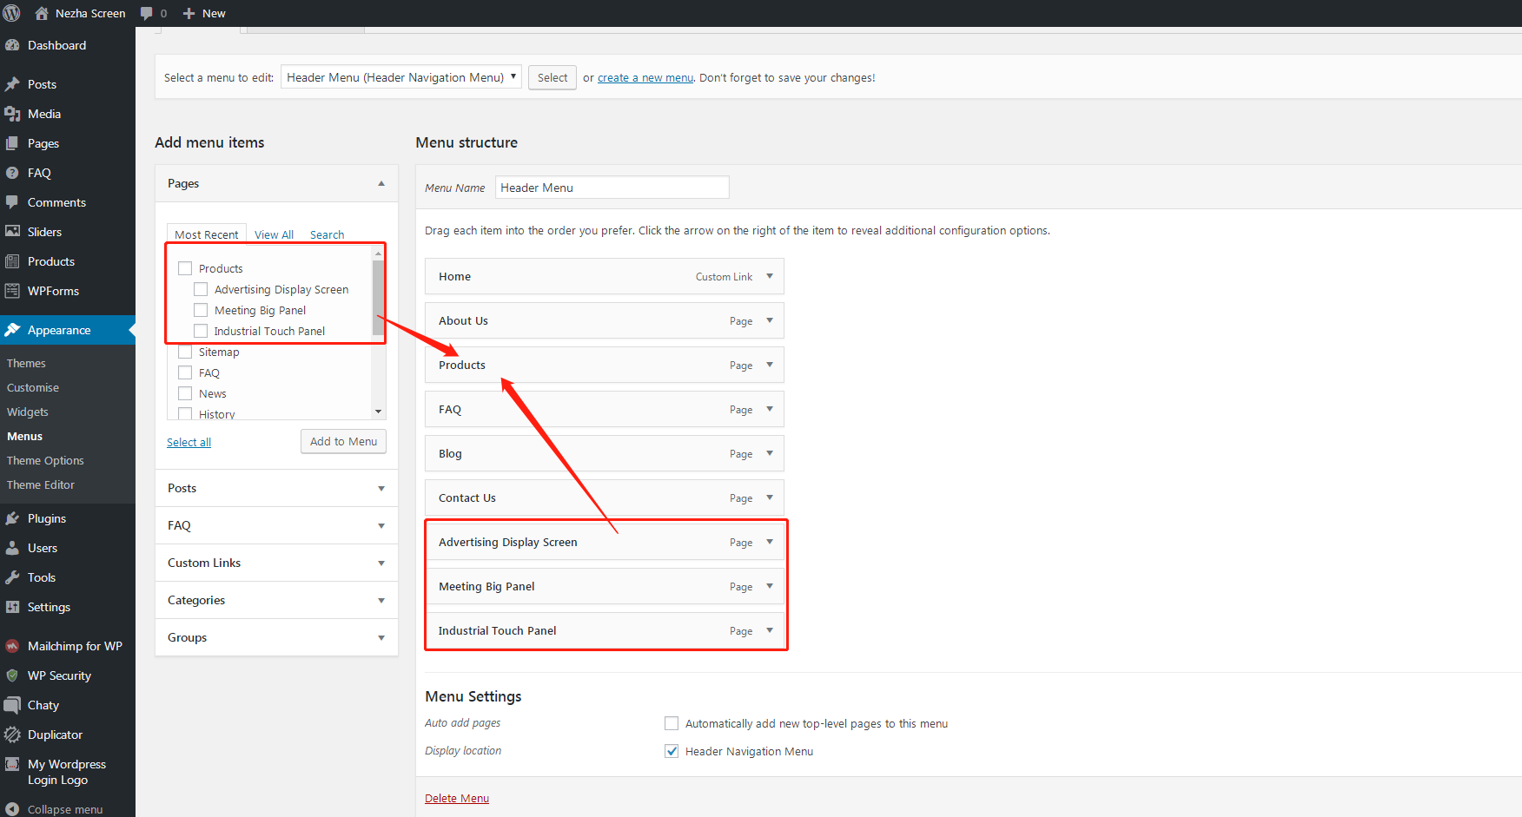
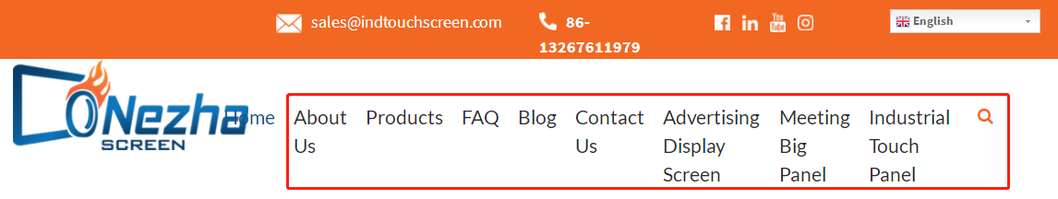
4th Change:Product Categories not set
We can not set the header product categories in a right way
on Nezha Screen Dashboard

Slide 7
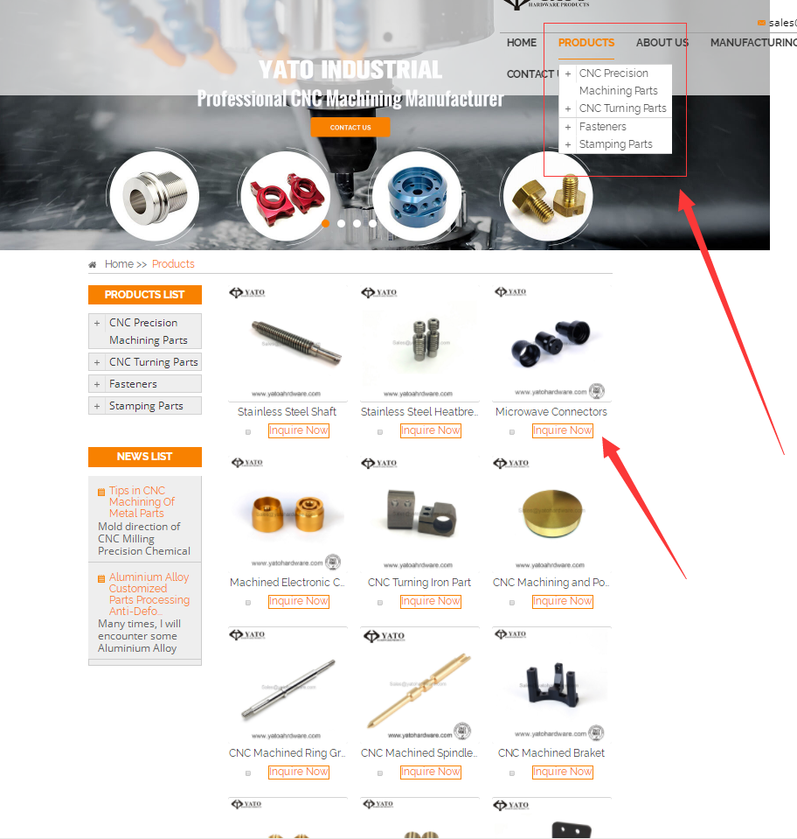
5th Change:Product Categories
since we have not products category page, we like to have functions like this page:https://www.yatohardware.com/products/,
Button of "Inquiry" besides the product specification
can you help us to realize it?

Slide 8
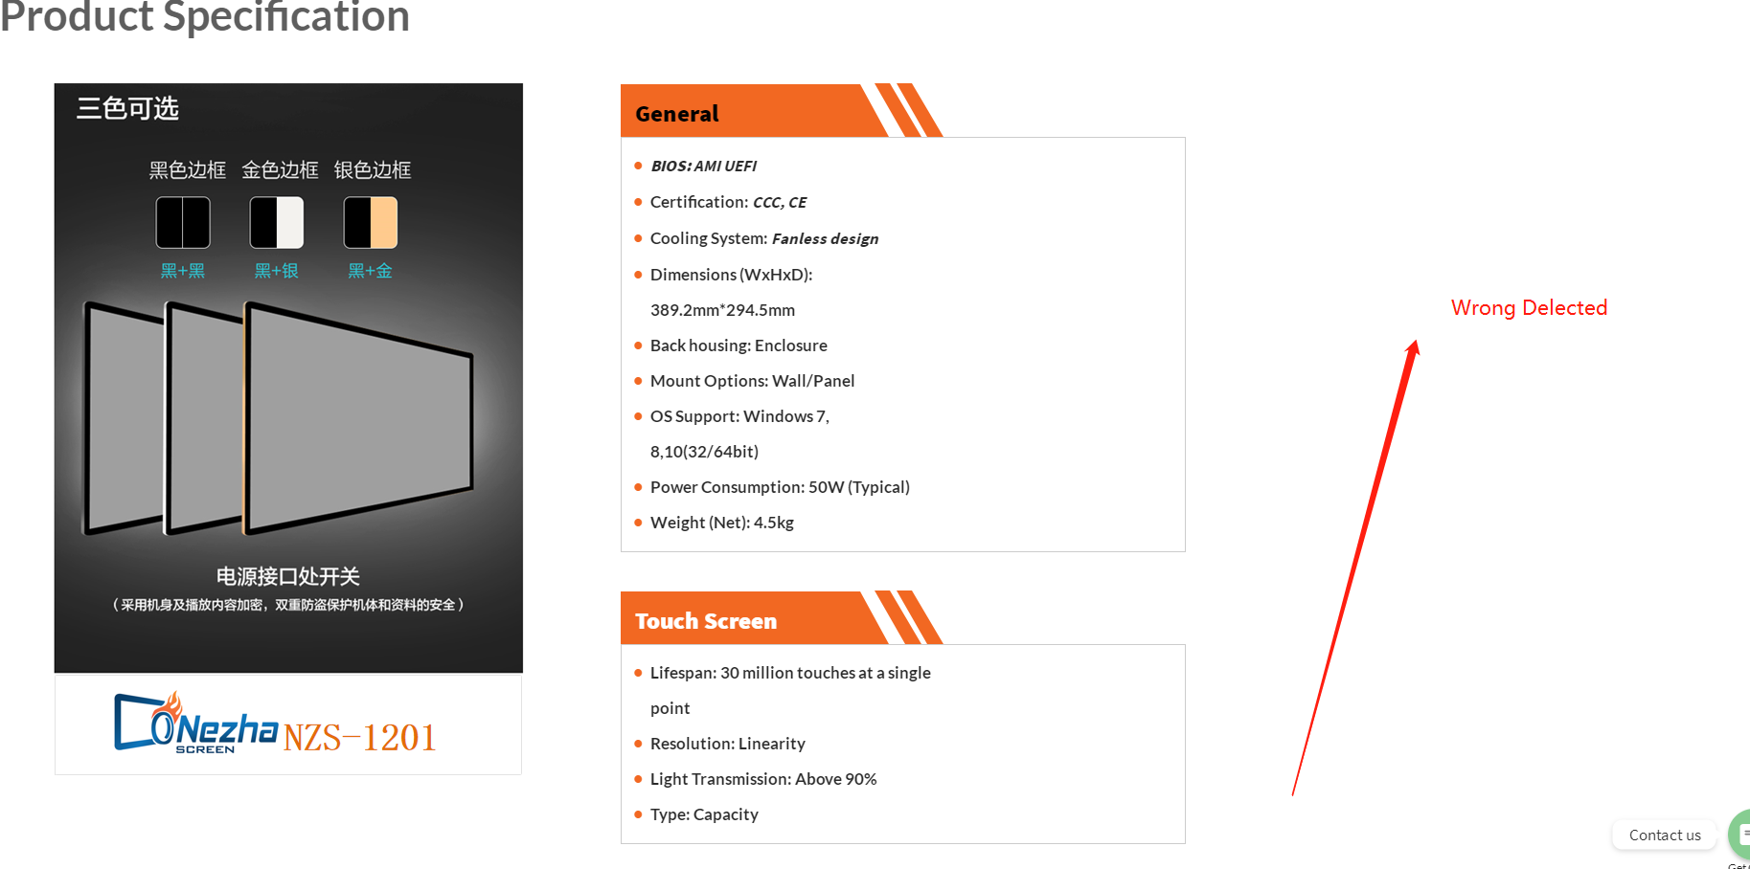
6th Change:Product Specification

