Slide 1


A Healthy HIPP Louisiana
Louisiana Health Insurance Premium Payment (LaHIPP) program allows for Medicaid to pay the premium costs of member’s private health insurance when cost effective for the State.
To increase program participation the State is implementing strategic changes to increase enrollment by 95%, resulting in an $11.2M cost savings to the State by the end of SFY23.
Infographic 1
Infographic 1
Graphic 1
Graphic 2

Slide 2
Project Summary
Louisiana Health Insurance Premium Payment (LaHIPP) program allows for Medicaid to pay the premium costs of member’s private health insurance when cost effective for the State.
To increase program participation the State is implementing strategic changes to increase enrollment by 95%, resulting in an $11.2M cost savings to the State by the end of SFY23.

Slide 3
Wording for Infographic 1
THE OBSTACLES:
BUDGET CONSTRAINTS
Due to a budgetary shortfall the LaHIPP program was discontinued on Dec 2015. By ending the program, all members were forced to cover their private insurance premiums, or switch to Medicaid.
LACK OF PUBLIC KNOWLEDGE
Members are unaware that this program exists or find it hard to believe that Medicaid will pay for their private health insurance.
LACK OF PARTICIPATION
Cost effectiveness formula is too restrictive excluding a large portion of the viable population, including waiver, Fee for Service (FFS) members and the individual insurance market.
CROWD OUT
Crowd out occurs when members choose public insurance in lieu of available private health insurance

Slide 4
Wording for Infographic 2
THE SOLUTIONS:
PROGRAM RESTORED
LaHIPP was reinstated in April 2017, restoring LDH’s focus on promoting employer-sponsored insurance.
INCREASE AWARENESS AND PUBLIC KNOWLEDGE
LDH has contracted a marketing firm to develop a comprehensive marketing and outreach strategy aimed at engaging providers, employers, insurance companies and members.
INCREASE PARTICIPATION
Refinement of the cost effectiveness formula increased the pool of members eligible for the program, including waiver, Fee for Service (FFS) members and the individual insurance market. .
DATA AND ANALYTICS
The use of data mining identifies individuals and populations to be targeted for program outreach

Slide 5
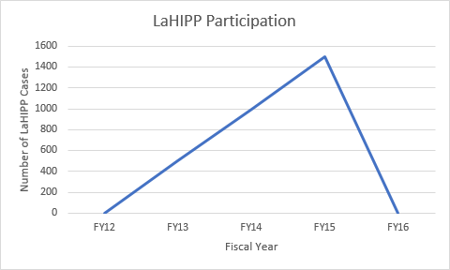
Graphic 1
Funding Lost

Slide 6
Data for Graphic 1
Fiscal Year | Number of LaHIPP Cases | Key Events
FY12 | 0
FY13 | 500
FY14 | 1000
FY15 | 1500 | Funding Lost
FY16 | 0

Slide 7
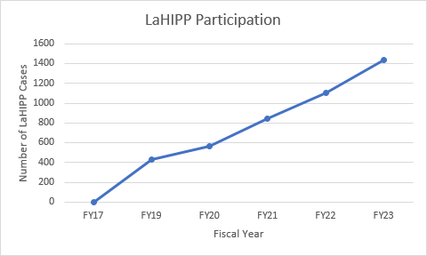
Graphic 2
Marketing Firm Engaged
Current
Formula Refined
Program Restored

Slide 8
Data for Graphic 2
Fiscal Year | Number of LaHIPP Cases | Key Events
FY17 | 0 | Program Restored
FY19 | 435 | Current
FY20 | 566 | Marketing Firm Engaged Formula Refined
FY21 | 848
FY22 | 1,103
FY23 | 1,434

