Slide 1
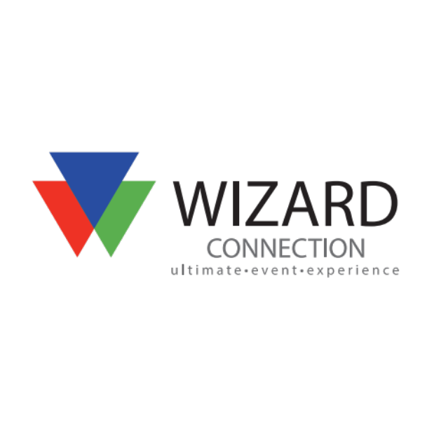
Founded in 1999, Wizard Connection is a specialist organizer of business-to-business events, including conferences, award ceremonies, seminars, workshops, roadshows, roundtables and exhibitions for the public, commercial and third sectors. www.wizardconnectionn.com
Event Management Services
BRINGING PEOPLE, BUSINESSES, MARKETS AND IDEAS TOGETHER
Themed Props and Décor
At Wizard Connection we are known for providing décor that completely changes the surrounds of your venue and provides your guests with an immersive event experience. Our expert event designers understand how the product will be used and where it will be most impactful.
Whether being transported to outer space or to a tropical paradise, our props drive each theme home. We also will use foliage, lighting, ice, and even custom décor items
LED Connection
LED Connection was born from the need to eliminate pesky cords at our events. Our lighted décor is now completely battery operated. We now sell most of our lights to multiple companies and theme parks throughout the United States.
Our lighted products are brand friendly, meaning we can add a logo or monogram to just about any of our lighted décor items.
Foliage Connection
Foliage Connection is our only company that is not located on property. We have 40,000 square feet of green houses with a large selection of inventory from 14’ Amstel Ficus Trees, 12’ Palms, to lush Boston Ferns and many more in between.
Carving Ice
Ice sculptures are a central point and unique statement at a corporate event or wedding. Ice will attract attention and provide a memorable focal and visual for attendee discussion. It can even be an interactive experience when your guests use an ice luge for the first time or drink from a glass with a large ice cube featuring your logo!
Custom Fabrication for All Types of Events
At Wizard Connection our in-house fabrication team has the ability to deliver custom designs and fabrications that will make your next event a unique one. Our team of professionals specializes in providing creative event solutions for companies planning both in-office and off-site activities. Our services provide the very best in custom staging, furniture and décor, scenic displays, tradeshow booths, and much more.

Slide 2
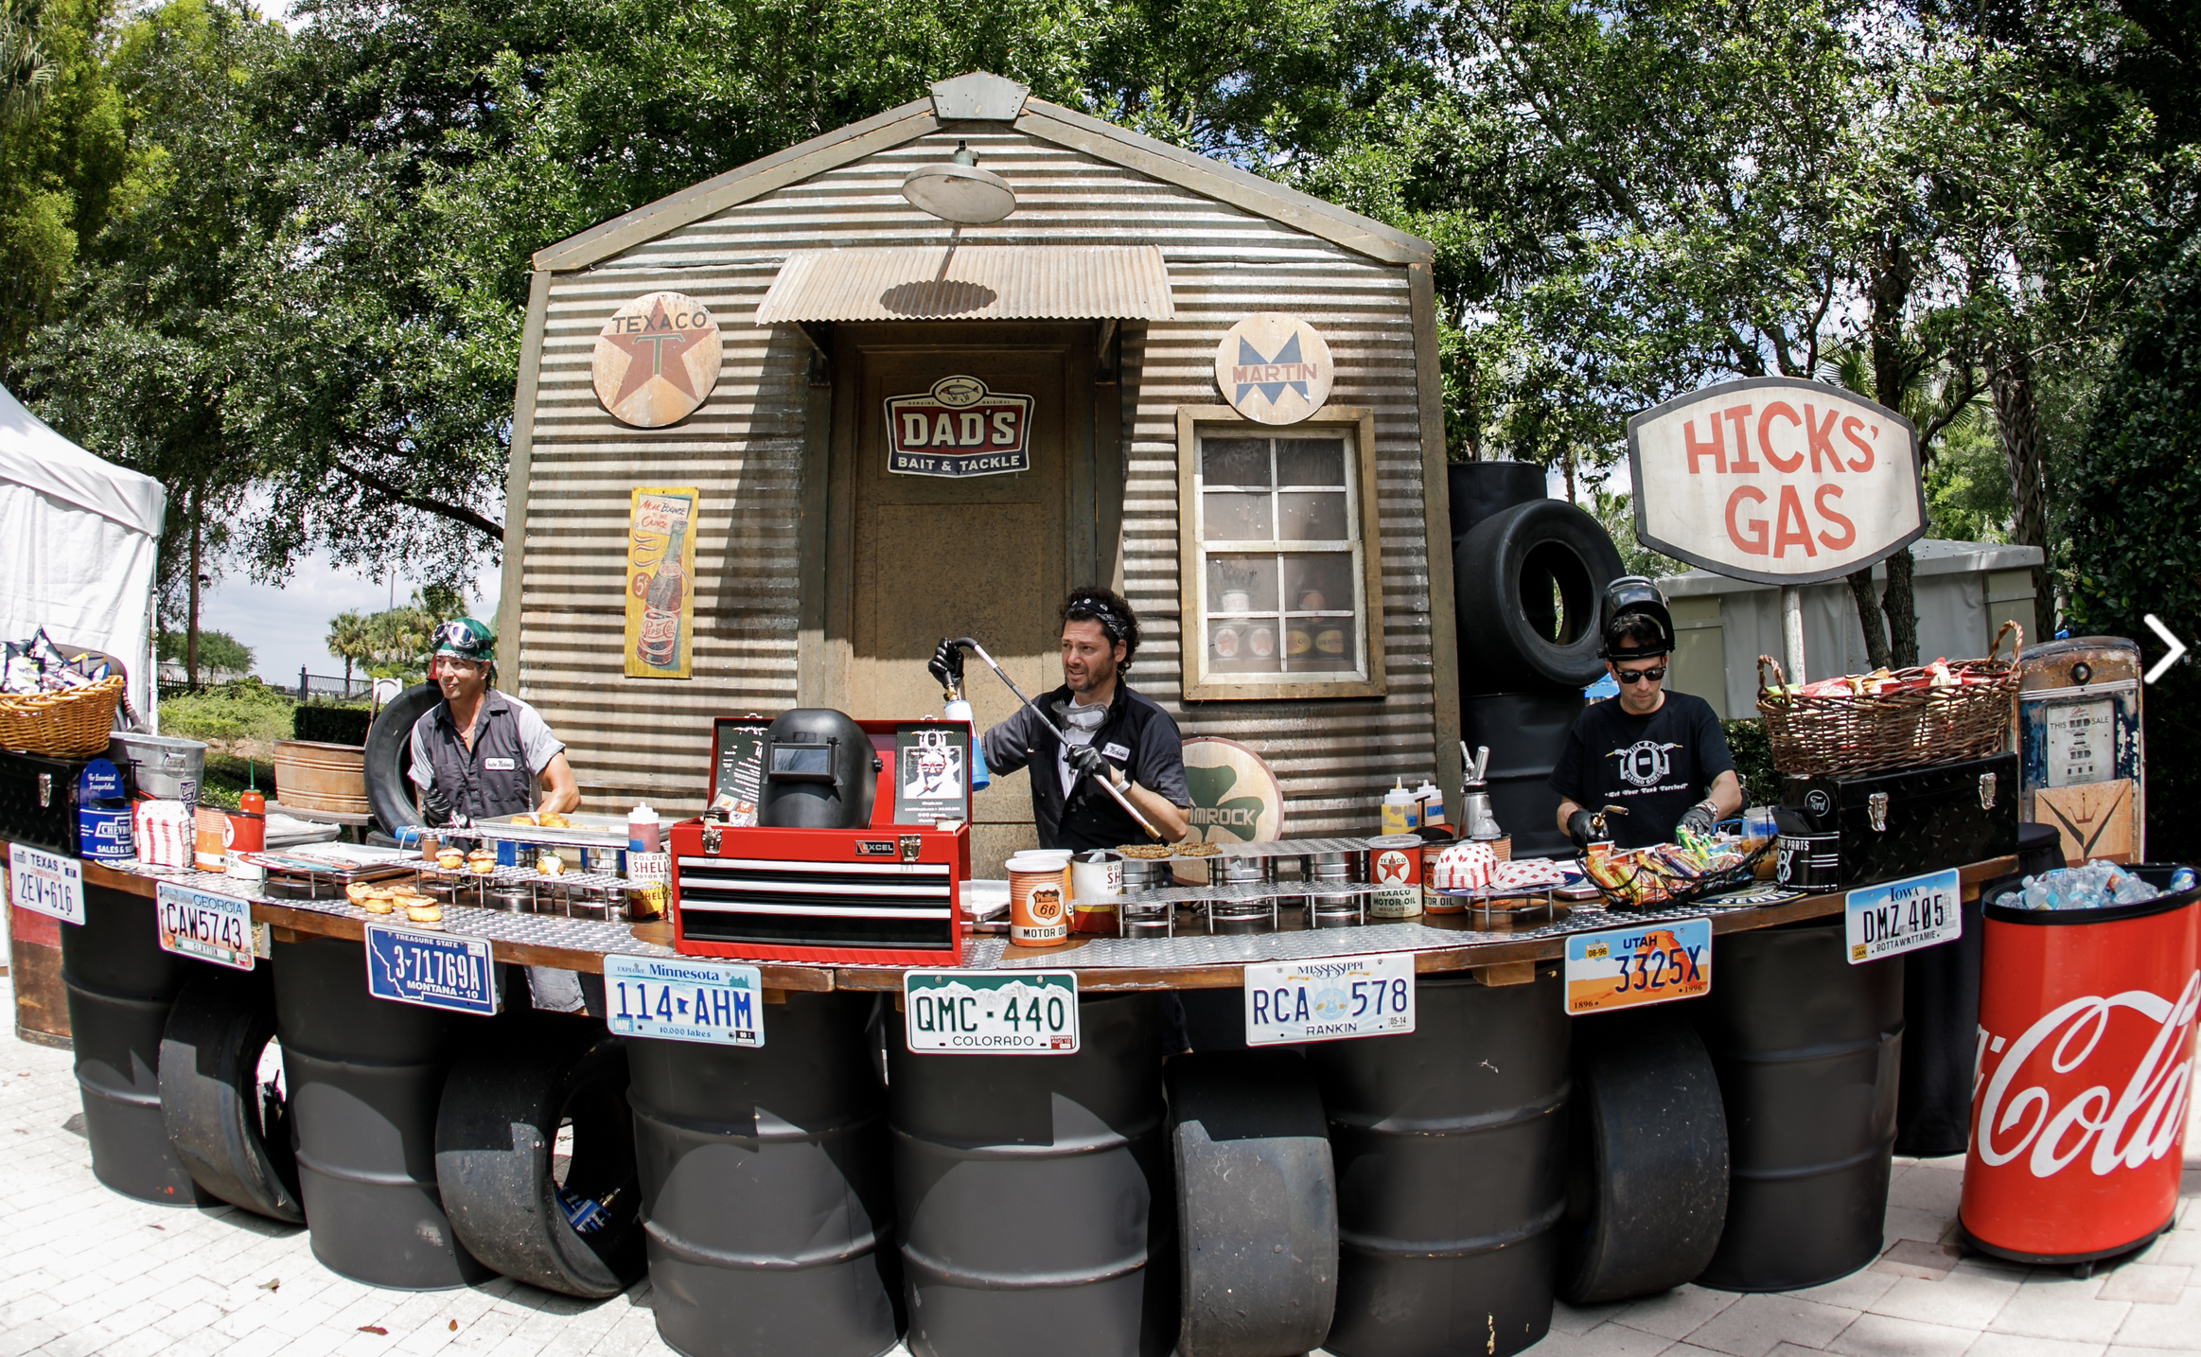
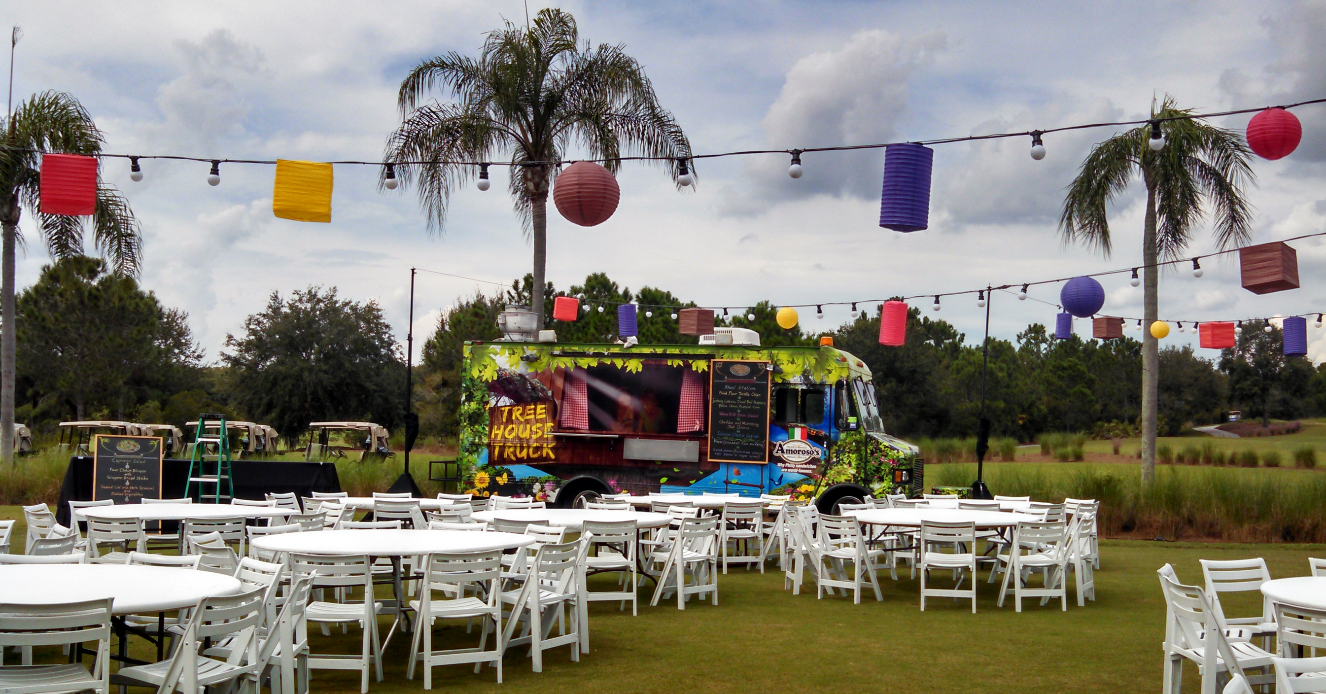
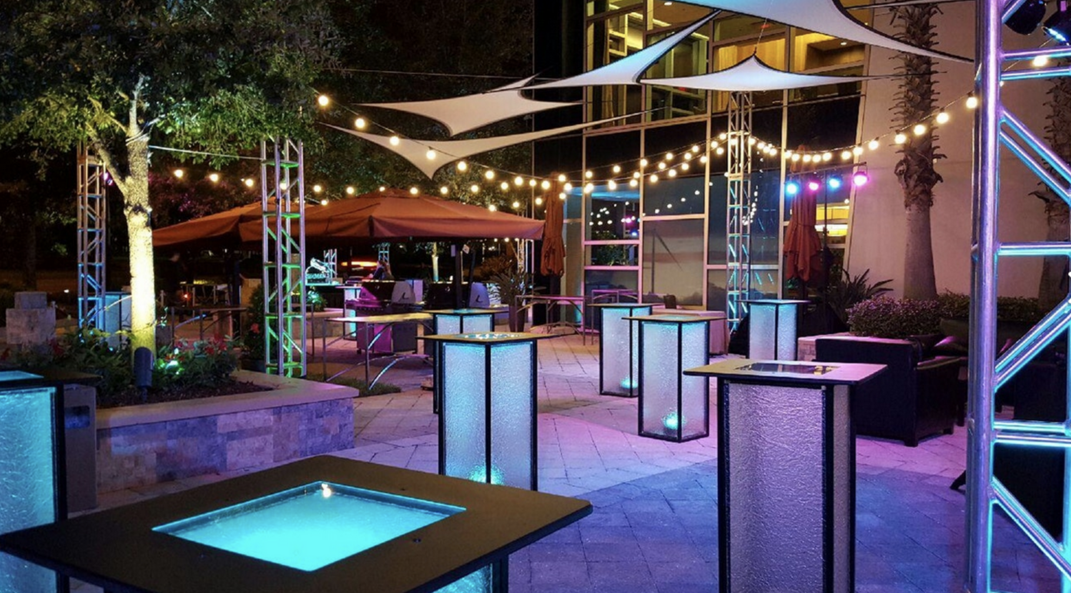
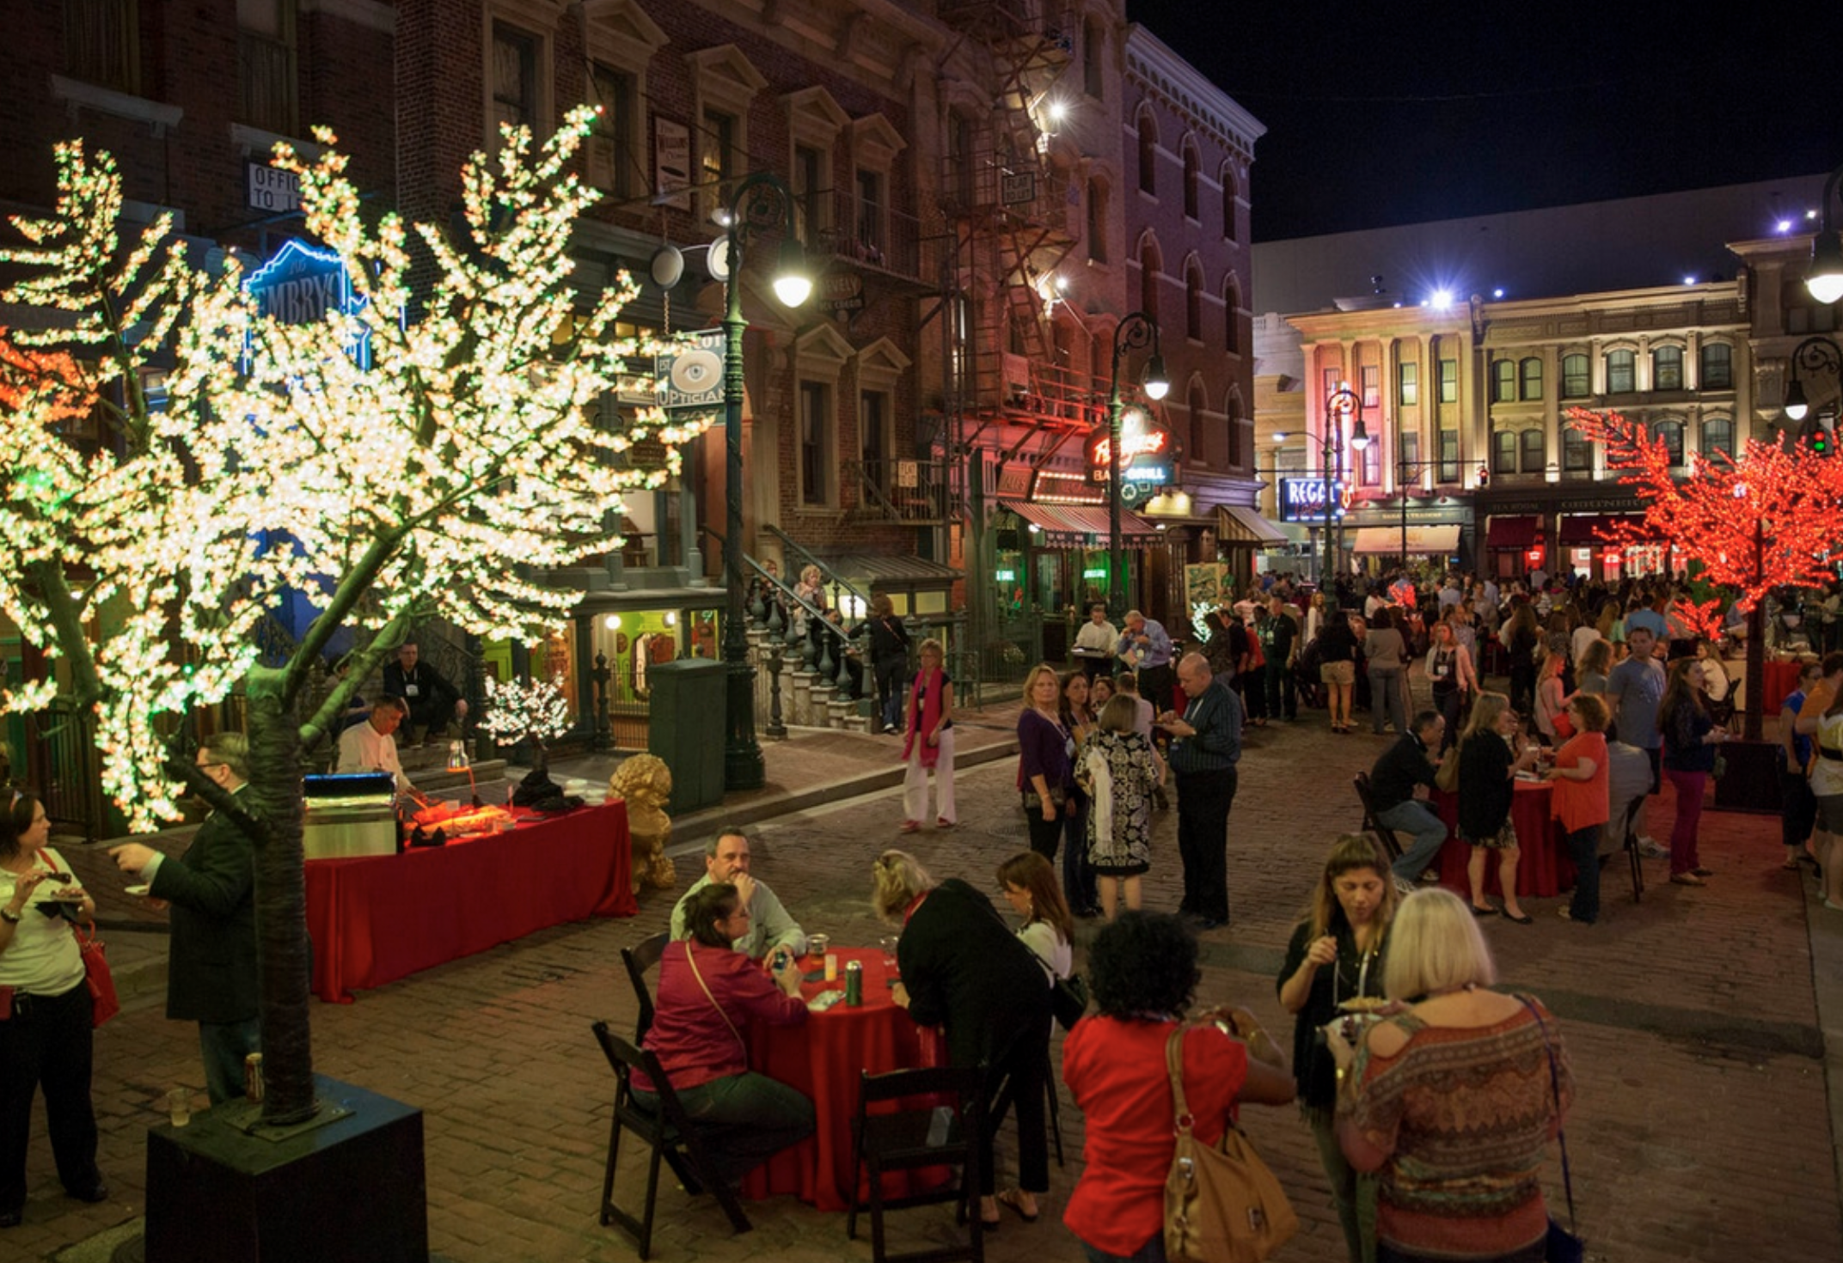
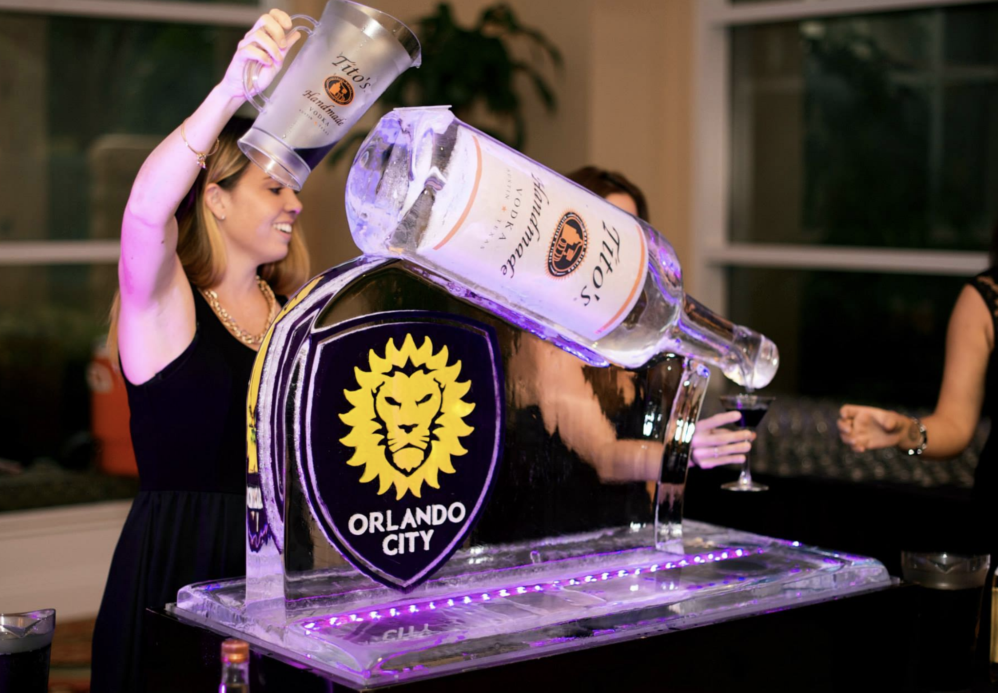
Our Approach to a Successful Event
An Extension of Your Own team
When you employ Wizard Connection to create or manage one of your events, you can be assured that you are in the safe hands of thoroughbred event organizers.
We like to work as an extension of your own company, treating your events and brands as respectfully as we do our own and consulting carefully on all significant decisions.
We have a strong understanding of budget constraints, constantly monitoring expenditure commitments and managing the various risks involved.
We use our extensive supplier and venue relationships to keep your costs low whilst ensuring the highest quality, with many clients finding that using our services is more cost-effective than running their events through an in-house team.
Budget transparency
We always work to a pre-agreed budget and a pre-agreed management fee, based on the amount of sales, marketing and logistical time needed to manage your event.
Your final bill will not differ from this pre-agreed amount unless there have been significant changes to the project along the way.
Meet the team
Organizing professional events requires a significant amount of time and ‘attention-to-detail’ across a whole range of different disciplines – but we endeavor to provide a single point of contact to streamline client communications wherever possible.
Wizard Connection
6855 President's Drive, Orlando, FL 32809 (407) 888-9238 I
nfo@wizardconnection.com www.wizardconnection.com

