Slide 1
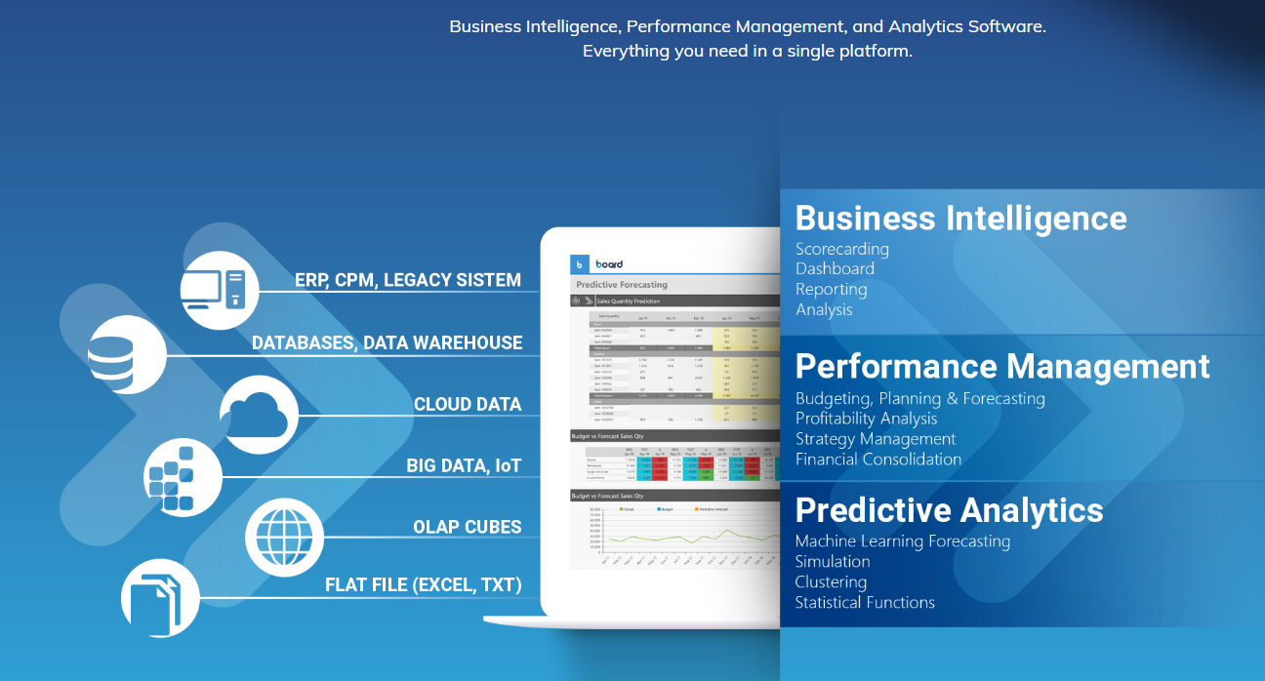
Digitalization software
Business Intelligence
Reporting
Analytics
Datawarehouse
Data mgt.
Webshop analytics
Performance management
Budgeting & Forecast
Integrated business planning
Simulation
Strategy mgt.
Risk mgt.
Loan portfolio mgt.
Consolidation
Digitalization
Rapid Application Development - RAD
Work process optimization
Production mgt. system
Bridge ERP gaps

Slide 2
These are the sources that should be used in the graphoc:
ERP
Operational system
Databases & Warehouse
Excel files
Cloud data
Legacy system

Slide 3













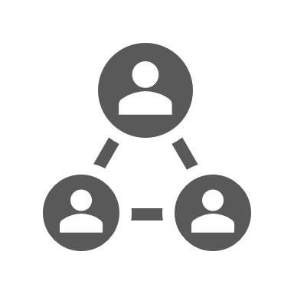

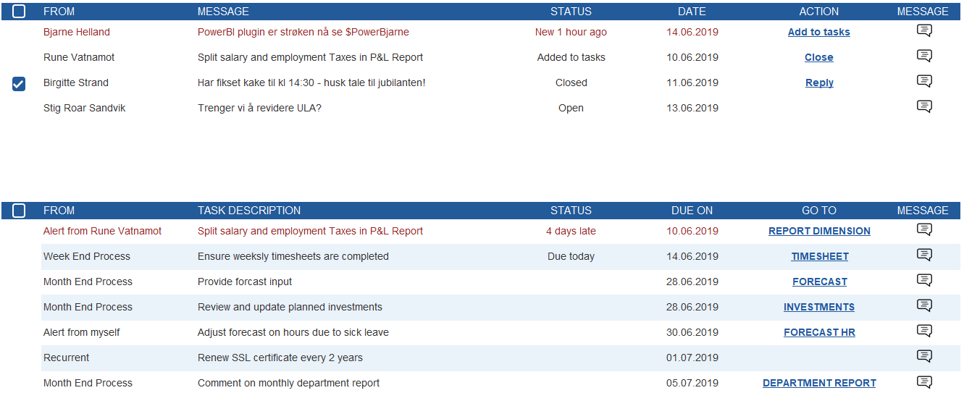







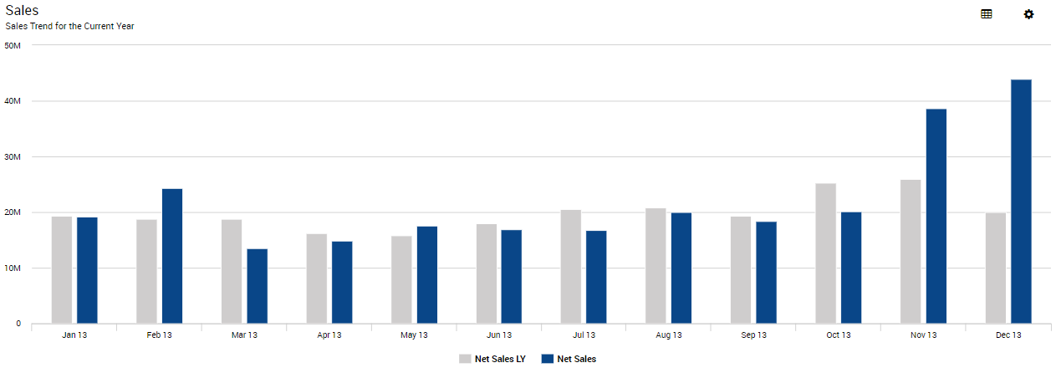




< Mai 2019 >
My shortcuts My Dashboard P&L ERP Forecast
PLANNING & FORECASTING
Budget
Forecast
Settings
Administration
My Tasks
My KPI’s
…
1.2
(Mill)
78 %
(Billing Rate)
INSIGHT AND ANALYTICS
My Power BI Dashboard …
Report Setup
Administration
Solution monitor
Alerts
My performance
…
1
Tasks overdue
CONSOLIDATION
Month end Close
Aquisitions
Manual Entries
60
Billable Hours
CUSTOME SOLUTIONS
Sales
OPERATING TASKS
Sales
30/50
Tasks on time
OPERATIONS MONITOR
WORK PROCESS MANAGER
DIMENSION AND MODEL ADMIN
USER ADMINISTRATION
Status

Slide 4
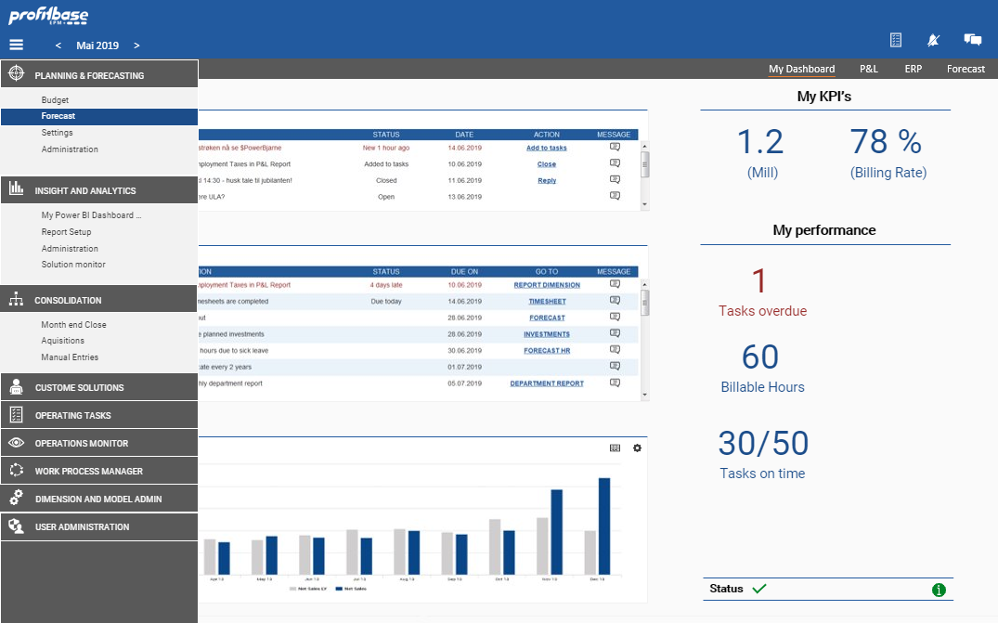

Slide 5
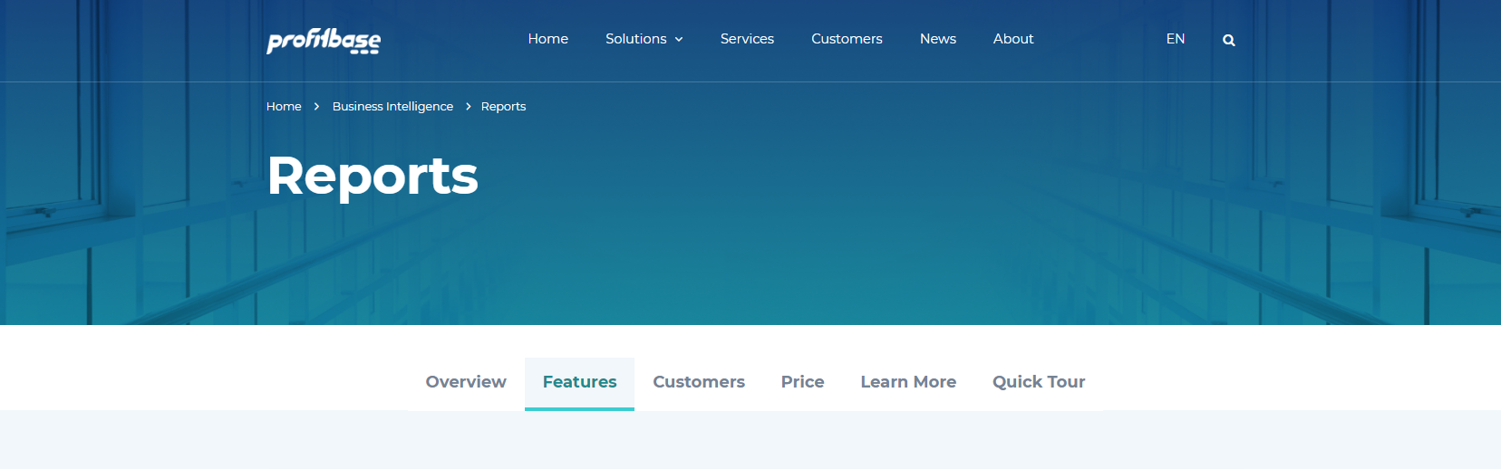
Next are some presentations with our colors:

Slide 6
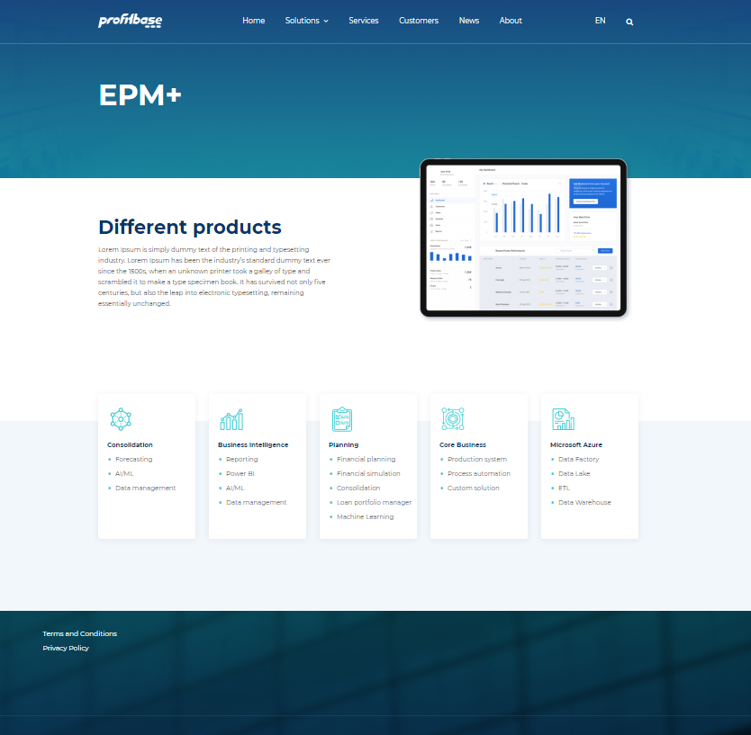

Slide 7

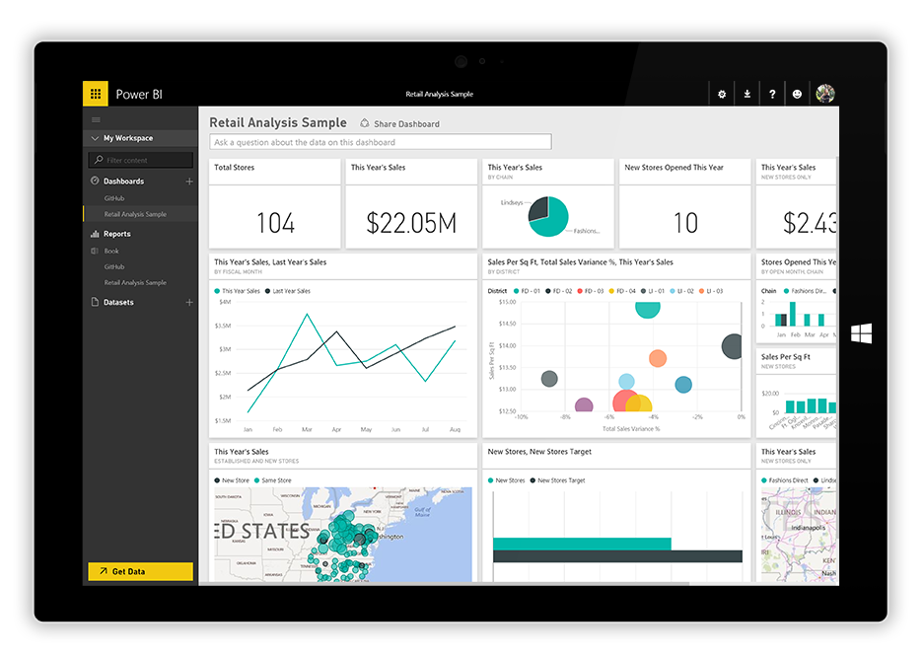

Strategy and Decision-Making
Business Support (Finance, HR, etc)
Value Creation
Information & Knowledge
INSIGHTS AND ANALYTICS
PLANNING
OPERATION
INTEGRATIONS &
DATA MANAGEMENT
Reporting
Business intelligence
Power BI
Strategy formulation
Financial planning
Financial simulation
Consolidation
Loan portfolio manager
Machine Learning
Production system
Process automation
Custom solutions
Data Factory
Data Lake
ETL
Data Warehouse

