Slide 1
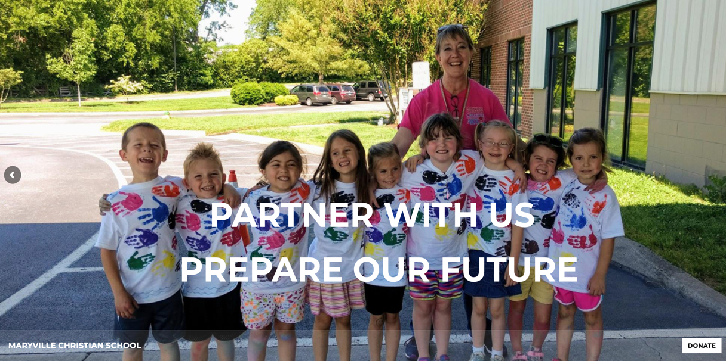

Slide 2
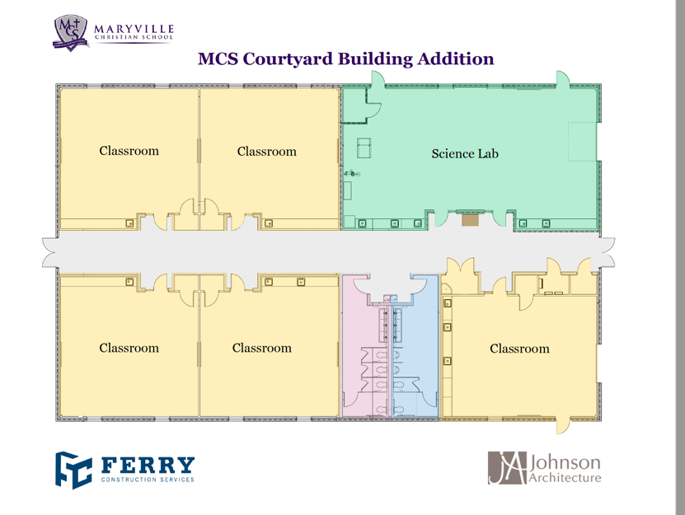
Phase 1

Slide 3
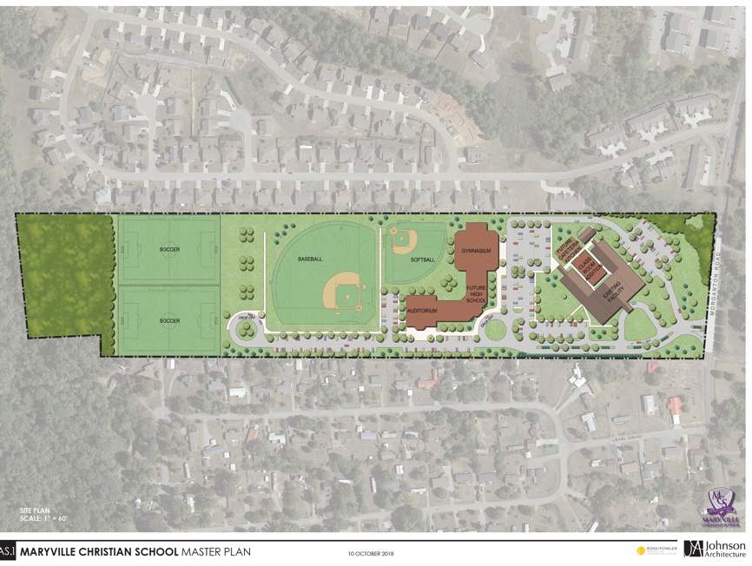
Phase 2

Slide 4
Campaign Ideas
ARE YOU IN
EXPECT GREAT THINGS FROM GOD
ATTEMPT GREAT THINGS FOR GOD

Slide 5
This is a sample from a hospital that used the same campaign idea? Ours could be similar but uses pictures of our students, etc.

Slide 6
Background:
http://www.maryvillechristianschool.org/
Use the above website for images and content
The marketing idea is “ARE YOU IN?”
There are multiple sub categories to the campaign
  ARE YOU “IN”
  IN (vested):
  IN (debted):
  IN (fluential):
  IN (tune):
  IN (volved):
  IN (vited)
  IN (cluded):

Slide 7
Are you IN (vested)
invested in the next generation
Invest in your child’s future
Invest in the next generation
Invest in our culture
Invest in the community
“Remember this—a farmer who plants only a few seeds will get a small crop. But the one who plants generously will get a generous crop. You must each decide in your heart how much to give. And don’t give reluctantly or in response to pressure. “For God loves a person who gives cheerfully.” And God will generously provide all you need. Then you will always have everything you need and plenty left over to share with others.”
2 Corinthians 9:6-8 NLT
http://bible.com/116/2co.9.6-8.nlt

Slide 8
Are you IN (debted)
Indebted to the belief that we get to choose the culture for our children.
“After all, who is Apollos? Who is Paul? We are only God’s servants through whom you believed the Good News. Each of us did the work the Lord gave us. I planted the seed in your hearts, and Apollos watered it, but it was God who made it grow. It’s not important who does the planting, or who does the watering. What’s important is that God makes the seed grow. The one who plants and the one who waters work together with the same purpose. And both will be rewarded for their own hard work. For we are both God’s workers. And you are God’s field. You are God’s building.”
1 Corinthians 3:5-9 NLT
http://bible.com/116/1co.3.5-9.nlt

Slide 9
Are you IN (fluentail)
influential in your child’s future and the next generation.
“Because of God’s grace to me, I have laid the foundation like an expert builder. Now others are building on it. But whoever is building on this foundation must be very careful.”
1 Corinthians 3:10 NLT
http://bible.com/116/1co.3.10.nlt

Slide 10
Are you IN (tune)
in tune with the cultural and learning aspects of your child’s future
Do not conform to the pattern of this world, but be transformed by the renewing of your mind. Then you will be able to test and approve what God’s will is—his good, pleasing and perfect will.

Slide 11
Are you IN (volved)
involved in the future of this community and lives of future children
“You know the saying, ‘Four months between planting and harvest.’ But I say, wake up and look around. The fields are already ripe for harvest. The harvesters are paid good wages, and the fruit they harvest is people brought to eternal life. What joy awaits both the planter and the harvester alike! You know the saying, ‘One plants and another harvests.’ And it’s true. I sent you to harvest where you didn’t plant; others had already done the work, and now you will get to gather the harvest.””
John 4:35-38 NLT
http://bible.com/116/jhn.4.35-38.nlt

Slide 12
Are you IN (cluded)
Give today , make a difference for tomorrow.

