Slide 1
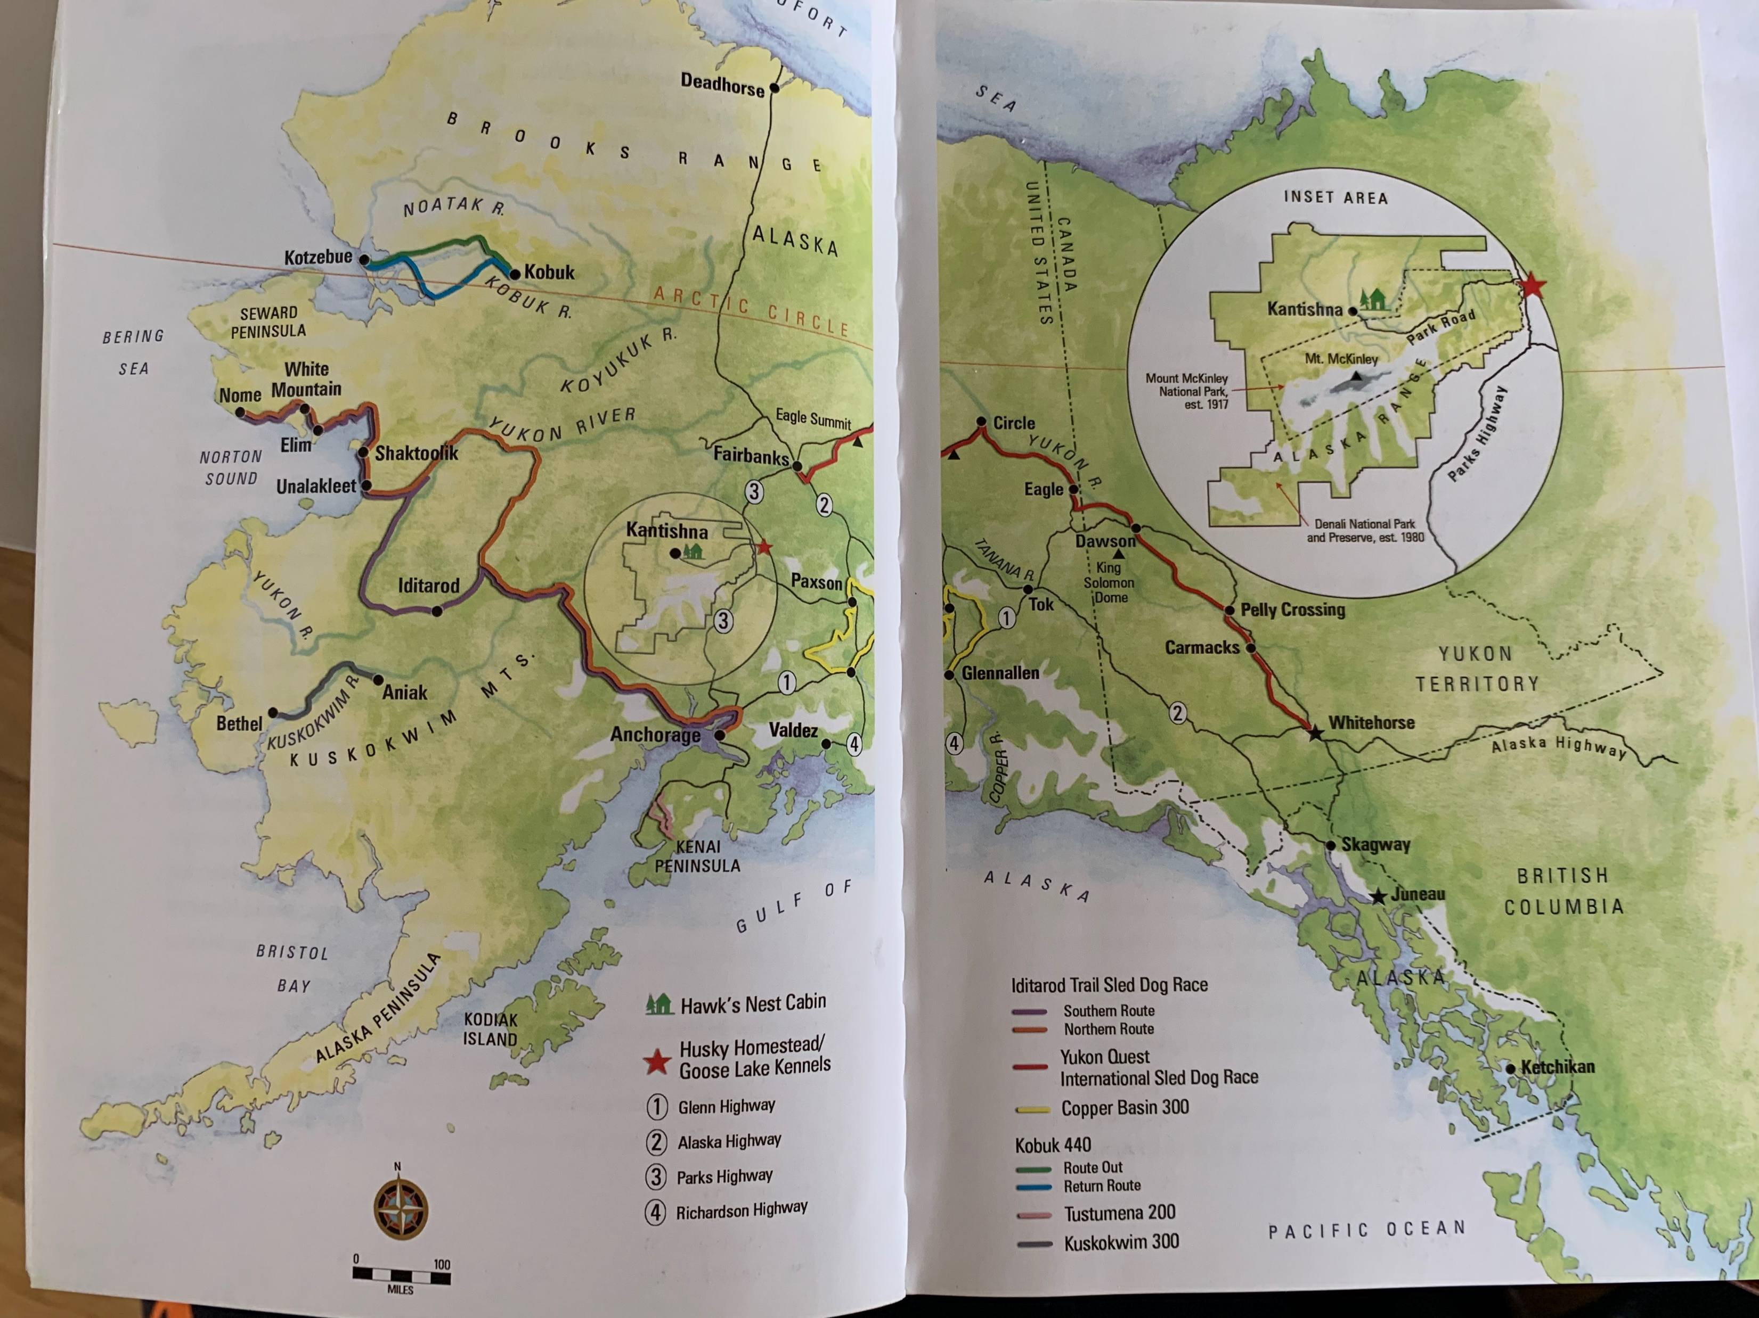
Sample map from a similar example. The end result from this project will be similar to this one.

Slide 2
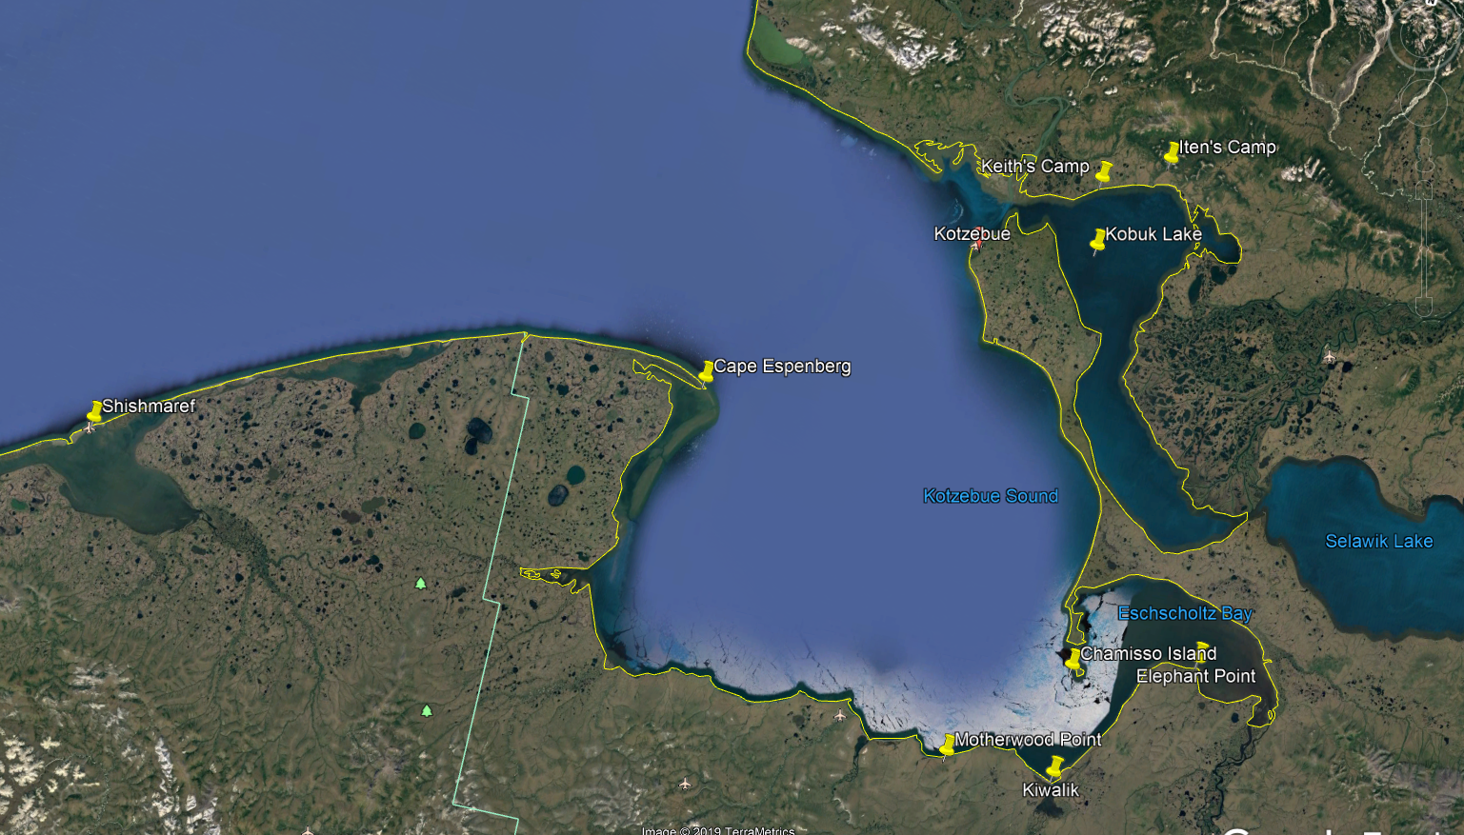
Inset

Slide 3
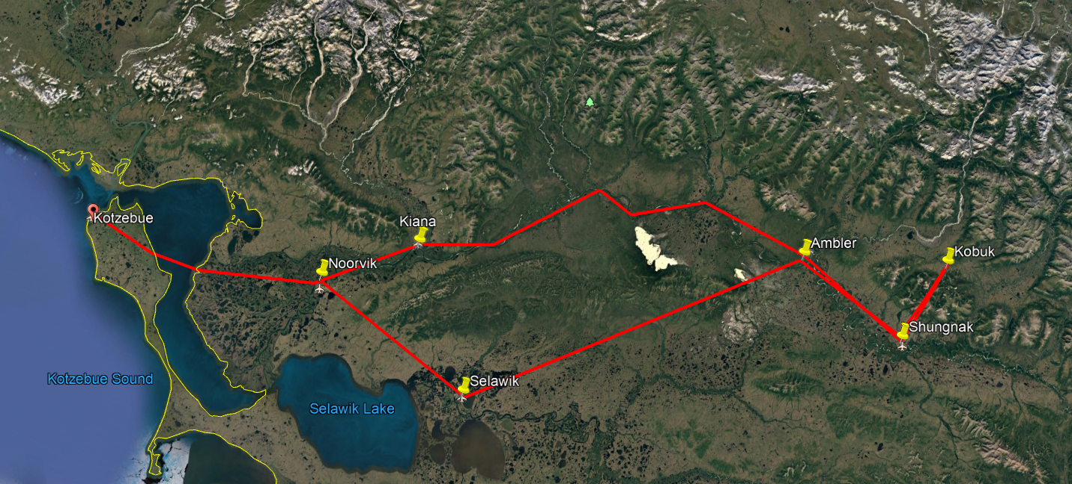
Kobuk 440 Trail

Slide 4
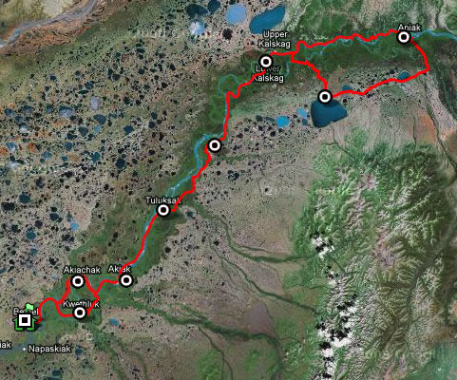
Kuskokwim 300 Trail

