Slide 1

^{Scan, Inspect, Filter, Target}
Don’t grade your shrimp, SHIFT them!
Notes: I was thinking in trying to copy the distribution curve and the tight limits.
Right now there is no color, but we might use the colors from the Scanner on the logos.

Slide 2


Slide 3


^{Scan, Inspect, Filter, Target}
Don’t grade your shrimp, SIFT them!

Slide 4
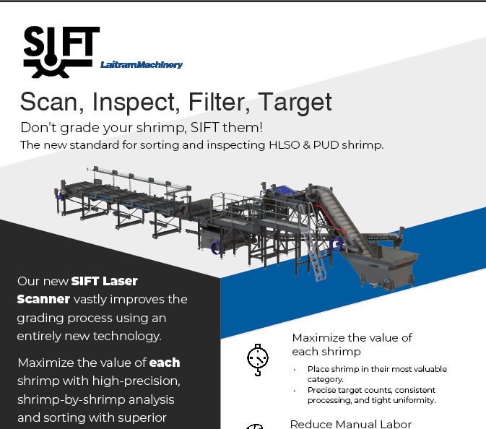

Slide 5

^{Scan, Inspect, Filter, Target}
Notes: Prophet tools, inside the scanner we can have different icons for Scan, Inspect, Analysis, portal etc.

Slide 6
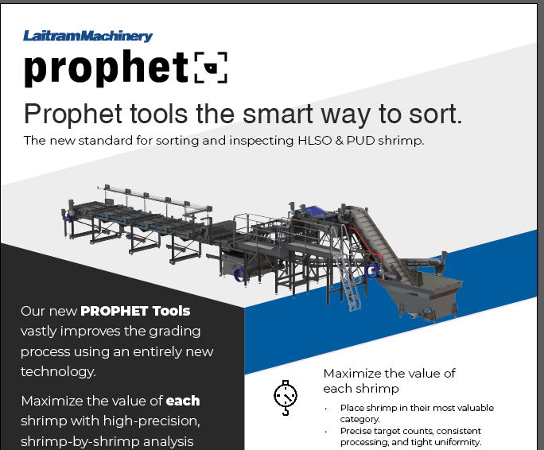

Slide 7



Slide 8


Slide 9

^{Sorter | tools}

Slide 10


Slide 11


Slide 12


