Slide 1
Georgia Sunrise Botanicals
The Georgia Company
Wholly owned and operated by Georgians for Georgians
June 2019

Slide 2
Mission Statement
Georgia Sunrise will provide the highest quality all-natural cannabinoid-based therapeutics to the public. Georgia Sunrise will legally cultivate, process and sell pharmaceutical grade marijuana at competitive prices to Georgia residents who suffer from chronic pain, epilepsy, dementia and numerous other debilitating conditions.

Slide 3
Guiding Principles (1/2)
1.
Integrity
GSB founders, board members and employees shall always operate with the utmost integrity and transparency
2.
Compliance
GSB shall comply with and exceed all legal, health, safety and quality requirements in every part of the business through daily self-inspections using audits by internal and external resources
GSB shall create a comprehensive security plan with the collaboration of outside professionals, including monitoring by the Georgia Bureau of Investigation and local law enforcement
3.
Leadership
The diversified board and the management of the company will be people with substantial experience in a variety of fields
4.
Operational Excellence
GSB shall implement industry leading policies, processes, and procedures throughout its operations
GSB shall invest in leading edge technologies and processes to meet and exceed regulatory requirements and / or to deliver operational efficiencies that provide an attractive ROI
Notes:
May require more than one slide

Slide 4
Guiding Principles (2/2)
5.
Culture
Our culture will be the lifeblood of the company and instilled in every associate within GSB; we will strive to make our associates part of our family
We will embrace diversity and encourage opportunity at all levels regardless of race, gender, age, sexual orientation, ethnicity or religion
We strongly believe in the concept of “owned by the managers and managed by the owners” which includes employees at every level
There will be a stock sharing plan for all employees that meet certain criteria
6.
Community
GSB shall partner with educational institutions in areas to include agriculture, pharmacy, chemistry, IT, business, security and health for research and other purposes
GSB will positively impact the local community and broader state economy by providing attractive employment opportunities within the local and regional areas; GSB will also implement leading environmentally sustainable practices into all aspects of its operations
Notes:
May require more than one slide

Slide 5
Organization Structure
Citadel Family Farms, LLC
Property and Finance Company
100% owned and operated by:
Ronald Wallace (CEO) William Lusk John Morley Roger Bonds
New Horizon Health, LLC
Finance/Holding Company: will allocate funds to Georgia Sunrise
100% owned and operated by: Roger Bonds (CEO) William Lusk John Morley Ronald Wallace
Georgia Sunrise Botanicals, LLC
Operational Company
Board Members: Alanna Lavelle (Chair) Elisabeth Drevet (Vice-Chair) Lisa Ayala-Davis
Michael Davis
DeLois Babiker Howard Hatfield
Christopher Bonds Jeff Rapoport
David Duncan Michael Steele
Terrance Fisher Howard Stirne

Slide 6
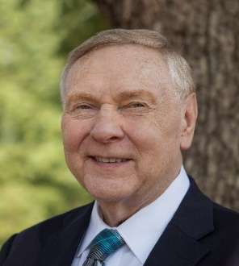
Citadel & New Horizon Founders & Board
Retired President of UPS International
CEO
Citadel Family Farms, LLC
Number One Group
13090 Freemanville Road
Milton, Georgia 30004
orientalsaloon@yahoo.com
Cell or Text 770-833-7578
Ron Wallace, a Georgia resident of 23 years, is the former president of UPS International. During his tenure, he was responsible for operations in more than 200 countries, with more than 60,000 people under his direction. He also served on the corporate management committee that oversaw the day-to-day operations of UPS, a 92 billion dollar company with 435,000 employees. He served as chairman or cochairman of thirty three boards of directors located around the world. Shortly after retiring from UPS, Ron
Ronald G. Wallace
was appointed by the governor of Georgia as chairman of the Governor’s Commission and charged with forming the City of Milton, Georgia.
Ron was in law enforcement for fourteen years and has served or is serving as a director on numerous companies including Wellstar North Fulton Hospital and other medical related businesses. He is the founder of several charitable organizations; has played significant roles in over 65 local, state and national political campaigns. Worked on a farm while attending school; authored three books; Played semi-professional football in Europe for two seasons. Currently a commercial developer and owner of four restaurants in Georgia.
Ron Wallace has nothing to disclose.

Slide 7
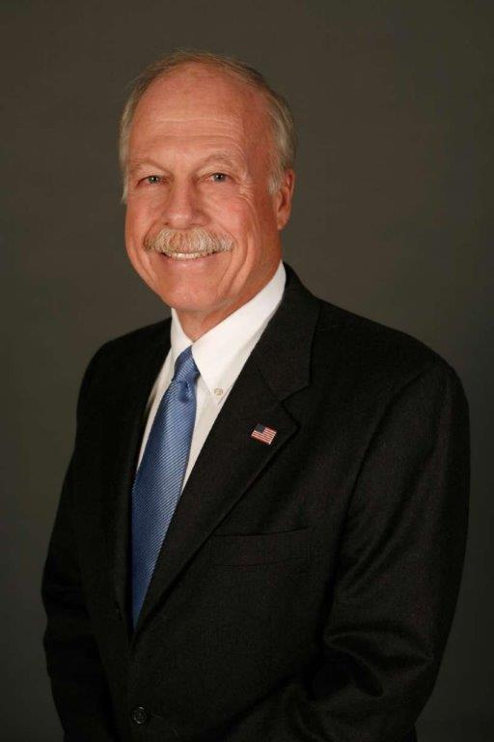
Citadel & New Horizon Founders & Board
General Contractor
(Retired)
Bill, a Georgia resident for 46 years, is a retired General Contractor. He worked for 55 years in the construction industry and founded his own commercial general contracting firm, which continues to operate in the Southeast after 33 years. His company, has built several award winning projects in the Southeast, including various LEED Certified projects. His integrity and quality workmanship has earned the company a reputation second to none. His personal experiences include construction of military installations, wastewater
1355 Summit Road
Milton, Georgia 30004
luskwc@gmail.com
Cell or Text 678-458-4208
William C. Lusk
P.E.
treatment, tunnels, airports, education, healthcare, religious, and high rise structures. Bill helped create the General Contractor licensing legislation and was one of the first licensed general contractors in Georgia. He is also a Certified Professional Estimator.
He is a graduate Civil Engineer and Registered Professional Engineer in Georgia and other states. Bill served with the U.S. Navy Construction Battalions (Seabees) in Vietnam in 1966 and 67 where he was involved in several unique projects in remote outposts . He is also an active member in several veterans and historical organizations, and served, or is serving on several non-profit organization boards.
Bill was a member of the Formation Committee to incorporate the new City of Milton in 2006. Shortly thereafter, he was elected to that City’s first Council, a position he held for eleven years. He was instrumental in creating the development codes in Milton. Milton achieved the distinction of having the Best Quality of Life in the State
During his tenure in office.
William Lusk has nothing to disclose.

Slide 8
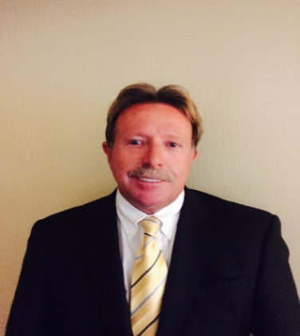
Citadel & New Horizon Founders & Board
President and CEO
J.J. Morley Enterprises, Inc.
Morley Environmental, Inc.
www.morleycompany.com
7560 Industrial Court
Milton, Georgia 30004
johnmorley@morleycompany.com
Cell or Text : 404-372-8670
John J. Morley, a Georgia resident for 27 years, has an extensive engineering background which formed the foundation for J.J. Morley Enterprises, Inc. in 1988 with the goal of creating a General Construction Company and in 1994 started Morley Environmental, Inc. which put client’s satisfaction as its first priority. John Morley believes that his client’s needs must be fully understood and then an appropriate project plan implemented to insure they are met.
John J. Morley
John Morley has managed and directed J.J. Morley Enterprises, Inc. / Morley Environmental, Inc. into having a long standing history of quality products, on time performance, professional workmanship, outstanding supportive staff and some of the most qualified contractors in the industry. John Morley has developed markets and offices in Nashville, Tennessee, Birmingham, Alabama, West Palm Beach Florida, and Alpharetta, Georgia with a controlled growth pattern and a solid, satisfied, client base.
John Morley previous experience was in Nuclear Power, Oil Production / Refining Industries. He was responsible for design, fabrication, assembly, start-up and testing of ground water filtration facilities throughout the U.S.
John Morley has been producing high quality work and supplying services to the United States Postal Service since the founding of both companies. He has managed the companies into a well-respected company with a strong financial position and a favorable reputation.
John Morley has nothing to disclose.

Slide 9
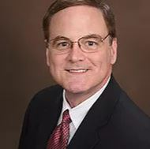
Citadel & New Horizon Founders & Board
President and CEO
American Academy of Medical Management
National Institute of Physician Recruitment
PhysicianCareerAdvisor.com
560 West Crossville, Suite 104
Roswell, Georgia 30075
RogerBondsMedical@Gmail.com
Cell or Text: 770-356-9541
www.YouTube.com/PhysicianCareerAdv
Roger G. Bonds, a Georgia resident of 30 years, is CEO of the American Academy of Medical Management, www.AAMMweb.com, headquartered in Atlanta, Georgia, where his primary work is consulting with hospitals and group practices to develop the medical staff. His expertise includes physician manpower planning, physician recruitment, practice start-up, physician contracting and compensation.
Roger is a frequent lecturer to physicians at medical
Roger G. Bonds
MBA, FMSD, CMSR
schools and association meetings on how to make the best career and professional decisions. He has published multiple videos on YouTube, more than 100 articles, various book chapters and three full books, including his most recent book, The Complete Business Guide for a Successful Medical Practice, and the book How to Contract, Compensate and Employ Physicians. Also, in its fourth printing is his book, Physician Recruitment & Retention, Practical Techniques for Exceptional Results. His other books as co-author include Entering Private Practice, and the book Marketing your Clinical Practice, as well as Physician Bonding, Volume II.. Mr. Bonds has appeared extensively in both print and television including the Los Angeles Times, The Boston Globe, Associated Press, CNN, CBS and ABC.
He previously worked as a Corporate Director for a healthcare system and as a Senior Vice President for a hospital and group practice in New Orleans. He earned his Executive MBA from the Fogelman College of Business and Economics, University of Memphis and maintains credentials as a Fellow in Medical Staff Development and as a Certified Medical Staff Recruiter.
Roger Bonds has nothing to disclose.

Slide 10
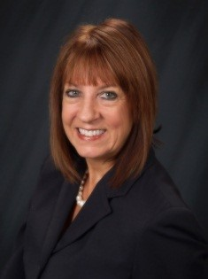
Georgia Sunrise Botanicals Board
Alanna M. Lavelle, a Georgia resident for the past 20 years, is a Senior Principal for the “Center for Transforming Health” at the MITRE Corporation, a non-profit that operates federally funded research and development centers across the government. Her primary work includes consulting with the Centers for Medicare and Medicaid (CMS) to ensure patient safety, program integrity, combat fraud, waste and abuse, and assisting states with the opioid epidemic. She currently serves as an Adjunct Professor teaching Healthcare
Senior Principal, Center for Transforming Health
MITRE Corporation
McLean, Virginia
12072 Cotton Alley
Alpharetta, GA 30009
amlavelle@comcast.net
Cell or Text :404-805-2158
Alanna M. Lavelle MS,CFC,AHFI,ACFE
Fraud Investigation, Analytics and Human Trafficking for the University of New Haven, CT.
Previously she served as a FBI Agent/Supervisor for over 25 years where she managed criminal investigations of complex healthcare fraud to include kickbacks cases, false claims, identity theft and money laundering. Following her FBI career, Ms. Lavelle joined the Georgia offices of Anthem Blue Cross Blue Shield as the Director of Investigations. She was requested to testify at two U.S Congress subcommittees to share best practices in program integrity from the private health sector, and has testified numerous times as an expert witness. Ms. Lavelle has served on the boards of various organizations, was instrumental in the creation of the national Healthcare Fraud Prevention Partnership, and has presented extensively at healthcare conferences across the globe.
Ms. Lavelle holds an MS in Conflict Management and a BA in International Relations from the University of Minnesota. She maintains credentials as a Certified Clinical Coder, Court Mediator and Accredited Healthcare Fraud Investigator.
Alanna Lavelle has nothing to disclose.

Slide 11
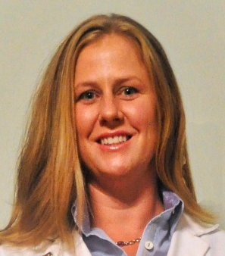
Georgia Sunrise Botanicals Board
Registered Pharmacist
14035 Cowart Road
Milton, Georgia 30004
elisabethdrevet@gmail.com
Cell or Text: 774-266-3624
Elisabeth Drevet, a Georgia resident of 7 years, is a licensed pharmacist in the states of Massachusetts and Georgia. She received her bachelor of science degree from Bates College in 2001 and her doctor of pharmacy from The Massachusetts College of Pharmacy and Health Sciences in 2007.
Elisabeth spent her entire pharmacy career with leading national retail chains including Walgreens and Wal-mart. Elisabeth has over seven years of experience in
Elisabeth Drevet
PharmD
pharmacy roles including, staff pharmacist, manager and pharmacist-in-charge. She was involved in the implementation of clinical services within the retail environment for her market, ultimately making disease state management, medication therapy management and immunization services more readily available to the public.
Prior to her career in pharmacy, Elisabeth served in the U.S. Food and Drug Administration as a Consumer Safety Officer.
In addition to her professional career, Elisabeth currently serves her local community as a member of the Milton Equestrian Committee.
Elisabeth Drevet has nothing to disclose.

Slide 12
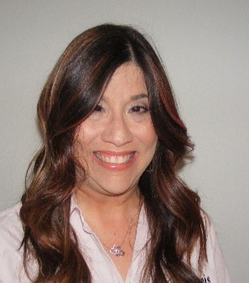
Georgia Sunrise Botanicals Board
Vice-President
Davis Floral Company, Inc.
Davis-floral.com¹
1825 Bowman Highway
Dewy Rose, Georgia 30634
ladavis@davis-floral.com
Cell or Text: 706-614-5606
Lisa Ayala-Davis, a Georgia resident of 16 years, is the Vice President of Davis Floral Company, Inc., one of the longest running wholesale greenhouses in the state of Georgia. She is responsible for all the human resources and regulatory issues and is the point of contact for all the brokers, the Department of Agriculture, and ongoing research projects, internships and outreach with UGA. She is also responsible for community outreach and all around morale.
Lisa Ayala-Davis
MA
Prior to joining Davis Floral, Lisa was a resident of Athens-Clarke County and worked at the University of Georgia’s Office of International Education for seven years. During her time at OIE, Lisa was an immigration services specialist and worked day to day with government regulations and several state and federal agencies. It was an integral part of her job to balance government regulations and university policies with the interests of the international students and scholars. During this time she also completed her Master’s Degree from UGA.
Lisa graduated from the University of Puerto Rico at Mayaguez with a degree in Political Science.
Lisa Ayala-Davis has nothing to disclose.
Notes:
1. See appendix for an overview of Davis Floral Company

Slide 13
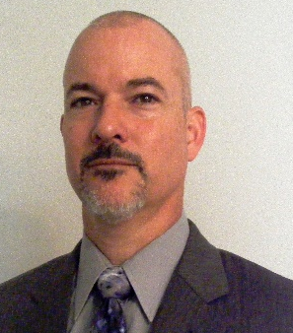
Georgia Sunrise Botanicals Board
President
Davis Floral Company, Inc.
Davis-floral.com¹
1851 Bowman Highway NW
Dewy Rose, Georgia 30634
mdavis@davis-floral.com
Cell or Text: 404-372-2021
Michael Davis, a life-long resident of Georgia of 45 years, is the President of Davis Floral Company, Inc., one of the longest continuously operating wholesale greenhouses in Georgia. He has overseen the direction and growth of the company for the past nine years. On a daily basis, he manages issues across multiple areas related to growing, production, and maintenance of the business. As the owner of a family business in its’ second generation, Michael has worked hard at developing new ideas and
John Michael Davis
MBA
relationships, while maintaining traditions and relationships that go back half a century.
Michael grew up in the family business, starting at a young age working after school and summers. Michael studied Chemical Engineering at Georgia Tech for two years, before transferring to UGA where he completed his BS in Horticulture.
He is fluent in Spanish and was a webmaster for CNNenespanol.com. Michael earned his MBA in finance from Georgia State University.
Michael Davis has nothing to disclose.
Notes:
1. See appendix for an overview of Davis Floral Company

Slide 14
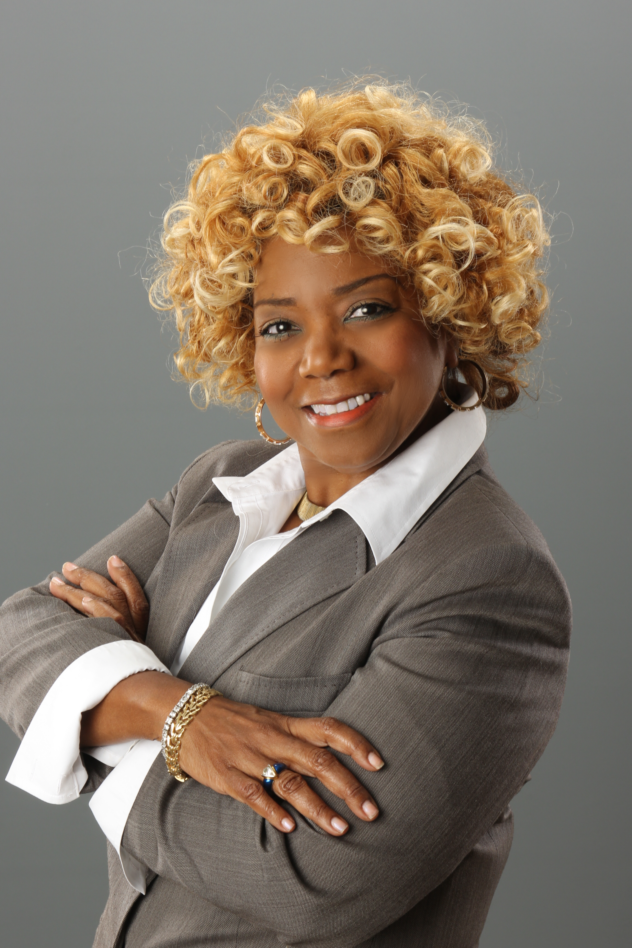
Georgia Sunrise Botanicals
CEO
Intellectual Concepts, LLC
www.intellectualconcepts.com
400 Ashdown Way
Sandy Springs, GA 30350
Cell or Text: 202.321.4560
DeLois B. Babiker a Georgia resident of 14 years. For more than 35 years, she has successfully provided senior leadership to technology and management initiatives in government and private industry. Thirteen years ago, she founded Intellectual Concepts (IC), a global management consulting firm providing specialized program and management consulting services to supporting HIV, Polio Eradication, Zika, and Cancer supporting Public Health, mobility Intelligent Technical sensor solution, device installation and project management supporting the
DeLois Babiker
Transit industry, and logistics, information technology, cyber security and administrative services for the DoD.
Ms. Babiker provides leadership to a number of local and national organizations, including as active Board Member of Atlanta Life Insurance; previously a Board Member for TechBridge, Chapter Chair of TechExecs, and Atlanta Chapter; as Board Member of Mary Hall’s Freedom House; and as Board Advisory Member of Every Woman Works. She is also an active participant with the American Public Transportation Association (APTA), Council of Minority Transportation Officials (COMTO), Women In Transit (WTS), Industry Advisory Council (IAC); Women's Business Enterprise National Council (WBENC), Georgia Minority Supplier Development Council (GMSDC, )National Contract Management Association(NCMA), ONBOARD, and Women In Defense (WID) and life time member of Armed Forces Communications & Electronics Association(AFCEA).
Ms. Babiker earned her undergraduate and Master’s degree in Management Information Systems from George Mason University as well as a Chief Information Officer Certificate from Carnegie Mellon University
DeLois B. Babiker has nothing to disclose

Slide 15
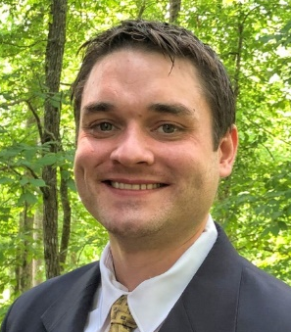
Georgia Sunrise Botanicals
Christopher Bonds, a Georgia resident of 30 years, is a Hope Scholarship recipient, receiving a bachelor’s degree in Agribusiness from The University of Georgia’s College of Agricultural and Environmental Sciences.
Combining his love for living things, desire to contribute to society, and respect for emerging agribusinesses on the forefront of medicine, he moved to Denver, Colorado in order to work in the medical marijuana industry. There he tasked himself with studying the industry as a whole
Founder and Manager
Springhill Rabbits
Springhillrabbits.com
40 Pruitt Road
Alpharetta, Georgia 30004
ChrisBonds2019@gmail.com
Cell or Text: 770-570-9306
Christopher Bonds
while finding work at Green Solution’s cultivation facilities.
After a year of studying the industry first-hand in Colorado, he returned home seeking opportunity in Georgia’s developing medical marijuana market. He maintains the Master Grower Certification from Green CulturED, Cannabis Training University’s Master Certificate, and will soon be attending Oaksterdam University’s horticulture courses. He received the Colorado MED Occupational License after passing all qualifications to work in Colorado MED licensed facilities. Work and studies have also included: cannabis clone transplanting, cannabis grow cleaning and sterilization, cannabis grow cultivation assistant, and cannabis husbandry.
Christopher Bonds has nothing to disclose.

Slide 16
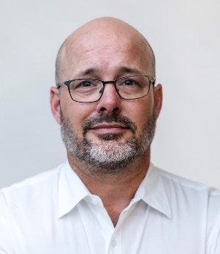
Georgia Sunrise Botanicals
David Duncan, a Georgia resident of 46 years and a 3rd generation Atlantan, is a graduate of Georgia State University.
David has over 25 years of strategic experience in taking innovations from concept to market success, David understands the Cannabis space and has been directly involved in each phase of the Cannabis product development cycle commencing with extraction up to the pre-clinical phase. Driven by passion for helping those
Founder and Former CEO of tier one luxury retail Candle Company
1272 Lullwater Park Circle
Atlanta, GA 30306
Duncan.Davida@gmail.com
Cell or Text: 404-423-3149
David Duncan
suffering from pain, seizures, autism, depression, and Parkinson’s, as well as those seeking alternatives to opioids and alcohol, David has successfully provided solutions, services and relief to a loyal community for over a decade.
David is the Founder and former CFO of a tier one luxury retail Candle Company in the United States still distributed at Whole Foods and other leading retailers. He developed this concept from garage to market and to date this firm has grossed more than $100 Million in revenues. He led and developed concepts to product through manufacturing, production, sales and marketing cycles for over 15 years. During this time David was noted as 40 under 40 in 2009 in his home City.
David has been an active entrepreneur and has served as President for the prestigious Entrepreneurs Organization (EO) in his home city. He is engaged with University developments and new businesses as an advisor as organizations seek David out for making and formulating strategic decisions.
David Duncan has nothing to disclose.

Slide 17
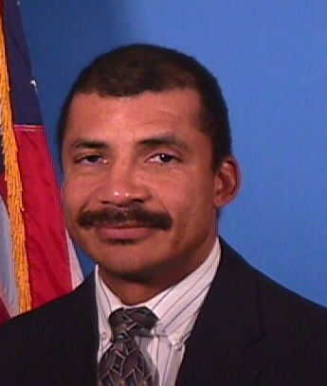
Georgia Sunrise Botanicals
Member, Blue Line Threat Analysis
Alpharetta, Georgia
12460 Crabapple Road
Suite 202-330
Alpharetta, Georgia 30004
tfisher924@att.net
Cell or Text :404-392-3038
Terrance Fisher, a Georgia resident for the past twenty years, is a Member of Blue Line Threat Analysis, LLC, a Georgia licensed Private Investigations/Security Agency.
Prior to Blue Line, Mr. Fisher was a Special Agent (SA) with the FBI. During his 22-year tenure with the FBI, Mr. Fisher conducted investigations and served in various posts domestically and internationally; trained extensively at Quantico and was selected to become a Technically Trained Agent (TTA). As a TTA, he received
Terrance Fisher
extensive specialized training in electronic eavesdropping, deployment of countermeasures and computer intrusion and forensics programs. Mr. Fisher was also involved in conducting covert audio/video surveillance, countermeasures and computer/information systems security.
Mr. Fisher was a member of the FBI SWAT team that rescued 13 hostages from the Talladega prison uprising; participated in the investigation of the 1996 Olympics bombing, is a certified computer forensics examiner; conducted examinations of technology in support of FBI investigations and served as a Supervisory Special Agent at FBI Headquarters, Counter-terrorism Division.
Mr. Fisher received his undergraduate degree from Howard University; member of the Society of Former Special Agents of the FBI; continues to receive highly technical training in the field of eavesdropping countermeasures. Ultimately, Mr. Fisher’s knowledge and expertise with the installation and identification of highly sophisticated and classified technology means he has some of the most sought after skills in the commercial and private sectors.
Terrance Fisher has nothing to disclose.

Slide 18
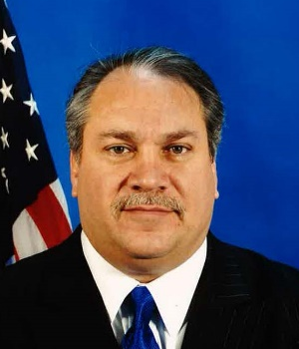
Georgia Sunrise Botanicals
Principal, Blue Line Threat Analysis
Alpharetta, Georgia
12460 Crabapple Road
Suite 202-330
Alpharetta, Georgia 30004
hhatfield@blueline247.com
Cell or Text :404-805-2540
Howard H. Hatfield, a Georgia resident for the past twenty years, is the Principal Partner of Blue Line Threat Analysis, LLC, (Blue Line) a Georgia licensed Private Investigations/Security Agency. Blue Line employs retired FBI Special Agents to manage security and response for numerous Special Events, which included the Olympics, World Cup, Super Bowls, and meetings of world leaders.
Prior to Blue Line, Howard spent over 28 years in state
Howard H.
Hatfield
and federal law enforcement. After serving as a police officer, Howard joined the FBI and held numerous roles including SWAT Team Operator, Defensive Tactics Instructor, Under-Cover Agent, Supervisory Special Agent and Assistant Special Agent in Charge in Atlanta.
These roles covered a wide range of responsibilities which included leading the investigative activities of several FBI Field Offices, managing a Division’s Domestic and International Terrorism, Foreign Counterintelligence, Weapons of Mass Destruction and Physical Security Programs, and managing White Collar Crime, Public Corruption, Civil Rights, Violent Crime, Organized Crime, Drug, Computer Crime and Intrusion Programs.
Mr. Hatfield is a recognized Senior Executive Fellow at the John F. Kennedy School of Government at Harvard University and the Kellogg School of Management at Northwestern University. He is a graduate of the Royal Hong Kong School for Overseas Officers, Hong Kong.
Howard Hatfield has nothing to disclose.

Slide 19
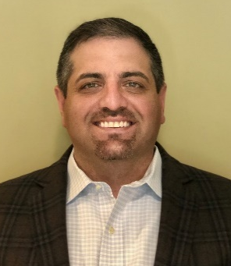
Georgia Sunrise Botanicals
Medical Sales Management
103 Glencedars Lane Canton, GA. 30115
jeff.rapoport@gmail.com Phone: 404-886-4546
Jeff Rapoport, a Georgia resident for over 35 years, has a 20 plus year background in sales and marketing with a focus in the medical field for over 10 years. Jeff works for one of the largest medical companies in the world, where his involvement includes being inside of the operating room educating physicians and O.R. staff to ensure certain medical devices are used for the best possible patient outcome. Jeff educates top physicians, hospitals, and surgery
Jeff Rapoport
centers, which has led him to become a top 5% performer in leadership programs.
During his tenure, Jeff has been a top performer and was chosen to train future sales consultants. Jeff has trained and worked in some of Georgia’s top hospitals, such as Grady Memorial Hospital, Atlanta Medial Center, as well as Northside and WellStar Hospitals and taught multiple courses to nurses and surgical technicians. Throughout his extensive medical sales career he has started a distributorship, successfully hired and managed sales consultants, and helped train/mold them to be leaders in their space. He has strong relationships with some of the most elite physicians in Georgia which have been built on years of trust and hard work. Jeff’s extensive knowledge of medical sales makes him a key component in an industry where patient care and service is the gold standard. In addition, Jeff has worked with non-profit organizations that focus on caring for terminally ill children.
Jeff Rapoport has nothing to disclose

Slide 20
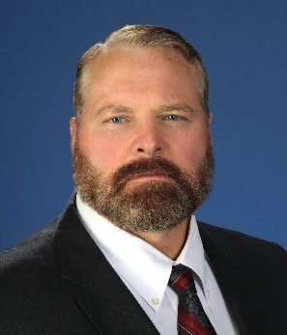
Georgia Sunrise Botanicals
President and CEO
One Focus International Training Group
2480 Fears Road, Suite B
Madison, Georgia 30650
msteele@ofitg.com
Cell or text: 678-763-6569
Mike Steele, a Georgia resident for 58 years, is an expert in security. He is the founder and CEO of One Focus International Training Group (OFITG), headquartered in Georgia. OFITG is a global services company that provides holistic security solutions, full-spectrum training, and operational support to clients around the world. Clients include governments, militaries, corporations, and individuals.
Colonel Michael Steele
MA
Prior to OFITG, Mr. Steele served as the Senior Vice President, Special Operations and International Markets for The Columbia Group. He was the primary surrogate speaker for Herman Cain, Newt Gingrich and was the keynote speaker to over four hundred orthopedic surgeons at the annual Society of Military Orthopedic Surgeons (SOMOS).
Mr. Steele spent 30 years in the United States Army. He held command and leadership positions while in combat zones including Mogadishu, Somalia, Afghanistan, Iraq, and Bosnia.
Mr. Steele graduated from UGS, has a MA from Central Michigan University, a Master of Strategic Studies from the U.S. Army War College and is currently working on his MBA at the Kellogg Business School.
Mr. Steele founded Faces of Freedom, a charitable organization which assists wounded veterans reintegrate into society in Georgia. He also serves as an adjunct member of the medical staff at Shepherd Medical Center in Atlanta.
Michael Steele has nothing to disclose.

Slide 21
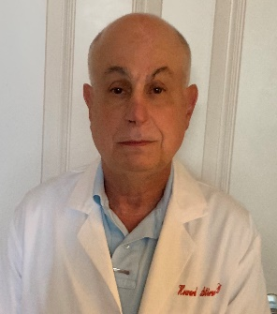
Georgia Sunrise Botanicals
<Insert picture>
Dr. Howard Stirne, a Georgia resident of 36 years, is the current Medical Coordinator for the FBI and a licensed practitioner in the states of Georgia and Florida. Previously, Howard served as the Medical Director for the Dekalb County Department of Public Safety and Emergency Medical Services; was a member of the Joint Terrorism Task Force, Region III Medical Services Council, a fellow of the American College of Emergency Medicine and a Diplomat of the American Board of Emergency Medicine.
Doctor of Medicine
3270 Walton Riverwood Lane SE
Apartment 5025
Atlanta, Georgia 30339
howard.stirne@gmail.com
Phone:678-371-0720
Howard Stirne
MD
Dr. Stirne has been affiliated with numerous hospitals with in the states of Georgia and Florida and has been the recipient of numerous public safety awards and commendations.
Dr. Stirne received his undergraduate degree from Emory University, his MD from Wake Forest University and completed his postgraduate studies at Pennsylvania State University.
Howard Stirne has nothing to disclose.

Slide 22
Appendix

Slide 23

Davis Floral Company Overview
1851 Bowman Highway Dewy Rose, GA 30634 Davis-floral.com 706-283-1396
Davis Floral Company was started in 1964 by Robert Davis in his mother’s backyard. He intended to grow greenhouse tomatoes out of those few wooden framed greenhouse but quickly found out it was not profitable enough. Before long he was in the flower business, growing cut flowers for local florists and supermarkets. In the early 80s the cut flower business went overseas, and Davis Floral Company became a mostly propagation business. In 1984 Davis Floral incorporated. The propagation business grew and Davis Floral began shipping their plugs across the country through many brokerage companies. In 2004 Michael Davis joined Davis Floral with the intention of taking over the business. In 2010 Michael Davis officially took the reins of the Davis Floral Company, and the business moved into its second generation of management. Michael and Lisa have focused on bringing the business into the 21st century. Implementing irrigation systems, updated computer software, and WiFi throughout the facility. They have grown the finished side of the business, started selling to Whole Foods and Park Seed among other big sellers and have acquired reputable root and sell licenses on the propagation side. In addition to this, Lisa and Michael have worked hard at solidifying their relationship with the University of Georgia. During the last decade Davis Floral has hired over a dozen UGA graduates and interns. We have helped train the next generation of Georgia growers, and that is something we are very proud of. The HORT department has used our facility for different experiments and research, and calls on us to lecture their students and frequently uses our plants for their classes, grounds and trial gardens. Davis Floral Company and Lisa and Michael Davis are partners with the University of Georgia’s Horticulture program and that is something we take great pride in. After 55 years Davis Floral is as strong as ever. With 3 acres of greenhouse space and an additional acre of outdoor growing this small family owned business continues to grow. With 20 employees and after all this time, it still feels like a family. Every day we hear stories of current employees whose parents or grandparents once worked here.

