Slide 1
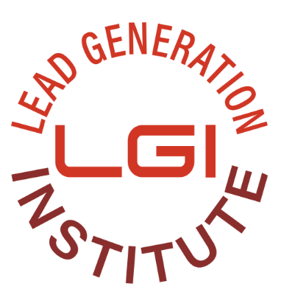
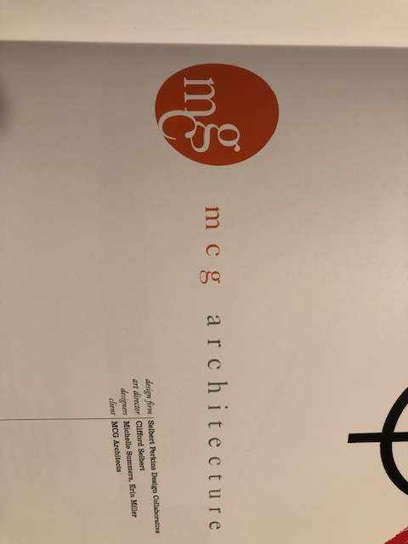
LGI Logo ideas
Not bad but would like to see reversed white type gradient background.
Perhaps like the logo below with Lead Generation Institute to the right
We can also reverse just LG and have the words lead generation institute to the right like CMI does here https://contentmarketinginstitute.com/

Slide 2
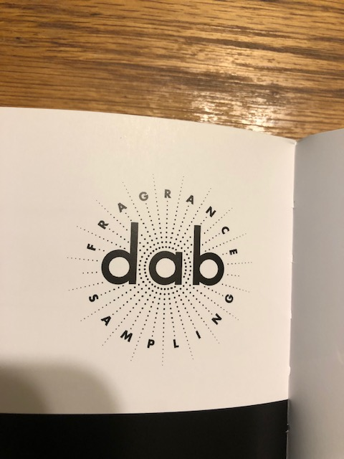
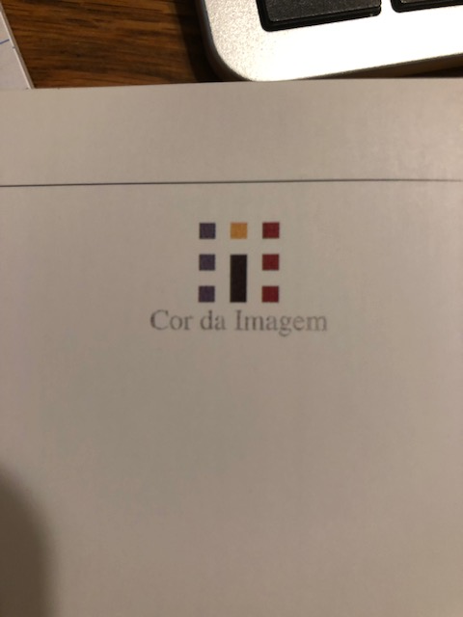
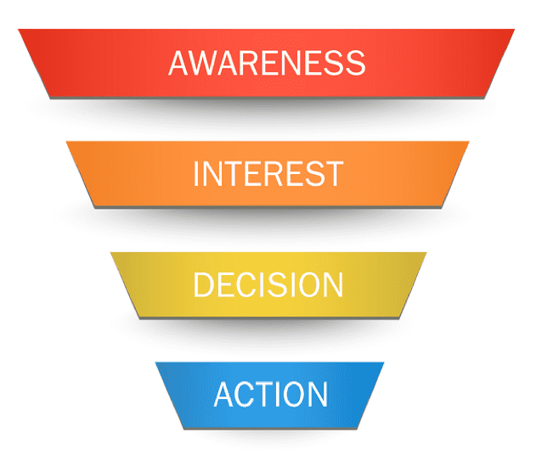
LGI Logo ideas
If we can use dots like this in the dab background but only in the shape of a sales funnel this might work as well i.e.
…………..
……….
.…..
Multiple colors like this but again in a funnel / upside down triangle might work

Slide 3
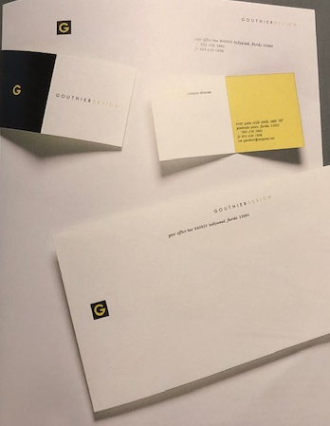
LGI Logo ideas
I definitely like the reverse G on the page. If we did a reversed funnel/updside down triangle that might work

Slide 4
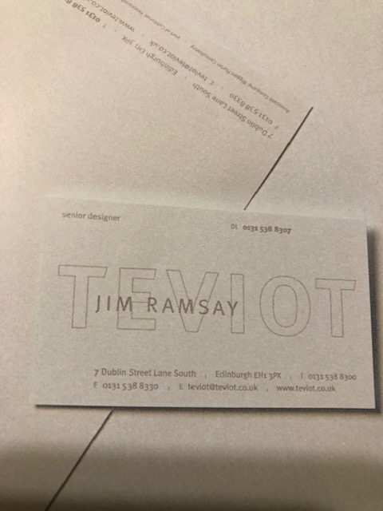
LGI Logo ideas
We might want to try something like this where LGI is line art behind the text

Slide 5
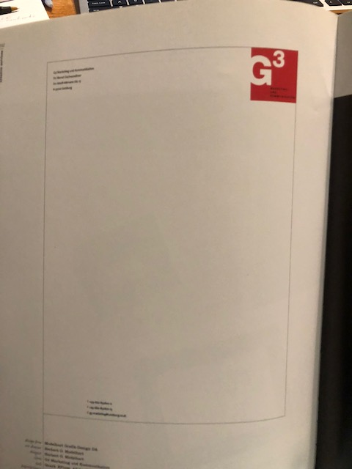
LGI Logo ideas
The funnel reversed like this might work or LG reversed
Lead Generation Institute
Spelled out to the side and funnel in the middle of the page small like the G logo on page 3?

