Slide 1


AGILE WORKSPACES IN INDIA
OVERVIEW

Slide 2
Indian Agile Workspace : Current Market Size
2018 was the year of flexible space operators – leasing crossed 6 mn sq. ft.
After a continuous dip for two years, tech grew at a rate of 11% (with a share of 34%) in office space take-up in 2018.
Number of Agile Workspace Operators in India – 150+
Number of Customised Managed Office Space Providers in India – 5

Slide 3
Indian Agile Workspace : Growth Trend
In 2018, the global outsourcing market amounted to 85.6 billion U.S. dollars.
Total area occupied by Co-working spaces has crossed 18 mn sq ft
The industry is estimated to reach a valuation of $2.2 billion by 2022 while the coworking penetration would increase from 0.7 percent in 2017 to 5.7 percent in 2022.

Slide 4
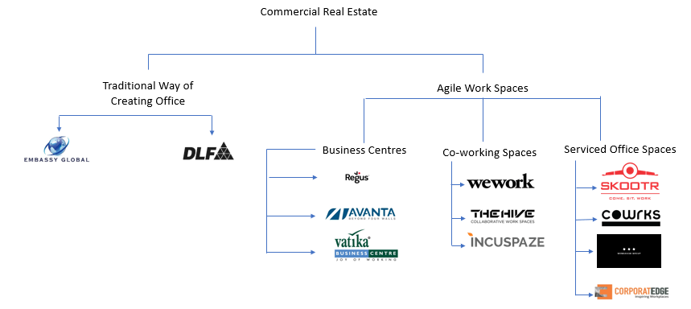
Indian Agile Workspace : Big Players

Slide 5
Indian Coworking Space : Way Ahead
Over 13 million people estimated to operate out of co-working spaces in India by 2020 as JLL India.
2019 indicates that the total amount of space taken up by agile workspace providers in seven major cities in India has tripled from 1.1 million sq ft. to 3.4 million sq ft. over a period of one year.
India will be home to 10,500 startups by 2020: Nasscom
JLL INDIA predicts supplies in the top seven cities to touch by the end of 2022, about 32% more than 166 million sq ft of office space added in the last 5 years

Slide 6

JLL INDIA predicts supplies in the top seven cities to touch by the end of 2022, about 32% more than 166 million sq ft of office space added in the last 5 years
Total area occupied by Co-working spaces has crossed 18 mn sq ft
350+ Shared office operators in India out of which on 5 provide Outsourced Serviced Office Services in India, Skootr is the largest player in this segment
Over 13 million people estimated to operate out of co-working spaces in India by 2020 as JLL India
2.6% of all office stock has already come under Agile Spaces in India

Slide 7
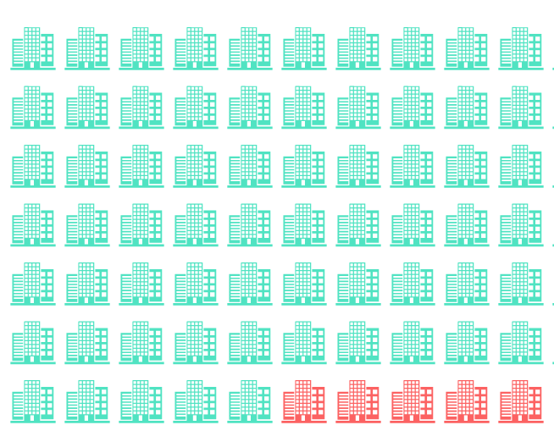
Larger Enterprises in India are apprehensive of entering Co-working Spaces
They cite low control over employees of other companies as a major concern
There are data security fears over a shared IT network
They experience a Brand Identity and Culture Delusion when their employees are placed in a place where they have limited control
Expansion outside top 7 cities still means they have to for traditional offices
Coworking spaces do-not allow deep level customisation which means the international standards for fitments and designs can-not be conformed to
Number of Agile Workspace Operators in India – 150+
Number of Customised Managed Office Space Providers in India - 5

