Slide 1
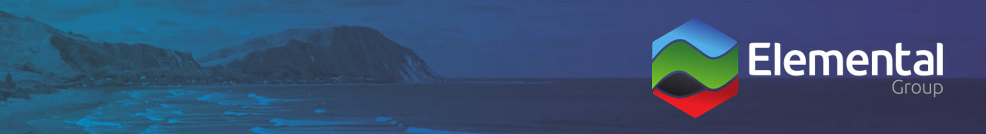
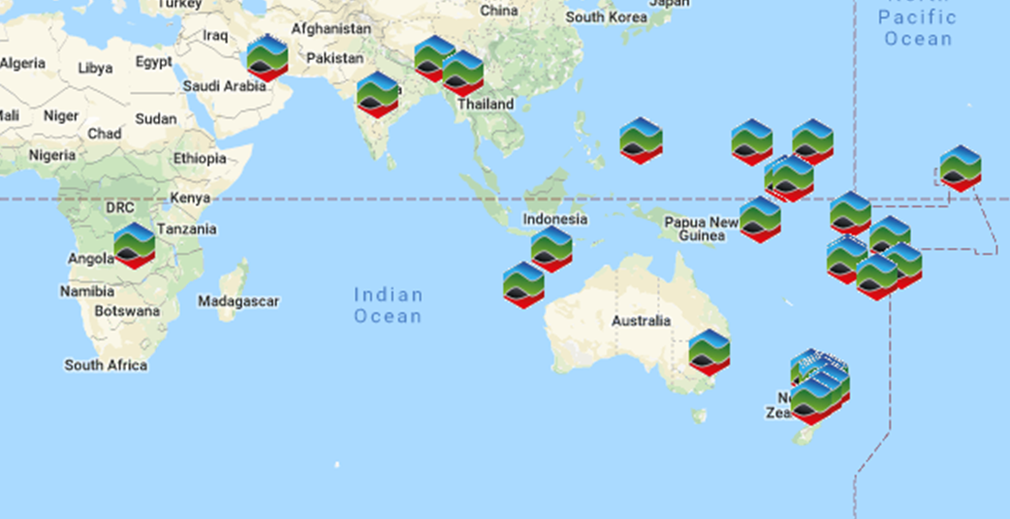
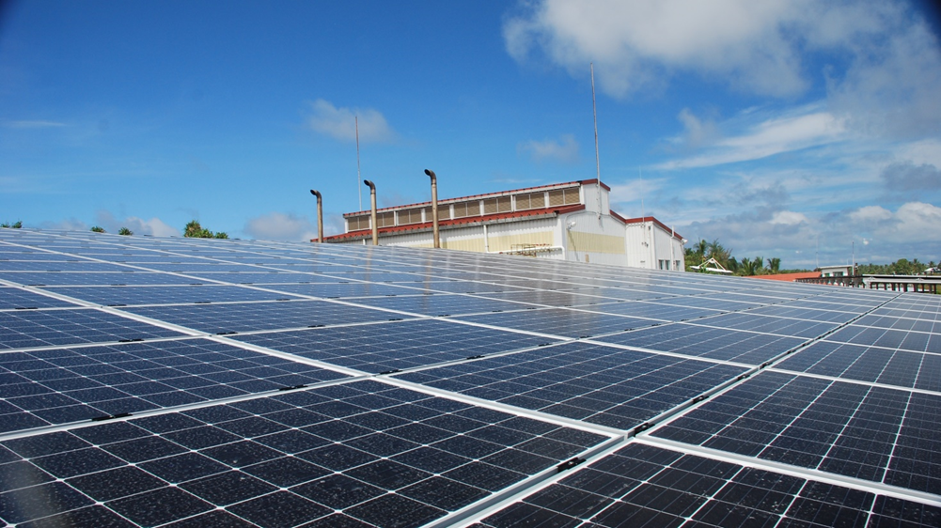
Elemental Group is an expert team of consultants with skills across the entire energy sector
Services we provide
Solar PV, solar thermal, wind, battery energy storage project expertise
Contract development & negotiation
Sophisticated financial modelling
Strategic planning
Feasibility studies, project concept design & specification / Owner’s Engineer and construction supervision
Stakeholder engagement
Environmental Impact Assessments (EIAs) / Environment Management Plans
Project management, risk management
Best Practice Environmental Options / Environmental Monitoring / Auditing
Compliance for Environmental Legislation & Regulations
RE Training and capacity building
Health and Safety training and auditing
Commercial Lead for Shams One solar thermal plant / Wind farm on Sir Bani Yas Island / London Array offshore opportunity
Environmental and Social Safeguards for RE projects
Wind Farm tender evaluations, ACT Wind Auctions I, II and III, Australia
Consultancy advice for Tararua wind farm stages I, II and III, NZ
Consultancy advice for Hallett I wind farm, Australia
Technical due diligence of wind turbines
Places we’ve worked
Case study
KEY PROJECTS
Energy planning, grid integration studies, project design, ESIA, procurement and construction supervision in the Pacific. Includes projects such as 1.1 MWp PV with SCADA integrated remote control in Nauru, and 65 kWp PV, 72 kW/165 kWh BESS automated PV/battery/diesel hybrid system on Kayangel Island, Palau (in progress)
RMI Electricity Roadmap
Capacity building for Ministry of Electricity and Energy, Myanmar
Project inception, feasibility studies, bidding documentation for solar and battery projects in the Caribbean
Pacific Capacity Building and Training Workshops
Energy sector opportunities and vision, Taranaki, New Zealand
Solar Fuel-saver projects and Solar PV and grid integration projects
GHG emissions and offsetting for a greenfields gas project in New Zealand
Elemental Group recently conducted project management, feasibility studies, environmental and social impact assessment, oversight engineering and representation services as part of the UAE USD50 million Pacific Partnership Fund. We optimised project development, design & delivery for:
Fiji Islands - 225 kW, 153 kW & 153 kW PV/diesel hybrid systems
Funafuti, Tuvalu - 500 kW PV, diesel/PV control
Tarawa, Kiribati – 500 kW PV, diesel/PV control
Nauru – 500 kW PV
Majuro, Marshall Islands – 600 kW PV
Pohnpei, Micronesia – 600 kW PV
Palau islands – 100 kW & 100 kW PV/diesel hybrid systems & water purification
Aleipata, Samoa – 550 kW wind
Consultants experience

