Slide 1
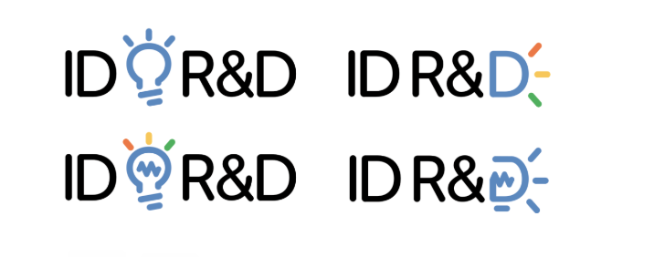
Existing Logo
Our existing website is www.idrnd.net
The existing logo is shown to the right.
Overall, we don’t like the current font.
We aren’t sure we like the “&” being as large as the other letters.
We have some fonts suggestions later in the deck.
We feel the lightbulb graphic looks too much like clip art and is a little cliché. The thought process behind it was INNOVATION and bright ideas. The colored lines were meant to represent the multiple modalities of biometrics we support.
We are also not sure of the color section. We are not opposed to an icon that has multiple colors if executed well. We think of the Slack logo for example.
It’s important to note that this is a product that secures information and fights fraud. The banking industry is our top vertical.
We are open to other ways to represent innovation and ideas. Keep in mind this company is very driven by research and development. The team is comprised of scientists with PhDs in speech and artificial intelligence.
Prior iterations of existing logo:

Slide 2
Our Brand Archetype
Magician
Inventor. Transformer. Visionary. Catalyst.
Basic desire: Bring the future to the present
Objective: To help people transform
Voice: Articulate, compelling, masterful, confident
Customers feel: Fascinated, inspired, wiser, on the cutting edge
The genius, technological, guru-type – turns visions into reality. Interested in new ways of doing things, solutions not yet imagined and products not yet built.
The magician archetype is ideal for a brand that is inherently transformative – providing magical moments.
(Walt Disney, Tesla, Disney, Dyson, Mastercard)

Slide 3
Colors
Stick to black text or VERY dark blue. We lean towards black.
The next slide has a few color schemes we played around with – core colors + secondary “pops” of color. But we are open to recommendations.

Slide 4
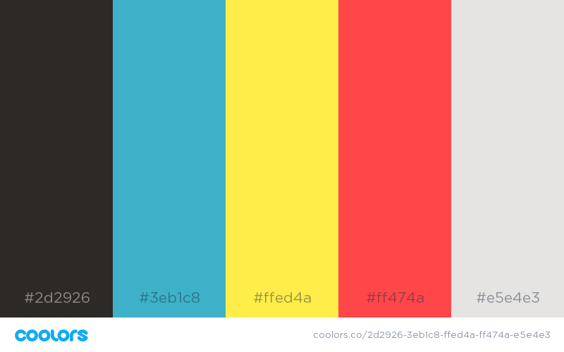
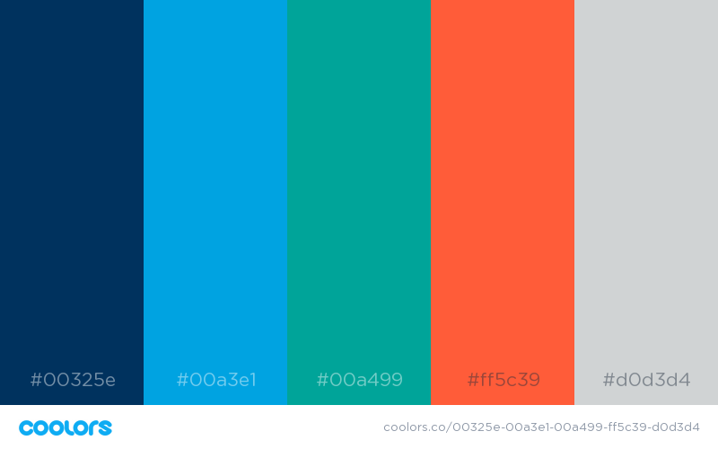
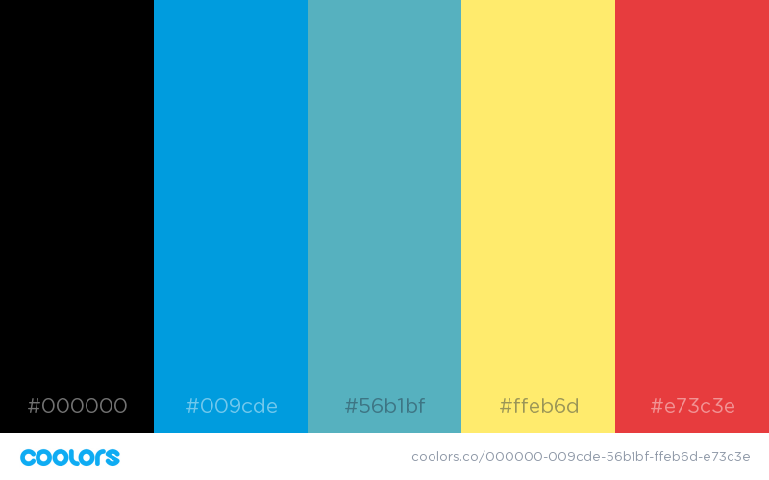
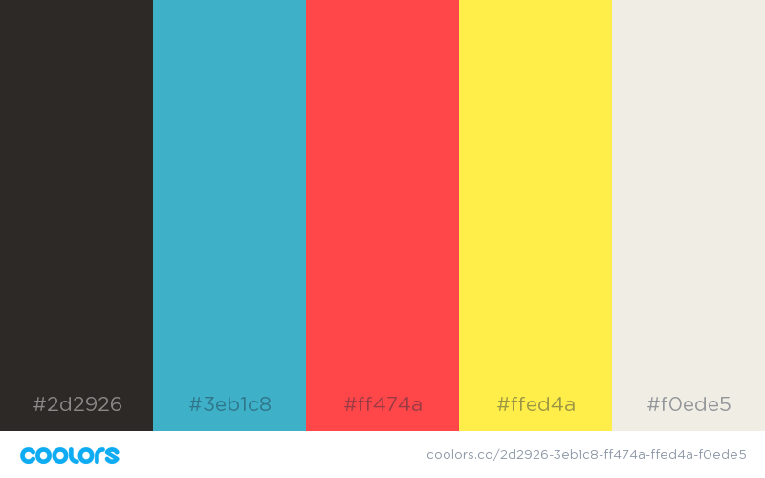

Slide 5
Fonts
Need a font with a good “&”’
We have considered going with “+” vs “&”
See next slide
We are open to the icon being between ID and R&D, as well as before or after it.

Slide 6
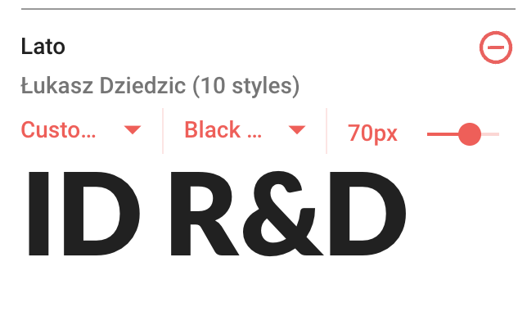
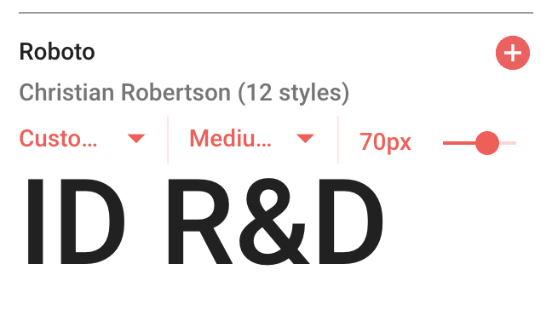
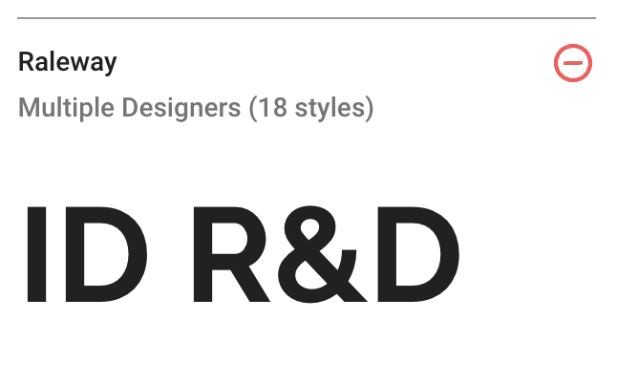
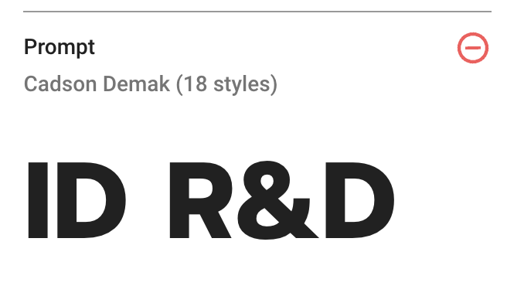
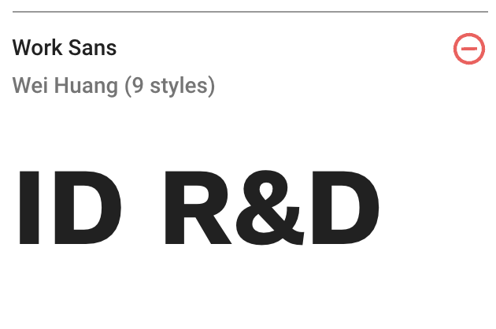
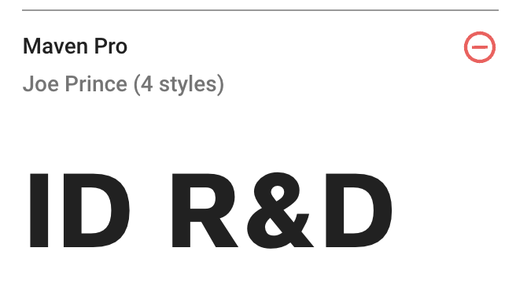
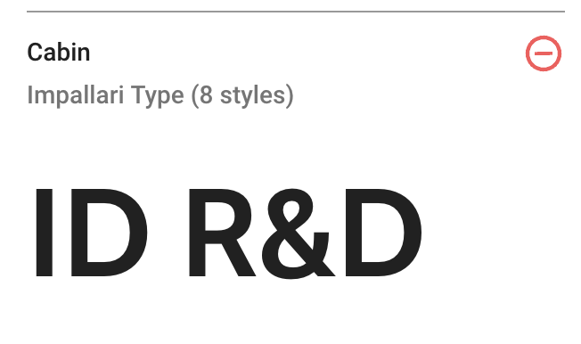
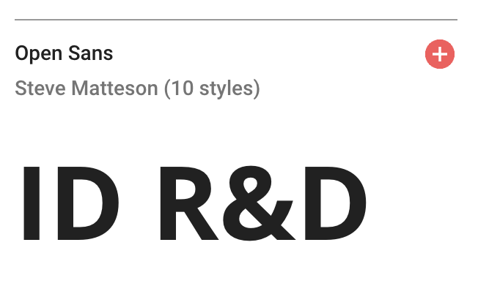

Slide 7
Iconography
Lightbulbs
  Widely known as a symbol for ideas
  Super cliché unless we do something abstract/unique with it
So where do we go from here….
Regarding the next page, I’m not suggesting any of these per se… but providing some visuals for idea starters.
We are open to another graphic element that can represent innovative thinking, leading technology,… Artificial Intelligence is important but it’s not just AI alone.
I would stay away from fingerprints as that isn’t what we do. We verify based on someone speaking, keystroke or using face recognition combined with a very sophisticated passive liveness technology. So, the user doesn’t have to blink, smile, turn their head etc. If someone takes a video of me or a photo cut out, the software detects that.

Slide 8


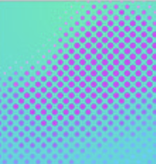

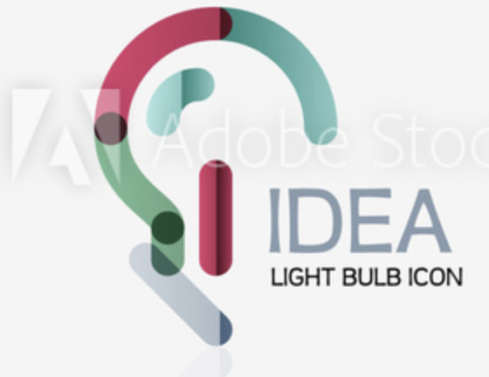
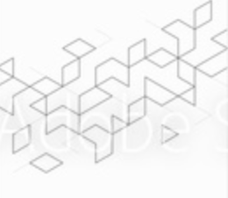

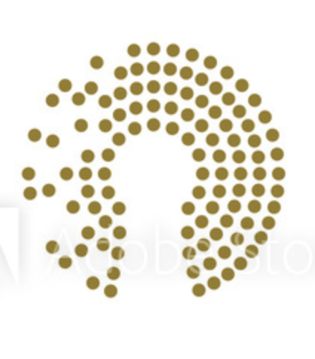
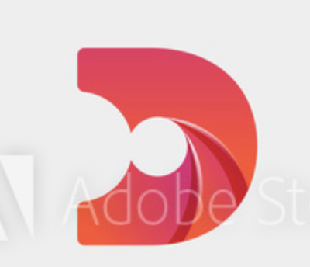
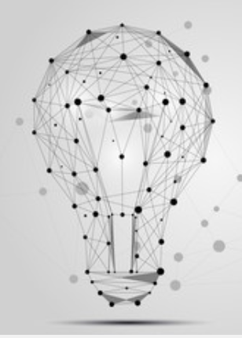
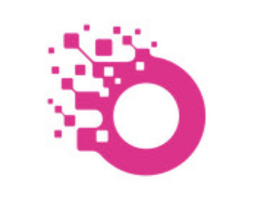

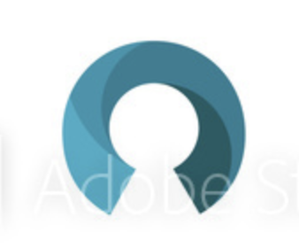
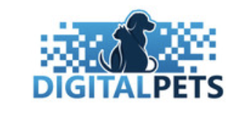
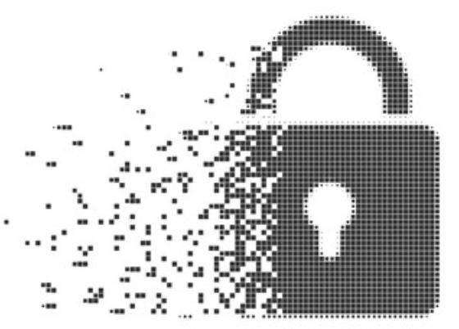
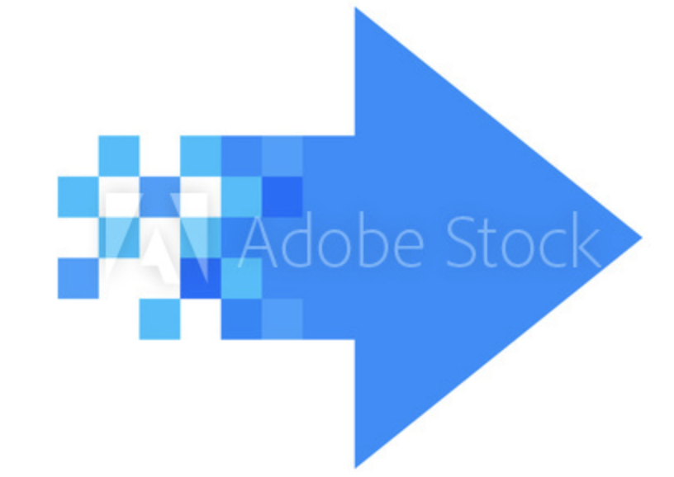

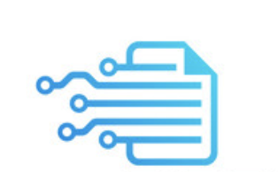


Slide 9
Another option to the above would be something like the right but where the color circle surrounding the negative space (the person icon), turns from red to a greenish blue going clockwise.

