Slide 1

First Mile Last Mile Opportunities
Innovation, Inspiration and Obligations
Escher Group
Wayne.Haubner@eschergroup.com

Slide 2
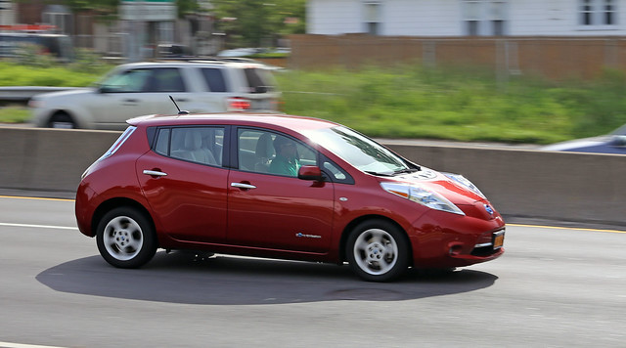
Have you ever looked for a red car on the highway?
Photo: Vetatur Fumare

Slide 3
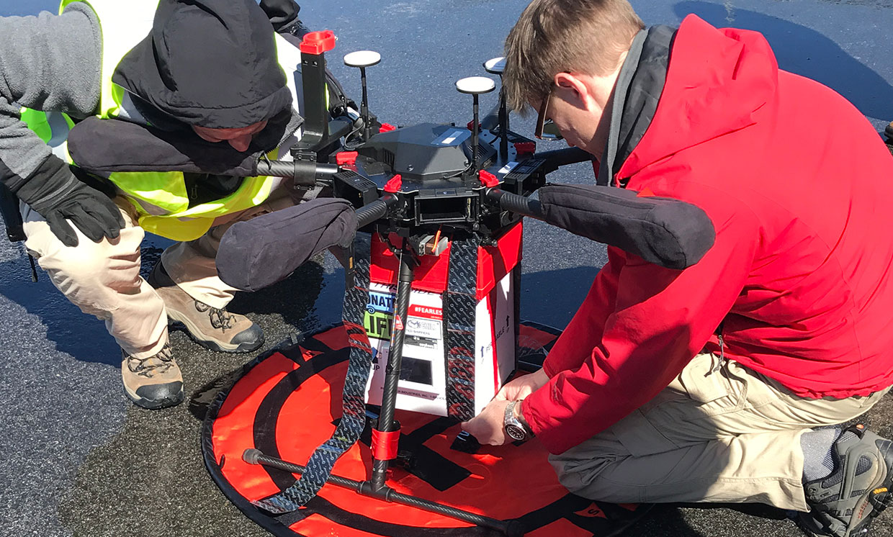
Drone Delivery of Kidney for Transplant
Photo : Joseph Scalea

Slide 4
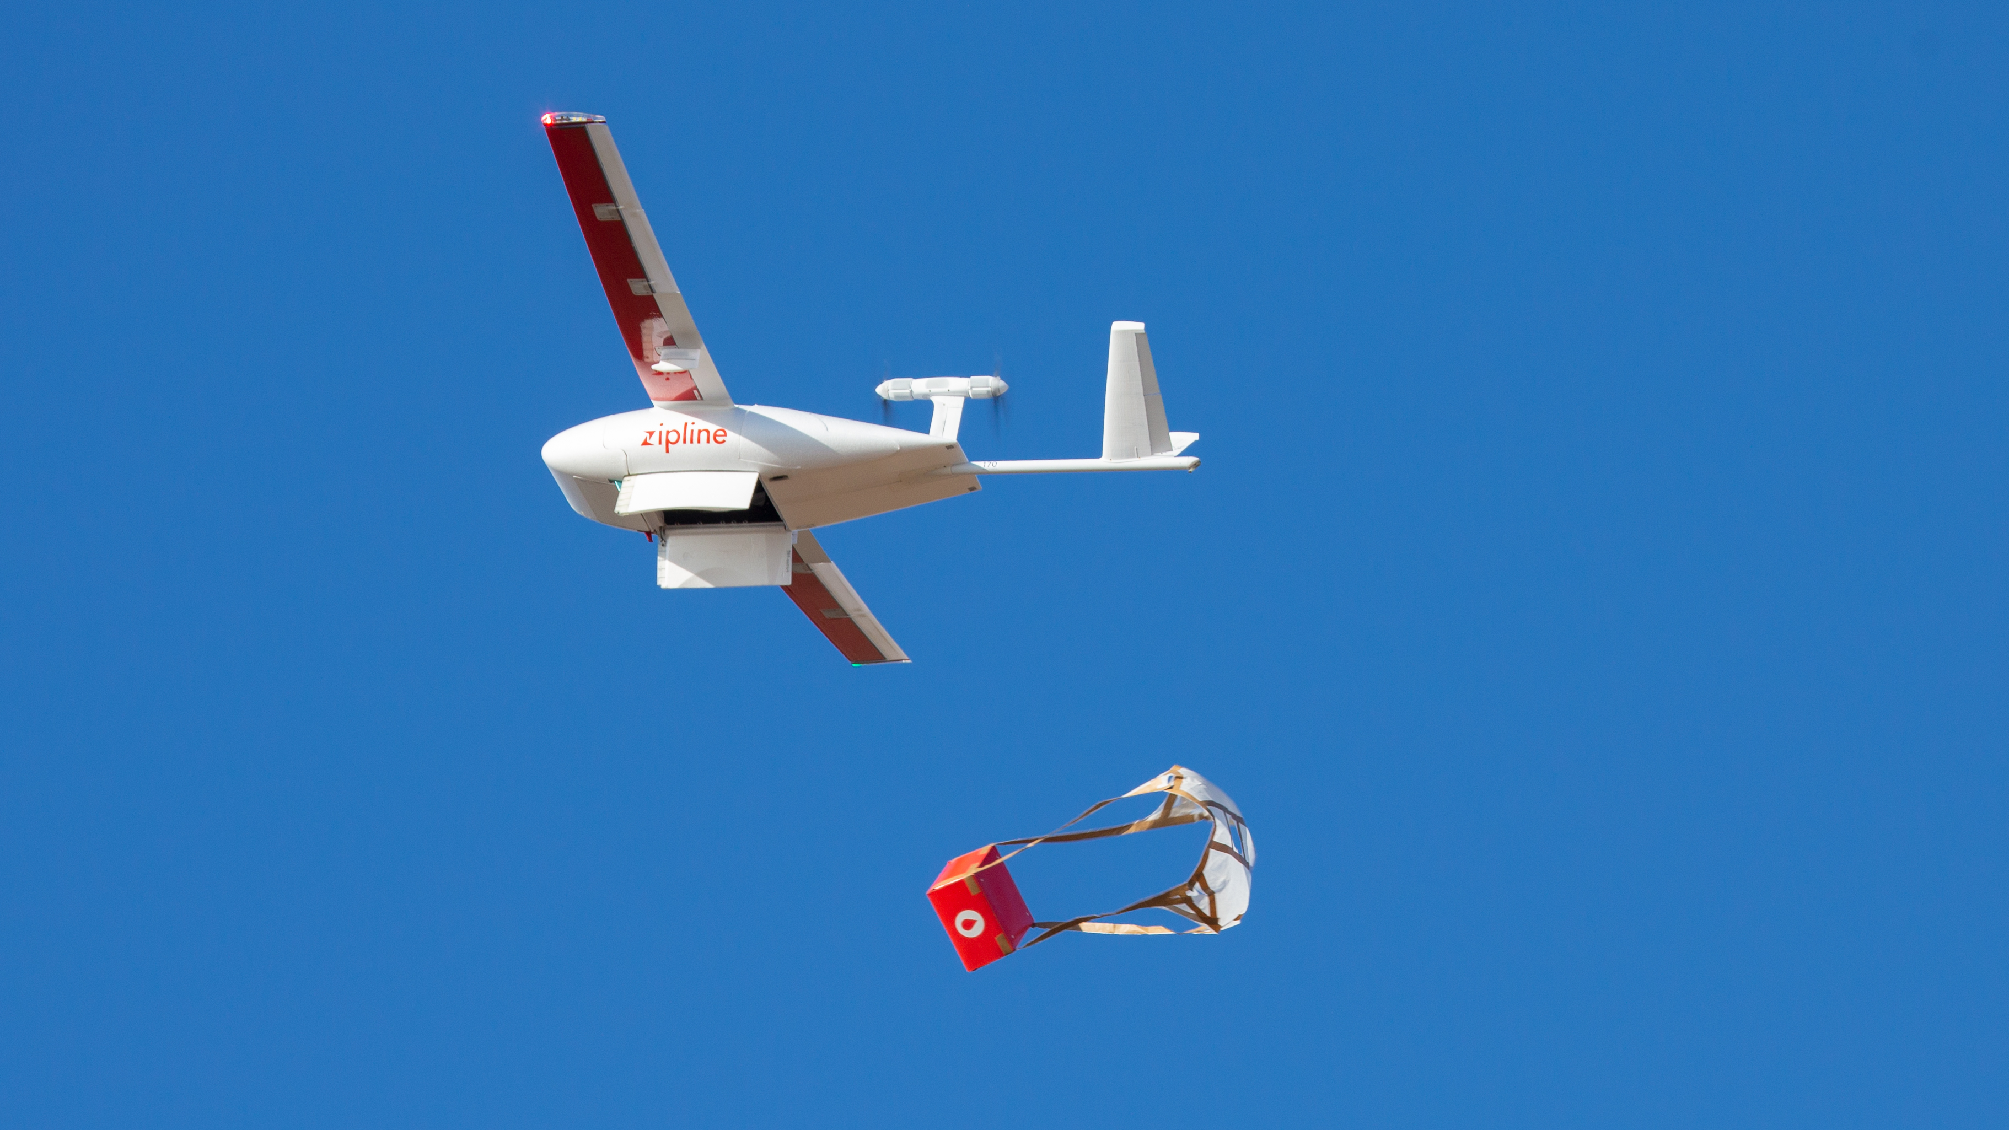
Parachute Vital Medical Supplies
Photo: Zipline

Slide 5
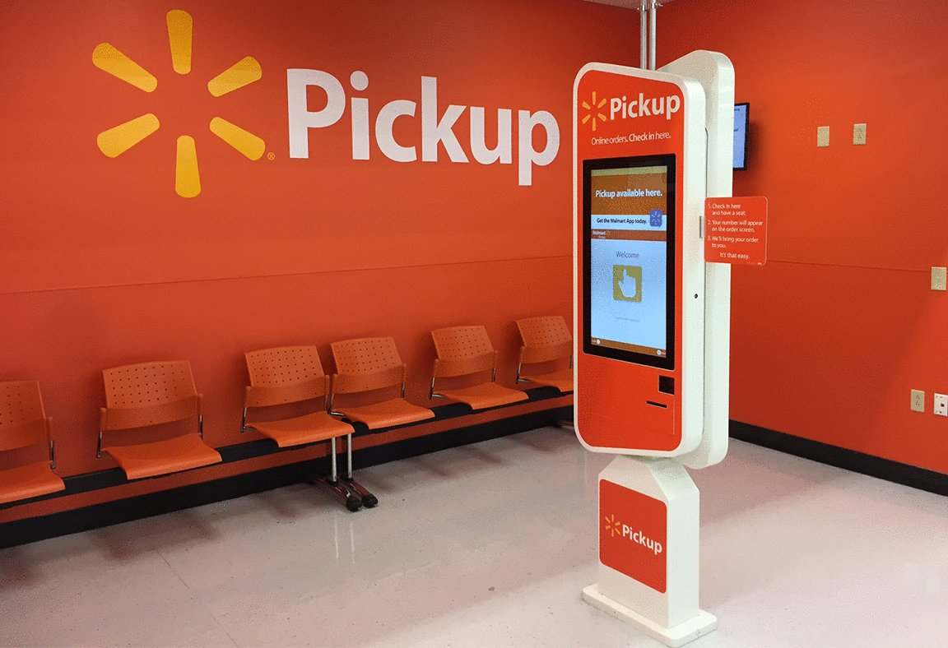
Buy Online Pickup at Store
Just in time baby shower gift for 15th great grandchild
Photo: Optimia Signs

Slide 6

What makes innovations possible?
Unconstrained thinking
Collaborate with a variety of industries & disciplines
Public Private Partnership
Investments in infrastructure
Leverage the local environment
Accelerate every step

Slide 7

Customer Expectations
Intimate unified experience
Convenience
Flexibility
Personalized
Transparency – Realtime updates
Interactive – Ability to adapt, modify and change
Speed – “I want it now”

Slide 8
Technology to Enable Innovation
Data - Real Time
Streaming analytics
Federated data sources
Algorithms
Machine learning
Predictive analytics
Optimization
Collaboration
Machine to Machine
Organization to Organization
Internet of Things
Autonomous Operations
User Experience
Omni channel
Self Driving vehicles
Interactive
Self organizing machines
Smart Cities
Convenient

Slide 9
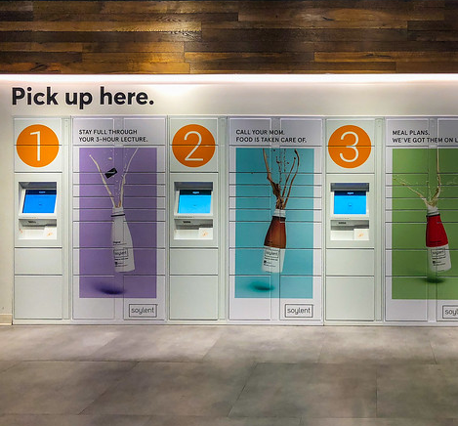
Final Thoughts
Technology is available
Focus on people and
experience
Collaboration is critical
Wayne.Haubner@eschergroup.com
Photo: Will Buckner

