Slide 1
How Will Polystyrene Bans Improve Ocean Health?
A recent report looks at the role plastics play in marine debris that sheds light on previous assumptions about how different plastics contribute to the problem and where its coming from.
In this ground breaking study, scientists conducted cutting-edge research at a much larger scale than had ever been done before. Over the course of three years, an international team including The Ocean Cleanup Foundation, six universities, and an aerial sensor company, collected data and mapped debris fields for the Great Pacific Garbage Patch, one of the most problematic plastic pollution hot spots.
Polystyrene ban legislation imply product restrictions will minimize plastic marine debris. Let’s take a closer look.
The total plastics mass in the GPGP is projected at 78,908 tons.
52% is mostly abandoned fishing gear, not consumer plastics.
47% is hard plastics, sheets and film, making up the majority of the microplastics mass.
.05% is foamed plastics – including polystyrene – making it a minor component of the GPGP.
Design Notes:
This is the introduction for the information units on the upcoming slides/pages.
It includes the title for the entire document.
The emphasis should be on the bullet point information.

Slide 2
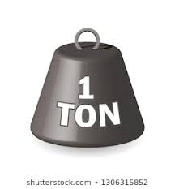
How Big is Big?
Design Notes:
This is Information Unit 1
We prefer infographic style here
Both examples show the data in different ways. Please provide samples of each.
1 Cruise Ship
100,000 tons
1 Blue Whale 150,000 tons
1 Week NYC Waste Generation
269,230 tons
Image of a
Cruise ship
Image of a
Blue whale
Image of New York City w/ Garbage Truck (see attached sample)
GPGP = 79%
GPGP = 53%
GPGP = 29%
Image of a weight with ‘50k Ton’ on it
⅗
Image | All GPGP Plastics | 78,908 tons
Image | 1 Cruise Ship | 100,000 tons
Image | 1 Blue Whale | 200,000 tons
Image | 1 Week NYC City Waste Generation | 269,230 tons

Slide 3
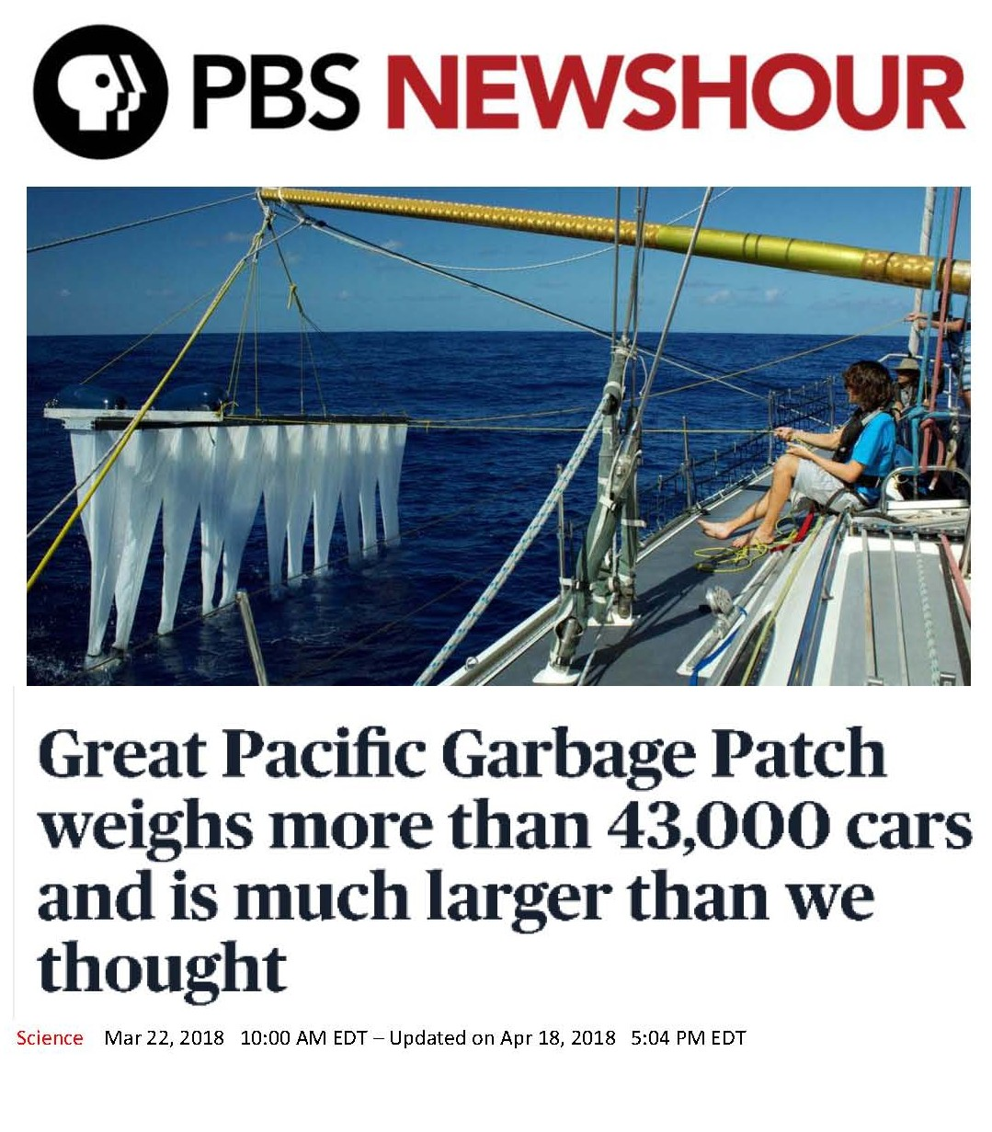

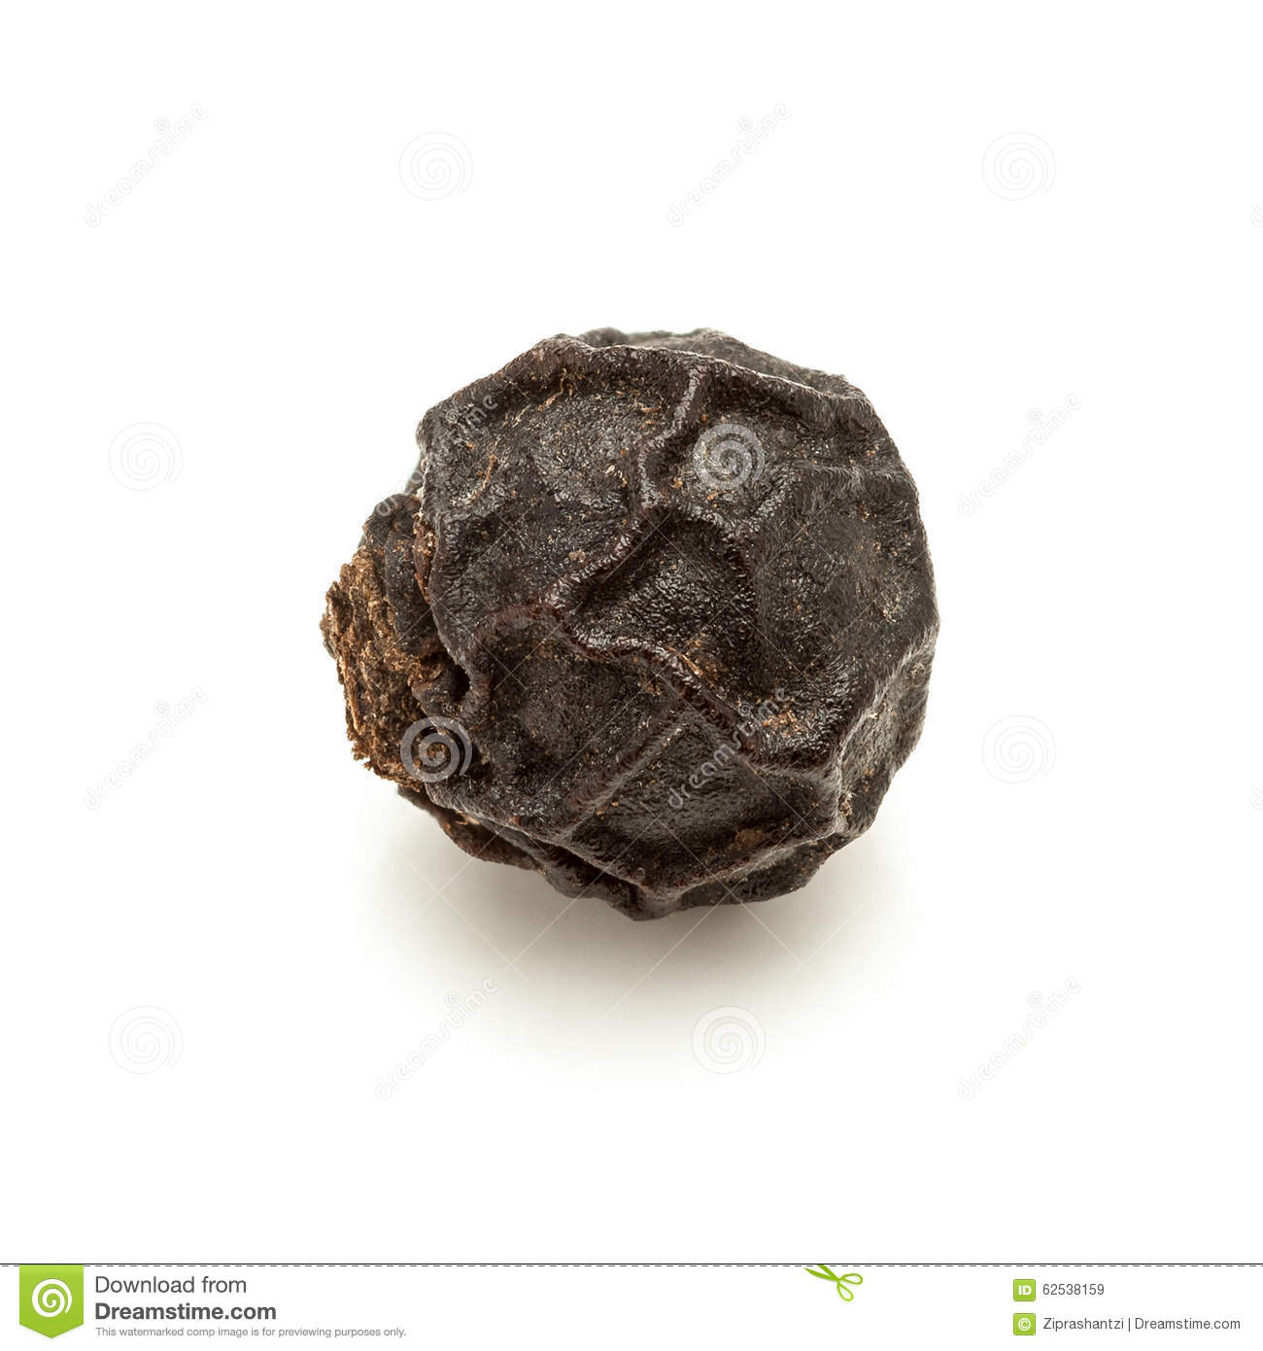
Sizing It Up
Design Notes:
This is information unit 2 and is a companion to information unit 1.
This may work as a call out but we are interested in other ideas as well.
PBS Article photo is attached ‘PBS News Hour 3/22’.
Total GPGP Mass
> 43,000 Cars
Total Foam Plastic Mass 18 Cars
Design Notes:
This is information unit 3.
This data needs to be presented as an infographic to help people understand the size variations.
A sliding scale may work.
We have provided one example
Total GPGP 78.9 K Tons | Marine Debris Size Classes | Measurement Values
42 tons | Megaplastics | >50 cm
20 tons | Macroplastics | 5 – 50 cm
10 tons | Mesoplastics | 0.5 – 5 cm
6.5 tons | Microplastics | O.05 – 0.5 cm
Mesoplastics Think peppercorn to house key.

Slide 4
How Much Mismanaged EPS Waste Was Found?
320,000,000 tons Worldwide Annual Plastics Production
78,908 tons Total GPGP Plastics
0.000024% Percent of Global Production in GPGP
6,620,000 tons Worldwide Expanded Polystyrene (EPS) Plastics Production
35 tons Total GPGP Foam Plastics
0.0000053% Percent of Global Production in GPGP
Design Notes:
This is information unit 4.
This data needs to be presented as an infographic to help people understand the very small amount of plastics that are ending up as marine debris.

Slide 5
Surprising Discoveries
Approximately 50% of GPGP Plastics are From Marine-Based Sources.
Beach Litter Studies Were Not Indicative of GPGP Content.
20% of the GPGP Plastic Debris Is From the 2011 Tohoku Tsunami
All Marine Plastic Debris Is A Problem! However, plastic product bans will be ineffective in reducing ocean debris. Since the U.S. contributes just 0.9% of the World’s Mismanaged Plastic Waste¹, it is even more important to consider all parts of equation.
¹Source: 6 things you can do to stop plastic pollution today, USA Today, September 7, 2018
Design Notes:
This is information unit 4.
This data needs to be presented as an infographic to help people understand the very small amount of plastics that are ending up as marine debris.

