Slide 1
Where we are now in terms of identity: Col-lab Website
First slides are screen shots of the Col-lab website, to show that we don’t have (yet) a strong identity or color schemes.
Please go to Col-lab.org to know us better.
Where we want to go with the brochure:
We want to move away from Black & White, but maintain the same “professional”, “simple” and modern feel.
We also want to be disruptive and create a “Wow” effect in terms of design and layout in a sector where com pieces tend to all look the same.
You feel find graphic designs we liked across this presentation..it should guide you in your creative process.

Slide 2
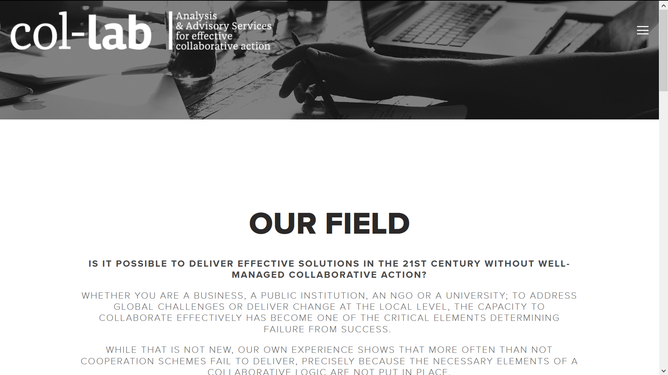

Slide 3
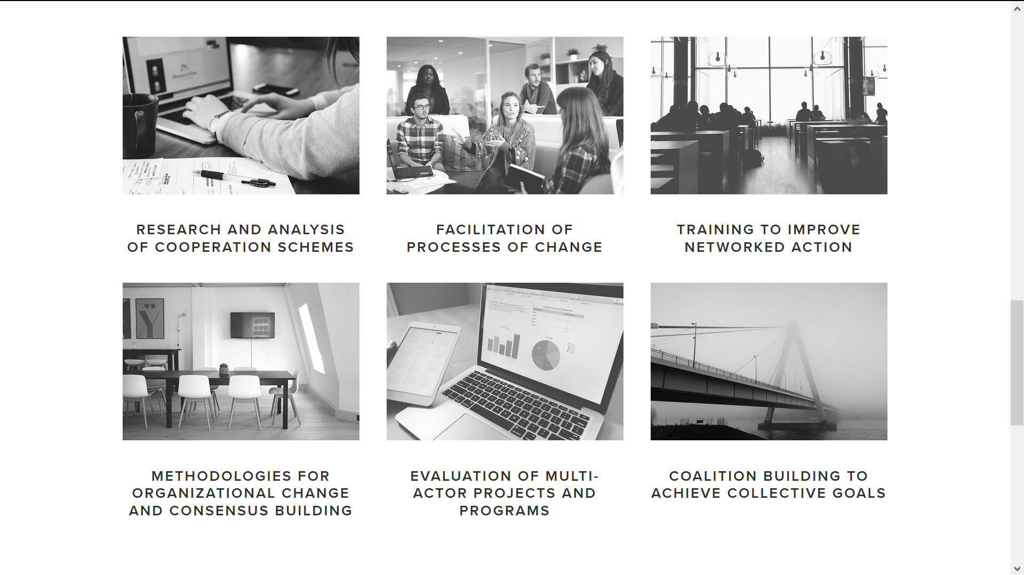
Col-lab Services:
These services will go on the inside page front: what icons (or other graphic elements) can you come up with to illustrate “research” “training”, “change management” “project management” etc? How can we make this sexier?
Some icon examples on the next slide

Slide 4
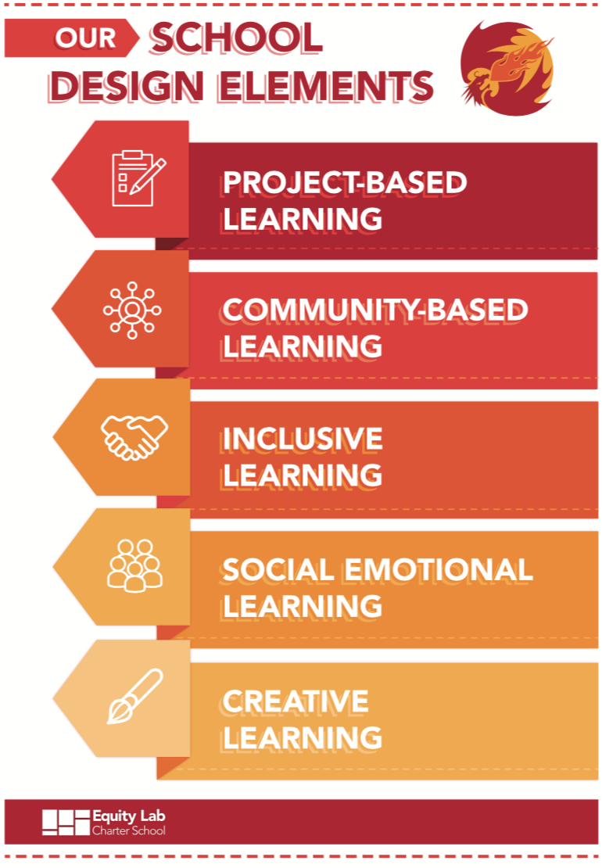
Nice execution to reflect “concepts” with icons ;)

Slide 5
Mood board
The following slides contain some examples of brochures, graphics etc that can serve you as inspiration for your creative work.
I think it is better to go over the top and then tone it down than the other way around.
So…free yourself, have fun and show us what you got! ;

Slide 6
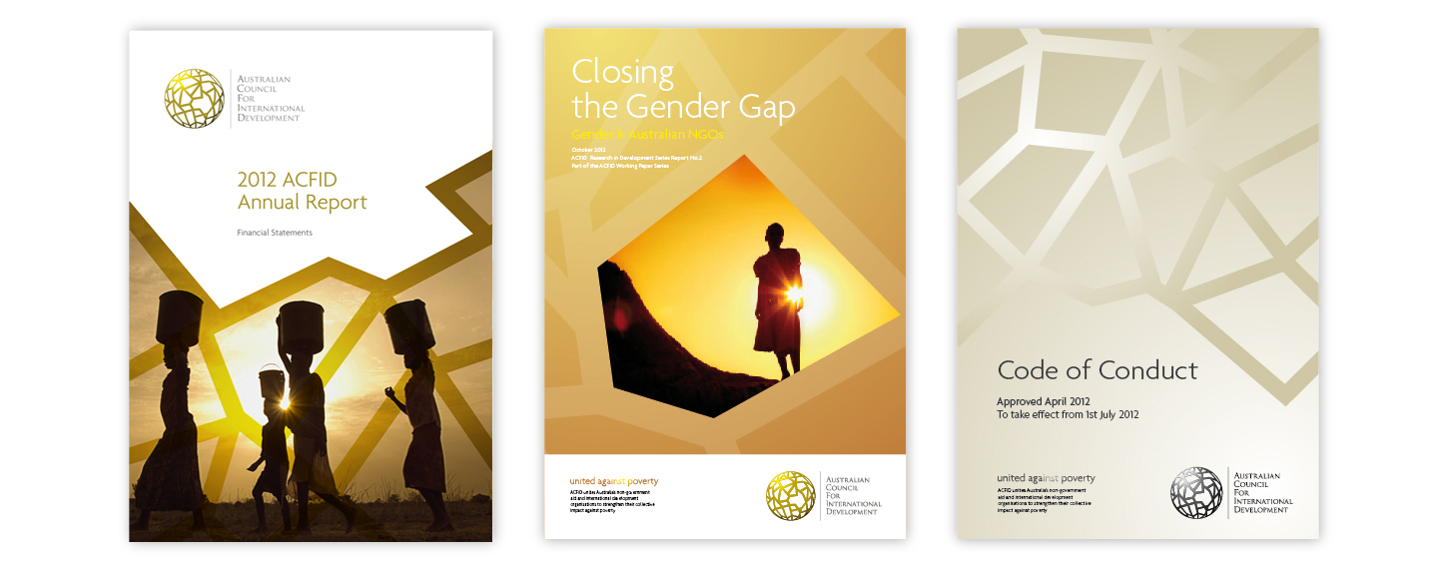
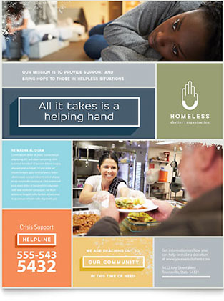

Above: Coherent, simple and impactful.
Above: Nice layout, easy to read and mixing icons, text boxes and visuals.
Left: Example of a picture that “tells a story” for front cover

Slide 7
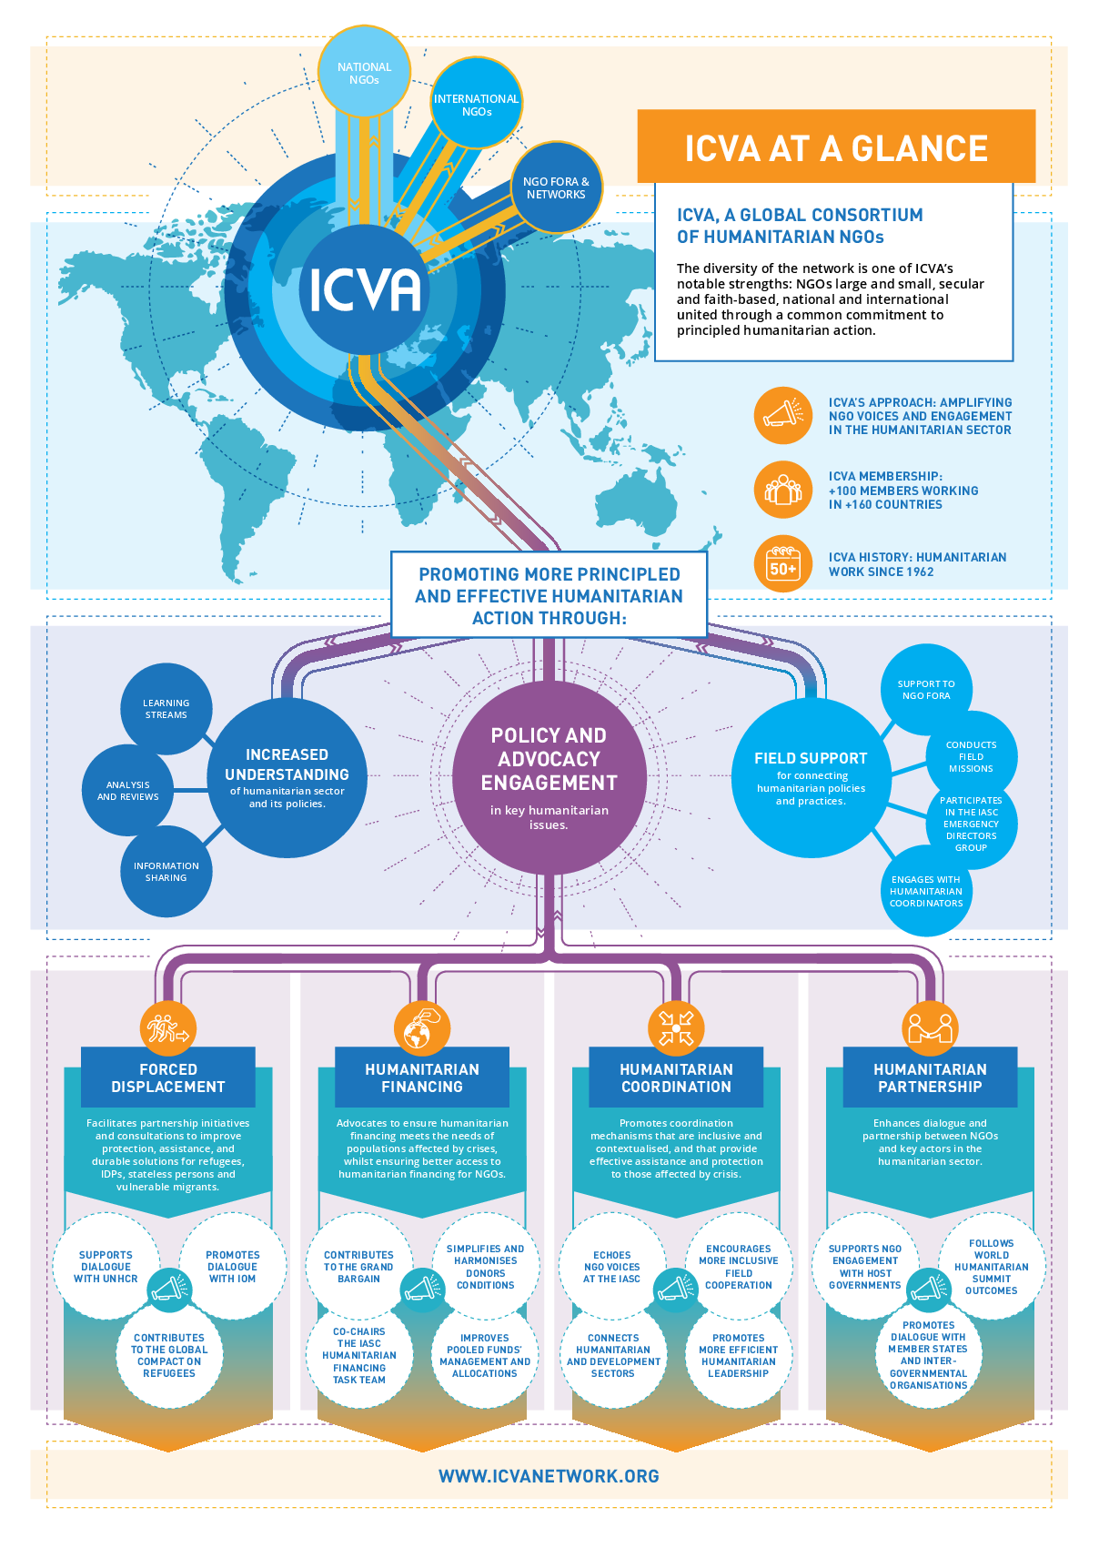
One excellent example that illustrates complex notions in a graphic way. NB: ICVA provides very similar services to Col-lab. So, it would be great to use a similar graphic representation for our services (only 2 levels, not as detailed as on this one). We also like the use of icons: Please Show us what icons could you come up with for “our services”?

Slide 8
One “Must Have”: the map of countries where we are present: Place in inside page front: “Our Projects”
Counties List:
Europe: EU 28, Norway, Switzerland, Turkey, Montenegro, Ukraine, Serbia, Moldova, Armenia, Georgia and Belarus.
America: US, Canada, Guatemala, El Salvador, Panamá, Costa Rica, Honduras, Colombia, Perú, Bolivia, Brazil, Argentina, Uruguay and Paraguay.
Asia: China, Vietnam, Thailand, Indonesia, Malaysia, Singapore, Bangladesh, Kyrgyzstan, Kazakhstan and Myanmar.
Africa: South Africa, Mozambique, Ethiopia, Kenya, Uganda, Benin, Senegal, Zimbabwe, Ghana, Tunisia, Egypt and Libya.

Slide 9
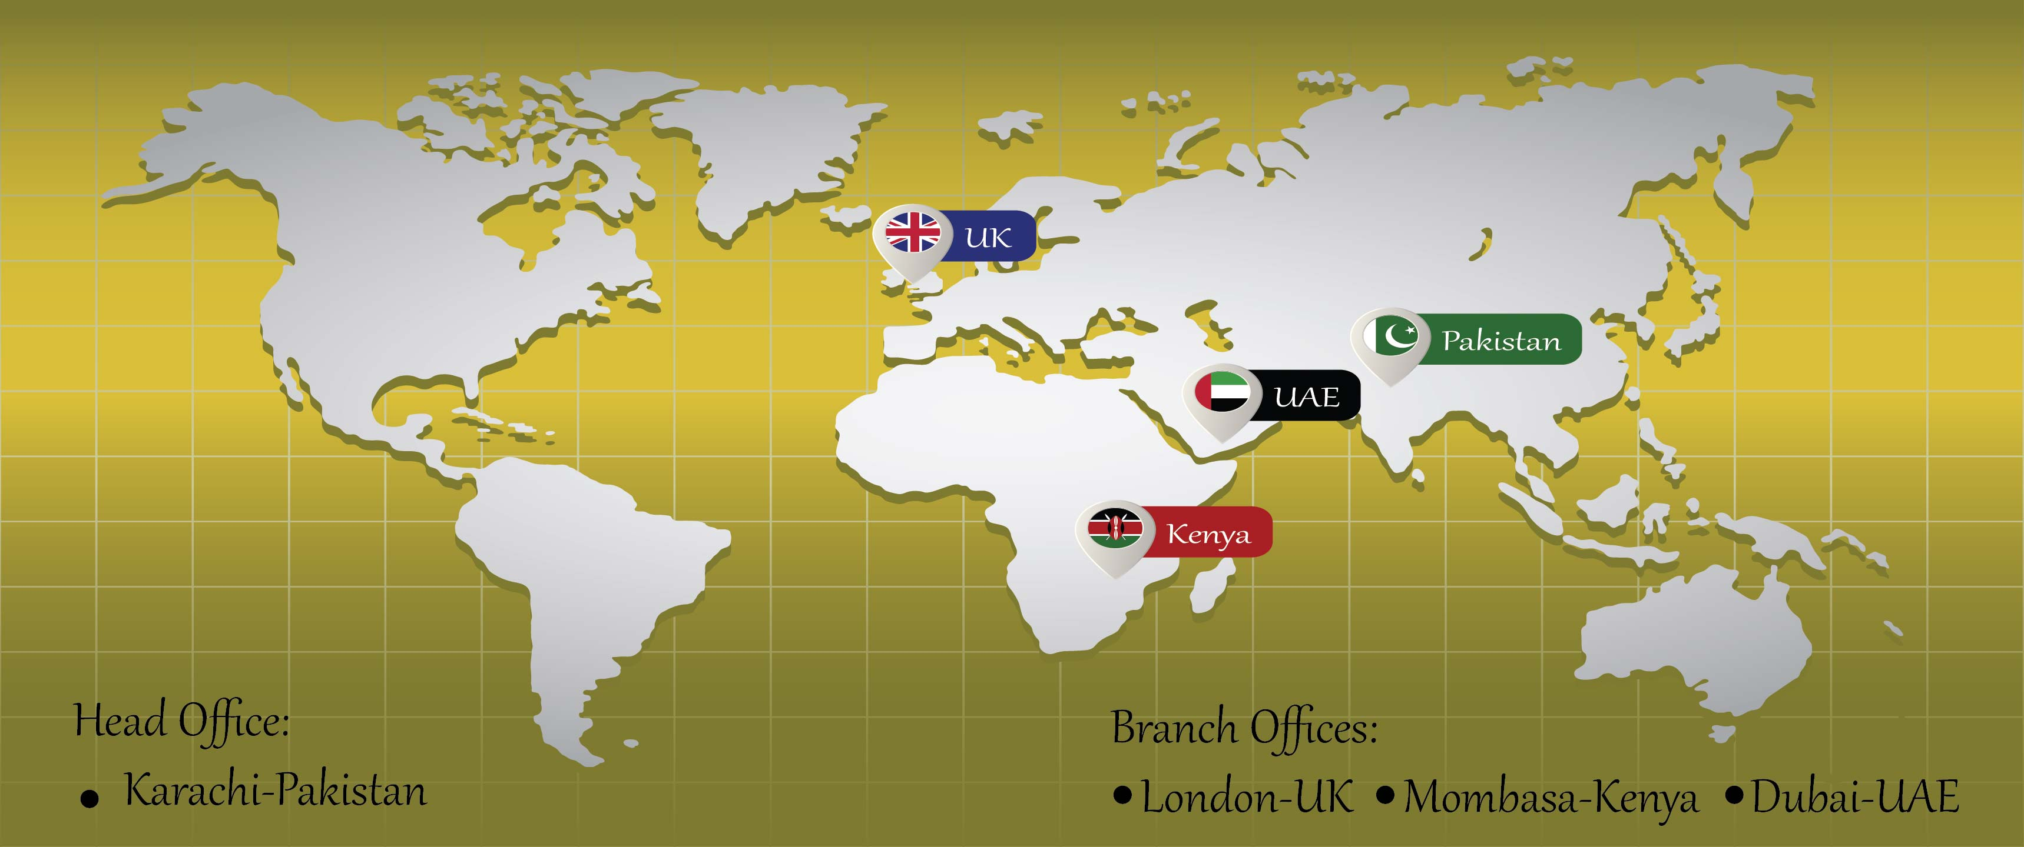
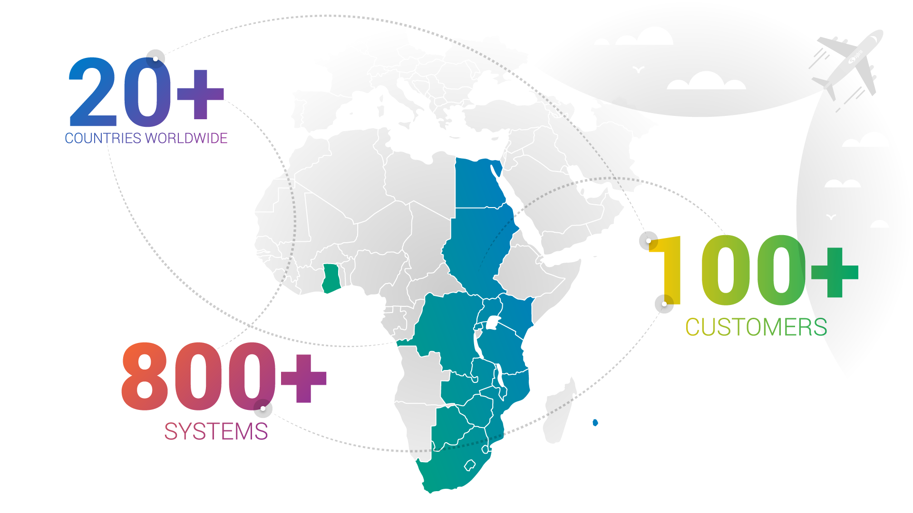
Some map examples and what we like about them:
Can you give a 3D effect to your map? Flat maps are a bit….dull ;-)
Nice fade effect on the colors

Slide 10
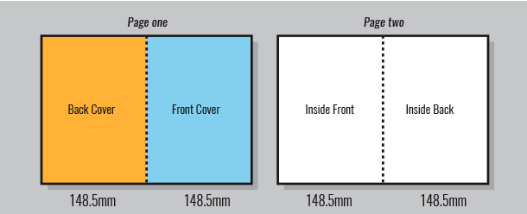
Requested design layout and dimensions for print – A4 folded in half:
210.
mm

Slide 11
Layout:
Front Cover:
Impactful visual + our logo + our new headline: “Collective action for sustainable development and impact”
Inside Front (left):
Our Services, mentioned here: http://col-lab.org/
Inside Back (right):
Our current projects + map of our presence
Back cover:
Contact us + logos of partners

Slide 12

Please use this logo but not the headline attached to it, just “Col-lab” with the headline: “Collective Action for Sustainable Development and Impact”

Slide 13
We look forward to seeing your work!!
Need help? Have questions or wanna discuss the brief?
Contact me on designcrowd.
Thank, you,
JD

