Slide 1

LEE’S DINNERWARE
Lee’s Dinnerware is a amazon ecommerce store that sells high quality and elegant plastic silverware. Its markets niche are weddings, graduations, parties of higher significance of class. We are looking for edgy and something different. The future of package design for silverware. This isn’t just ordinary plastic silverware but plastic silverware of class, beauty, and style. We want a young, vibrant, and edgy feel to our package to catch the eyes of the consumer.

Slide 2
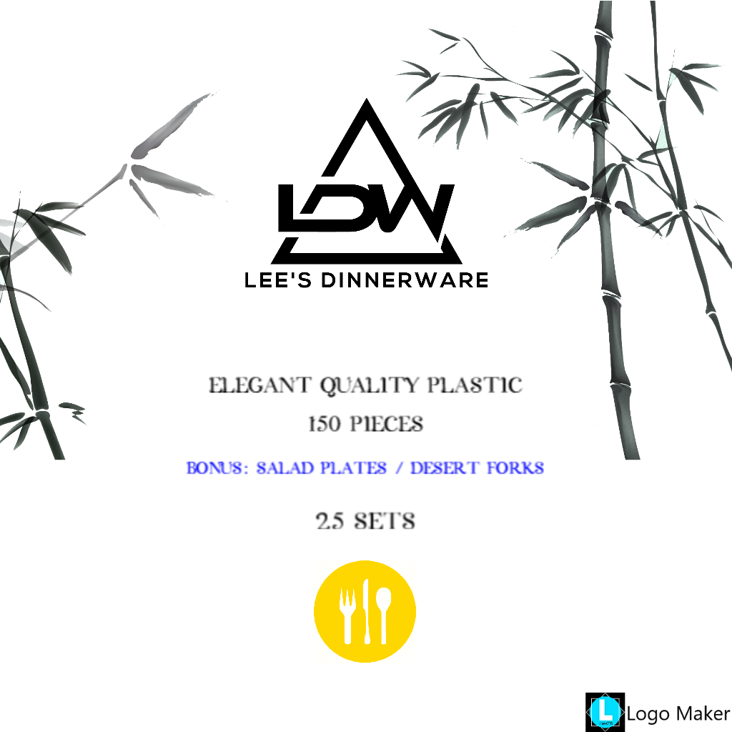
Front of Package.
Note: It needs to state the color on each design right above “QUALITY PLASTIC” . One package will say “GOLD” and the other “ROSE GOLD” and it needs to be typed in that appropriate color.
I am looking just a slightly transparent background either having to do with bamboo or palm leaves.
Abstract and consistent background
I am not a fan of this background. I want more consistency of design through the package. Leave what needs to read CLEARLY VISIBLE ------ Please feel free to play with the design. This is to only give you a idea of what I am looking for.
The silverware ICON and the description of color needs to be in the color to which the color is. (GOLD = written in gold color and the ICON = GOLD
You can play around with other colors that have already been colored.
Stick to a 2 FONT maximum and minimum
GOLD
=====
We do not want the word quality in this
Note: Feel free to play with placements and other variations.
Match the colors
We are not a huge fan of this ICON, but we do want it to show one of each so we can throw the BONUS in there.

Slide 3
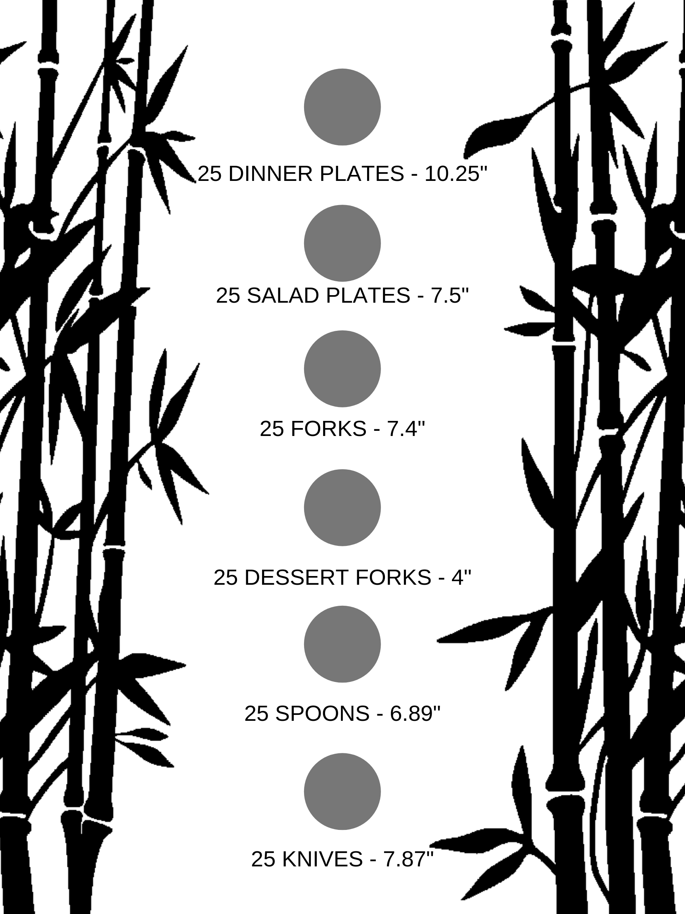
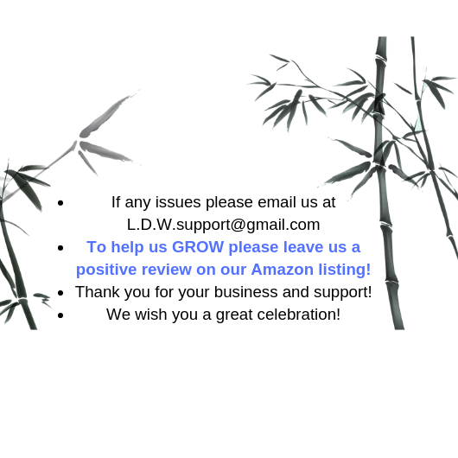
Again, design pattern is not consistent but to give an idea of what we are looking for.
Left + Right Side of Package
Back Side of Package
Here I will send you transparent photos of each piece to take the place of the circles. Feel free to play with placement, size, and colors.
Feel Free to play with color and placement variations.
=============
INSTEAD of having all 6 images and descriptions on one side please put 3 on each! As to enable a larger display of the products on the package and for the description of each be easier to read.
Email: leeswarehouse1@gmail.com
ggggggggggggggggggggggggggggggggggggggggggggggggggggggggggggg

Slide 4
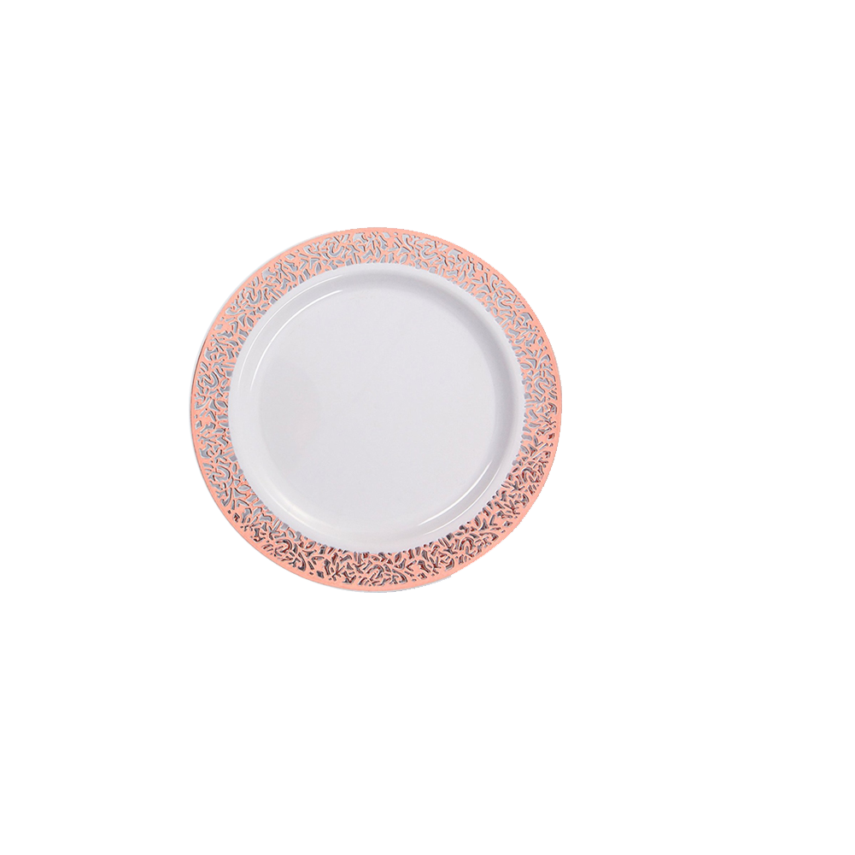
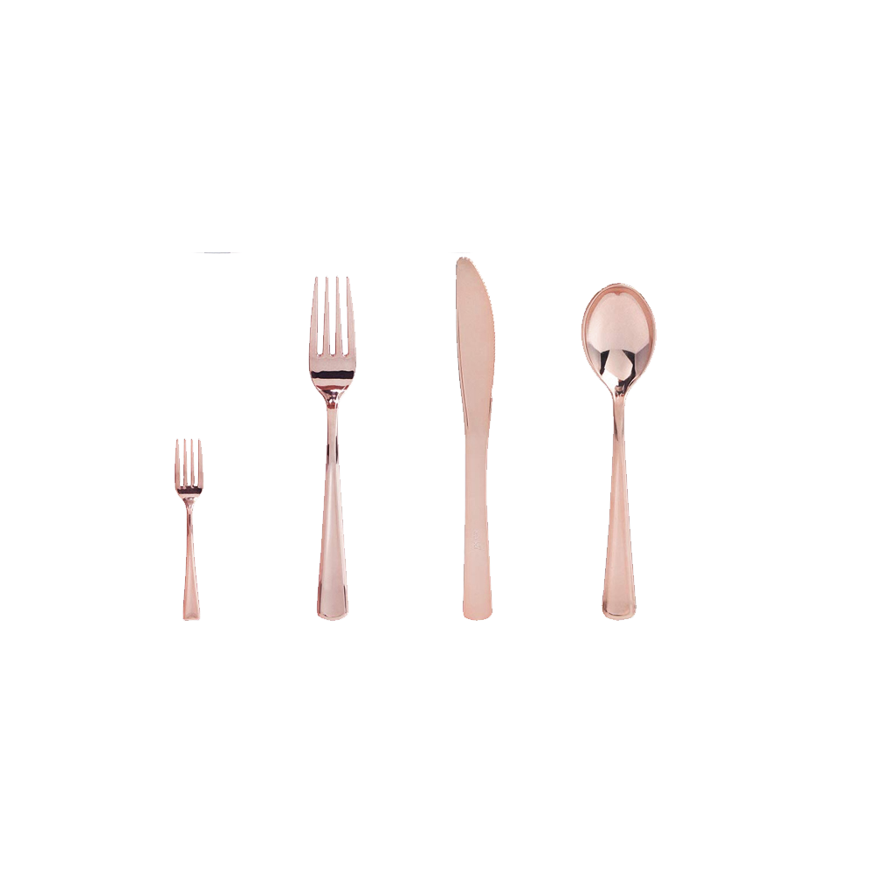
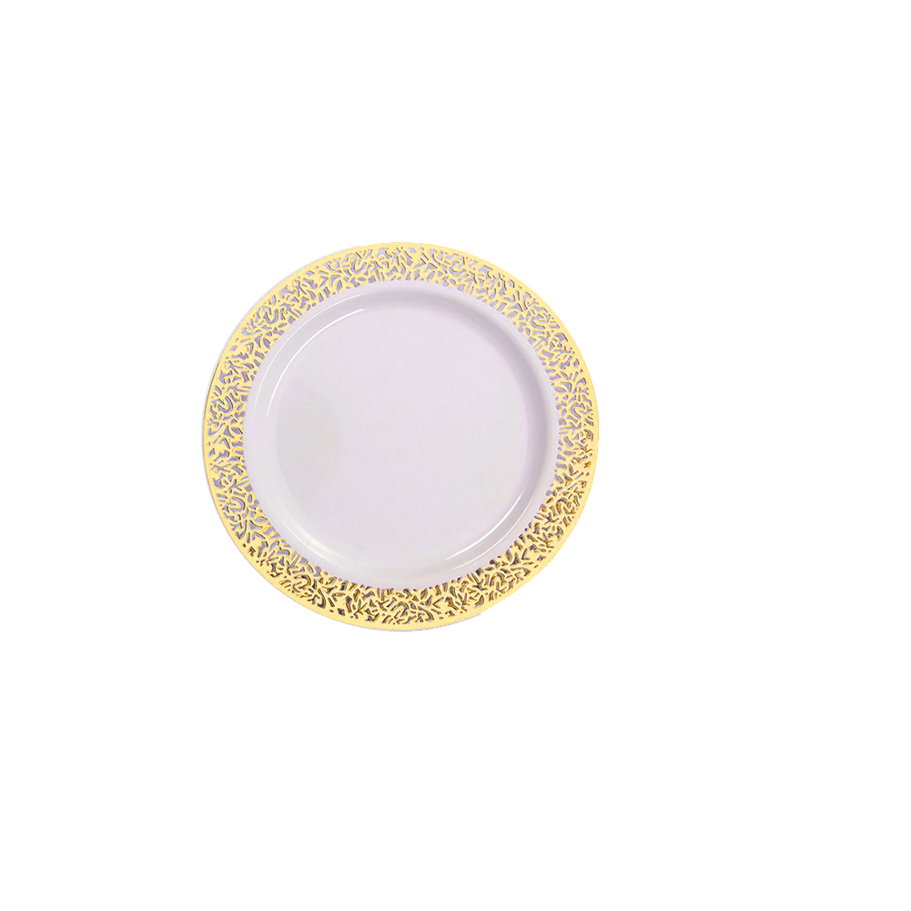

Note: The package contains both a dinner and salad plate. Please just modify the size of this one plate to display both.
Side of Package Display Photos Gold
Side of Package Display Photos Rose Gold
Quantity of each and Size Spec. is on slide 3.

Slide 5

Top and Bottom of Package.
Note: Keep consistency of design. Looking for abstract.

Slide 6
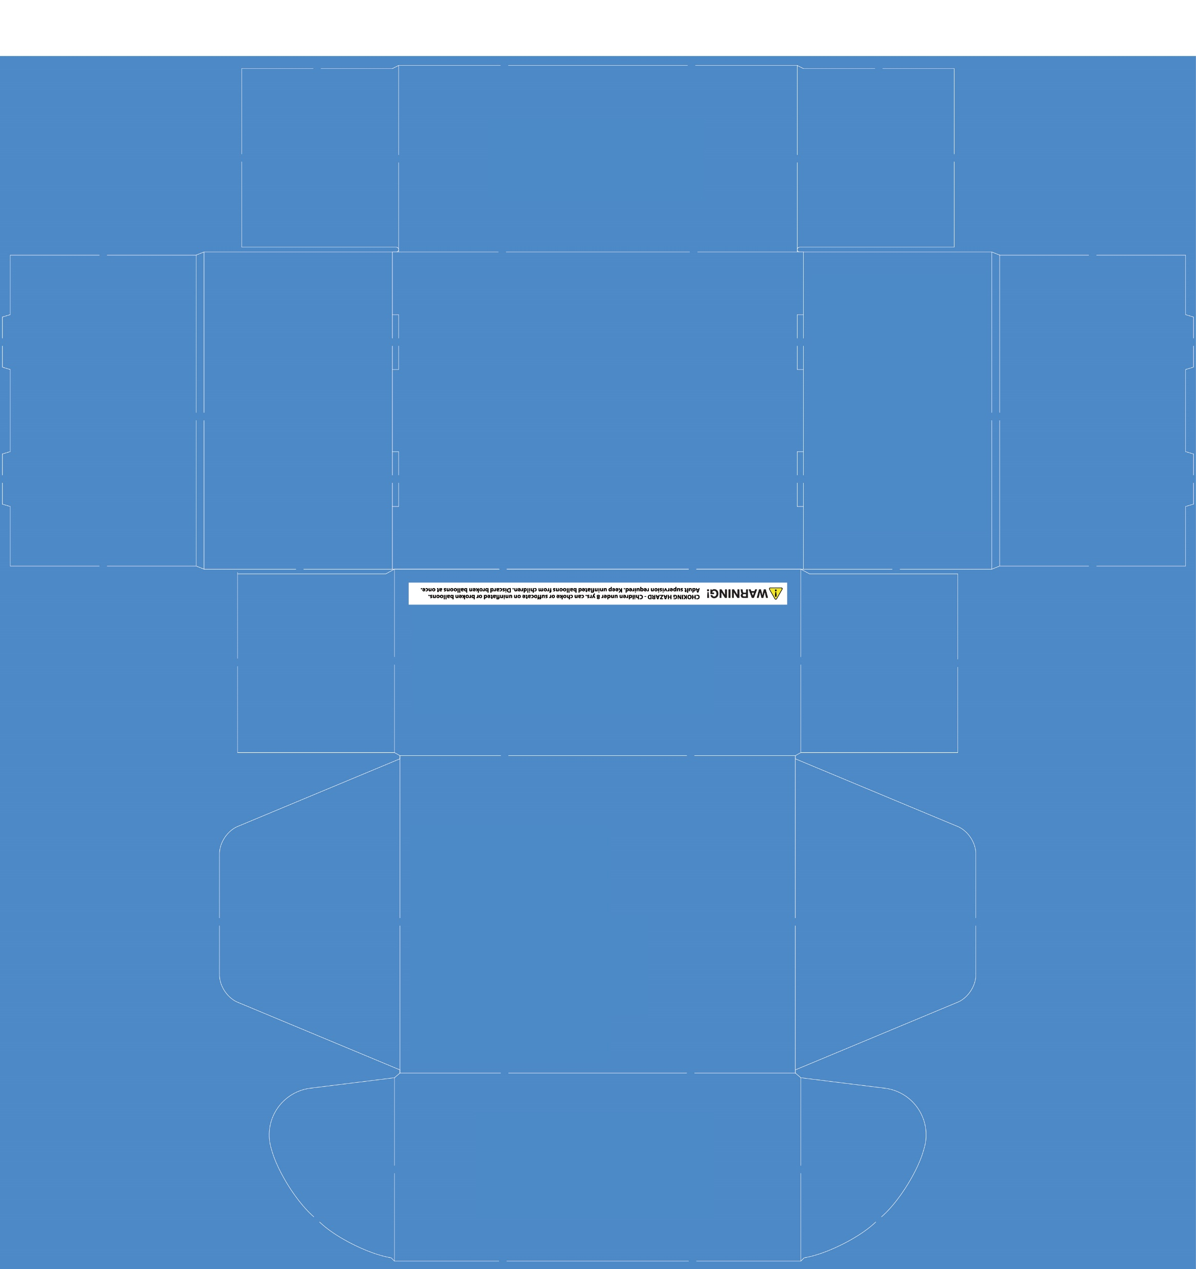
BOX SIZE and BOX – DIE CUT
BOX – DIE CUT
BOX SIZE
HEIGHT: 14.7 cm 147 mm
Length: 30.5 cm 305 mm
Width: 26.3 cm 263 mm

Slide 7
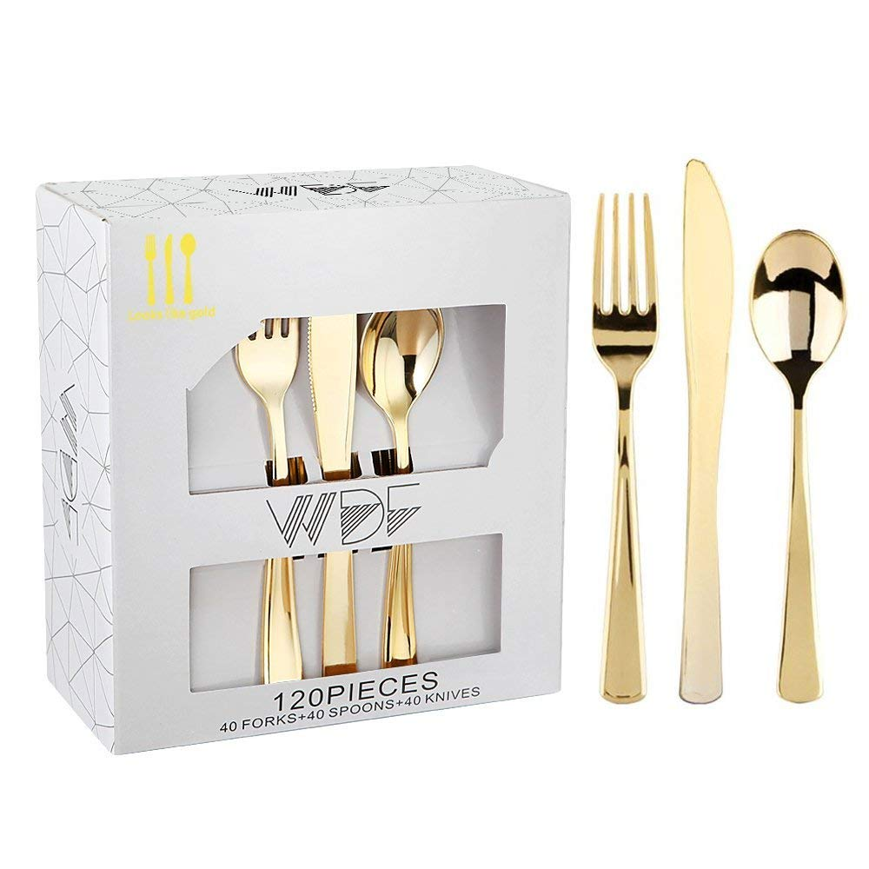
This is a competitors package.
This is one of our competitors package.
This is a different box die – cut layout design but to give an idea of what we are chasing after.
We aren’t looking to be a copy cat. We want to provide this same kind of warm and quality feeling they offer but leave our own finger print in the design.
If this inspires you to go from my initial rough draft please feel free to move forward with it! I am not a artistic person by any means and I am open to new ideas!

Slide 8
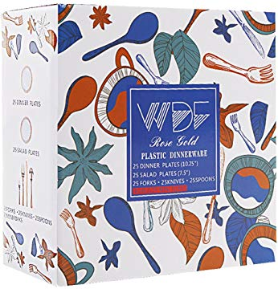
Competitors Matching BOX DIE - CUT
This is my competitors matching BOX DIE – CUT package design.
This has way too much color and it is too cheesy for my liking.
I’m not thinking class, elegance, or quality when I see this package.
It is too complicated, I hear too much noise making it difficult to read the cursive and the design draws me away from the product images and description.
We want to draw the attention to the brand and to the product, and product description by using the color variations there and edgy/elegant font. Easy to read.

